Slide 1

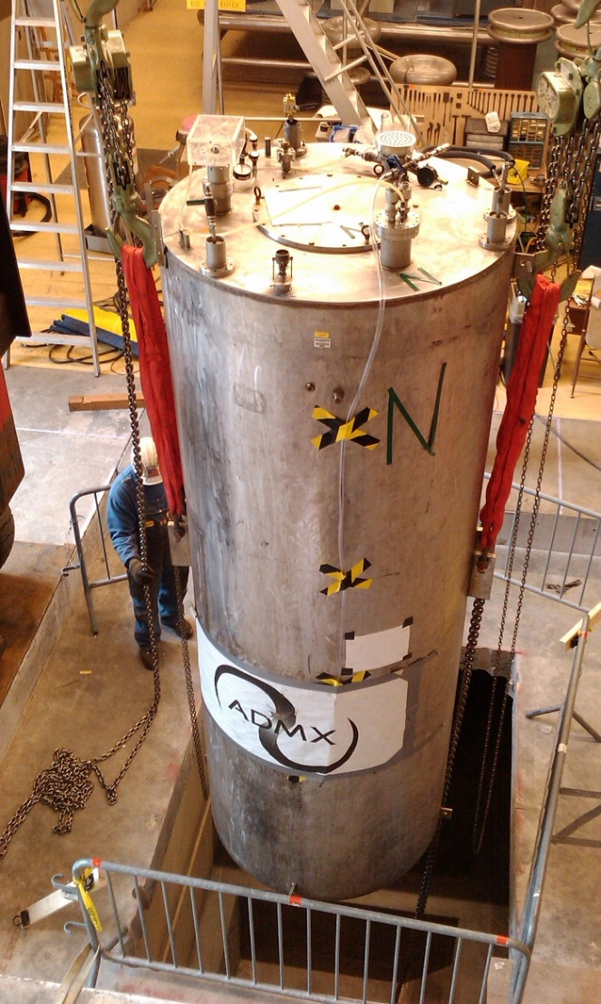
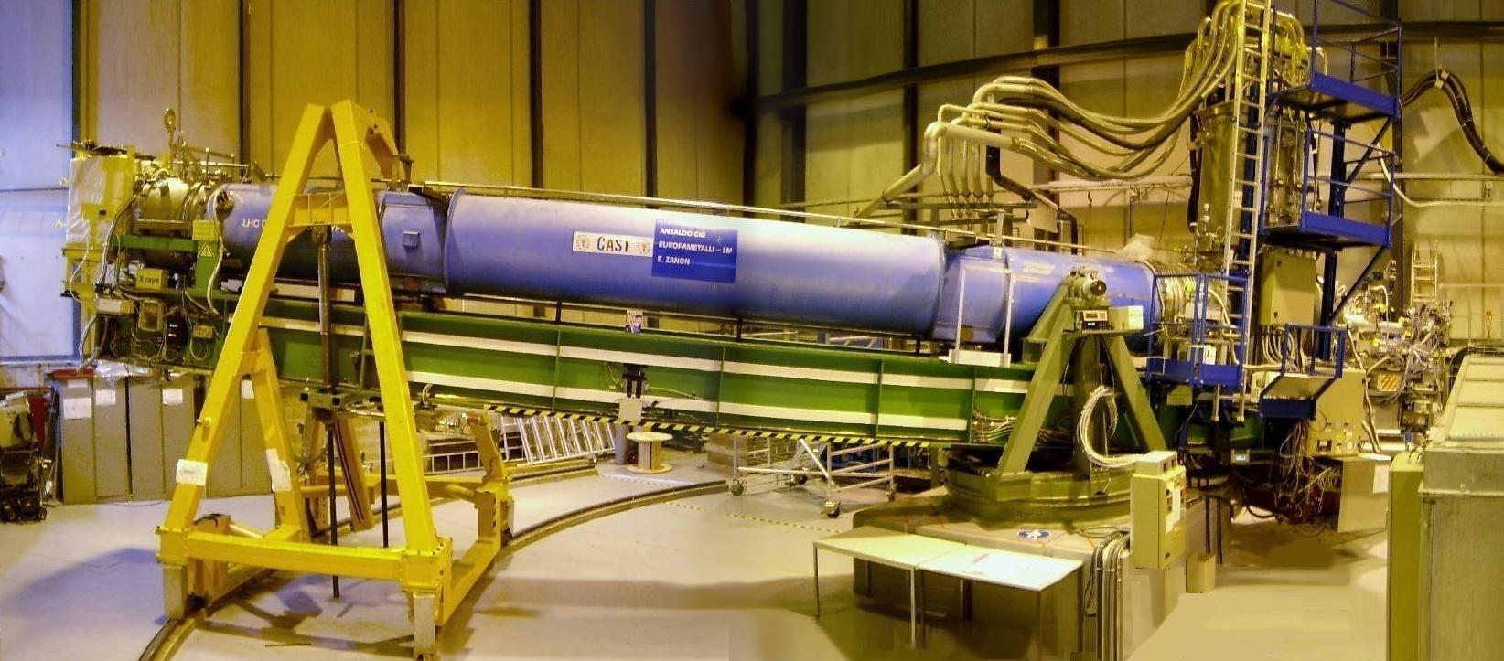
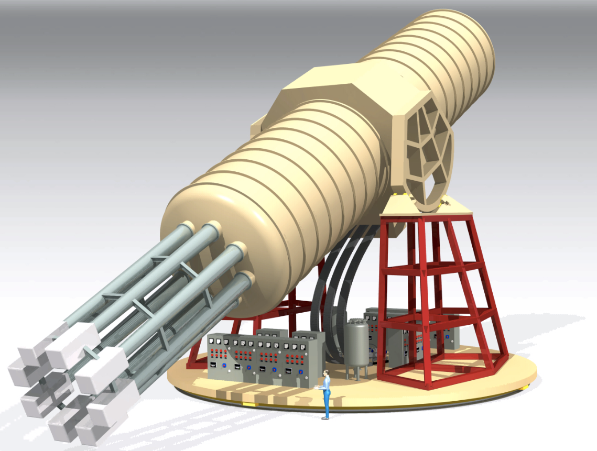
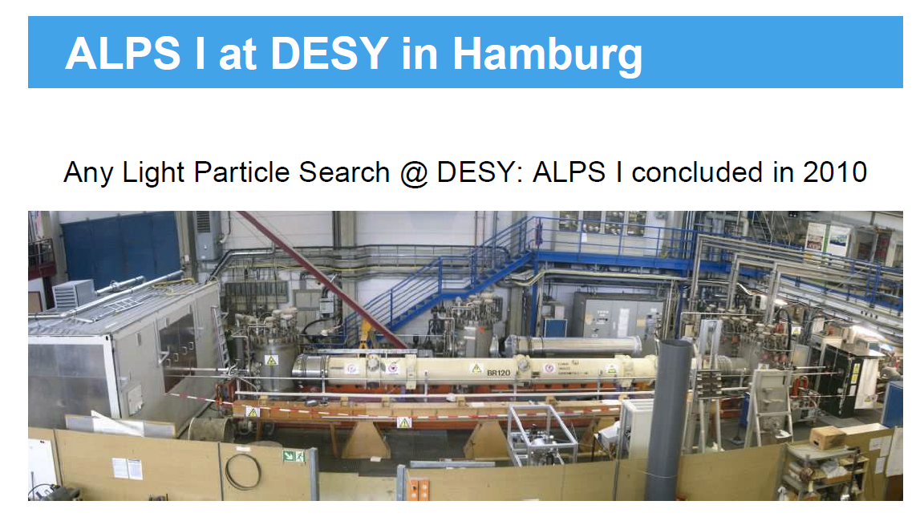
Axion searches
Igor G. Irastorza
Centro de Astropartículas y Física de Altas Energías (CAPA)
University of Zaragoza
ISSAP 2024: Particle candidates for Dark Matter, SGGS, Padova, July 2024

Slide 2

Outline of the lectures
Axion theory (introduction)
Axions in cosmology
  Axion as DM candidate
Axions in astrophysics
Axion detection:
  Laboratory axions
  Axions from the Sun
  Dark matter axions
Lectures 1 & 2
Lectures 3 & 4

Slide 3
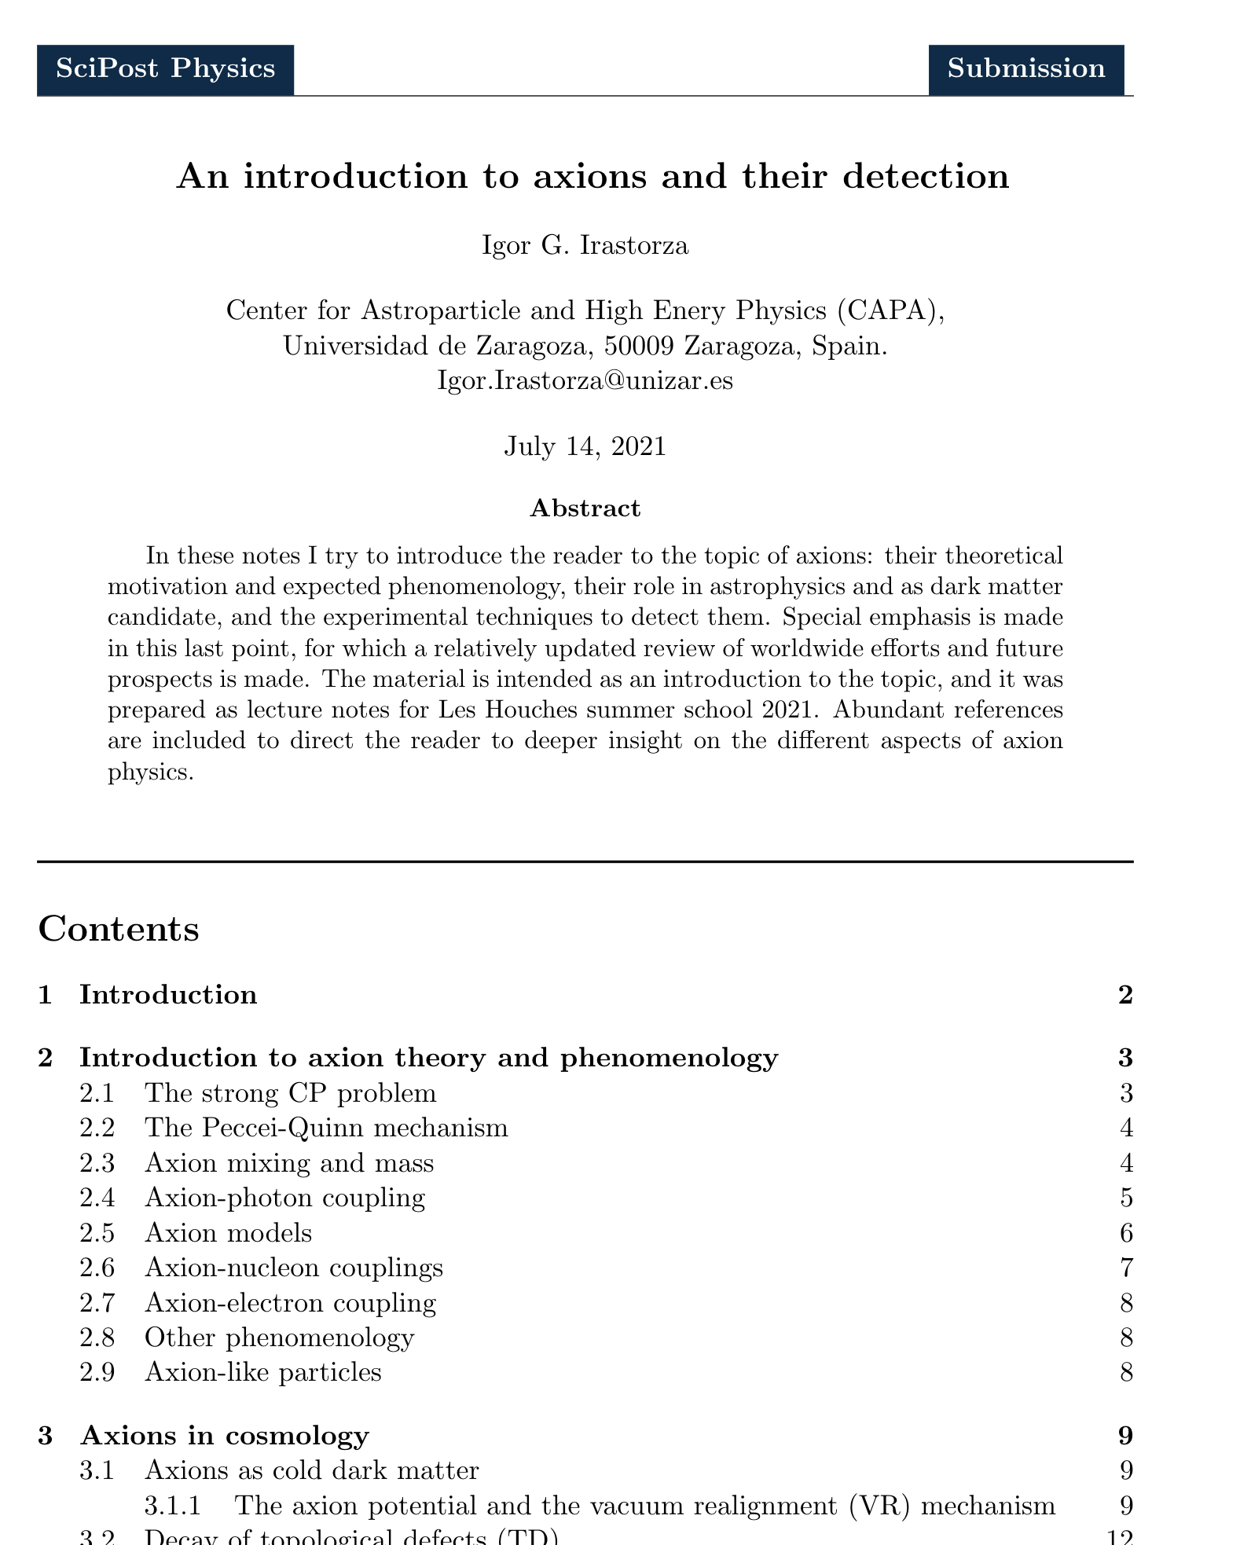
Some bibliography & references
Notes for similar lectures at Les Houches 2021: https://arxiv.org/abs/2109.07376
  Abundant references for further deepening
Some recent reviews:
  I. G. Irastorza and J. Redondo arXiv: 1801.08127
  Di Luzio et al. arXiv: 2003.01100
  Axions in wider contexts:
  J. Billard et al., arXiv: 2104.07634
  P. Agrawal et al., arXiv: 2102.12143
  Textbook “Ultralight Bosonic Dark Matter”, edited by D. Kimball and K. van Bibber, May 2021. in press, to be published by Springer
(focus on detection)
(focus on theory & phenomenology)
(axions among other DM searches)
(feebly interacting particles (FIPS) in extensions of SM)

Slide 4
Axions in a nutshell
Most compelling solution to the Strong CP problem of the SM
Axion-like particles (ALPs) predicted by many extensions of the SM (e.g. string theory)
Axions, like WIMPs, may solve the DM problem for free. (i.e. not ad hoc solution to DM)
Astrophysical hints for axion/ALPs?
  Transparency of the Universe to UHE gammas
  Stellar anomalous cooling → g_{aγ} ~ few 10⁻¹¹ GeV⁻¹ / m_{a} ~few meV ?
Relevant axion/ALP parameter space at reach of current and near-future experiments
Still too little experimental efforts devoted to axions

Slide 5
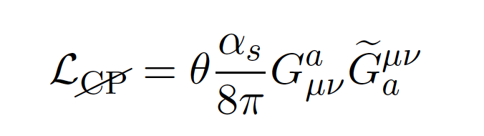
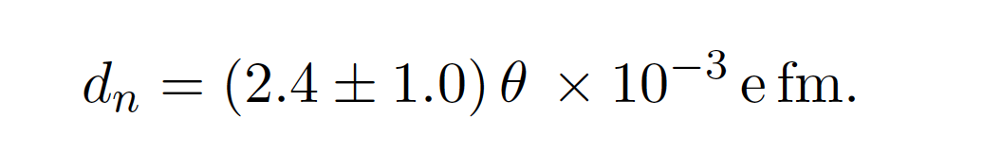

Strong CP problem
QCD Lagrangian contains the famous “$θ$-term”:
Total derivative term: no effect in perturbative calculations
BUT it has observational consequences: e.g. it predicts electric dipole moments (EDM) to hadrons,most importantly, to neutrons:
This term is
CP violating.
input parameter of the SM

Slide 6
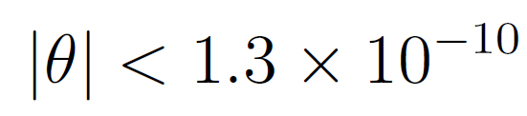
Strong CP problem
QCD Lagrangian contains the famous “theta term”:
From non-observation of neutron EDM in experiments:
Why so small?
This term is
CP violating.

Slide 7

Strong CP problem
QCD Lagrangian contains the famous “theta term”:
This term is
CP violating.
input parameter of the SM
Two contributions of very different origin
From the vacuum structure of QCD
Quark mass matrix

Slide 8
Strong CP problem
Two contributions of very different origin
The essence of the strong CP-problem is why $θ$ is so small if composed of two phases of completely unrelated origin

Slide 9
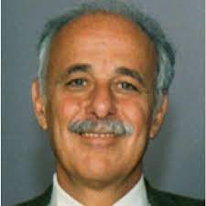
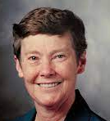

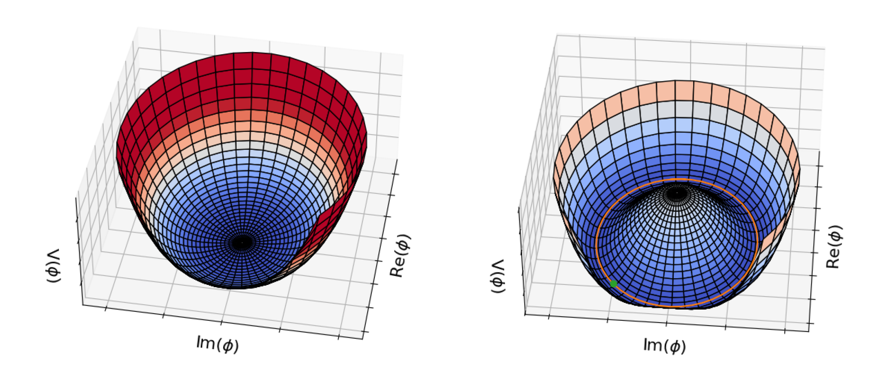


Peccei-Quinn mechanism
New U(1) symmetry introduced in the SM: Peccei Quinn symmetry of scale $fA$
The symmetry is spontaneously broken at the scale $fA$ → a Nambu-Goldstone boson appears
PQ symmetry
Potential of a Higgs-like field
PQ symmetry spontaneously broken below scale $fA$
Radial mode acquires a VEV:
Angular mode is the NG boson

Slide 10
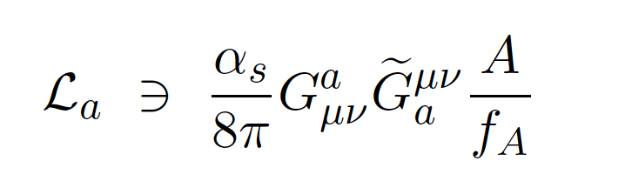
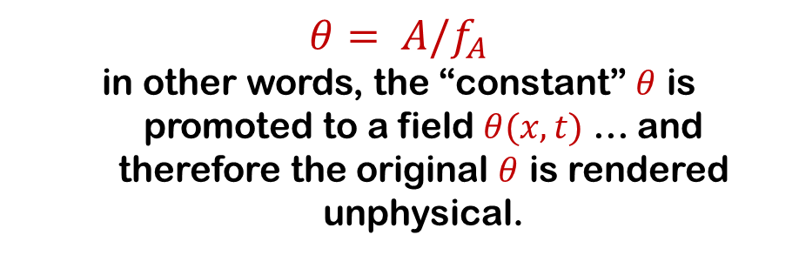
Peccei-Quinn mechanism
A new term appears in the lagrangian, formally identical to the theta term, but instead of parameter we have a field.
θ absorbed in
the definition of the field A
“Axion lagrangian”
$$θ= A/f_{A}$$
in other words, the “constant” $θ$ is promoted to a field $θ(x,t)$ … and therefore the original $θ$ is rendered unphysical.

Slide 11
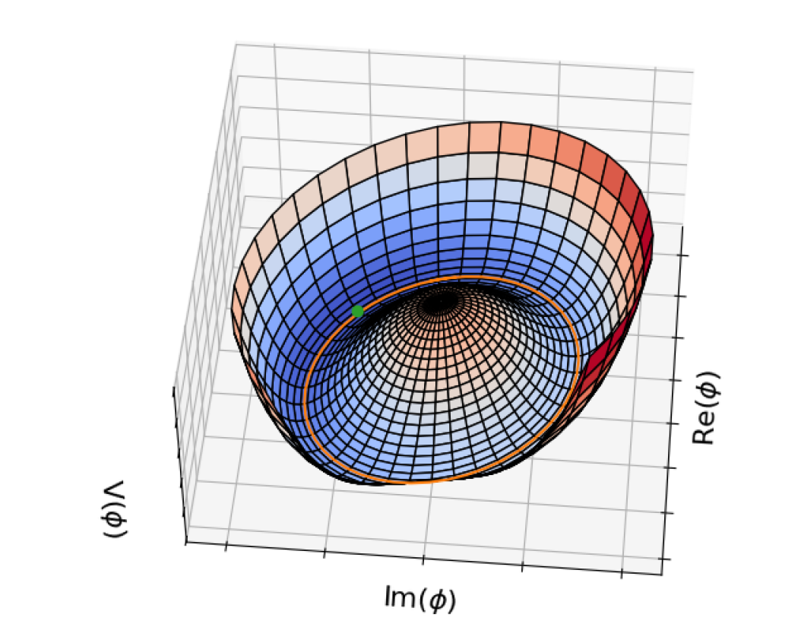


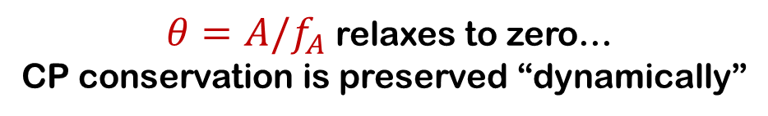
Peccei-Quinn mechanism
A new term appears in the lagrangian, formally identical to the theta term, but instead of parameter we have a field.
θ absorbed in
the definition of A
“Axion lagrangian”
QCD-induces a potential to the $A$ field (*)
Minimum of potential is CP conserving
$θ=A/f_{A}$ relaxes to zero…
CP conservation is preserved “dynamically”
(*) note that this potential is periodic because $A/f_{A}$ is an angle

Slide 12
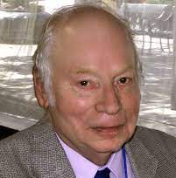
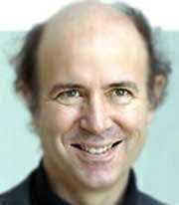
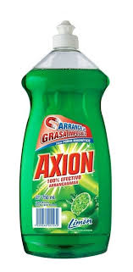
The axion
Weinberg and Wilczek independently noted that the quanta of the new field could be observable particles, baptized as axions.
“Axion lagrangian”
axion field
“…because it cleaned up a problem…”

Slide 13
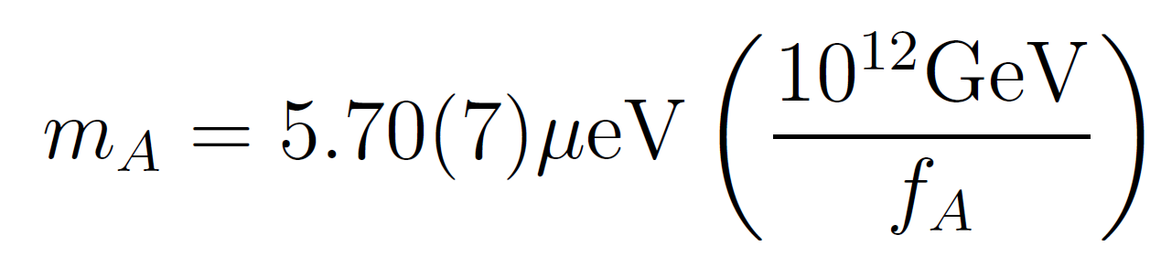
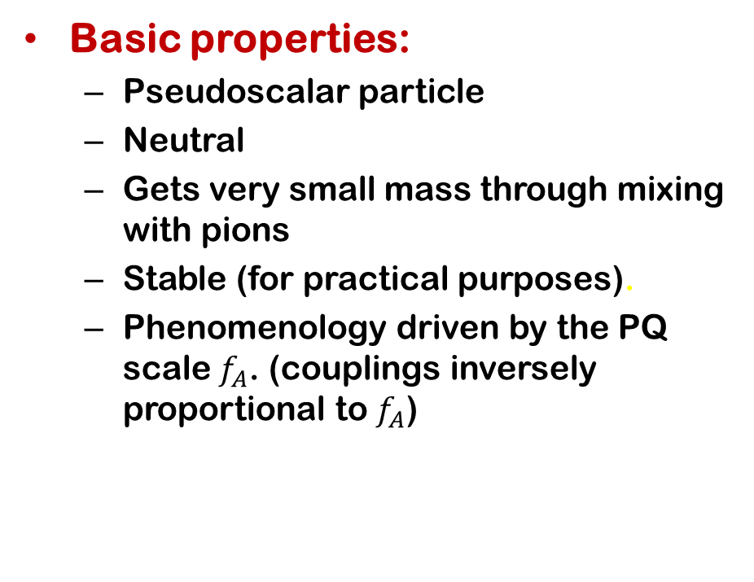
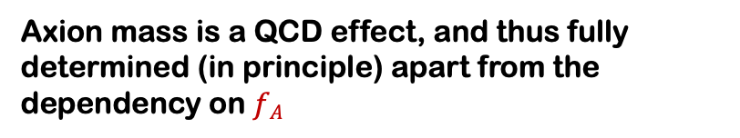
The axion
Basic properties:
  Pseudoscalar particle
  Neutral
  Gets very small mass through mixing with pions
  Stable (for practical purposes).
  Phenomenology driven by the PQ scale $f_{A}$. (couplings inversely proportional to $f_{A}$)
axion field
Note on notation: uppercase A when we refer to QCD axion; lowercase a when we refer to more generic axion-like particles
Axion mass is a QCD effect, and thus fully determined (in principle) apart from the dependency on $fA$

Slide 14
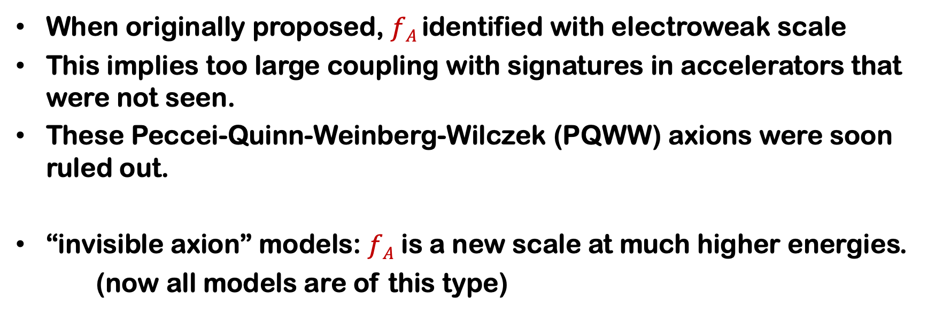
Axion models
When originally proposed, $fA$ identified with electroweak scale
This implies too large coupling with signatures in accelerators that were not seen.
These Peccei-Quinn-Weinberg-Wilczek (PQWW) axions were soon ruled out.
“invisible axion” models: $fA$ is a new scale at much higher energies.
(now all models are of this type)

Slide 15
Axion models
Many models exist (specially recently, large model-building effort). But most can be linked to these “benchmark” models:
KSVZ axions
SM extended with: heavy q + singlet complex scalar H
H → implements spontaneous breaking of PQ symmetry
More complex generalizations possible
They do not feature coupling to electrons
Sometime called “hadronic axions”
DFSZ axions
No exotic fermions, SM fermions assigned
  PQ charges
SM extended with: 2 Higgs doublets + singlet complex scalar H
2 variants DFSZ-I or –II (depending on which Higgs is involved in lepton masses)
They do feature coupling to electrons
Sometime called “GUT axions” as they are compatible with GUT scenarios

Slide 16
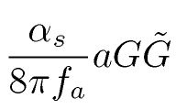
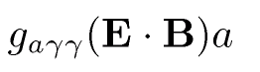
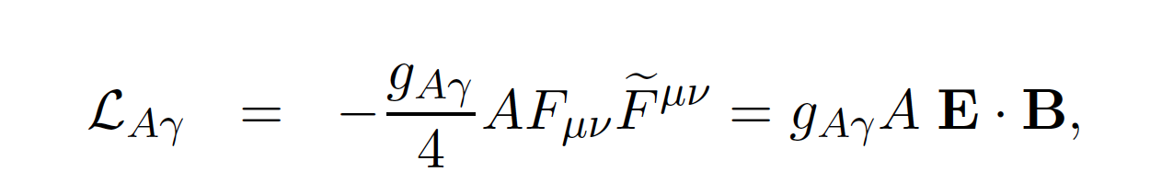
Axion phenomenology
Some phenomenology is directly expected from the PQ mechanism, while other depends on the particular way it is implemented in the SM, or the “axion model”.
Gluon coupling
generic
Mass
generic
Photon coupling
generic but value
model dependent
Fermion couplings
Electron coupling
Nucleon coupling
…
Model dependent
×

Slide 17
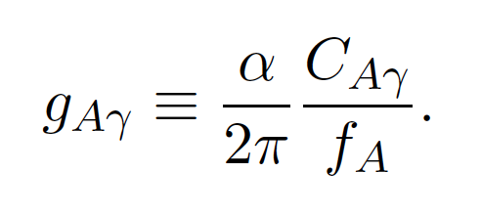


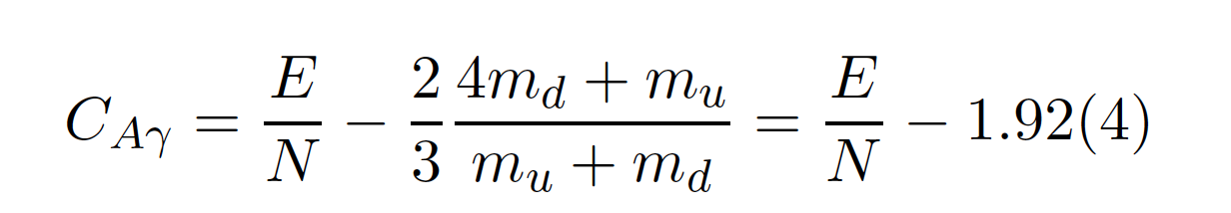
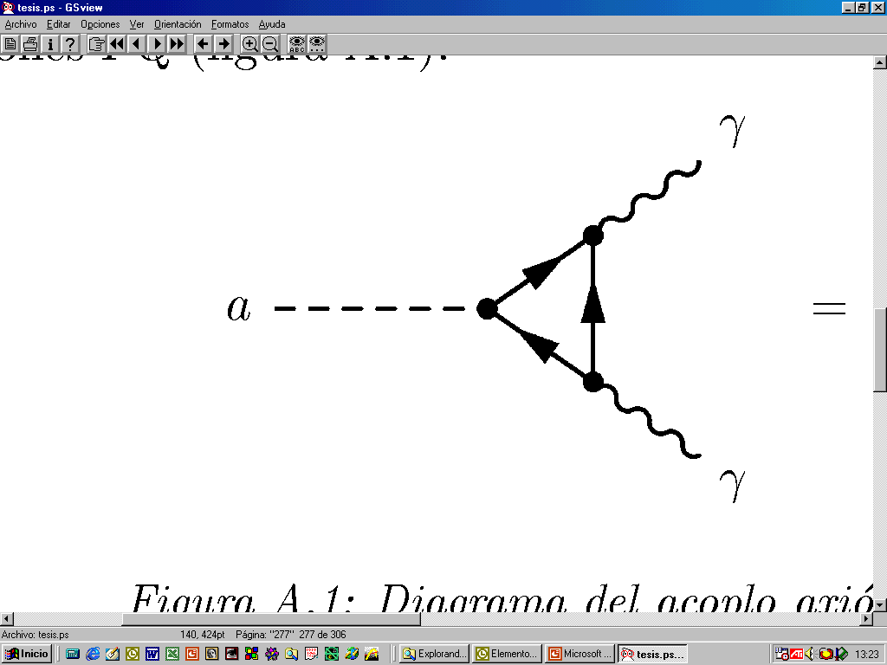
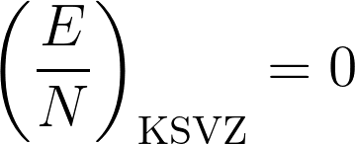
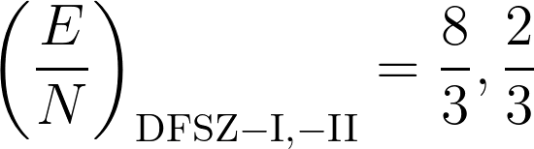
Axion-photon coupling
It contains both a model-independent contribution and a model–dependent one.

Slide 18
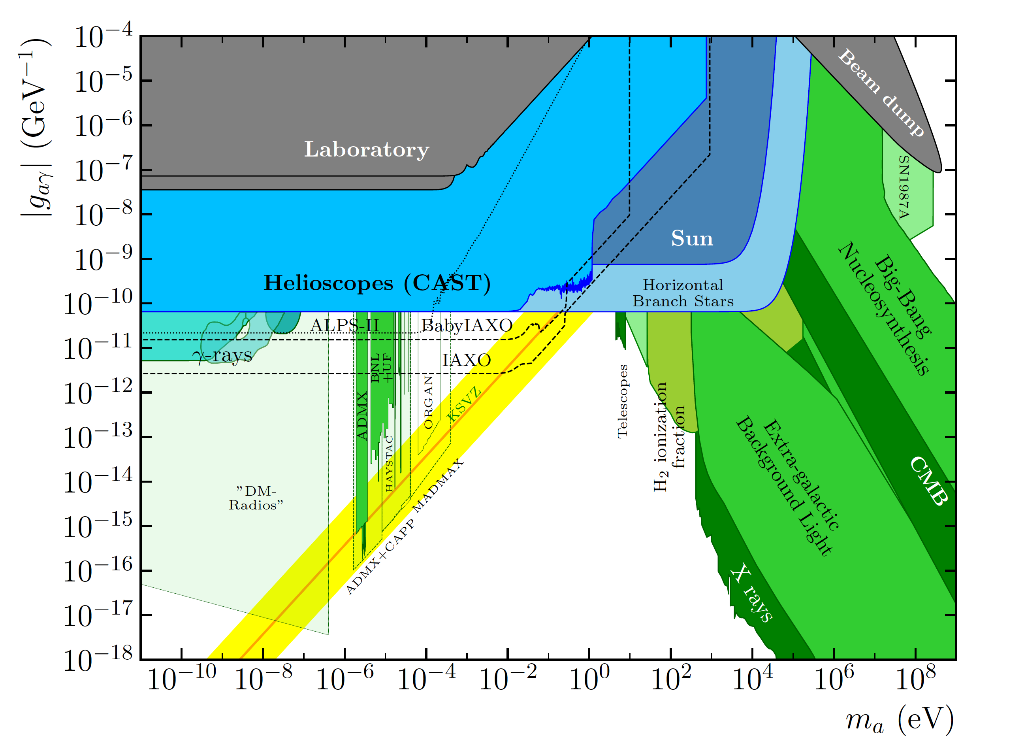
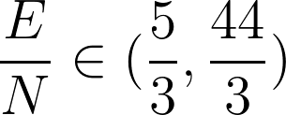
The “models band”
For a given model, g_{Aγ} is proportional to m_{a}.
Under rather general assumptions:
This fixes a yellow band where QCD axions are typically expected
Note: however, more contrived modelling allows to bypass this constrain (axions outside the band are possible)

Slide 19
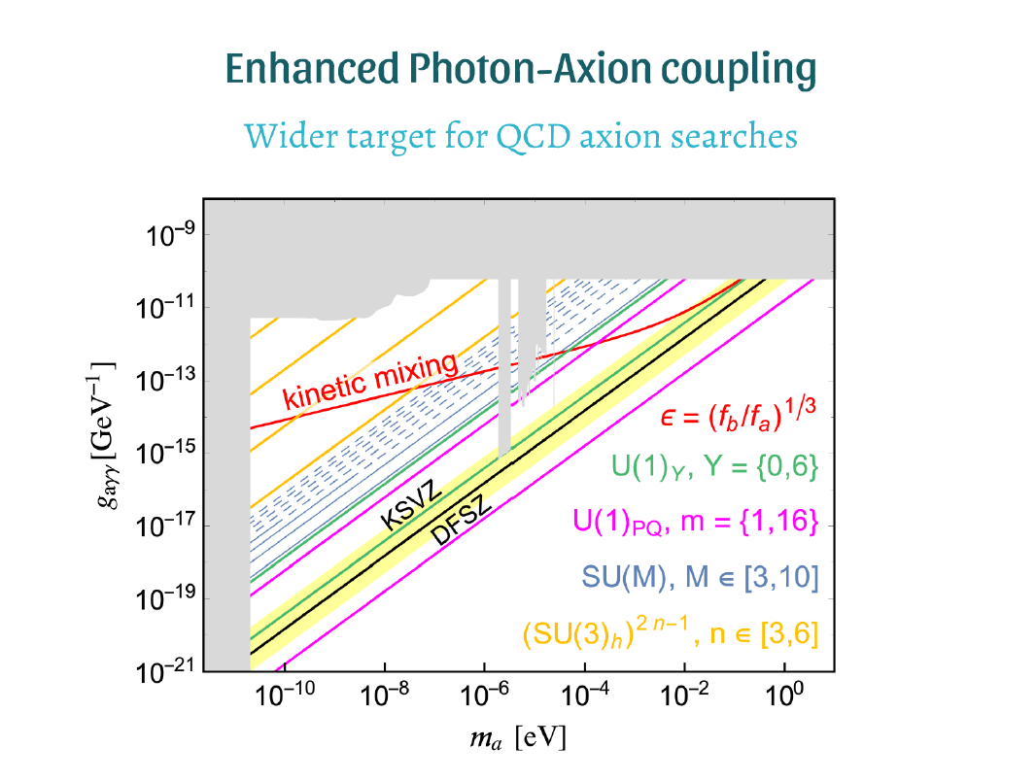
Axions beyond the “band”
Conventional QCD axion models lie on the “yellow band”
  KSVZ, DSFZ benchmarks
Outside the band typically ALPs
BUT a lot of “model building” activity in recent years, leading to QCD axion models outside the conventional band…
  Normally populating higher g_{aγ}.
  Very interesting for experiments!
P. Agrawal, ESPP 2019 Granada

Slide 20
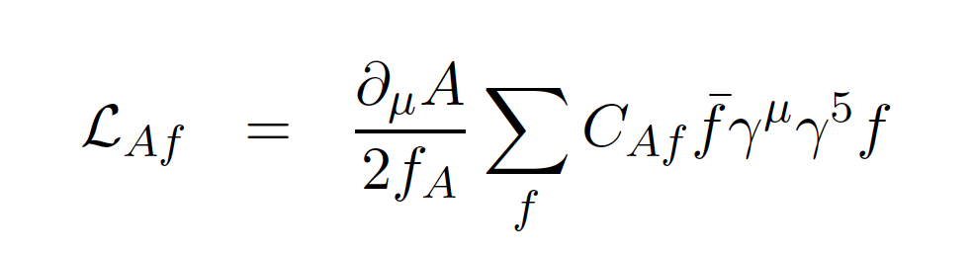

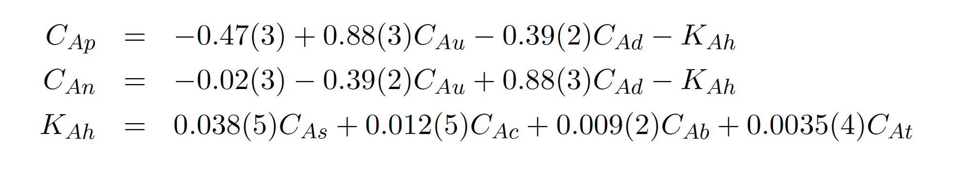

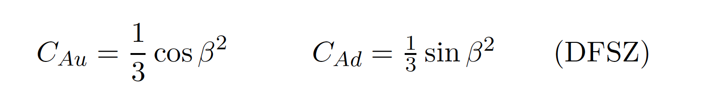

Axion-nucleon coupling
It contains both model-independent contributions and model–dependent ones.
protons
neutrons
Note that cancellations between terms can occur (although for typical models not simultaneously for protons and neutrons)
is the ratio of VEVs of the 2 Higgs

Slide 21
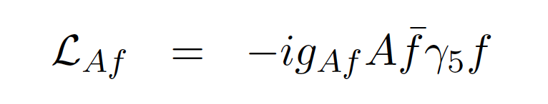
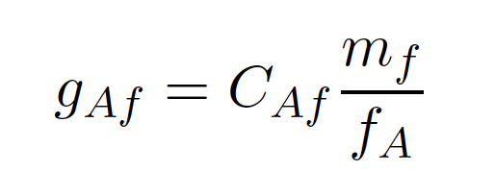
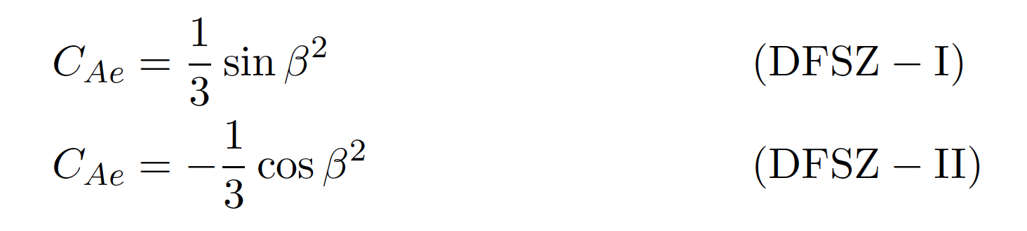

Axion-electron coupling
$$≈$$
The model-independent component is negligible (second order effect), so this coupling is model–dependent. E.g. DSFZ models feature it.

Slide 22
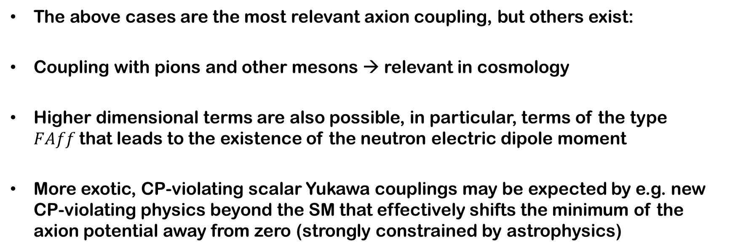
Other couplings
The above cases are the most relevant axion coupling, but others exist:
Coupling with pions and other mesons → relevant in cosmology
Higher dimensional terms are also possible, in particular, terms of the type $FAff$that leads to the existence of the neutron electric dipole moment
More exotic, CP-violating scalar Yukawa couplings may be expected by e.g. new CP-violating physics beyond the SM that effectively shifts the minimum of the axion potential away from zero (strongly constrained by astrophysics)

Slide 23
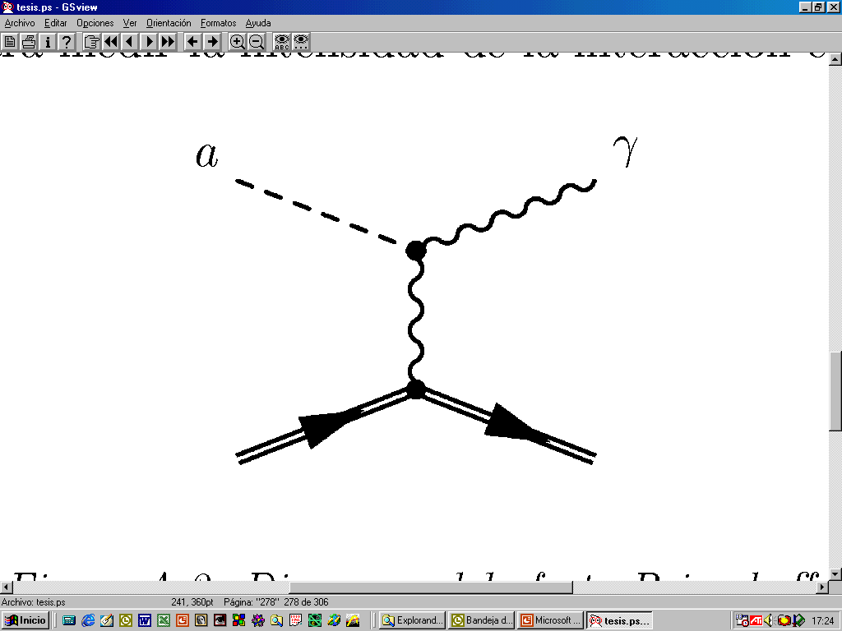
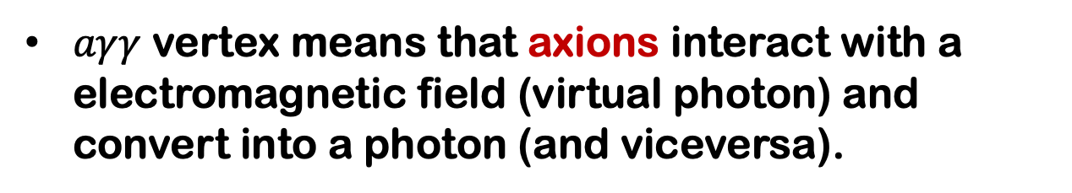
Axion-photon mixing / conversion
$aγγ$ vertex means that axions interact with a electromagnetic field (virtual photon) and convert into a photon (and viceversa).
Axion-photon conversion in the presence of an electromagnetic field (Primakoff effect)
This is probably the most relevant of axion properties.
Most axion detection strategies are based on the axion-photon coupling

Slide 24


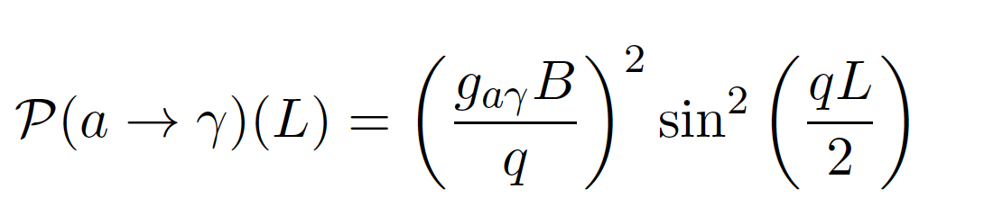
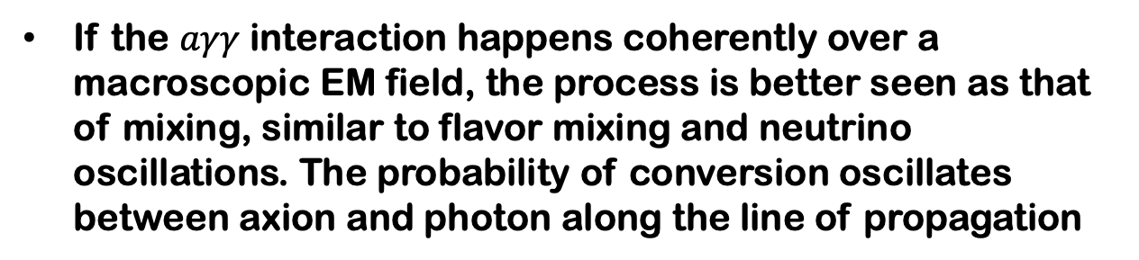


Axion-photon mixing
If the $aγγ$ interaction happens coherently over a macroscopic EM field, the process is better seen as that of mixing, similar to flavor mixing and neutrino oscillations. The probability of conversion oscillates between axion and photon along the line of propagation
Length propagated
Transverse B field
N
$$a$$
$$γ$$
(*)
S
momentum difference
(*) Approximations: 1D propagation, small mixing, relativistic velocities.

Slide 25

Axion-like particles (ALPs)
Phenomenological definition: particles with similar phenomenology that the axion (light particles coupled to photons,…)
Theoretical frameworks: Many extensions of SM predict axion-like particles
  Higher scale symmetry breaking
Not necessarily linked with PQ mechanism
WISP: similar (more generic) nomenclature
Weakly Interacting Sub-eV Particles
(WISPs)
Hidden Photons
(HPs)
Axion Like particles
(ALPs)
String theory predicts a plenitude of ALPs
AXIONS
Stringy ALPs
Arion
Majoron
Familon
Millicharged Particles
Chameleons

Slide 26
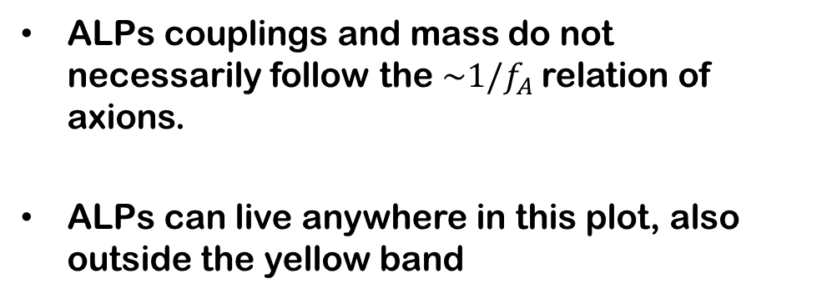
Beyond axions
ALPs couplings and mass do not necessarily follow the $\sim 1/f_{A}$relation of axions.
ALPs can live anywhere in this plot, also outside the yellow band
Generic ALPs parameter space →

Slide 27
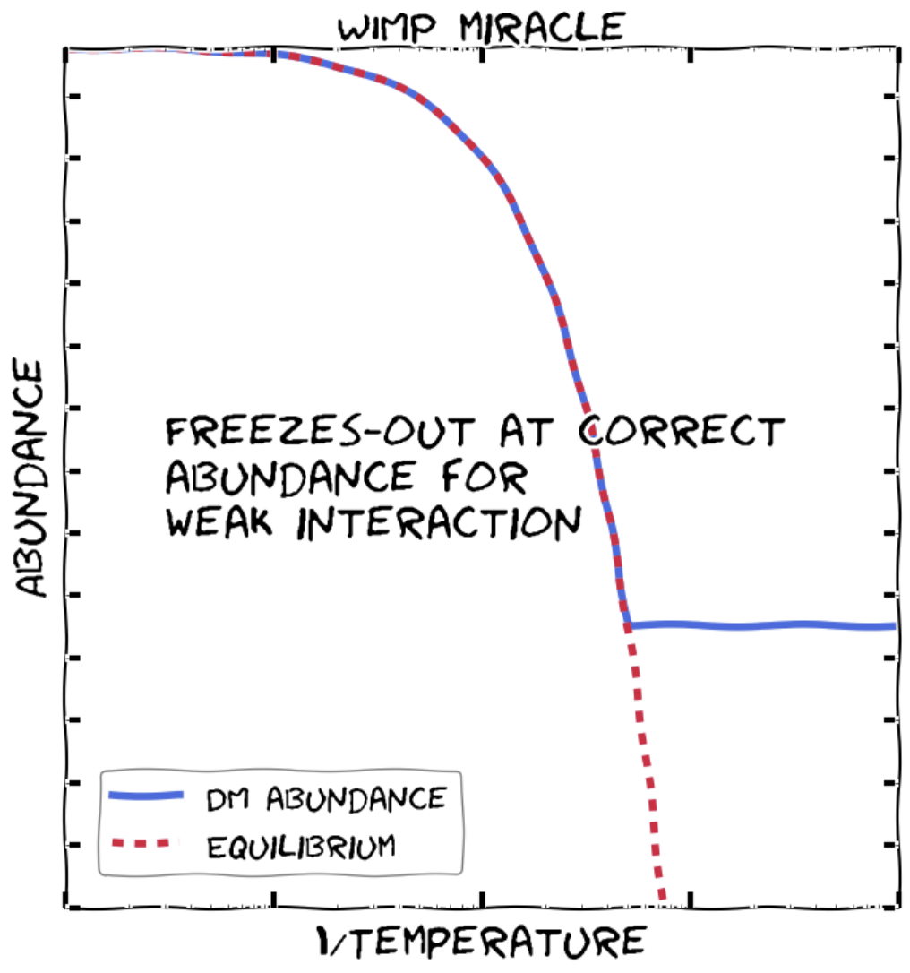


Axion Cosmology
¿How can it be that such a light particle can be a good DM candidate? (remember the WIMP miracle, it works for particle masses ~100 GeV)
Thermal production of axions lead to a relativistic population, that is, Hot DM (for $m_{a}\sim 1 \text{eV}$) or Dark Radiation (for lower $m_{a}$). So, it does not solve the DM problem.
If fact, one can use the maximum HDM density allowed by cosmological observations to constrain the axion mass:
Note: this limit applies only to axions not to generic ALPs (as coupling with mesons are invoked in the argument)
But the PQ mechanism itself offers a non-thermal production of non-relativistic axions in quantities large enough to fit the Cold DM required density

Slide 28

Lee-weinberg curve for axions

Slide 29




Vacuum realignment (VR)
Let’s follow the evolution of the axion potential with the Universe temperature $T$.
When $T\sim f_{A}$ (PQ transition) the (massless!) axion first appears as a physical degree of freedom.
Before PQ transition
$T>f_{A}$
After PQ transition
$T<f_{A}$
Potential of a Higgs-like field
PQ symmetry spontaneously broken below scale f_{a}
The field is forced to take a particular (random) value in the angular component.
Radial mode acquires a VEV $\sim f_{A}$
Angular mode is the axion. The potential is flat in the circular “valley” (the axion is massless)
PQ symmetry

Slide 30







Vacuum realignment (VR)
When $T\sim T_{QCD}$ The QCD-induced axion potential “turns on”.
The axion acquires its mass.
Before QCD transition
$T>T_{QCD}$
After QCD transition
$T<T_{QCD}$
The axion is massless
It takes a random value $θ_{i}∈\left[−π,π\right)$
(remember $θ=A/f_{A}$)
Note→ $θ_{i}$ doesn’t need to the be same is different parts of the Universe.
The QCD axion potential can be seen as a “tilting” of the Mexican hat potential of $φ .$
There is now a minimum that turns out to be CP conserving (that is the essence of the PQ mechanism)
The axion field starts rolling from whatever value had (randomly) taken before $θ_{i}$to the minimum of the potential. And keeps oscillating around it.

Slide 31






Vacuum realignment (VR)
The oscillations of the axion field fills the Universe with non-relativistic axions (→ Cold DM). Its density depends on the initial angle $θ_{i}$.
The VR mechanism is fully determined given $θ_{i}$and $f_{A}$.
For $θ_{i}\sim 1$a $\sim 6 μ\text{eV}$ axion would fill the needed DM axion via VR mechanism
Ratio of VR axion density over total DM density
Note the approx. inversely proportional relation between $Ω\sim 1/m_{A}$ . Contrary to thermal relics.
O(1) factor accounting for anharmonicities in the axion potential (calculable in principle – QCD effects)

Slide 32






Pre- and post-inflation scenarios
Pre-inflation scenario
$$f_{A}>{2πH}_{I}$$
The PQ symmetry is broken during inflation and not restored afterwards
Inflation “selects” one $θ_{i}$, that is now constant across the observable Universe.
Post-inflation scenario
$$f_{A}<{2πH}_{I}$$
The PQ symmetry is broken after inflation.
The angle $θ_{i}$ takes different values in different “patches” of the Universe.
Hubble scale at inflation
The same $θ_{i}$ in all the observable Universe
$θ_{i}$ is “sampled” from $\left[−π,π\right)$with equal probability across the Universe.
INFLATION
typical size of single patch nowadays:

Slide 33




Topological defects
The value of $θ(x)$ smoothly connects between different patches.
It may happen that in some boundaries it is topologically trapped to go around the domain $\left[−π,π\right)$, where it stores a large energy.
$$θ\left(x_{1}\right)=θ_{\text{min}}$$
$$θ\left(x_{2}\right)=θ_{\text{m}\text{ax}}$$
$$θ\left(x_{3}\right)=θ_{\text{min}}$$

Slide 34




Topological defects (TD)
The walls are the boundaries between two domains in different minima.
The field across the domain wall takes all values $\left[0,2π\right)$between the minima.
In the strings the field takes all values $\left[0,2π\right)$along any loop enclosing the string.
TD take the shape of strings and walls.
Their formation, dynamics and eventual decay must be computed with complex cosmological simulations.
There is a lot of research activity in this topic nowadays.
There is no consensus on the importance of TD axions wrt VR axions.
If $f_{A}>{2πH}_{I}$ inflation wipes out TD. Therefore they are only important in post-inflation scenarios
$$\left[0,2π\right)$$
axion string
Saikawa, arXiv:1709.07091

Slide 35



Pre-inflation scenario
Pre-inflation scenario
$$f_{A}>{2πH}_{I}$$
TD are wiped out by inflation, so VR is the only mechanism of DM axion production.
Inflation “selects” one $θ_{i}$, that is now constant across the observable Universe, but its value is unknown, is a free parameter of the model.
$θ_{i}$ can be finetuned to get the right $Ω_{A,VR}$ for practically any $m_{A}$ up to $\sim \text{meV}$
Very low $θ_{i}$ and very low $m_{A}$could be justified by anthropic reasons
The same $θ_{i}$ in all the observable Universe
INFLATION

Slide 36





Post-inflation scenario
Post-inflation scenario
$$f_{A}<{2πH}_{I}$$
The angle $θ_{i}$ takes different values in different “patches” of the Universe.
At cosmological scales, it is justified to assume an effective average:
And then:
But in this case one has also to take into account $Ω_{A,TD}$,
Different estimates for $Ω_{A,TD}$: from similar to $Ω_{A,VR}$ up to one order or even two orders of magnitude larger….
(*)
Its computation is uncertain
$$Ω_{A}=Ω_{A,VR}+Ω_{A,TD}$$
(*) = 2.15 when anharmonicities in the axion potential are taken into account

Slide 37






Domain wall problem
For some models, the axion potential features several ($N_{DW}$) physically-distinct degenerate minima.
$N_{DW}$ → “domain wall number”
The $θ_{i}$ of different patches may roll down to physically different minima. In such cases the TC formed are stable and do not decay, leading to a Universe very different, incompatible with observations…
$$N_{DW}=4$$
This is a problem only in the post-inflation scenario (in pre-inf TD do not form)
Possible solution: add new physics to make the minima non-degenerate.
The TD are longer-lived and the resulting $Ω_{A}$higher. Pushes interesting $m_{A}$to higher values (up to few x100 meV).
The original PQWW axion has $N_{DW}=3$ and the DFSZ models described
above have $N_{DW}=3$ or $6$.

Slide 38


Best $m_{A}$for axion DM?
Traditional window to look for axionDM $m_{A}∈\left(1,100\right) \text{meV}$(VR production with “natural” values of $θ_{i}$)
But finetuned values of $θ_{i}$ may be justified by anthropic reasons.
+ TD is post-inflation models…
Main message: right DM can be obtained in a large range of $m_{A}$ values.
Subdominant DM component $Ω_{A}<Ω_{DM}$→ corresponding larger $m_{A}$ values
Remember: thermal production of axions (as neutrinos) gives hot DM (upper limit m_{a}~1 eV)

Slide 40

Best $m_{A}$for axion DM?
Distribution of our “confidence” on where the DM axion is:
  Assumptions: DM is all axions, QCD axions, standard models,…
Bayesian analysis from Hoof et al. 1810.07192

Slide 41



ALP dark matter
The axion DM production mechanism are common to other ALPs from HE symmetry spontaneous breaking.
Much of the $(m_{A},g_{Aγ})$ parameter space can potentially contain viable ALP DM models. Not very predictive
  Exception: ALP miracle models (ALP is also the inflaton)
Arias et al arXiv:1201.5902
Daido et al arXiv:1710.11107

Slide 42



Other cosmological implications of ALPs
Axions can be hot DM: $m_{A}<0.53 \text{eV}$
Lighter axions can be Dark Radiation: ${∆N}_{eff }\sim 0.027$ → detectable effect in future cosmological probes.
In pre-inflation models, the axion imprints isocurvature fluctuations in the CMB.
They are not seen so far, leading to $H_{I}$dependent constraints →
Visinelli & Gondolo PRL 2014

Slide 43

Other cosmological implications of ALPs
Axion decay $a→γγ$ is longer than the lifetime of the Universe. But can lead to visible $γ$-lines from DM rich regions.
Shorter decay times would have other cosmological consequences:
  distortion of the CMB spectrum,
  affect the result of the primordial nucleosynthesis,
  Produce monochromatic X-ray and gamma-ray lines in the extragalactic background light,
  alter the H₂ ionization fraction.
Cadamuro et al. 1011.3694

Slide 44

Axions in astrophysics
Stars as axion laboratories:
  Axions modify the stellar evolution in ways that may produce observable consequences
Stars as axion factories (*):
  Axions can be produced in stars and offer a direct detection opportunity (axion helioscopes)
Effects in the propagation of photons over large distances:
  The mix with axions in the large scale B-fields may produce observable effect
Still a fundamental reference !
Similar to the neutrino case: solar neutrinos have been crucial to dilucidate fundamental properties (neutrino oscillation) and at the same time are an excellent probe to confirm our understading of the solar interior (solar models)

Slide 45

Stellar evolution
The life of a star is determined by a balance between the gravitational collapse and the pressure from nuclear fuel. The mass of the star determines its fate.
A massive star’s life cycle. From Eldridge 2008
Martínez-Pinedo, 2016

Slide 46

Stellar evolution
As long as the gravitational pressure increases and the lighter nuclear fuel is exhausted, new stages start to burn H → He → C & O , etc…
A massive star’s life cycle. From Eldridge 2008

Slide 47





Color-magnitude Diagram
Properties of star’s surface
$$L$$
$$T_{eff}$$
observational CMD of the M5 globular cluster, which shows the luminosity and surface temperature of stars at a fixed time (isochrones).

Slide 48
Color-magnitude Diagram
H
H
He
He
C O
Asymptotic giant star
Horizontal branch star
H
H
He
Main sequence star
Red Giant

Slide 49



The role of axions in stellar evolution
Axions (or any other feebly interacting particle – like neutrinos) can be produced in the star’s core. If they escape without interacting, they may constitute a relevant energy drain mechanism for the star and alter its evolution.
Which observables can best manifest the presence of such energy drain?
emission rate
Volume emission
Surface Emission
coupling
Feeble
neutrions, axions, …
photons, electrons, …

Slide 50

RGB and HB stars
Additional cooling delays the He-ignition, moving the tip of the RGB to higher luminosities
Particle emission reduces He burning lifetime, i.e. number of HB stars
R-parameter: $R=\frac{N_{HB}}{N_{RGB}}$
The ratio depends on the efficiency of the energy loss in the two evolutionary stages
Also R₂: $R_{2}=\frac{N_{AGB}}{N_{RGB}}$

Slide 51

White dwarfs
Last stage of evolution of low mass stars. Nuclear fuel exhausted. Evolution is a simple gravothermal process. Very well known evolution.
Particle emission affects the distribution of number of WD of a given luminosity, i.e. the WDLF (WD luminosity function)

Slide 52

The “blue loop”
Heavy stars in the He-burning stage have a particular evolution towards the blue (hotter) region of the HR diagram and back, a feature known as the blue loop.
The time spent in this transient would be particularly sensitive to extra cooling mechanism, and indeed such a case could explain the observed defficitof blue versus red stars

Slide 53













Axion production mechanisms in stars
Depending on the stellar environment ($ρ,T$) the relevant mechanism of axion production is different.
Important. Different stars constraint different axion couplings
Production mechanisms:
Primakoff
Low $ρ$, high $T$
Compton
Low $ρ$, high $T$
Bremsstrahlung
High $ρ$
$$g_{aγ}$$
$$g_{ae}$$
$$Ze$$
$$g_{ae}$$
$$Ze$$

Slide 54






R-parameter
Cooling mechanism in HB stars can be due to $g_{aγ}$ or $g_{ae}$. Assuming $g_{ae}$negligible, one can extract a bound from the observation of R-parameter:
Preference for non-zero coupling
HB bound
HB hint
More recently, R2 parameter (sistematics?):
$$g_{aγ}<0.47×{10}^{−10} {\text{GeV}}^{−1}$$
2207.03102
helium mass fraction

Slide 55






$g_{aγ}$coupling – astro summary
< 0.65 ($2σ$), best: 0.3
Straniero, Ayala, Dominguez, M.G., Mirizzi (2015)
HB stars
(R-parameter)
< 0.66 ($2σ$), best: 0.4
Ayala, Dominguez, M.G., Mirizzi, Straniero (2014)
< 1
Raffelt, Dearborn (1987)
< 0.47
Dolan et al. (2022)
Blue loop
Massive stars
< 0.8
A. Friedland, M.G., M. Wise (2013)
N. Vinyoles, A. Serenelli, F. L. Villante, S. Basu, J. Redondo, J. Isern, (2015). — Global analysis
< 4.1 ($3σ$)
Sun
P. Gondolo, G. G. Raffelt, Phys. Rev. D79 (2009) — neutrinos from ${}_{}^{8}B$
< 7 ($3σ$)
$$g_{aγ}×{10}^{10}GeV$$

Slide 56


$g_{aγ}$coupling
HB bound
HB hint

Slide 57



White dwarfs: WDLF
The WDLF strongly constrains the axion-electron coupling
Slight preference for a non-zero coupling can be translated to a “hint”:
Extra cooling depletes this part of the WDLF
For recent review of situation: Isern, arXiv:2002.08069

Slide 58





WD variables: period drift
Drift is visible in observations many years apart
Measures of the period change rate in WD variables offer a way to directly test the cooling rate in a single WD:
$$\dot{P}/P∝\dot{T}/T$$
Observations over the past ~30 yr showed consistently ${\dot{P}}_{obs}>{\dot{P}}_{th}$, which seems to imply an overly efficient cooling.
Córsico et al. 2019

Slide 59





RGB tip
RGB tip luminosity increases for larger $g_{ae}$ values
(Straniero et al 20202)
The luminosity of the RGB tip, the point of maximum luminosity, when RBG stars reach the condition to ignite Helium (known as the He-flash), is sensitive to extra cooling mediated by $g_{ae}$.
Recent analysis using better quality data:
Statistical combination with WD and RGB point to a almost $\sim 3σ$ hint for a non-zero coupling:
Capozzi et al, 2020 ; Straniero et al. 2020

Slide 60






$g_{ae}$ coupling – astro summary
22 GC
< 1.4 ($2σ$), best 0.6
O. Straniero et al., Astron.Astrophys. 644 (2020)
RGB tip
NGC 4258
< 1.6 ($2σ$)
F. Capozzi, G. Raffelt, Phys.Rev.D 102 (2020)
WDV
< 4.1 ($2σ$), best: 2.9
Córsico, Althaus, Miller Bertolami, Kepler,
Astron. Astrophys. Rev. 27 (1) (2019)
0.5-2.1 ($2σ$), best: 1.4
M. Bertolami, E. Melendez, L. G. Althaus, J. Isern (2014)
WDLF
< 3.5
Raffelt (1986)
$$g_{ae}×{10}^{13}$$

Slide 61


$g_{ae}$ coupling
Stellar bound
WD hint

Slide 62



Global fits on ($g_{ae},g_{aγ}$)
A global analysis of RGB, WDLF, WDV and R-parameter gives a preference to some energy loss unaccounted in the SM and explainable by axions coupled to photons and electrons.
Couplings accessible to next gen. experiments (ALPS II, BabyIAXO), if $m_{a}$ sufficiently small (see experiments)
Giannotti et al. 2017 (+ work in prep)

Slide 63



SN1987A neutrino signal
Few neutrinos detected in coincidence of SN1987A explosion. Time spread of few seconds.
Emission of very weakly interacting particles would “steal” energy from the neutrino burst and shorten it. (Early neutrino burst powered by accretion, not sensitive to volume energy loss.)
Late-time signal most sensitive observable
Raffelt 2012

Slide 64



SN1987A neutrino signal
Axion-nucleon interactions are the relevant ones in the core of a SN.
Combined on $g_{ap}$ and $g_{an}$:
Can be translated to a bound on $m_{a}$:
Carenza, et al, 2019
Considerable uncertainty remains in the derivation of this bound, that stems from the supernova modelling itself, the sparse neutrino data on which it is based, and from the difficulty of describing the axion production in processes in a high density nuclear medium. A lot of literature on the topic…
Cooling of neutron stars: similar constraints derived.

Slide 65

Summary of astro bounds & hints
←To be updated…
+ R2…
Di Luzio et al 2020

Slide 66

Summary of astro bounds & hints
Irastorza-Redondo 2018

Slide 67


Stars as axion factories
Axions can be produced in stars and offer a direct detection opportunity: axion helioscopes (no counterpart in the WIMP sector)
Axions from the Sun
Also axions from a future SN explosion…
Axions from massive stars back-converted into photons…
More about this in the “experiments” part…

Slide 68



HE $γ$ propagation over large distances
Gama ray telescopes like MAGIC or HESS observe HE photons from very distant sources. $γ −a$ mixing in intervening $B$-fields:
  Reduced opacity of medium to HE $γ$→ apparent hardening of spectra
  Oscillatory features in the photon spectrum due to turbulent structure of $B$-fields.
Sánchez-Conde, 2009

Slide 69





HE $γ$ propagation over large distances
These effects have been invoked both in claims of hints and exclusions in the ballpark of:
Lots of papers. Whether there is now a hint or not is controversial. In any case, region at reach of near-future experiments.

Slide 70


Axion/ALP searches motivation
“Focuses of interest” in the ALP parameter space
Theory
Astrophysics
Cosmology
Generic
ALP DM models

Slide 71

Sources of axions
Natural sources
Laboratory sources
Photon-ALP conversion in strong magnetic fields (axion-photon coupling)
ALP fields from macroscopic bodies (fermionic couplings)
Dark matter
Dark radiation
Stellar

Slide 72

Axion detection strategies
Most detection strategies rely on the axion-photon conversion
Table from Irastorza & Redondo 2018

Slide 73



How to detect an axion?
Axion
source
a
γ
Photon detector

Slide 74



Detection of axions
Source | Experiments | Model & Cosmology dependency | Technology
Relic axions | ADMX, HAYSTAC, CAPP, MADMAX, BRASS, ORGAN, RADES, QUAX, CASPEr, SHAFT, ABRA, DM-Radio, … | High | New ideas emerging, Active R&D going on,…
Lab axions | ALPS, JURA, OSQAR, PVLAS, ARIADNE,… | Very low | Ready for large scale experiment
Solar axions | SUMICO, CAST, (Baby)IAXO | Low | Ready for large scale experiment
Large complementarity among categories

Slide 75

Laboratory axions
γ
a
γ
Photon source
Photon detector
WALL

Slide 76


Light-shining-through-wall (LSW)
Standard configuration →
Enhanced “resonant”
configuration (future) →

Slide 77



Axion-photon conversion in a B-field
Length propagated
Transverse B field
N
$$a$$
$$γ$$
(*)
S
momentum difference
Momentum difference:
If $qL≪1$, i.e. the length of magnet is much smaller than the oscillation length, the conversion is “coherent”, and $P∝L^{2}$:
(*) Approximations: 1D propagation, small mixing, relativistic velocities.

Slide 78







LSW figure of merit (FOM)
In a LSW we have a double conversion $γ→a→γ$:
The signal will be proportional to the double probability:
FOM proportional to signal-to-noise ratio:
Power build-up factors in production and reconversion cavities
(*)
Power of laser
Detector noise

Slide 79


LSW experiments – current state-of-the-art
OSQAR @ CERN
Also past experiments:
GammeV & REAPR @ Fermilab, US
BMV @ Toulouse
…

Slide 80


From ALPS-I to ALPS-II
Resonantly enhanced
L ~ 2 x 100 m (12+12 magnets)
Taking first data already at DESY!!

Slide 81


LSW at other wavelenghts
CROWS experiment @ CERN
Microwave photons
Resonant implementation easier
Lose L enhancement…
Large scale MW LSW studied and proposed in the literature (STAX exp)
LSW at X-rays also explored in the past (not large power)

Slide 82


Future LSW: JURA concept
Concept being discussed at the Physics Beyond Colliders group at CERN
Piggybacking on development of future FCC dipole magnets.
L ~ 1km, B ~13T, P~2.5 MW,… Very challenging parameters…
Physics case to be settled (it may depend if positive signal in other exps)
A. Lindner, talk at PBC2019

Slide 83


Polarization experiments
PVLAS experiment: study QED vacuum birrefringence (standard effect), but also sensitivty to ALPs:
Future project under discussion at PBC: VMB@CERN
Dichroism:
Production of real particles
Ellipticity:
Production of massive virtual particles

Slide 84


Laboratory experiments sensitivity
Also:
GammeV & REAPR @ Fermilab, US
BMV @ Toulouse
PVLAS @ Ferrara
CROWS @ CERN
…

Slide 85


Axion-mediated macroscopic forces
Axions could be detected as short-range deviation of gravity…
(but traditionally though without enough sensitivity to QCD axions)
Recently proposed: ARIADNE experiment
Short-range force by NMR technique
Good prospects for sub-meV axion
Arvanitaki, Geraci
Phys. Rev. Lett. 113, 161801 (2014)
NMR sample
Rotating source
mass
Rotating source

Slide 86

Axion-mediated macroscopic forces

Slide 87
Dark matter axions
a
γ
Photon detector
Axions from DM halo

Slide 88





Dark matter “axion field”
If DM is (mostly) axions, they are very light, non-relativistic, very high number density → they can be better seen as a classical field oscillating at a frequency $f_{A}\sim m_{A}$
Energy of axions $m_{A}\left(1+O\left({10}^{−6}\right)\right)$. Small kinetic energy acquired by falling in the galactic potential well.
Field coherent over lengths ~ de Broglie wavelength $λ_{c}$
  The field can then be considered spatially constant over distances ${<λ}_{c}$
For an observed DM density of
The axion number density is
Axion DM field, non-relativistic
Oscillates at frequency ${f\sim m}_{A}$
De Broglie wavelength

Slide 89






Dark matter “axion field”
The velocity distribuition ${f(v}_{A})$ is given by galactic dynamics (falling into the potential well)
Standard Halo Model: ${f(v}_{A})$ is a Maxwellian distribution.
Other models predict other distributions. ${f(v}_{A})$ can also be extracted from DM simulations.
More precise shape from DM sims
Lentz et al 2017
${f(v}_{A})$ determines spread in frequency $Q_{A}\sim {10}^{−6}$
Axion DM field, non-relativistic
Oscillates at frequency ${f\sim m}_{A}$
$$δf\sim {10}^{−6}f$$

Slide 90









Detecting DM axions
Conversion of DM axions into photons in a B-field: too weak signal
Energy of converted photon $E_{γ}=m_{A}(1+O\left({10}^{−6}\right))$
Use of resonant cavity with resonant frequency matching the axion mass: Axion haloscope concept, Sikivie, 1983
If cavity tuned to the axion frequency, conversion is “boosted” by resonant factor
($Q$ quality factor)
Geometric factor: overlap of cavity mode and external B-field
Axion DM field, non-relativistic
Oscillates at frequency ${f\sim m}_{A}$
$$B_{e}$$
Cavity dimensions smaller than $λ_{c}$

Slide 91



Axion haloscopes
Cavity geometry constrained by:
  Maximizing geometric factor. E-field of the cavity mode (as much as possible) parallel to external B-field
  Data taking proceeds by scanning small $δf\sim f/Q$ mass steps and taking limited data a each step → need to mechanically modify the cavity geometry to change resonant frequency
Figure of merit:
(proportional to “time needed to scan a given mass range”)

Slide 92


ADMX
ADMX is the older axion haloscopes in operation. Sited at U. of Washington
Pioneer collaboration. Many years of R&D
Low noise receivers based on SQUIDs + dilution refrigeration at 100 mK.
Tuning achieved by set of movable rods
Sensitivity to few μeV proven
Good support through Gen 2 DM US program
- High $Q$ cavity $\sim {10}^{5}$
- Large volume: $1\text{m} × 60\text{cm} ∅$
- Suited for resonance
at few $× μ\text{eV}$
- 8T superconducting magnet

Slide 93


ADMX
First results >10 years ago.
New data being released in the last few years
First data down to DFSZ coupling…
Current program will surely cover 1-10 μeV with high sensitivity (i.e. reaching even pessimistic coupling).
What about higher masses?

Slide 94






Higher-m_{a} haloscopes
Problematic: seeking a resonance at higher $m_{A}$ normally implies lower $V$ cavities → lower sensitivity
One needs to overcome this by pushing other parameters of the FOM
Many development lines:
Many R&D lines:
Use of more powerful, higher-B, magnets
Larger instrumented volumes: matching more cavities or new multicavity designs
Reducing noise: cryogenics, new detection techniques… but beware of the standard quantum limit $T_{SQL}$
Larger $Q$ can be obtained by superconducting cavities, but improvement only up to $Q<Q_{A}\sim {10}^{6}$

Slide 95





Higher-m_{a} haloscopes
Problematic:
higher m_{a} → lower V → lower sensitivity
R&D to go to:
  Higher B magnets
  Larger instrumented volumes
  Lower noise sensors
  Higher Q cavities
Very active R&D in many groups!
More powerful magnets
Multicell structures:
  Phase-matched
  Filter-like
  Dielectric loading
  Photonic bandgap
  …
SC deposited cavities
RADES project
in CAST
CAST-CAPP project
In the CAST magnet
QUAX at LNL
“Pizza cavity”
at CAPP
→ 2008.10141

Slide 96




Going for lower $T_{sys}$
SQUID amplifier from ADMX collaboration
Leading haloscopes use cryogenics to cool down well below $T_{phys}≪1 \text{K}$.
But $T_{sys}{=T}_{phys}+T_{sen}$ (contribution from the sensor technology). New technologies with lower $T_{sen}$ are also needed. Quantum technology needed to profit from $T_{phys}$ at reach by dilution refrigerators (SQUID, JPA,…)
But Standard Quantum Limit (SQL): when $T_{phys}$ approaches $\sim hν$, irreducible noise from vacuum fluctuations

Slide 97




Beyond the SQL: HAYSTAC
  Quantum information technologies for axion searches
Squeezed photon state: one quadrature has lower variance, and the complementary one has higher-than-normal variance (to respect Heisenberg principle)
If the cavity vacuum is prepared in a squeezed state, the axion signal can be read with a noise that is effectively lower than the SQL in an amount dependent of the degree of squeezing. Concept studied in Malnou et. al 2018
First experimental application HAYSTAC at Yale (Backes et al 2021). Factor x2 effective faster scan rate obtained

Slide 98




Beyond the SQL: photon counting
Counting photons (versus phase preserving readout): SQL is evaded as phase uncertainty is maximal…
But, how to implement photon counters at these energies? → quantum technologies Several promising ideas. Some examples:
QUAX+Saclay group: 2403.02321 (x20)
Dixit et al (PRL 126)
RADES/DarkQuantum project
…

Slide 99





Going for higher $Q$
HTS coated cavity
(RADES)
NbTi coated cavity
(QUAX experiment)
Coating the walls of the cavity with a superconductor material will increase $Q$ (decreases the losses on the walls)
Technological challenges: the material must remain SC in the magnetic field.
Novel high-T superconductor (HTS) are difficult to handle (brittle materials, etc.)
Physical limit to improving $Q$: above $Q_{a}\sim {10}^{6}$ it does not translate in improved FOM (the axion peak must fit in the cavity bandwidth!)
HTS coated cavity
(CAPP)

Slide 100



CAPP
  CAPP18T: Search in a 18T magnet @ ~20μeV (Phys. Rev. Lett. 128, 241805)
  CAPP-PACE: near quantum-limited search with JPA (2207.13597)
  CAPP-12T: Search in a 12T magnet with JPA @ ~4μeV (presented in Patras 2022)
CAPP: “Center for Axion and Precision Physics” at South Korea
  A lot of generic R&D activity (SC cavities,…)
  Also multicell setup (pizza cavity)
  Several experimental platforms, already producing restuls…

Slide 101

New cavity designs to increase V
Combining the power of many smaller cavities is possible but challenging -> “phase matching”
  Probably only possible for “a few” cavities
New cavity designs to “decouple” V from m_{a}, and go for larger effective V and larger m_{a}.
ADMX R&D
Long thin cavities: ma is fixed by small dimensions, but V can be ~larger
Properly designed arrays of cavities with couplings
*Also ORGAN project in Autralia
CAST-CAPP project
in the CAST magnet
RADES project
Filter-like cavities
in the CAST magnet at CERN
“Pizza cavity”
at CAPP

Slide 102


Higher-m_{a} haloscopes
HAYSTAC
ADMX-Sidecar: small demonstrator adjacent to main ADMX
QUAX @ LNL/LNF:
  SC coated cavity
  Setup with sensitivity to g_{ae} coupling
  Quantum limited JPA: Phys. Rev. D 103, 102004 (2021) → limit @ 10.4 GHz
RADES & CAST-CAPP @ CERN
  New cavity geometries inside a dipole magnet (CAST)
ORGAN in Australia
GraHal in Grenoble (arXiv:2110.14406)
  Access to very powerful hybrid magnet
TASEH in Taiwan (arXiv:2205.05574)
ADMX-Sidecar
CAPP-PACE
CAPP projected
5-y plan

Slide 103




Magnetized dish antenna
DM field + B field + boundary condition in the dish → photon emission normal to surface
No resonance (loss a factor Q) BUT may be compensated with very large areas ?
Resonance versus area
Implementation
In the BRASS Project at Hamburg
Also BREAD Project @ US
Variation: solenoidal geometry

Slide 104



Dielectric haloscopes
Effect of dish antenna “boosted” by the addition of many dielectric disks
Some “mild” resonance
  Concept between a haloscope and a dish antenna
  It needs tuning! (challenging)
Relevant sensitivity in the 10⁻⁴ eV ballpark for a ~m³ 10T experiment (80 disks)
Similar high-m resonant structure:
ORPHEUS: multi-wires
  LAMPOST: dielectric haloscope at visible wavelengths (PRD98 (2018))
  ALPHA: plasma haloscope (metamaterial)… (arXiv:1904.11872)
MADMAX dielectric haloscope

Slide 105



Directional effects
DM directionality would be a powerful signature to confirm a putative signal
Long aspect-ratio cavities should show a directional dependence if $L>λ_{c}$
Dish antennas: small parallel component proportional to axion momentum
  pixelised detector at the focal point could image velocity distribution
An “axion astronomy” era would follow a discovery

Slide 106




Lower m_{a} haloscopes
Large V haloscopes are technologically simpler, but expensive → huge magnet needed.
Use of existing magnets could be an effective strategy
KLASH proposal: use of 50 m³, 0.6T, KLOE magnet at LNF
Future IAXO helioscope (see later) will offer B²V > ~100 T²m³
Also
GraHal in Grenoble
ADMX plans for lower masses
See recent workshop on low-mass haloscopes https://indico.cern.ch/event/1115163/
  Also, recent work pointing to opportunities to detect gravitational waves with these experiments

Slide 107


Pick-up coil & resonant circuit
DM-induced oscillating B in the center of a toroidal magnet
Resonance is achieved externally with a circuit (no cavity)
Both wideband search and resonance search possible
ABRACADABRA @ MIT
DM-Radio @ Stanford
Also
ADMX-SLIC
SHAFT @ Boston
BASE @CERN
ABRA-10cm
SHAFT
DM-Radio m3 program
CAST
ABRA: arXiv:1810.12257
SHAFT:arXiv:2003.03348

Slide 108


Spin precession experiments
DM-induced spin precession → it can be detected with very sensitive NMR techniques
Directly sensitive to the gluon term (also to fermionic couplings)
Maybe important at very low m_{a}
Also QUAX experiment:
  Electron spin precession
  Sensitive to “axion DM wind” through axion-electron coupling
CASPEr experiment (Mainz-Berkeley)
Phys. Rev. X 4, 021030 (2014)

Slide 109



DM-induced atomic transitions
DM can induce atomic excitations equal to m_{a}.
Sensitive to axion-electron and axion-nucleon coupling
Zeeman effect → create atomic transitions tunable to m_{a}
Detection of excitation via pump laser
AXIOMA → recent project aiming at an implementaiton
Relevant sensitivity for m_{a} ~ 10⁻⁴ eV
seems possible for kg-sized samples
P. Sikivie PRL 113(14)

Slide 110


Slide 111


Pre-inflation models
Post-inflation models
$$N_{DW}>1$$
$$N_{DW}=1$$
Finetunned$θ_{i}$
Summary of current status and future prospects…
A diverse experimental landscape has emerged with potential to cover a substantial fraction of parameter space
Caution: many of these prospects still rely on a prior succesful R&D phase
Caution: Green areas rely on axion as DM hypothesis…

Slide 112
Solar axions
a
γ
Photon detector
Axions from the Sun

Slide 113







Solar axions
Solar axions produced by $γ→a$ conversion of the solar plasma photons in the solar core. “Primakoff solar axions”
axions
Solar axion flux at Earth
Spectral shape fully defined by solar physics
van Bibber PRD 39 (89)
CAST JCAP 04(2007)010

Slide 114




Solar axions
In addition to Primakoff, “ABC axions” may be x100 more intense… but model-dependent.
axions
Primakoff
Non-hadronic “ABC” Solar axion flux at Earth
JCAP 1312 008
“ABC” axions (*)
* if the axion couples with the electron ($g_{ae}$)
(non hadronic axion)

Slide 115


…and more solar axions
Via axion-nucleon couplings: monochromatic lines from nuclear transitions:
  E.g. 14.4 keV axions emitted in the M1 transition of Fe-57 nuclei, MeV axions from 7Li and D(p;γ)³He nuclear transitions or Tm-169.
More recently proposed: photons interacting with macroscopic solar B-fields.
axions
longitudinal and transversal plasmons conversion.
Depend on $g_{aγ}$ !
TP depend on $m_{a}$too
Depend on solar B-field. Poorly known but constrained:

Slide 116



Axion helioscopes
Axion helioscope concept
P. Sikivie, 1983
+ K. van Bibber, G. Raffelt, et al. (1989)
(use of buffer gas)
axions
Transverse magnetic field (B)
L
X ray
detector
X ray
Coherence factor
Photons keep the same energy as incoming axions
momentum difference

Slide 117




Axion helioscopes
Figure of merit of axion helioscopes. Defined as proportional to SNR of a given signal:
axions
Data taking efficiency and observation time
Efficiencies of focalization and detection
Transverse magnetic field (B)
L
Field strength, length and cross-sectional área of magnet
X ray
detector
X ray
Normalized background and signal spot size
Photons keep the same energy as incoming axions

Slide 118





Buffer gas for higher $m_{a}$
Coherence condition ($qL ≪ 1$) is recovered for a narrow mass range around $m_{γ}$, the refractive mass acquired by the photon in the gas
axions
Transverse magnetic field (B)
Buffer gas
L
X ray
detector
X ray
N_{e}: number of electrons/cm³
r: gas density (g/cm³)

Slide 119


Other types of helioscope
Instead of magnetic field, one can use as « target » the EM fields or electrons in large WIMP detectors: recent excess in XENON1T? Not sensitive to unconstrained models…
‘Primakoff-Bragg’ effect: +cristaline target
WIMP-like experiments provide limit to axions: SOLAX, COSME, DAMA, EDELWEISS, CDMS, etc…
Characteristical temporal pattern:
axions

Slide 120



Excess in XENON1T
E. Aprile et al., 2020
The solar axion model has a 3.5 σ significance, but requires $g_{ae}\sim 3×{10}^{−12}$, … or a large coupling with photons plus a coupling with electrons (Gao et al. 2020)
Strong conflict with astrophysics: it cannot be solar axions
Excess disappeared in XENONnT data

Slide 121


Other types of helioscope
« TPC in a magnetic field »: conversion and absorption happening in the gas
Competitive only for high axion mass ~0.1-10 eV
No coherence, but large volume can compensate. Also no preferred direction, so no tracking needed
axions
Galán et al, arXiv:1508.03006

Slide 122



Axion Helioscopes
Previous helioscopes:
  First implementation at Brookhaven (just few hours of data) [Lazarus et at. PRL 69 (92)]
  TOKYO Helioscope (SUMICO): 2.3 m long 4 T magnet
Current state-of-the-art:
CERN Axion Solar Telescope (CAST)
First helioscope using low background techniques & x-ray focusing

Slide 123


CAST experiment @ CERN
Decommissioned LHC test magnet (L=10m, B=9 T)
Moving platform ±8°V ±40°H (to allow up to 50 days / year of alignment)
4 magnet bores to look for X rays
3 X rays detector prototypes used.
X ray Focusing System to increase signal/noise ratio.
Moving platform ±8°V ±40°H
LHC test magnet
2 low background Micromegas
1 Micromegas + XRT
1 Ingrid + XRT

Slide 124

CAST hunting axions (movie credit: M. Rosu / CERN)

Slide 125




Latest CAST limits
Enabled by the
IAXO pathfinder system
2003 – 2004 | CAST phase I vacuum in the magnet bores
2006 | CAST phase II - ⁴He Run axion masses explored up to 0.39 eV (160 P-steps)
2007 | ³He Gas system implementation
2008 - 2011 | CAST phase II - ³He Run axion masses explored up to 1.17 eV bridging the dark matter limit
2012 | Revisit 4He Run with improved detectors
2013-2015 | New vaccum phase with improved detectors → Result released in 2017
2019-2021 | Last solar axion run. More statistics → in arxiv last week! 2406.16840
Updated limit (2024)
X-ray optics specifically built for axions
Low background Micromegas

Slide 126





IAXO pathfinder system in CAST
Test MM detector + slumped-glass x-ray optics together
X-ray optics specifically built for axions
Detector: JCAP12 (2015)
Physics: Nature Physics (10.1038/nphys4109)
Background spectrum
Best SNR of any previous detector
290 tracking hour acquired (6.5 months operation)
3 counts observed in RoI (1 expected)
5 mm
Low background Micromegas at the focal point
Calibration data
“axion” data

Slide 127


IAXO – Concept
IAXO =
International Axion Observatory
Enhanced axion helioscope: JCAP 1106:013,2011
4+ orders of magnitude better SNR that CAST

Slide 128
IAXO – Conceptual Design
Large toroidal 8-coil magnet L = ~20 m
8 bores: 600 mm diameter each
8 x-ray telescopes + 8 detection systems
Rotating platform with services

Slide 129

BabyIAXO
Prototype: Intermediate experimental stage before IAXO
  Two bores of dimensions similar to final IAXO bores → detection lines representative of final ones.
  Magnet will test design options of final IAXO magnet
  Test & improve all systems. Risk mitigation for full IAXO
Physics: will also produce relevant physics outcome
  (~100 times larger FOM than CAST)
BabyIAXO conceptual design
JHEP 05 (2021) 137
Now under construction at DESY
~100x CAST SNR

Slide 130


IAXO technologies – magnet
IAXO magnet
Superconducting “detector” magnet.
Toriodal geometry (8 coils)
Based on ATLAS toroid technical solutions.
CERN+CEA expertise
8 bores / 20 m long / 60 cm Ø per bore
Baseline developed at:
IAXO Letter of Intent: CERN-SPSC-2013-022
IAXO Conceptual Design: JINST 9 (2014) T05002 (arXiv:1401.3233)

Slide 131


IAXO x-ray optics
X-rays are focused by means of grazing angle reflection (usually 2)
Many techniques developed in the x-ray astronomy field. But usually costly due to exquisite imaging requirements
ABRIXAS spare telescope, in use in one of the 4 bores of CAST
(pioneer use of x-ray optics in axion research)
Focal length

Slide 132

IAXO x-ray optics
Each bore equipped with an x-ray optics
Exquisite imaging not required
BUT need cost-effective way to build 8 optics of 600 mm diameter each.

Slide 133

BabyIAXO optics
2 detection lines in BabyIAXO with different solutions:
Hybrid approach for custom BabyIAXO optic
Inner part Al-foil or segmented glass optic
Outer part cold-slumped Willow-glass technology
XMM Flight Spare XRT
Engineering model sent to DESY, actual optic currently at PANTER (Munich).
Loan agreement from ESA to IAXO
Calibration at PANTER scheduled soon

Slide 134
IAXO low background detectors
8 detector systems
Baseline: small Micromegas-TPC chambers:
  Shielding
  Radiopure components
  Offline discrimination

Slide 135





IAXO low-$b$ Micromegas detectors
History of background improvement of Micromegas detectors at CAST
Goal background level for IAXO:
  10⁻⁷ – 10⁻⁸ c keV⁻¹ cm⁻² s⁻¹
Already demonstrated:
~8×10⁻⁷ c keV⁻¹ cm⁻² s⁻¹
  (above ground)
  10⁻⁷ c keV⁻¹ cm⁻² s⁻¹
  (underground at LSC)
IAXO goals
Nominal values at CAST
Active program of development.
IAXO-D0/D1 test-platforms to explore background sources and improve levels

Slide 136



Complementary technologies
Beyond baseline, “high precision” detectors
  Better threshold & energy resolution
  Design and material optimization ongoing in all fronts
  Background studies with different shielding configurations
TES: Transition Edge senstors
MMC: Metallic Magnetic calorimeters
Gridpix
SDD: Silicon Drift Detectors

Slide 137
Helioscopes & astrophysics hints
… as well as a large fraction of the axion & ALP models invoked in the “stellar cooling anomaly”
But for this the g_{ae} is particularly interesting
IAXO will fully explore ALP models invoked to solve the “transparency hint”

Slide 138
IAXO & stellar cooling
Multiple stellar anomalies (HB, RG, WD, NS,..). Overall 3σ effect.
g_{ae} channel
IAXO will explore most of the relevant models (especially with IAXO+)
Only experiment with such capability
Region of QCD axion models that solve the stellar anomaly
M. Giannotti et al.
JCAP 1710 (2017) 010
arXiv:1708.02111

Slide 139



Beyond baseline
BabyIAXO as a generic axion(-like) facility
Axions from SN:
O(100MeV) energies
Requires large HE γ-ray detector
Dark Matter axions:
Axion haloscope setup (RF cavities) inside BabyIAXO bores
Other axion DM sensors (pick-up coils or emitting surfaces)
Synergies with quantum sensors
Extra cryogenics needed?
Other (non-Primakoff) solar axion production mechanisms:
“ABC” axions (~1 keV)
12 keV or HE axions from nuclear transitions
LE axions from plasmon conversion
…
Other WISPs: hidden (dark) photons, chameleons, …
post-Discovery “precision” physics:
Signal polarization
Axion mass determination (spectral distortions)
Multi-coupling determination → QCD axion model
Solar physics (B & T of solar core)
And also high-frequency Gravitational Waves!!

Slide 140




“Post-Discovery” physics
Measuring axion properties:
  Detection of both ABC and Primakoff axion spectrum would allow distinguishing axion models ($g_{ae}$, $g_{aγ}$) Jaeckel et al. arXiv:1811.09278
  Axion mass can be determined from the spectral shape. Dafni et al. arXiv:1811.09278
  Helioscopes as solar magnetometers:
  O’Hare et al. arxiv:2006.10415
  (sensitivity to internal
  solar B-fields)
  Also as solar thermometers:
  S. Hoof et al. arxiV:2306.00077

Slide 141

Axions from a galactic SN
If a sufficiently closeby galactic SN explodes, SN axions could be detectable at (Baby)IAXO.
Ge et al. arXiv:2008.03924
SN axions have O(100MeV) energies
Requires IAXO to be equipped with large HE γ-ray detector, covering all magnet bore.
Complementary implementation with baseline layout, using opposite side of magnet.

Slide 142
Overall conclusions
Most compelling solution to the Strong CP problem of the SM
Axion-like particles (ALPs) predicted by many extensions of the SM (e.g. string theory)
Axions, like WIMPs, may solve the DM problem for free. (i.e. not ad hoc solution to DM)
Astrophysical hints for axion/ALPs?
  Transparency of the Universe to UHE gammas
  Stellar anomalous cooling → g_{aγ} ~ few 10⁻¹¹ GeV⁻¹ / m_{a} ~few meV ?
Relevant axion/ALP parameter space at reach of current and near-future experiments
Still too little experimental efforts devoted to axions

Slide 143


Overall picture (for $g_{aγ}$)
Helioscopes (IAXO) will probe astrophisically motivated ALP models
Helioscopes (IAXO) will probe meV – eV QCD axion models
… and most of the region hinted by stellar cooling
Haloscopes will soon probe 1-10 μeV QCD axions
Promising new haloscopes R&D to substantially expand explorable mass range
In overall, a large fraction of the ALP parameter space may be explored in the future

Slide 144
Overall conclusions (II)
Axion physics/search is an exciting field nowadays
Experimental and phenomenological efforts are increasing
  Consolidation of classical approaches into larger experiments + new ingenious ideas to tackle new regions
  Large impact still possible with relatively modest effort
Large fraction of parameter space at reach of near-future experiments: chances of discovery!
I hope this course has been of your interest and will help you in your future career (be it in axion research or in neighboring topics)
Thank you very much for your attention

