Slide 1
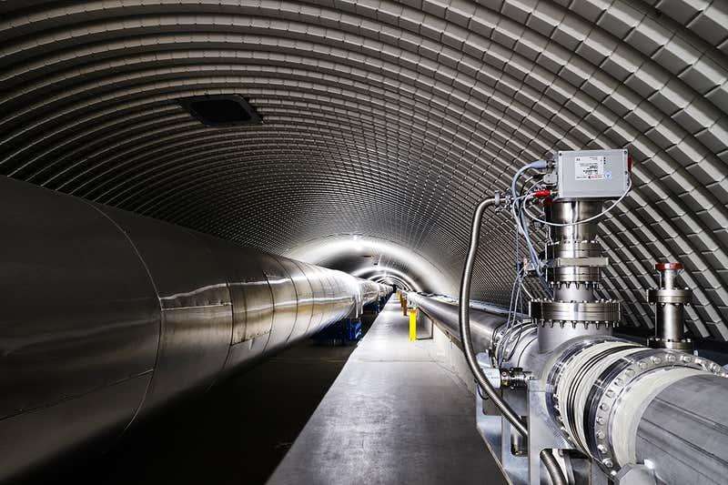
Integrated squeezed light sources
J.P. Zendri
On behalf of the Virgo-ET Padova group

Slide 2
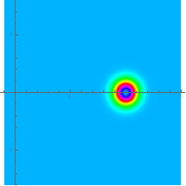
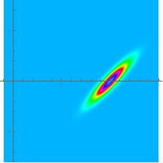
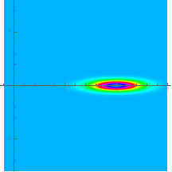
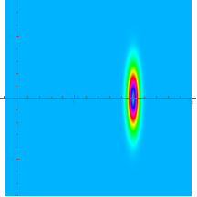
















Squeezed states of light
Electric Field Quadratures
Phase noise
$$\hat{E}=\left[X_{1}+{\hat{∆X}}_{1}\right]Cos\left(ω_{0}t\right)+\left[{\hat{∆X}}_{2}\right]Sin\left(ω_{0}t\right)=X_{1}\left[1+{\hat{∆X}}_{1}/X_{1}\right]Cos\left(ω_{0}t−{\hat{∆X}}_{2}/X_{1}\right)$$
Amplitude noise
Minimum Uncertainty States
$$∆X_{1}{∆X}_{2}=1$$
Coherent State
Squeezed State
Phase squeezing
Amplitude squeezing
$$X_{2}$$
$$X_{2}$$
$$X_{2}$$
$$X_{2}$$
$${∆X}_{1}$$
$${∆X}_{1}$$
$${∆X}_{1}$$
$${∆X}_{2}$$
$${∆X}_{2}$$
$${∆X}_{2}$$
$$X_{1}$$
$$X_{1}$$
$$X_{1}$$
$$X_{1}$$
$$θ$$
3.5 dB
3.5 dB
3.5 dB

Slide 3
Squeezing applications
Quantum computing
J. Zhao et al.,“A high-fidelity heralded quantum squeezing gate”, Nature Photonics volume 14, pages 306–309 (2020)
T. Kashiwazaki et al., “Over-8-dB squeezed light generation by a broadband waveguide optical parametric amplifier toward fault-tolerant ultra-fast quantum computers”, https://arxiv.org/abs/2301.12658, (2023).
Quantum comunication
T. Gehring, “Implementation of continuous-variable quantum key distribution with composable and one-sided-device-independent security against coherent attacks”, Nature Comunications 6, 8795 (2015).
Metrology
A. I. Lvovsky. Squeezed light - Quantum Physics https://arxiv.org/abs/1401.4118
Spetroscopy
J. Junker et al. “High precision cavity spectroscopy using high-frequency squeezed light” Opt. Express (2021), 29, 6053
Biology
W. Yang et al., “A Bright Squeezed Light Source for Quantum Sensing”, Chemosensors (2023), 11, 18
Others
Long Ma, “Generation of higher-order orbital angular momentum squeezed light”, Optik - International Journal for Light and Electron Optics 251 (2022) 168357

Slide 4
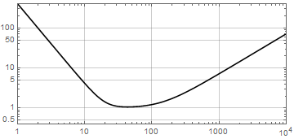
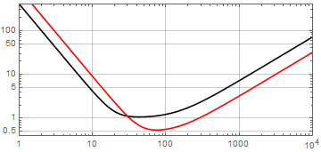
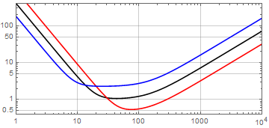
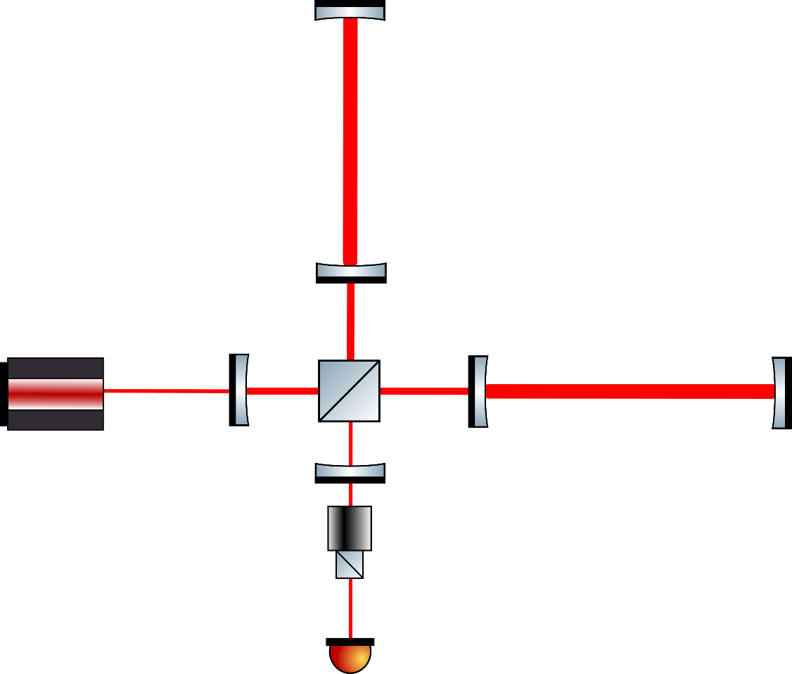
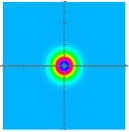
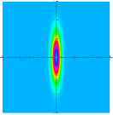
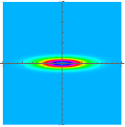
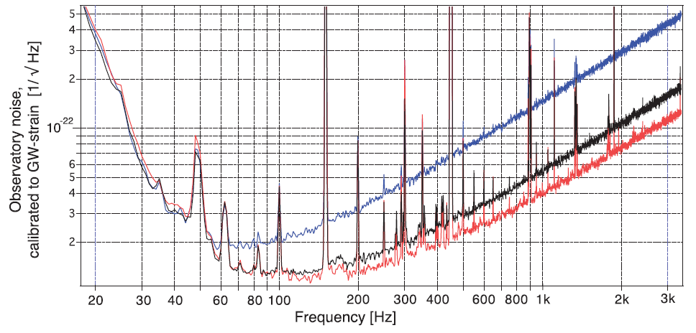
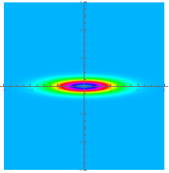
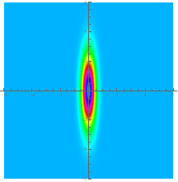
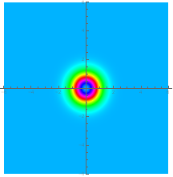


Squeezing and GW detectors
Quantum noise can be manipulated with squeezed light
$$∆X_{1} generates shot noise$$
$$(high frequency)$$
$$∆X_{2 }generates radiation$$
$pressure noise (low$
$frequency)$
$$PRL 123, 231108 (2019)$$
$$Virgo 2019$$

Slide 5
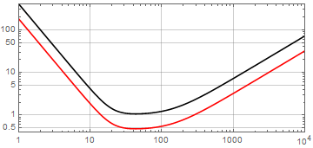
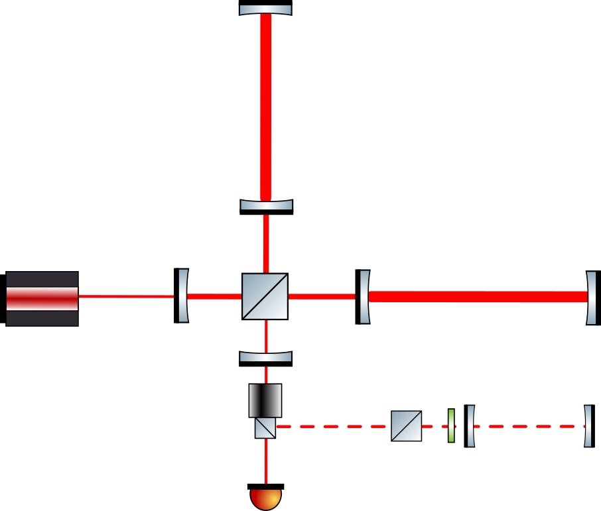
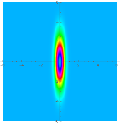
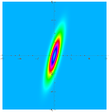
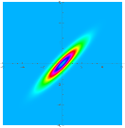
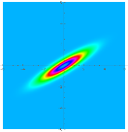
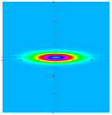
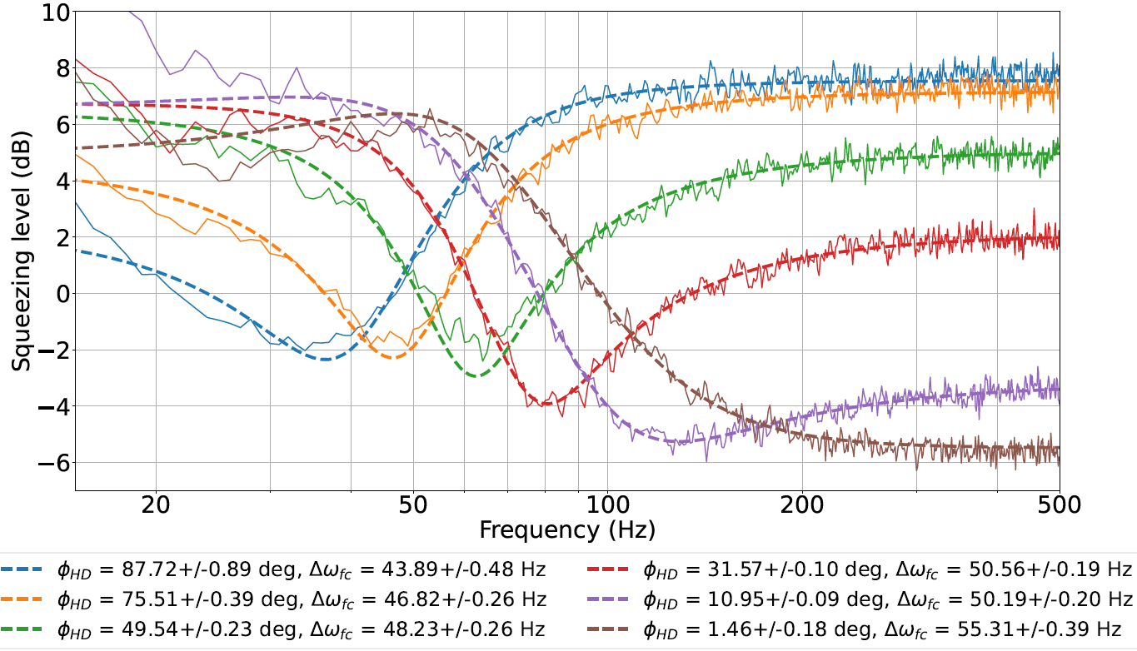
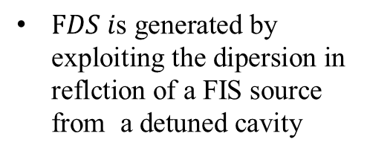

Squeezing and GW detectors
Frequency dependent squeezing (FDS)
$FDS i\text{s} \text{generated} \text{by} \text{exploiting} \text{the} \text{dipersion} \text{in} \text{reflction} \text{of} \text{a} \text{FIS} \text{source} \text{from} \text{a} \text{detuned} \text{cavity}$
3 Km
300 m
$$Virgo FDS source$$
FDS source

Slide 6
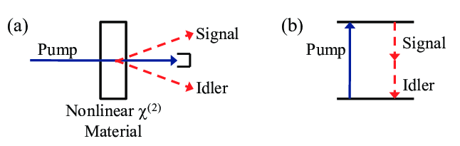
Squeezed light production
Squeezed state generation requires nonlinear processes.
Several methods explored (4 wave mixing, ponderomotive effect, kerr effect,..)
The most efficient exploits the cavity enhanced parametric down conversion in $χ^{(2)}$ crystals
Parametric Down Conversion
OPA: Optical parametric Amplification

Slide 7
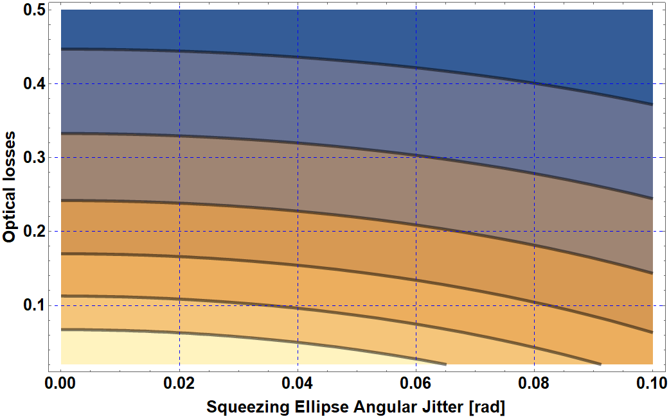
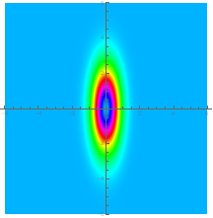
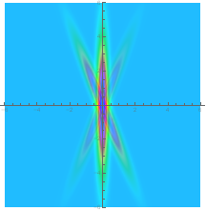


Squeezing degradation
Produced 10 dB
Optical losses:
Losses
3 dB
IN
OUT
4 dB
5 dB
6 dB
7 dB
8 dB
Squeezing ellipse angular jitter:
$${∆X}_{1}$$
Required:
High quality Optics (superpolished, low absorbtion materials, AR coating).
Fast and low noise phase stabilization loops.
$${∆X}_{1−actual}$$

Slide 8
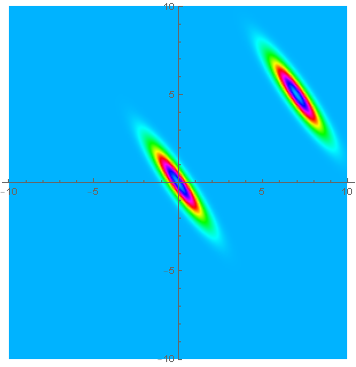
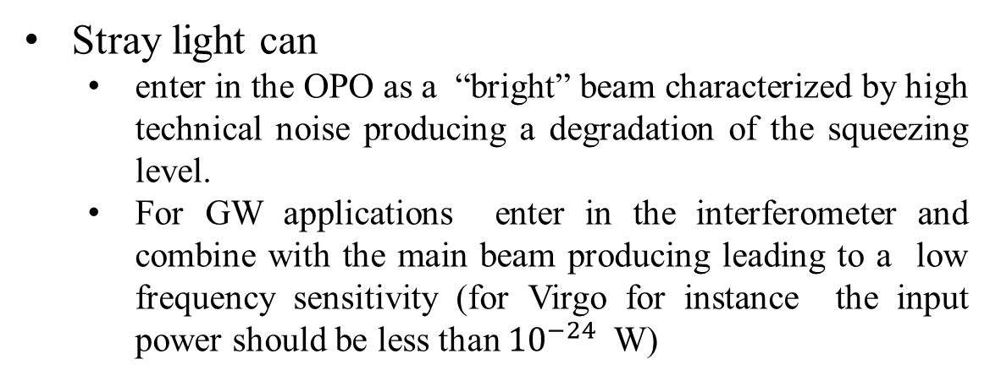
Squeezing degradation: stray ligth
Stray light can
  enter in the OPO as a “bright” beam characterized by high technical noise producing a degradation of the squeezing level.
  For GW applications enter in the interferometer and combine with the main beam producing leading to a low frequency sensitivity (for Virgo for instance the input power should be less than ${10}^{−24}$ W)
Bright SQZ
Vacuum SQZ
Solutions:
  Optics with low roughness (superpolished).
  Low dust contamination (clean room operation).
  Use of Faraday isolators.
  Active suppression loop (could be tested in the current project)
  OPA operating in vacuum (could be tested in the current project)

Slide 9
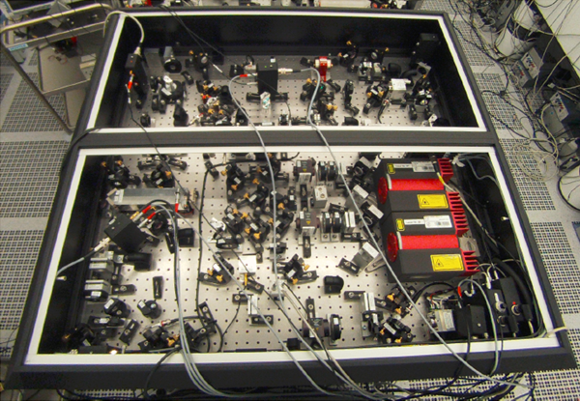
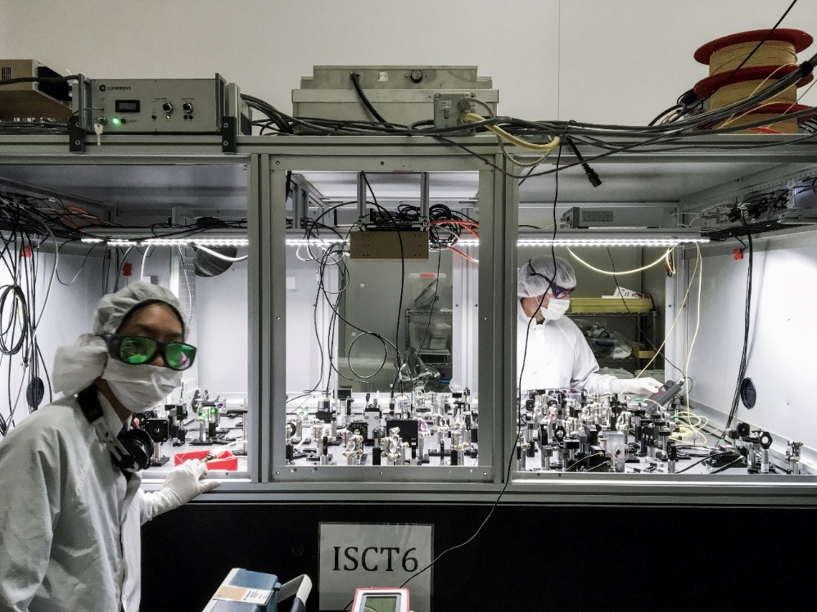
Real squeezer boards
Virgo AEI
squeezer
In addition to the OPO a squeezer board includes
  Pump power generator (SHG:Second Harmonic Generator)
  Pump power stabilizer (MZI:Mach Zehnder Interferometer)
  Phase and frequency modulators (EOM, AOM)
  Auxiliary control laser (coherent control laser, Sub Carrier laser..)
  Beam mode cleaners
  Faraday isolators
  Phase Locked Loop optical set-up
  Diagnostic homodyne detector
LIGO
squeezer
Most of these components can be integrated in a LNOI chip

Slide 10
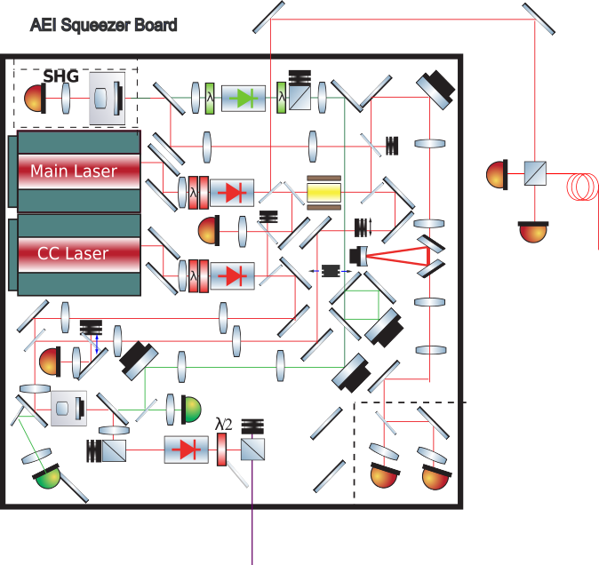
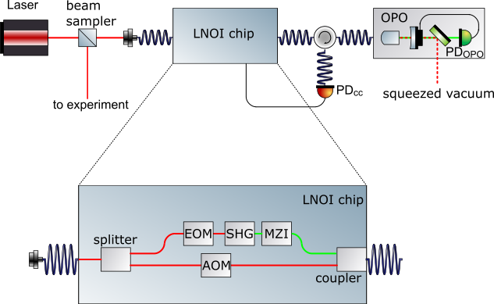
Hybrid squeezed vacuum source
Fabrication of integrated optical chips for the generation and preparation of optical signals to be fed to a quantum vacuum squeezing source.
Hybrid squeezer: all on chip except the main laser, the OPO and the homodyne detector
Free space AEI squeezer

Slide 11
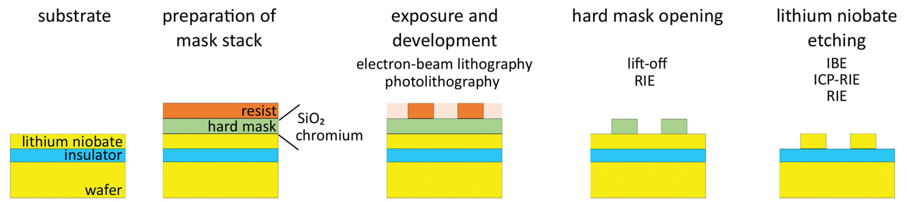
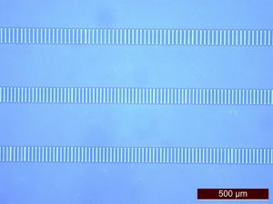
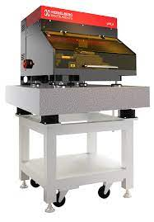
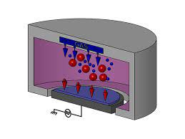
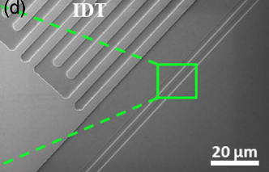
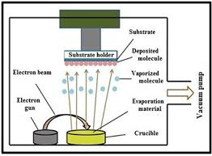
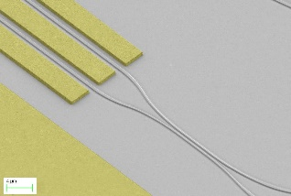
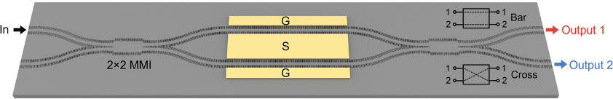
Hybrid squeezed vacuum source realization
The different functionalities can be obtained on a LiNbO3-on-Insulator wafer by a common fabrication procedure:
to experiment
realization
Optical lithography
E-beam evaporation
Reactive Ion etching

Slide 12
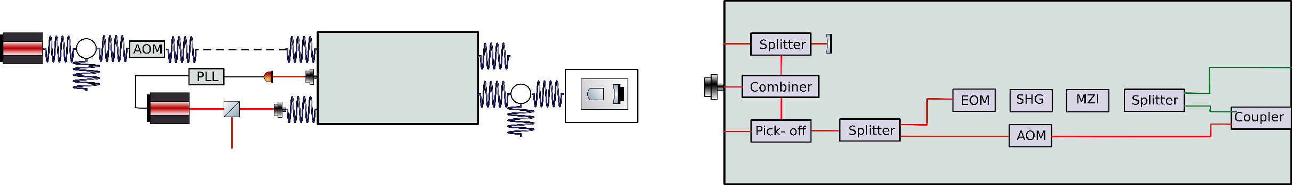
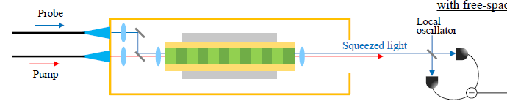
Further developments
Frequency locking to other laser sources, auxiliary beams and fiber phase noise compensation loop.
External Laser
LNOI chip
LNOI chip
OPO
To Phase noise loop
Main Laser
Squeezed board vacuum compatible.
Squeezing generation with PPLN waveguide (full integrated squeezer)
https://arxiv.org/abs/2301.12658

Slide 13




Perspectives: GW R&D
Advanced techniques for the next GW detector generation
  Coupled cavity for optimal FDS generation,
  Squeezed light coupled with white light cavities
S. L. Danilishin ,F. Ya. Khalili H. Miao, Living Reviews in Relativity volume 22, Article number: 2 (2019)
  High order spatial mode squeezing
  Quantum non demolution and BA evading techniques
  Advanced control strategies
  Bright light squeezing generation
  FDS
  T. Zhang, H. Miao, A. Freise, Phys. Rev. D, 101(8), 082002, 2020
  J. Heinze et al. Phys. Rev. Lett, 128, 083606, (2022)

Slide 14
Resources
Costs
 | Cost
Laboratory preparation (cleaning, safety rules, bench,…) | 25 keuro
High power laser source | 50 kEuro
Superpolished optics (including two coating run) | 30 keuro
Non linear superpolished crystals (including a coating run) | 20 keuro
Optomechanics and optical fibers components | 15 keuro
Electronics (VCO,DDS, photodiode amplifiers, analog controls) | 15 keuro
ADC/DAC system (monitoring and digital loops) | 20 keuro
Construction of optical integrated systems (included LN waveguide) | 75 keuro
TOTAL | 250 keuro
Person Power:
  dedicated RTDA position
  PhD

Slide 15
Conclusions
The development of a hybrid squeezer would allow easy access to squeezing sources for various applications in physics and technology within the DFA and the University.
In the field of GW this would lead to the possibility of explore new ideas for the next generation of detectors (ET).
This activity will foster interdisciplary collaboration with the physics of matter group and potentially with other groups interested in the applications of squeezing.

