Slide 1
Methods Comparison
Gorghetto et al:
Many simulations of full PQ at different resolution → control extrapolation.
Do not switch on axion mass.
Realize axion spectrum after string decay → non-linear transient.
Buschmann et al:
Simulations of full PQ at with AMR.
Do not switch on axion mass.
Moore et al
Multi-field model to mimic high tension strings → simulate all the way.
Switch on axion mass.
Axions from string sub-dominant → realignment result.
New sims on the way?
Vaquero et al
”Fat string” PRS trick → simulate all the way.
Switch on axion potential → axitons.
Hiramatsu et al
Simulate at few different low resolutions.
Switch on axion mass → string decay and domain walls.
Drew & Shellard
Simulate single string with AMR.
Aim to fit Nambu-Goto and Kalb-Ramond radiation fields.
Network sims on the way?

Slide 2
Scaling is maintained by continuous axion emission:
Sims: Gorghetto+(GHV)
Also for Hiramatsu et al (HKSSYY)
Radial mode Compton scale
Horizon scale = ma at physical log
Emission Spectrum
F = “instantaneous emission spectrum”.
Integrate → total emitted axion density.
q<1: UV dom.→ axions from strings sub-dom. to misalignment
q>1: IR dom., axions from strings dom.
Wavenumber
Gorghetto+: q also has log scaling violation →
Extrapolated spectrum is IR dominated (q>1).

Slide 3
Compare GHV and HKSSYY on equal footing.
Hoof, DJEM, Riess (2021)
Model and add all DM contributions:
stat. error ~10μeV
Realignment. Solve homogeneous e.o.m. and numerically average over initial conditions.
Strings. Fit the spectrum and extract q and x.
Domain walls (fit Hiramatsu+).
“Non-linear transient” (fit Gorghetto+).
sys. error ~ 100 μeV
Model uncertainties and DM likelihood:
String spectrum fitting parameters.
QCD topological susceptibility (fit from lattice QCD, Borsanyi et al).
Planck DM density: fix axions as all DM.
Particle physics from PDG.
MCMC using emcee, 12/13 dimensional parameter space. Marginalise to find axion mass.
Buschmann+ AMR simulations (log~9).
Scale invariance (q=1). Theory prediction?

Slide 4
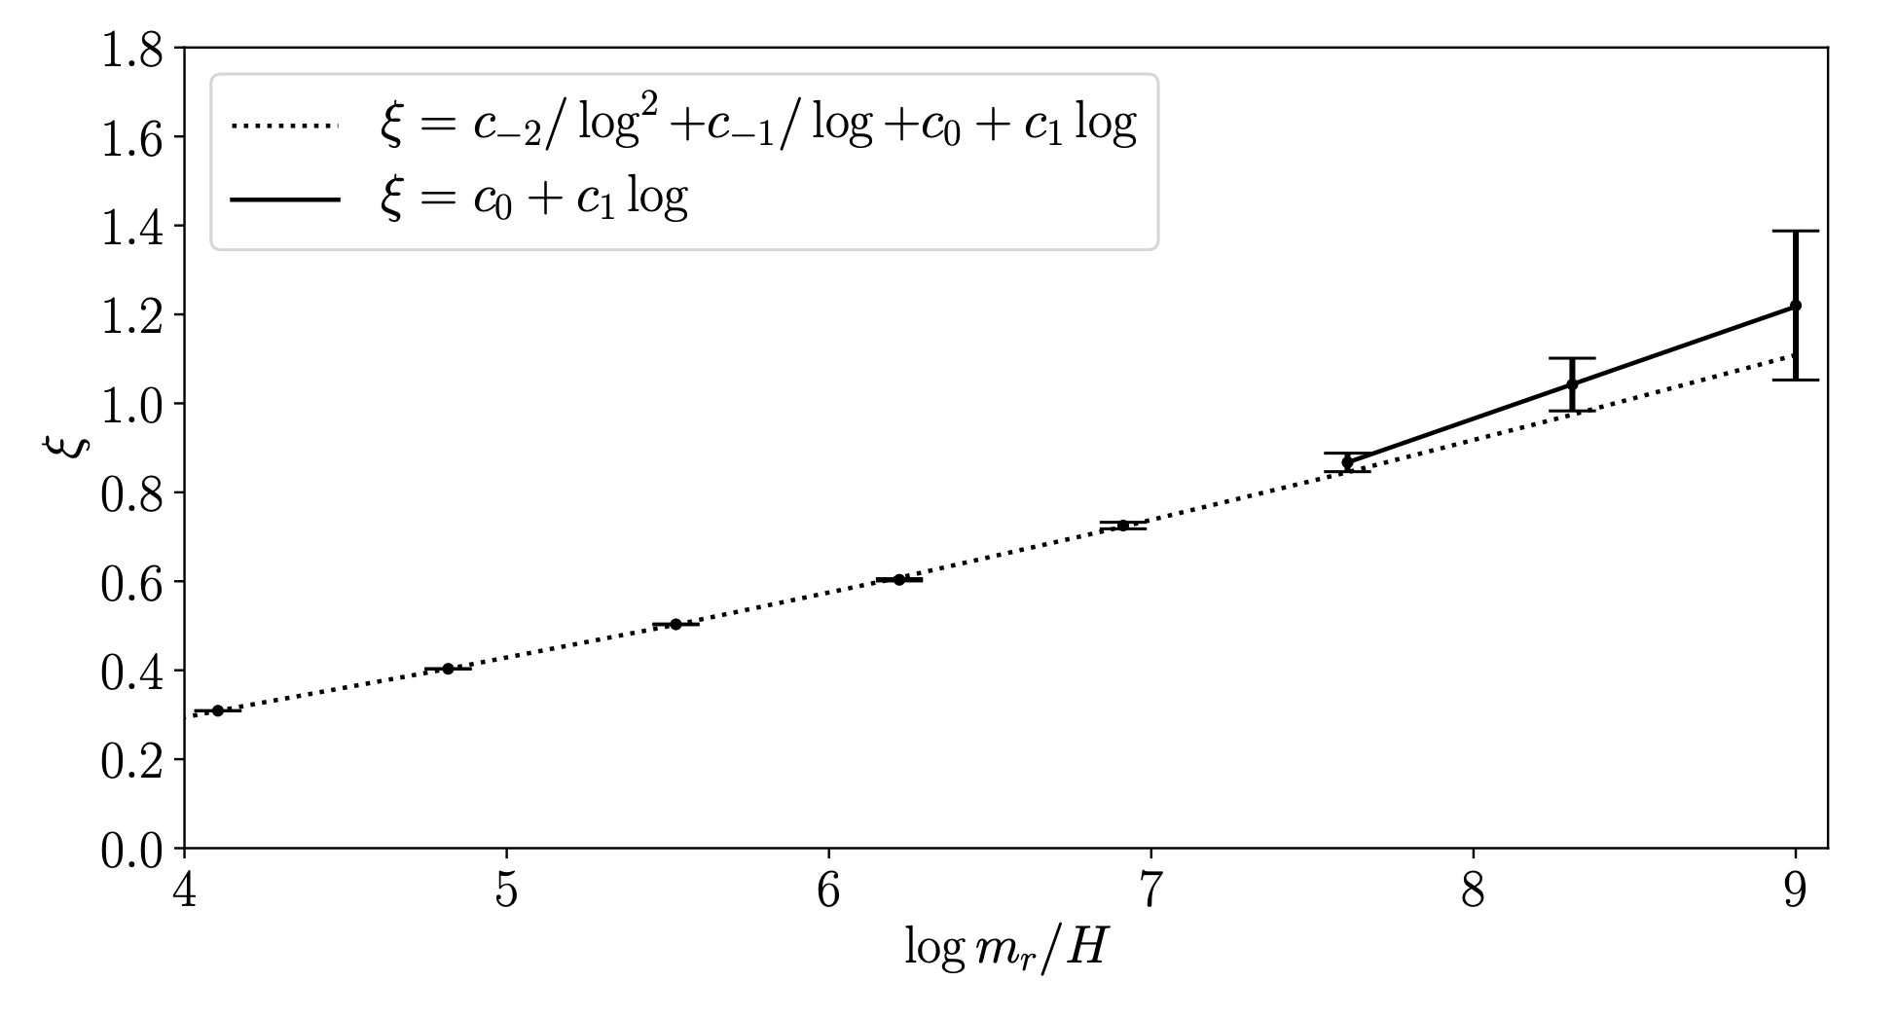
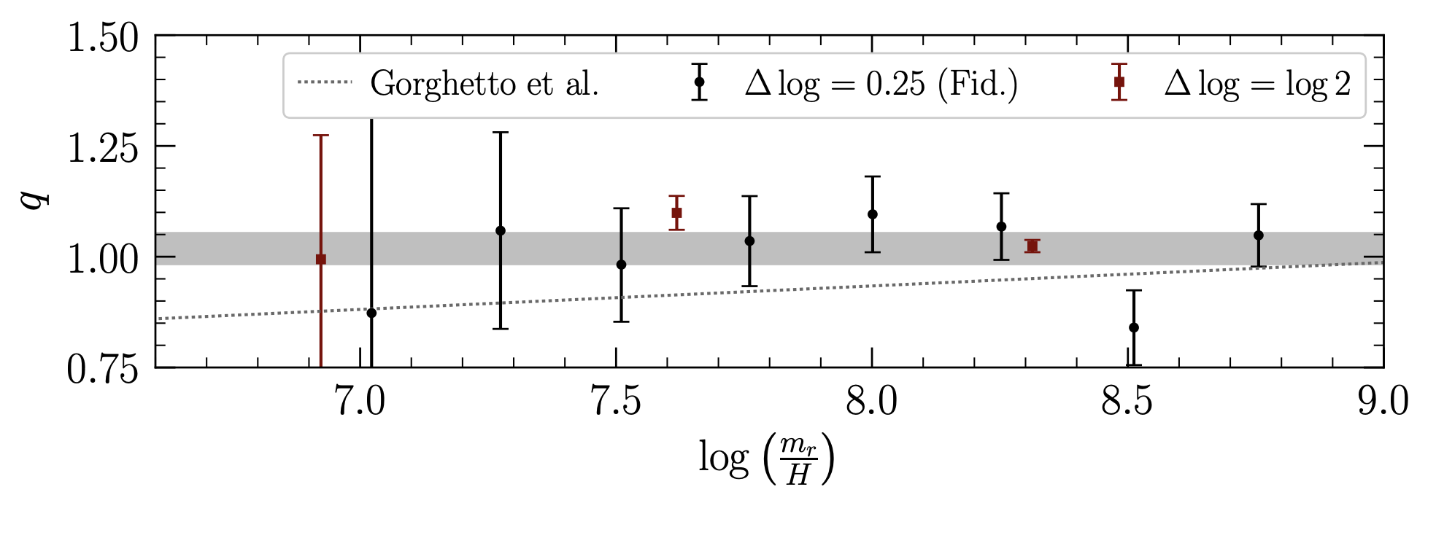
Buschmann et al (2021)
Use adaptive mech refinement to push log scale separation further.
Analytical argument in Appendix for q=1 scale invariance.
Assuming q=1, extrapolating xi
Errors on q, extrapolating xi

Slide 5
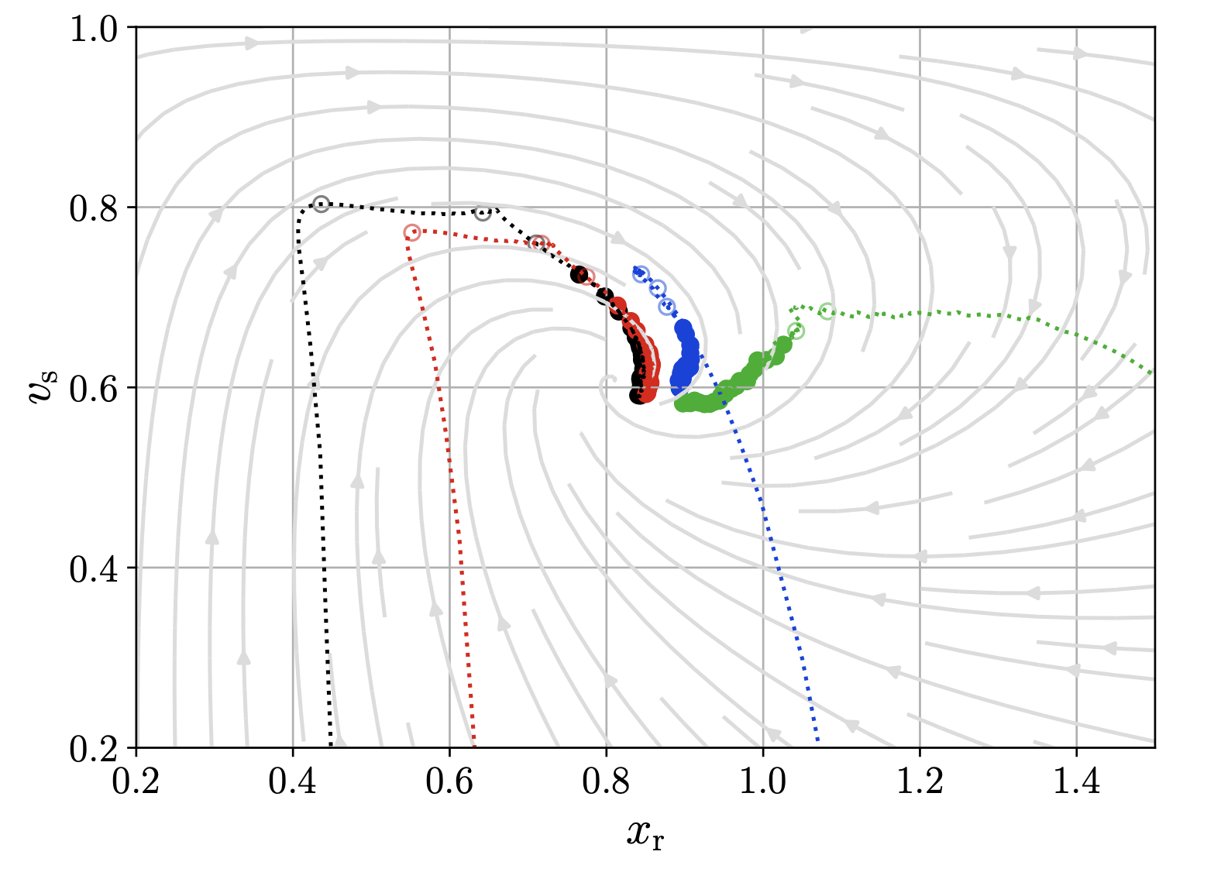
Hindmarsh+
Dine+
Use analytical argument (“velocity one scale model”) to argue that change in xi seen by Gorghetto & Buschmann is an initial condition transient.
Analytical EFT argument for sub-dominant axions from string emission → realignment result.

Slide 6
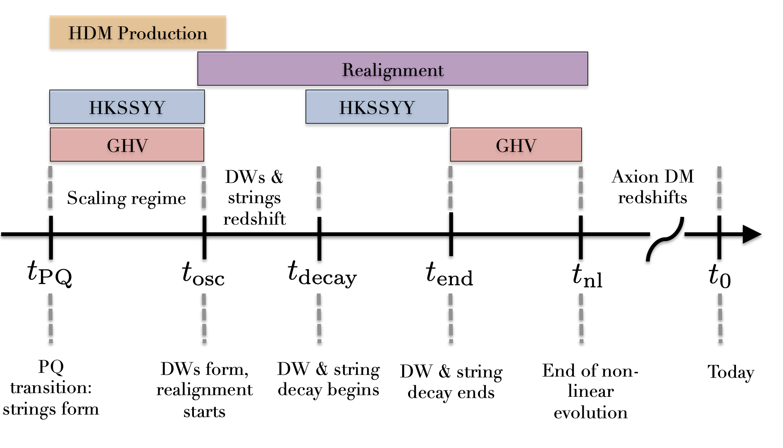
HKSSYY = Hiramatsu et al (2012+)
GHV = Gorghettog et al (2018+)

Slide 7
