Slide 1
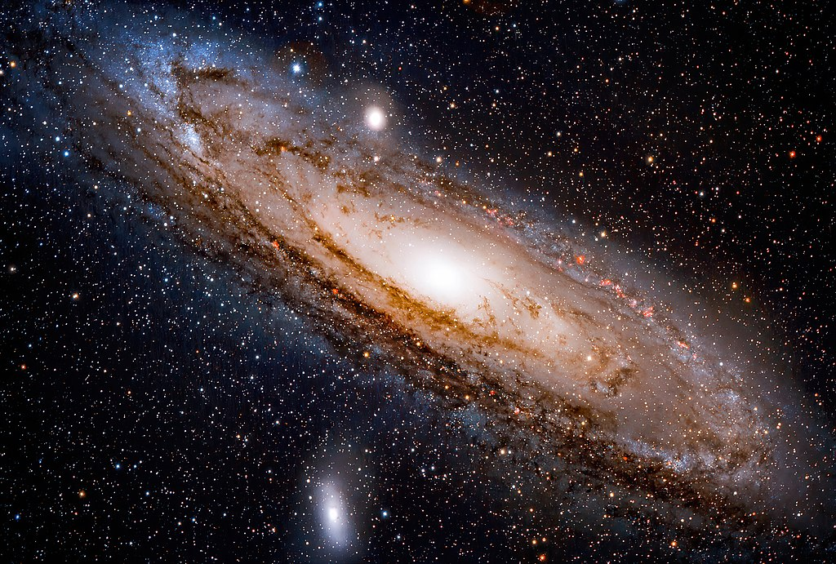


Axion Miniclusters: Recent Progress and Open Problems
Image: Andromeda
David J. E. Marsh
PADUA Workshop, September 2022

Slide 2
Minicluster Formation
Ellis, DJEM+ (2020, 2022), History: Kolb & Tkachev (1990’s)

Slide 3
Minicluster Seeds
We use these initial conditions, but we can test any others you might have.
Vaquero, Redondo, Stadler (2018), lattice field theory.
PQ field evolution through SSB and string decay using “fat string” method.
Final axion field configuration @ z~10⁵, T~ MeV.
Identify “minicluster seeds”:
Kolb & Tkachev (90’s) predicted power law density profiles from spherical collapse, virialise with:
These sims do not include gravity → don’t give the final MC masses and radii.
How much DM in miniclusters? Astrophysical probes? → depends on mass and density.

Slide 4
Gravitational Collapse
z>zeq Peak collapse. Poor Gaussian approx. Power law profile?
z<zeq hierarchical structure formation. Gaussian approx. good. NFW profile.
String decay → enhanced power spectrum (and large non-Gaussianity) on small scales → enhanced early structure formation.

Slide 5
Semi-Analytical Model
Ellis, DJEM, Behrens (2020)
Our approach: solve the “excursion set” spherical collapse barrier crossing problem in real space.
Use “peak-patch” method (Stein et al, Bond+)
Same δ as Kolb & Tkachev
Threshold ←→ redshift of collapse
Identify seeds and predict collapse and merger history. Fully non-Gaussian.

Slide 6
Ellis DJEM et al (2021)

Slide 7
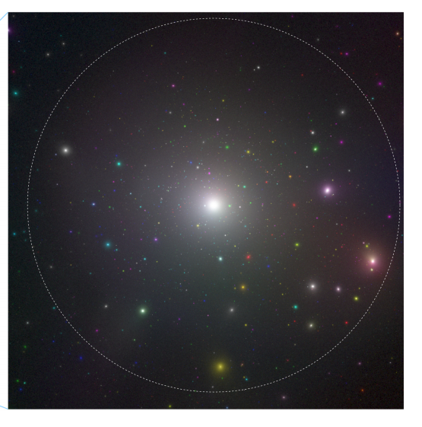
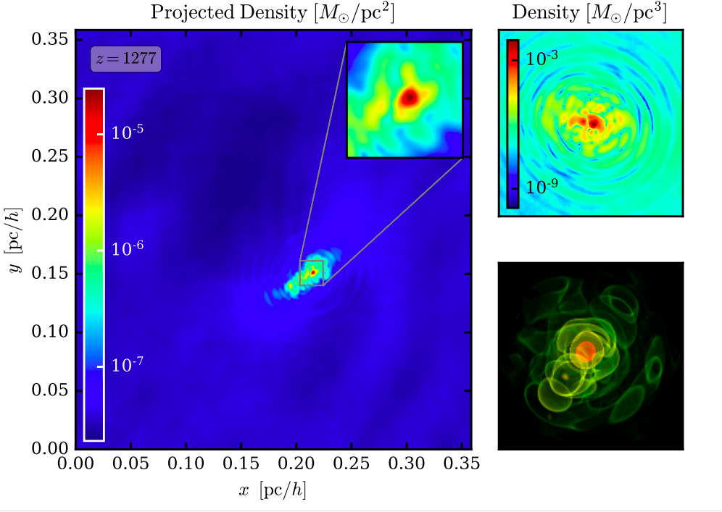
Numerical Simulation
Eggemeier+ (2019,2020)
Hierarchical structure formation after equality → NFW-like minicluster halos.
While dense compared to ordinary DM halos, pheno is still relatively boring (not dense enough).
Wave simulations: MCs contain central “axion stars” with virialized outer halo.
Miniclusters are NOT single axion stars!

Slide 8
Minicluster Fraction ~ 60%
Fraction agrees between methods, and with N-body.
Peak-Patch non-Gaussian peaks important before equality.

Slide 9
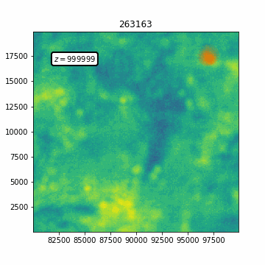
What happened to the “seeds”?
Ellis et al (2022)
Self-similar collapse before equality. Denser minicluster seeds, Δ>>200? Power law profiles?
Are simulations/halo finders missing the seeds? Swallowed as substructure? Missed dense cores?
Overdensity at Collapse
Tag ~1000 Peak-patch “seeds”. Label with overdensity, δ, defined via collapse redshift of merger tree, and M.

Slide 10
Morphology of MCs I
Ellis, DJEM et al (2022)
Many miniclusters end up as NFW minicluster halos predicted from hierarchical mergers.
Unresolved scale radius → *some* miniclusters *might* be steeper power-law profiles.
Power law, α~-3

Slide 11
Morphology of MCs II
Ellis, DJEM et al (2022)
NFW concentration-mass relation predicted from theory and matched to simulation. Maximum c~10⁵. NFW MCs are not dense enough to lens.
Large amount of mass is in heavy MC halos → NFW. But very large number of low mass MCs, and substructure, could be PL.

Slide 12
Morphology of MCs III
Ellis, DJEM et al (2022)
Need to estimate axion star mass and radius. Use relation from Schrödinger-Poisson (wave) simulations.
Measure virial velocity in N-body on tagged MC seeds surviving as group. Scatter in virial quantities → scatter in core-halo relation (see fuzzy DM literature).
Tidal stripping and survival: see Elisa Todarello talk next!

Slide 13
Microlensing?
Fairbairn, DJEM+(2017); Ellis, DJEM+(2022)

Slide 14
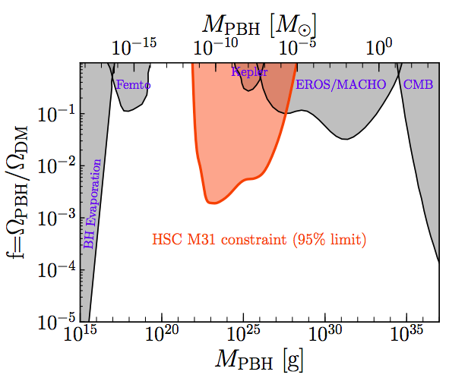
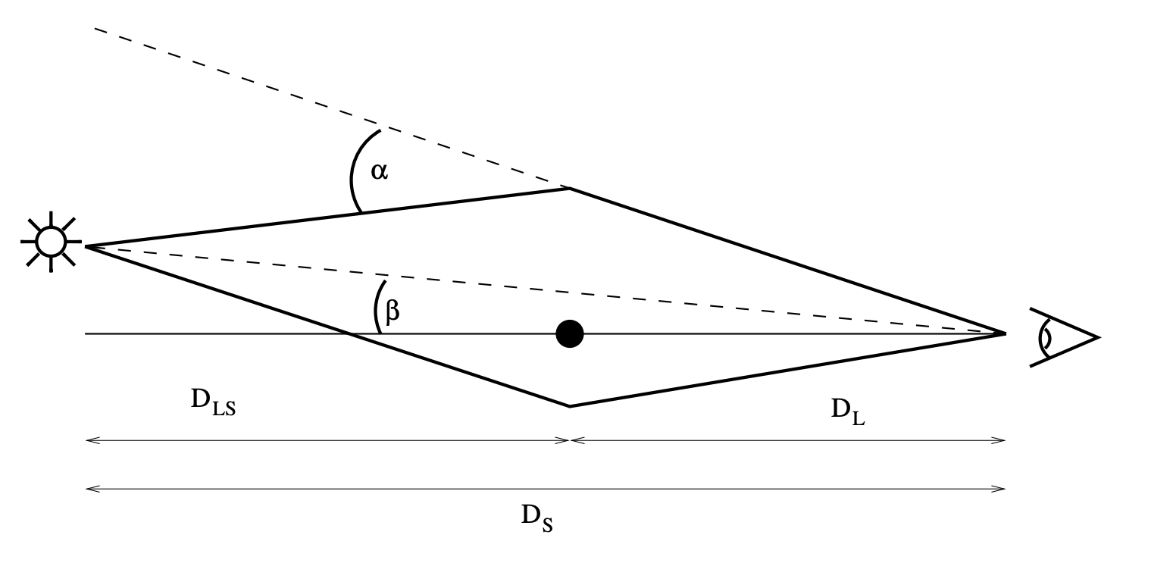
Why Microlensing?
Niikura et al (2018);
PBHs: point-like lenses must cross “microlensing tube”.
Many observations . Sub-percent accuracy.
Wave optics limit from HSC survey:
Accessible range covered by MC mass function.
Problem: MCs are not point masses. Need to account for density profile.

Slide 15
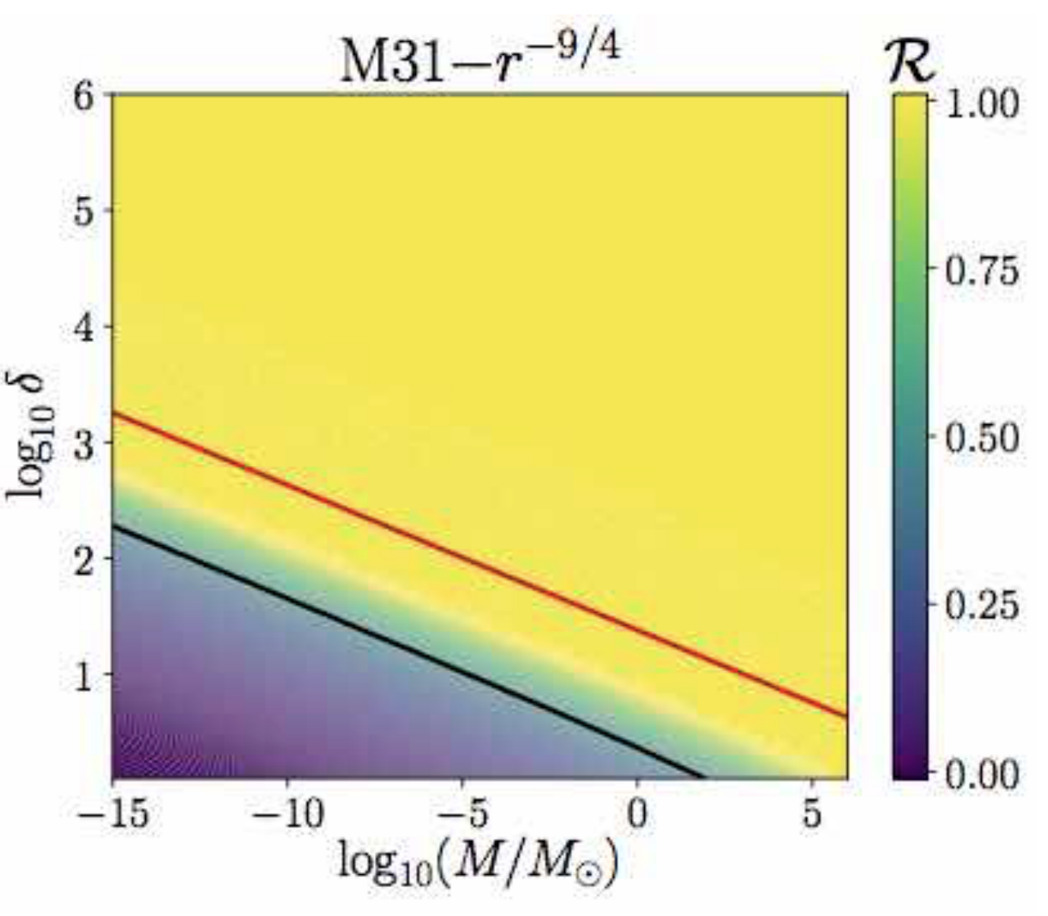
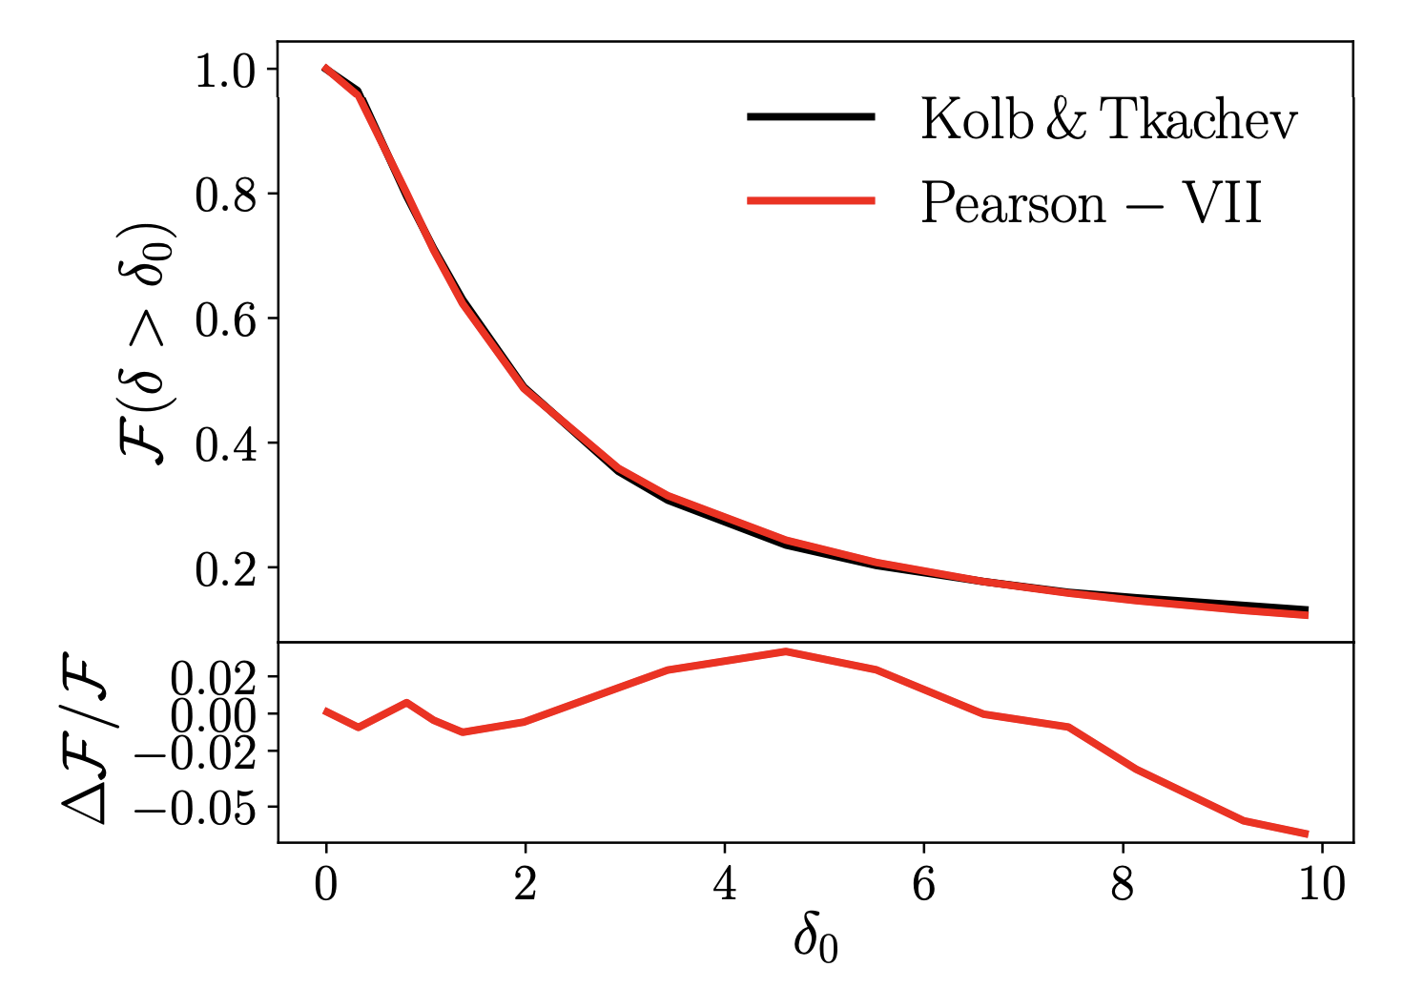
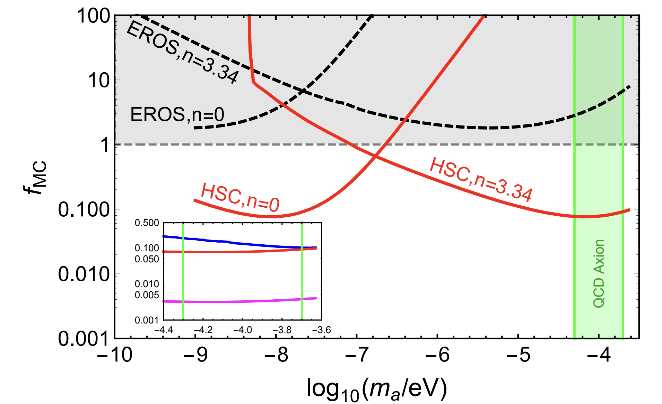
Pre-History (2017)
Fairbairn, DJEM, Quevillon (2017)
NFW profiles require exceedingly high c to lens. PL profiles only require moderate overdensity δ.
Fit and extrapolation of Kolb & Tkachev distribution → strong constraints on QCD axion.
Effective tube radius. Should be O(1). Need δ>>10.
Fit and extrapolate.
Limits at minicluster fraction ~10%

Slide 16
Microlensing of MCs I
Ellis, DJEM+ (2022)
Older work neglected many things.
Minimum mass for wavelike effects.
Miniclusters above a fixed mass are resolved as NFW with too-low concentration.
For PL profiles, axion stars give a UV cut-off to the lensing integral.

Slide 17
Microlensing of MCs II
Ellis, DJEM+ (2022)
NB: sample is not representative.
Sample ~10³ MCs in (M,δ) plane. Count fraction allowing PL profile and small axion star.
Estimate axion star radius from measured virial velocity. Significant scatter.
Lensing possible for ~1 meV & within uncertainty of resolution. Need zoom-in simulations!

Slide 18
Radio transients
With: Bradley Johnson, Luca Visinelli, Liam Walters, Jordan Shroyer, Christoph Weniger, Sam Witte, Tom Edwards, Bradley Kavanagh, Scott Ransom
6 Universities, 3 Continents

Slide 19
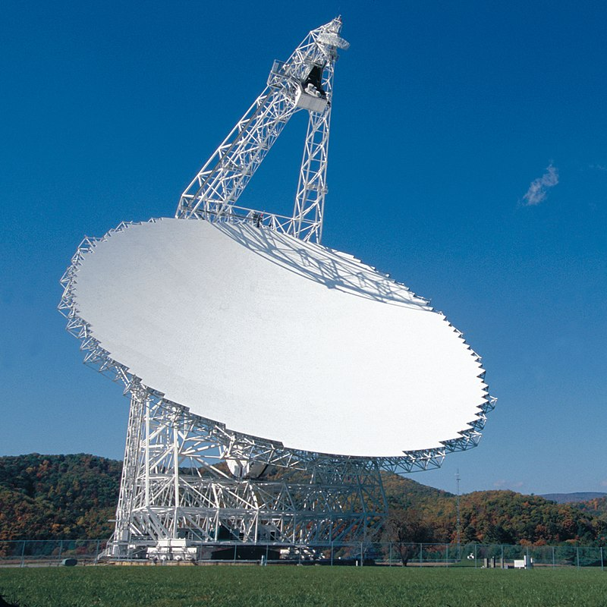
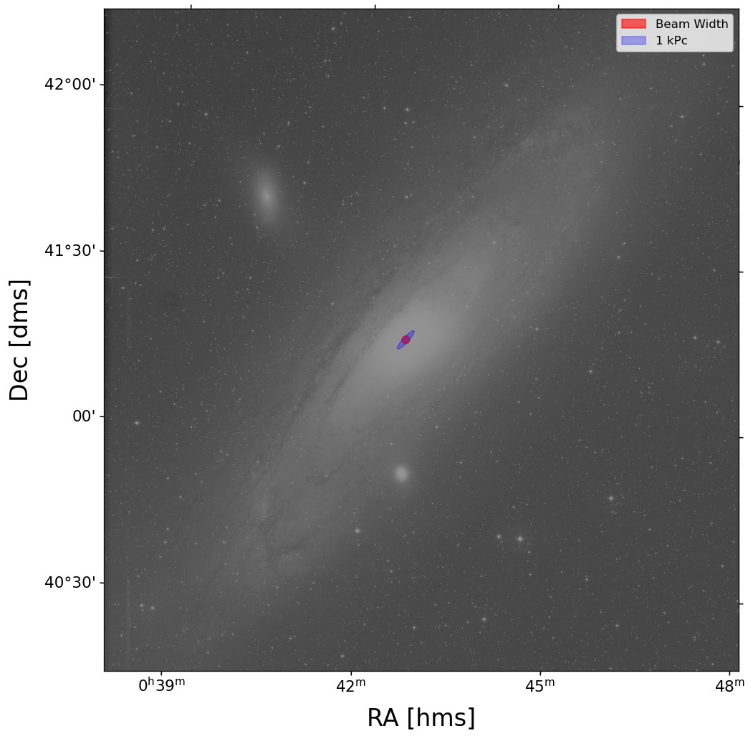
Green Bank Telescope
Johnson, DJEM et al (forthcoming)
Observe Andromeda (wide FOV) in X-band with VEGAS spectrometer. 5 nights for 2 hours per night → time information. Stack spectra → search for bright line transients. Observing complete.

Slide 20
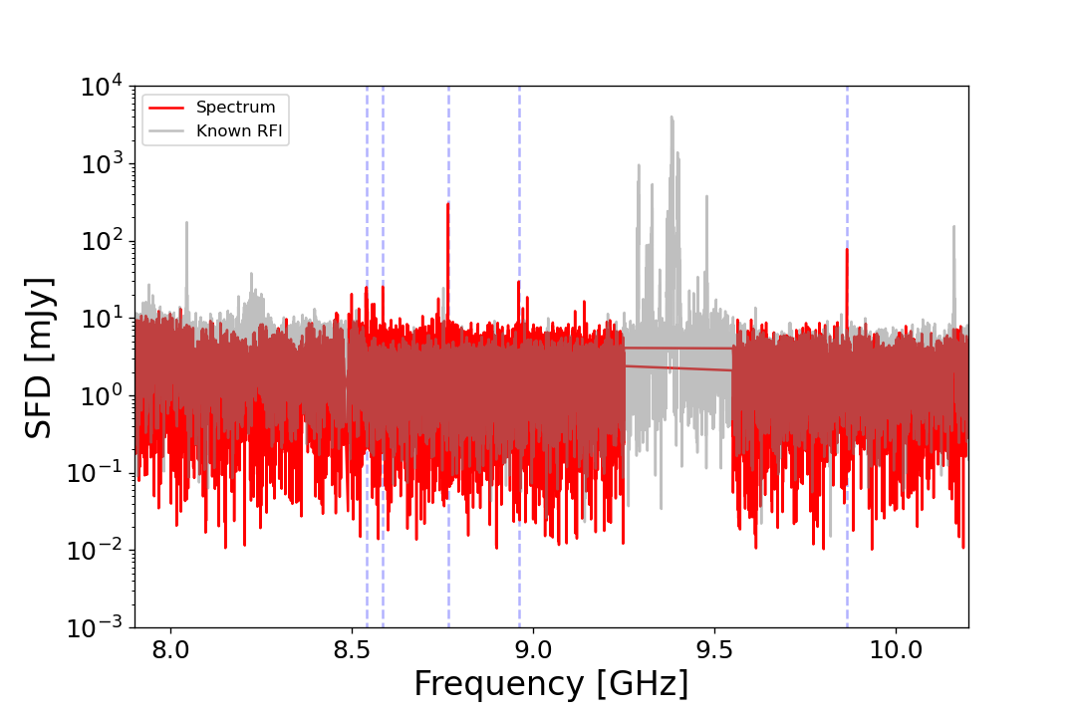
Spectrum of Andromeda
Liam Walters (U. Virginia)

Slide 21
Minicluster-NS Encounter Rate
Bradley Kavanagh
Model stripping and orbits of MCs. Various density profiles (NFW and PL varying c and δ).

Slide 22
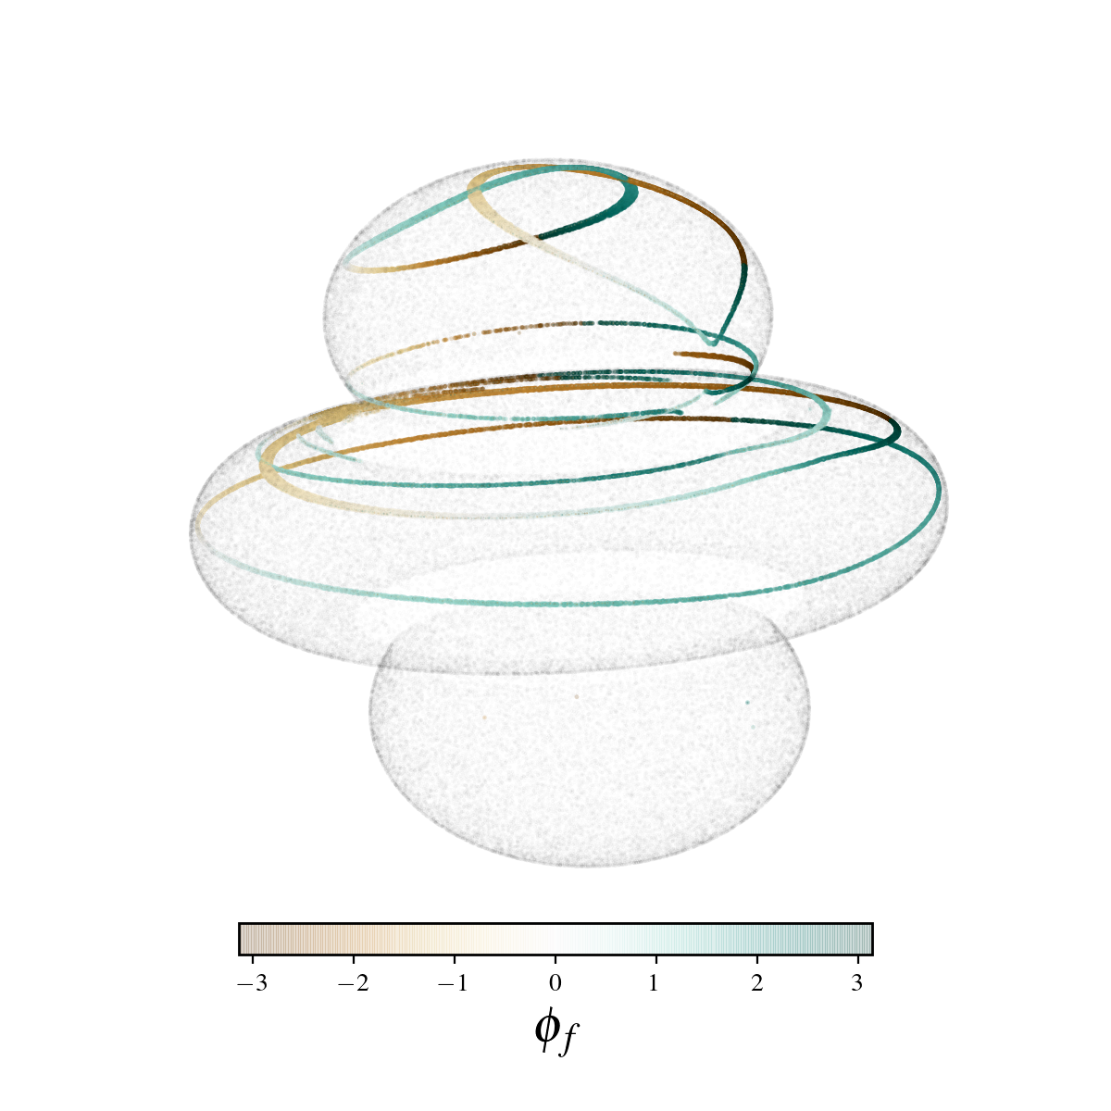
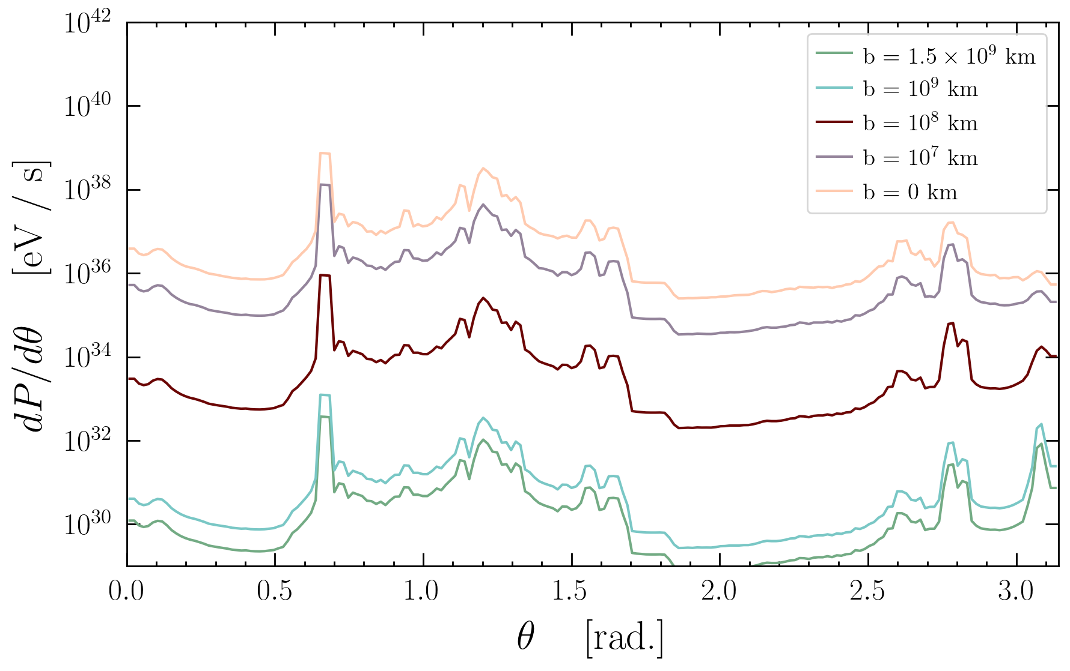
Anatomy of an Encounter
Sam Witte
Model B-field and electron density of NSs (Goldreich-Julian) → conversion radius when ma = ω_{p}.
Ray tracing → complex distribution and flux of photons.

Slide 23
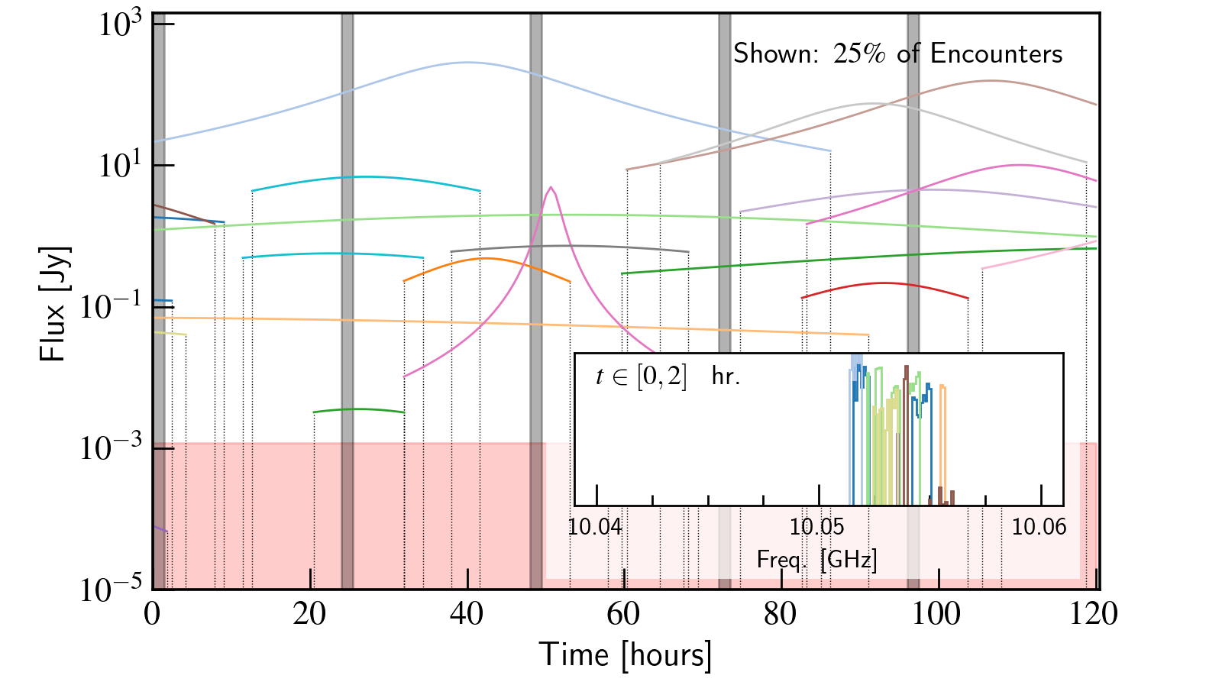
Simulated Events
Outdated NS population model. Current model → lower flux due to few NSs with large ω_{p}.
Distribution of ω_{p} → observations in lower spectral bands (C, UWB) better. Applied for obs.

Slide 24
Limits on Axion-Photon Coupling
WATCH
THIS
SPACE
In X band we will only be able to set limits with liberal modelling assumptions. Various options considered.

Slide 25
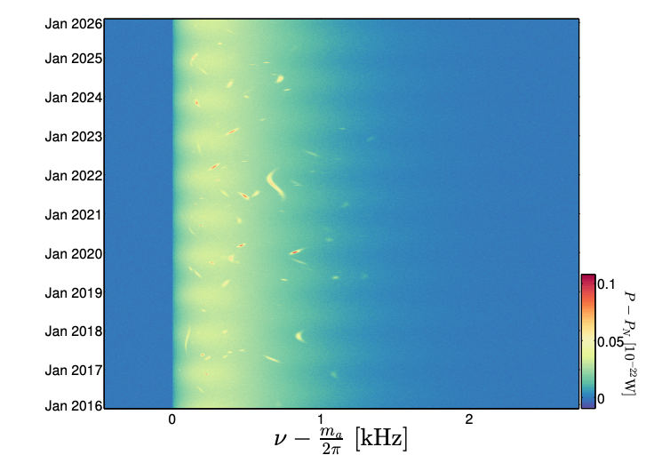
Summary & Outlook
Indirect detection: Andromeda is king! Large DM column density for lensing. Many neutron stars in single field of view.
Microlensing hope: axion mass ~ 1meV. Need zoom-in simulations to resolve axion star formation in candidate halos. Probe Gorghetto+ mass prediction.
Radio transients: X-band observations complete. Theory uncertainties → challenge to set limits. Best at low mass. Probe Moore+ prediction.
Largely unexplored uncertainty to axion direct detection, particularly at high mass/frequency (“the axion from hell”).
O’Hare & Green (2017)

Slide 26



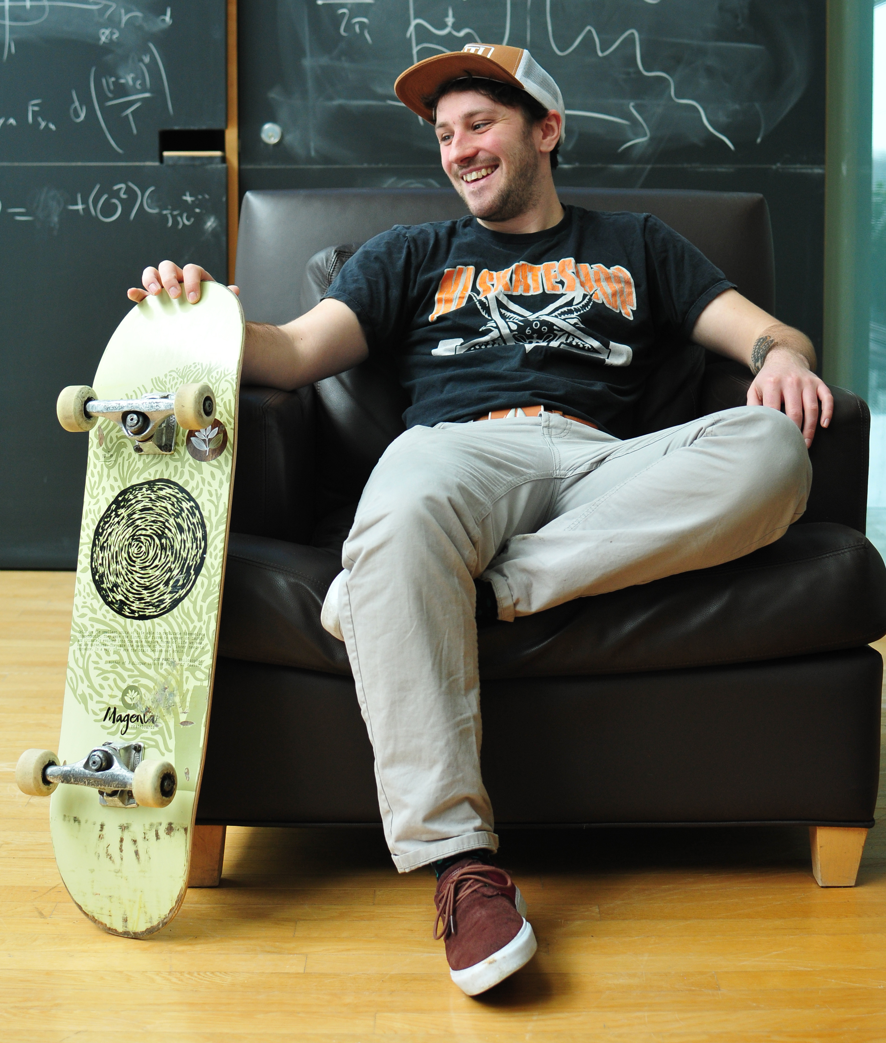
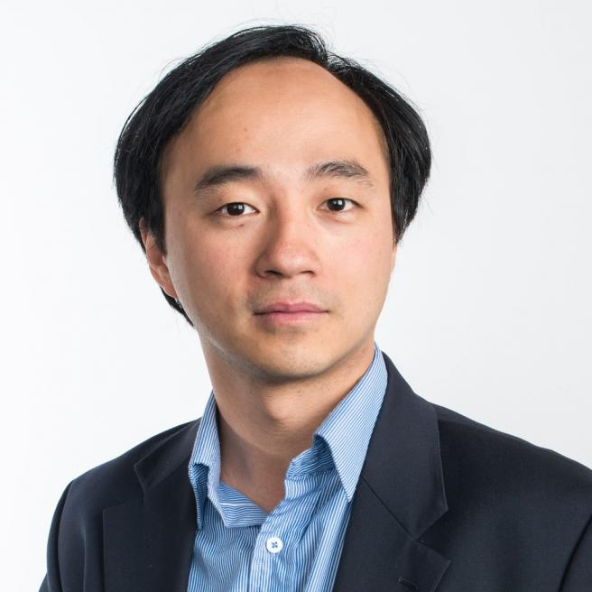
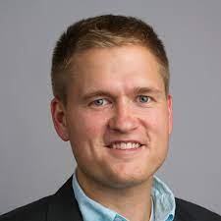
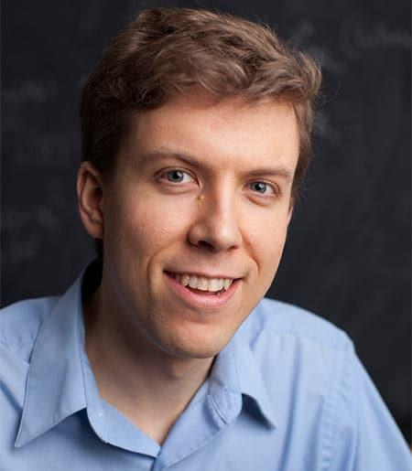
Topology from cosmology: axions, astrophysics, and machine learning
Seeking two postdocs. Two year positions in London (KCL and LIMS).
Extended visits to Cornell and Northeastern. Please enquire/tell your colleagues!

