Slide 1

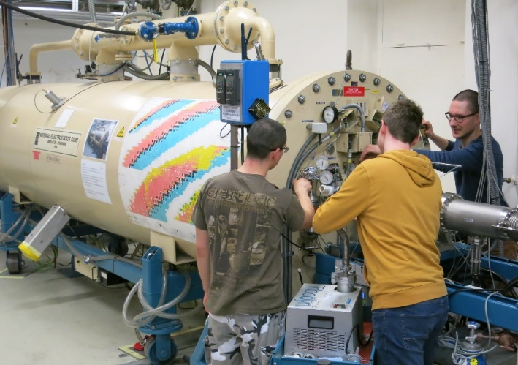
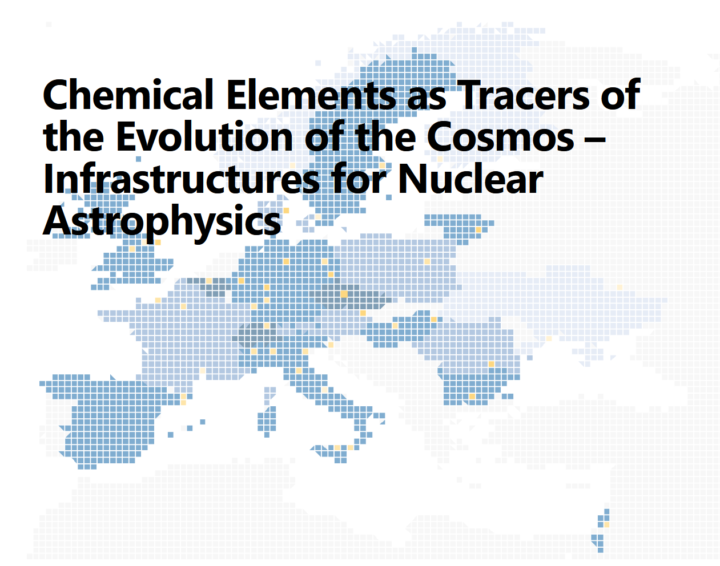
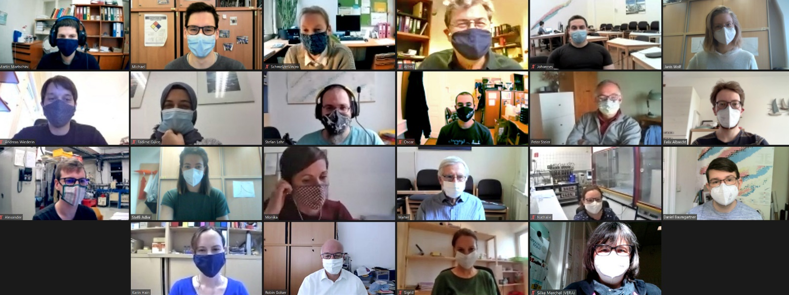
Detection of live radionuclides in stony meteorites by accelerator mass spectrometry – with and without tedious chemical sample preparation
Martin Martschini, Oscar Marchhart, Silke Merchel,
Alexander Wieser, Robin Golser & more people
University of Vienna, Faculty of Physics,
Isotope Physics, VERA Laboratory, Austria silke.merchel@univie.ac.at

Slide 2
Detection of live radionuclides in stony meteorites by accelerator mass spectrometry – with and without tedious chemical sample preparation
Martin Martschini, Oscar Marchhart, Silke Merchel,
Alexander Wieser, Robin Golser & more people
University of Vienna, Faculty of Physics,
Isotope Physics, VERA Laboratory, Austria silke.merchel@univie.ac.at
Introduction
  (Stony) meteorites
  Cosmogenic nuclides (CNs)
  Example with chemistry
Accelerator mass spectrometry (AMS) @ VERA
Examples without chemistry

Slide 3


Cosmogenic nuclides
in meteorites
cosmic rays
impact
Unknowns:
t_{irr.} @ MPB
depth @ MPB
r_{preatm.}
t_{irr.}
depth
t_{terr.} (find)
meteoroid parent body
(possible
pre-exposure
in regolith)
cosmic ray
exposure (CRE)
meteoroid
Earth’s atmosphere
& magnetic field
meteorite
(terrestrial age)

Slide 4
Cosmogenic nuclides
in meteorites
Solution:
Multi-nuclides (stable & radioactive)
MC with individual chemistry
Unknowns:
t_{irr.} @ MPB
depth @ MPB
r_{preatm.}
t_{irr.}
depth
t_{terr.} (find)

Slide 5
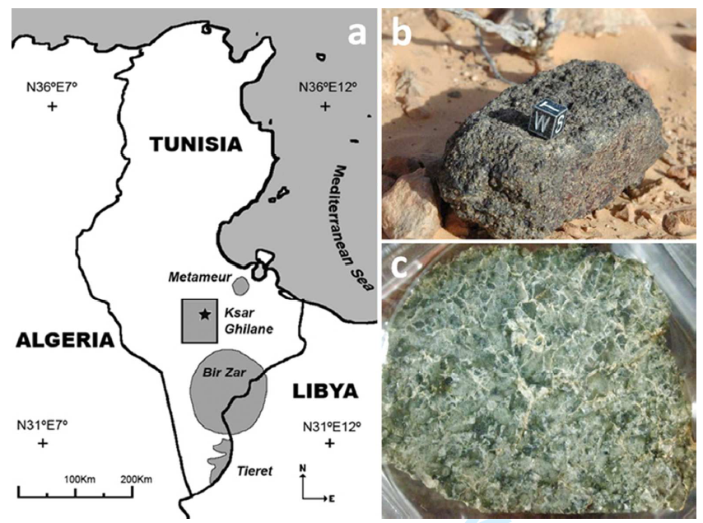
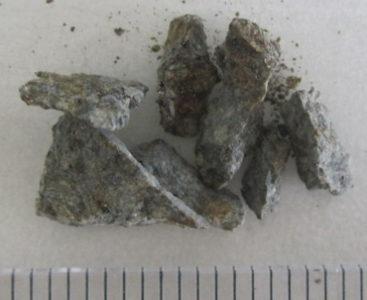

Ksar Ghilane 002, the 100th Martian meteorite
10 x 4.5 x 3.5 cm³
~ 200 mg
13th Jan 2010
Tunisia
538 g
paired with
Los Angeles?
(Mojave Desert
1999)
1.5 cm
J. Llorca et al., MAPS, 2013.
Notes:
Pulver 3 cm Bildlaenge
Name: Ksar Ghilane 002
This is an OFFICIAL meteorite name.
Abbreviation: KG 002
Observed fall: No
Year found: 13. January 2010
Country: Tunisia
Mass: 538 g

Slide 6
Ksar Ghilane 002 ¹⁰Be & ²⁶Al
r_{preatm.} = 35-65 cm
centre position
t_{irr.} = 2.8-3.7 Ma
Los Angeles:
r_{preatm.} = 20-40 cm
t_{irr.} = 2.8-3.3 Ma
similar element composition, petrography & mineral chemistry,
plus noble gases
suggesting a possible launch-pairing
1.5 cm
~ 200 mg
J. Llorca et al., MAPS, 2013.
Notes:
Pulver 3 cm Bildlaenge
Name: Ksar Ghilane 002
This is an OFFICIAL meteorite name.
Abbreviation: KG 002
Observed fall: No
Year found: 1. January 2010
Country: Tunisia
Mass: 538 g
undersaturated (¹⁰Be)
highest ²⁶Al ever:
(116.1 ± 1.9) dpm/kg
GCR only (²⁷Al)

Slide 7
Meteorite’s history
cosmic rays
impact
meteoroid parent body
(possible
pre-exposure
in regolith)
cosmic ray
exposure (CRE)
meteoroid
Earth’s atmosphere
& magnetic field
meteorite
(terrestrial age)

Slide 8
Meteorite’s history
cosmic rays
impact
meteoroid parent body
(possible
pre-exposure
in regolith)
cosmic ray
exposure (CRE)
meteoroid
Earth’s atmosphere
& magnetic field
e.g.
BeO
e.g.
¹⁰Be
meteorite
(terrestrial age)
chemistry
AMS

Slide 9
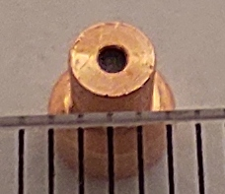
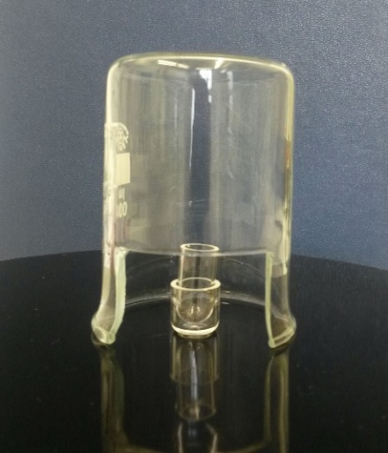
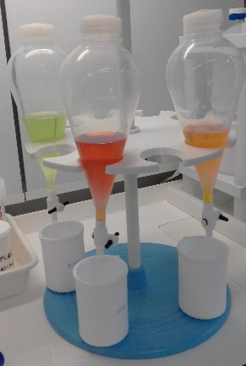
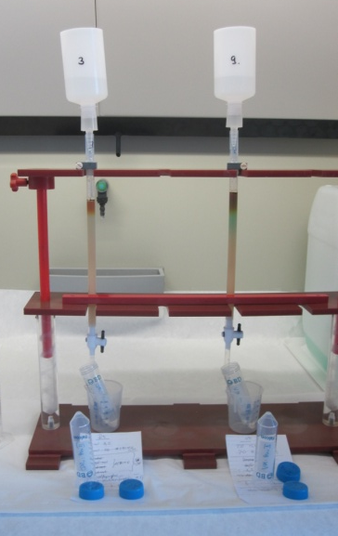
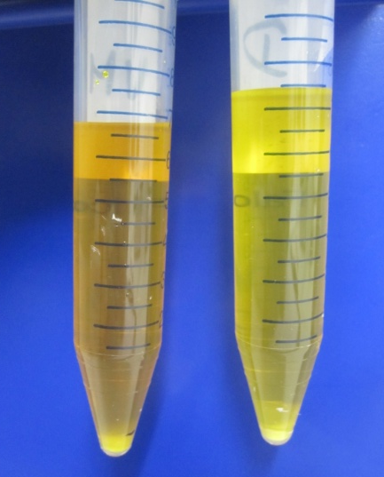
Extracting live cosmogenic nuclides from meteorites
~ 100 mg
dissolution (HF)
evaporation
ion exchange
precipitation
Merchel & Herpers, RCA (1999).
Notes:
No Zr-93 and Fe-60 @ Munich anymore…☹

Slide 10

Extracting live cosmogenic nuclides from meteorites
~ 100 mg
dissolution (HF)
evaporation
ion exchange
precipitation
www.zvab.com/servlet/BookDetailsPL?bi=30730238164&searchurl=sortby%3D20%26tn%3Dansichtskarte%2Baschenputtel%2Btauben&cm_sp=snippet-_-srp1-_-image4#&gid=1&pid=1
Merchel & Herpers, RCA (1999).
Notes:
No Zr-93 and Fe-60 @ Munich anymore…☹

Slide 11
Extracting live cosmogenic nuclides from meteorites
~ 100 mg
dissolution (HF)
evaporation
ion exchange
precipitation
Merchel & Herpers, RCA (1999).
Notes:
No Zr-93 and Fe-60 @ Munich anymore…☹

Slide 12
Detection of live radionuclides in stony meteorites by accelerator mass spectrometry – with and without tedious chemical sample preparation
Martin Martschini, Oscar Marchhart, Silke Merchel,
Alexander Wieser, Robin Golser & more people
University of Vienna, Faculty of Physics,
Isotope Physics, VERA Laboratory, Austria silke.merchel@univie.ac.at
Introduction
  (Stony) meteorites
  Cosmogenic nuclides (CNs)
  Example with chemistry
Accelerator mass spectrometry (AMS) @ VERA
Examples without chemistry

Slide 13
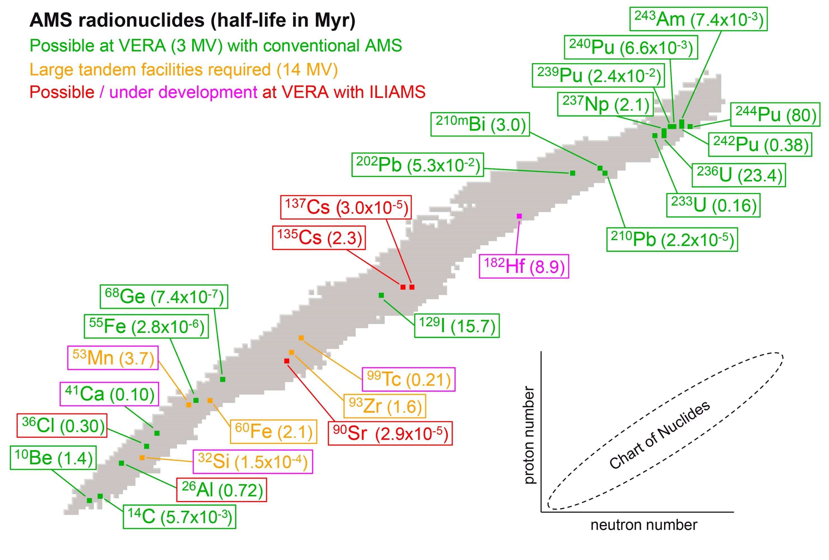
Radionuclides @ VERA
t_{1/2}: ~1 a – 80 Ma
Ion Laser Interaction Mass Spectrometry
Notes:
No Zr-93 and Fe-60 @ Munich anymore…☹

Slide 14
Cosmogenic nuclides @ VERA
t_{1/2}: 0.6 – 4 Ma
Ion Laser Interaction Mass Spectrometry
Notes:
No Zr-93 and Fe-60 @ Munich anymore…☹

Slide 15
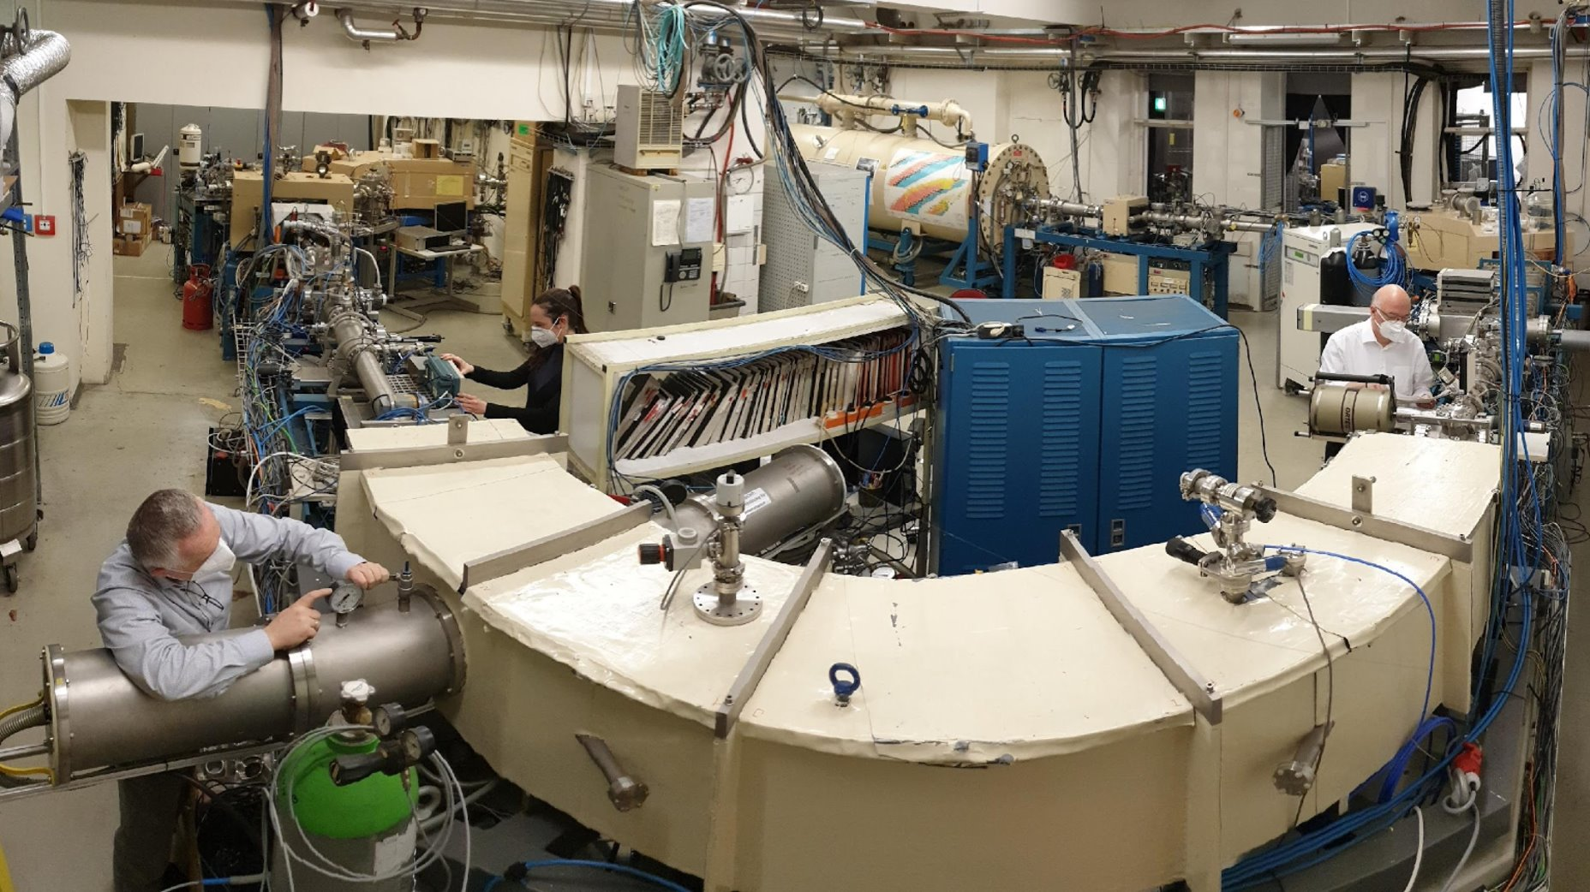
VERA – 3 MV Tandem

Slide 16
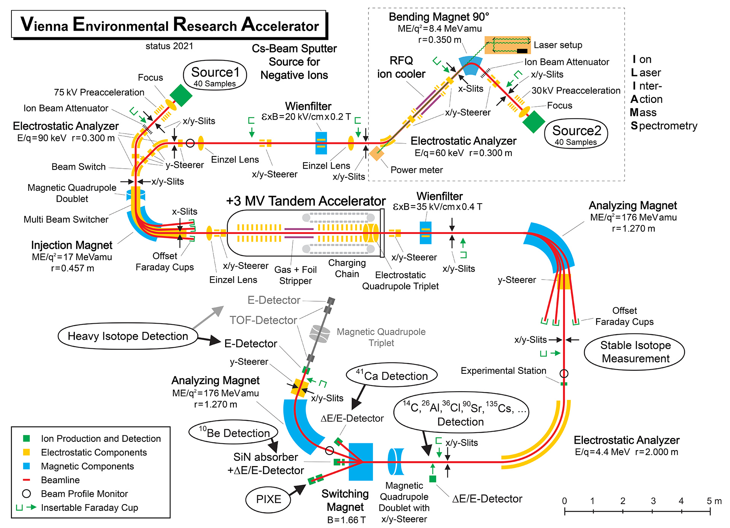
VERA – 3 MV Tandem

Slide 17
VERA & ILIAMS (²⁶Al – t_{1/2}=0.7 Ma)

Slide 18
VERA & ILIAMS (²⁶Al)
Ion-
Laser
Inter
Action
Mass Spectrometry
LE (keV)
MS (-)
[last talk tomorrow
by Alex!]
→ “no”
isobars
stripping
→ no molecules
HE (MeV) MS (+)

Slide 19
VERA & ILIAMS (²⁶Al)
90° bending magnet
laser set-up
Al₂O₃/Fe
in Cu/Cu
RFQ ion
cooler
MgO⁻
AlO⁻
30 kV pre-
acceleration
40-sample Cs sputter source
tandem @2.95 MV
analyzing
magnet
injection
magnet
Off-Set
FC
Ar stripper
Al³⁺
²⁷AlO⁻
Off-Set
FC
²⁷Al³⁺
2-anode gas ionization
chamber
²⁶Al³⁺

Slide 20
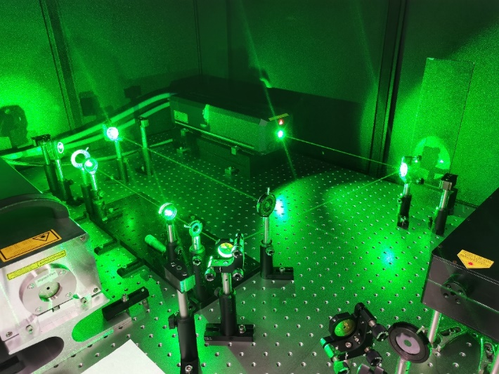
ILIAMS for ²⁶Al
AlO⁻, Cl⁻, CsF₂⁻, SrF₃⁻, TcF₅⁻
CaF₃⁻
TcF₅⁻
Cs⁻, FeH⁻
532 nm
Martschini et al., Radiocarbon 2021. Lachner et al., Int. J. Mass Spectr. 2021.
Notes:
Talk of Markus Schiffer
https://www2.chemistry.msu.edu/faculty/reusch/virttxtjml/spectrpy/uv-vis/spectrum.htm

Slide 21
ILIAMS for ²⁶Al
  → Isobar suppression (²⁶Mg) ~10¹¹
AlO⁻, Cl⁻, CsF₂⁻, SrF₃⁻, TcF₅⁻
CaF₃⁻
TcF₅⁻
Cs⁻, FeH⁻
532 nm
Martschini et al., Radiocarbon 2021. Lachner et al., Int. J. Mass Spectr. 2021.
Notes:
Talk of Markus Schiffer
https://www2.chemistry.msu.edu/faculty/reusch/virttxtjml/spectrpy/uv-vis/spectrum.htm

Slide 22
ILIAMS for ²⁶Al (AlO⁻)
Al⁻ → AlO⁻
→ 10 x current ☺
2.95 MV & 3+ (unchanged)
28% stripper yield (Ar)
54% cooler
+ ionis. eff. (~1.5%)
+ detector eff. (100%)
  → 0.23% total efficiency
  → 3 − 5 x more counts / time
  / sample
Martschini et al., Radiocarbon 2021. Lachner et al., Int. J. Mass Spectr. 2021.
Notes:
Talk of Markus Schiffer
https://www2.chemistry.msu.edu/faculty/reusch/virttxtjml/spectrpy/uv-vis/spectrum.htm

Slide 23
ILIAMS for ²⁶Al (AlO⁻)
Al⁻ → AlO⁻
→ 10 x current ☺
2.95 MV & 3+ (unchanged)
28% stripper yield (Ar)
54% cooler
+ ionis. eff. (~1.5%)
+ detector eff. (100%)
  → 0.23% total efficiency
  → 3 − 5 x more counts / time
  / sample
  → Background
  ²⁶Al / ²⁷Al = 5 x 10⁻¹⁶
Martschini et al., Radiocarbon 2021. Lachner et al., Int. J. Mass Spectr. 2021.
Notes:
Talk of Markus Schiffer
https://www2.chemistry.msu.edu/faculty/reusch/virttxtjml/spectrpy/uv-vis/spectrum.htm

Slide 24
ILIAMS for ²⁶Al (AlO⁻)
Al⁻ → AlO⁻
→ 10 x current ☺
2.95 MV & 3+ (unchanged)
28% stripper yield (Ar)
54% cooler
+ ionis. eff. (~1.5%)
+ detector eff. (100%)
  → 0.23% total efficiency
  → 3 − 5 x more counts / time
  / sample
  → Background
  ²⁶Al / ²⁷Al = 5 x 10⁻¹⁶
  → Isobar suppression
  (²⁶Mg)
  ~10¹¹
Martschini et al., Radiocarbon 2021. Lachner et al., Int. J. Mass Spectr. 2021.
Notes:
Talk of Markus Schiffer
https://www2.chemistry.msu.edu/faculty/reusch/virttxtjml/spectrpy/uv-vis/spectrum.htm

Slide 25
Detection of live radionuclides in stony meteorites by accelerator mass spectrometry – with and without tedious chemical sample preparation
Martin Martschini, Oscar Marchhart, Silke Merchel,
Alexander Wieser, Robin Golser & more people
University of Vienna, Faculty of Physics,
Isotope Physics, VERA Laboratory, Austria silke.merchel@univie.ac.at
Introduction
  (Stony) meteorites
  Cosmogenic nuclides (CNs)
  Example with chemistry
Accelerator mass spectrometry (AMS) @ VERA
Examples without chemistry

Slide 26
Extracting live cosmogenic nuclides from meteorites
~ 100 mg
dissolution (HF)
evaporation
ion exchange
precipitation
Merchel & Herpers, RCA (1999).
Notes:
No Zr-93 and Fe-60 @ Munich anymore…☹

Slide 27
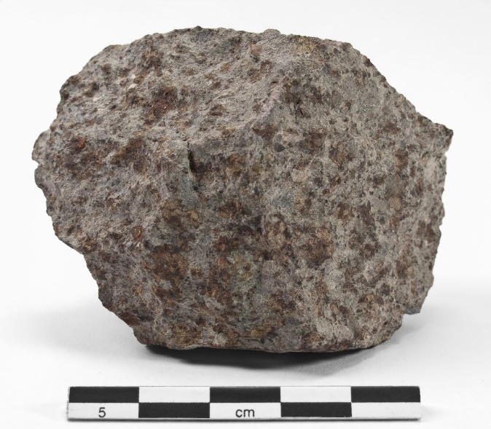
²⁶Al – No chemistry !
LL6 chondrite Dhurmsala
(32 kg, Fall, India, 1860)
1.2% Al
14.9% Mg (1.6% ²⁶Mg)
  → 22 nA AlO⁻ (chem. → µA)
  → 100 counts min⁻¹ sputtering
  → 3 mg lasts > 5 h
  → 3% uncert. in 15 min
*
*https://fundus.uni-hamburg.de/de/
collection_records/26856#pfad
U. Neupert, diploma thesis,U Hanover (1993).
S. Merchel, PhD thesis, U Cologne (1998).
Notes:
Talk of Markus Schiffer
https://www2.chemistry.msu.edu/faculty/reusch/virttxtjml/spectrpy/uv-vis/spectrum.htm

Slide 28
²⁶Al – No chemistry !
LL6 chondrite Dhurmsala
*
*https://fundus.uni-hamburg.de/de/
collection_records/26856#pfad
U. Neupert, diploma thesis,U Hanover (1993).
S. Merchel, PhD thesis, U Cologne (1998).
Notes:
Talk of Markus Schiffer
https://www2.chemistry.msu.edu/faculty/reusch/virttxtjml/spectrpy/uv-vis/spectrum.htm

Slide 29
²⁶Al – No chemistry !
LL6 chondrite Dhurmsala
*
  we need
  low-current standard for better accuracy!
  Dhurmsala!
*https://fundus.uni-hamburg.de/de/
collection_records/26856#pfad
U. Neupert, diploma thesis,U Hanover (1993).
S. Merchel, PhD thesis, U Cologne (1998).
Notes:
Talk of Markus Schiffer
https://www2.chemistry.msu.edu/faculty/reusch/virttxtjml/spectrpy/uv-vis/spectrum.htm

Slide 30
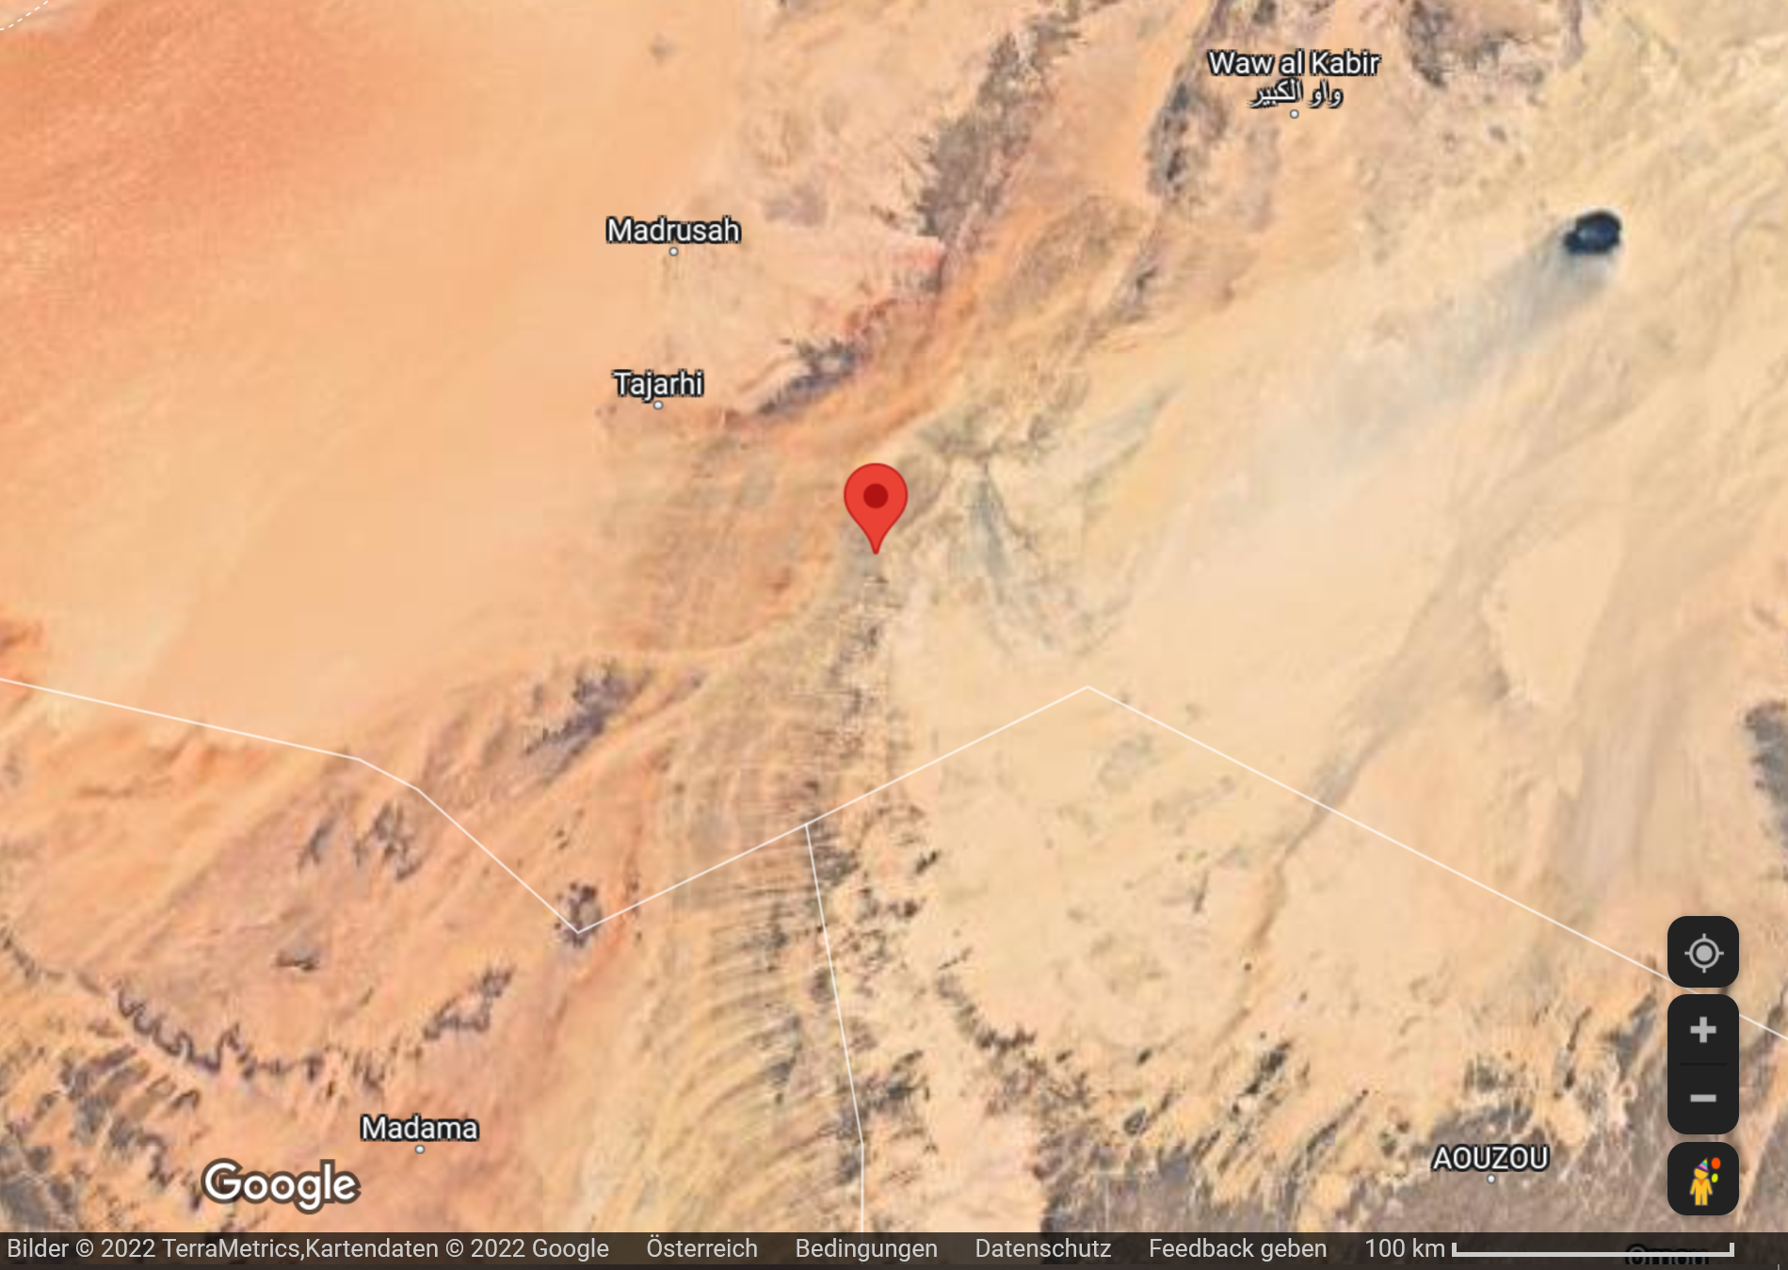
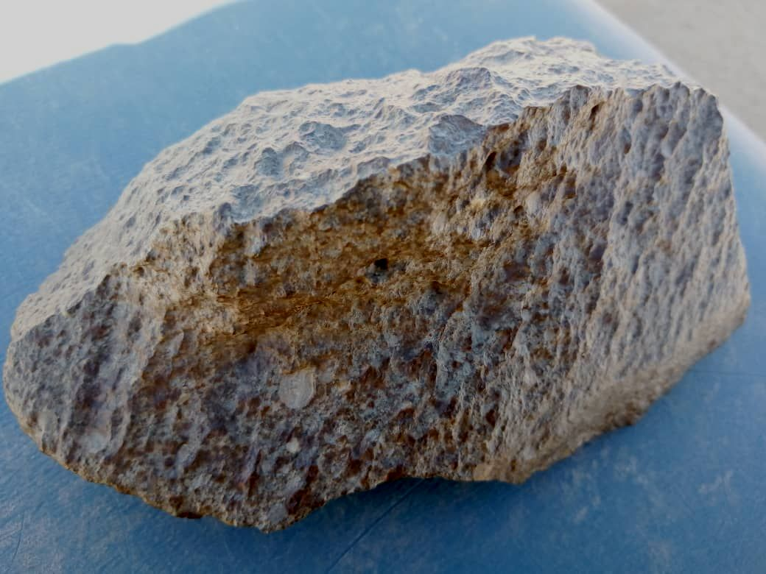
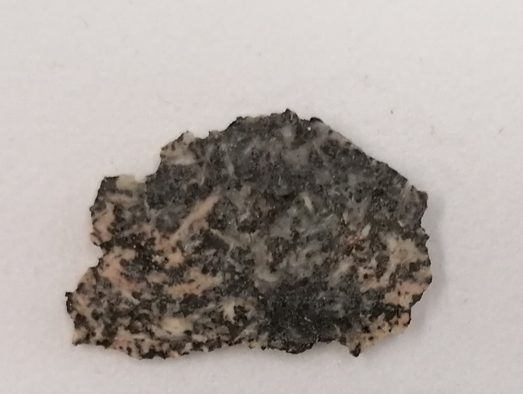
²⁶Al in fake meteorites
“Baraka Landi”
800 g found (gold prospector)
South Libya, 15th Feb 2021
²⁶Al/²⁷Al <1.1∙10⁻¹³
→ 0.06 dpm/kg (no ²⁷Al data)
(~1000 x < Dhurmsala)
Libya
Chad
Niger
800 g
24 mm
© Dieter Heinlein

Slide 31
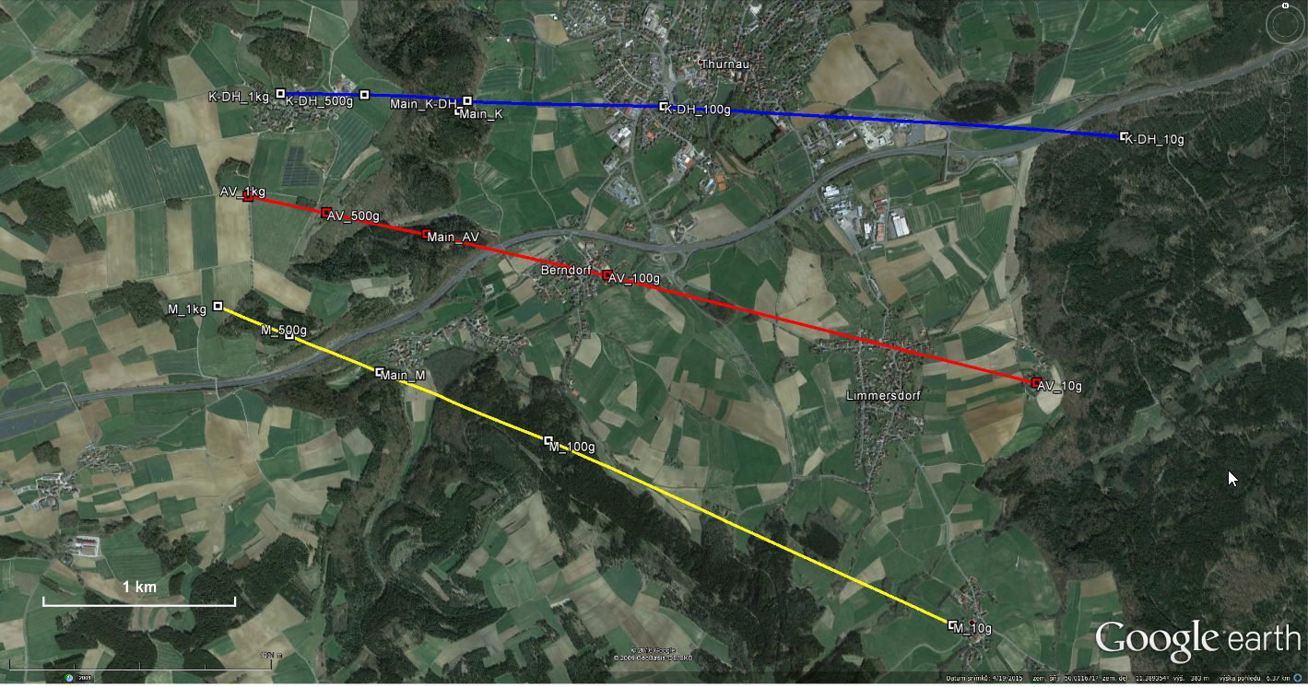
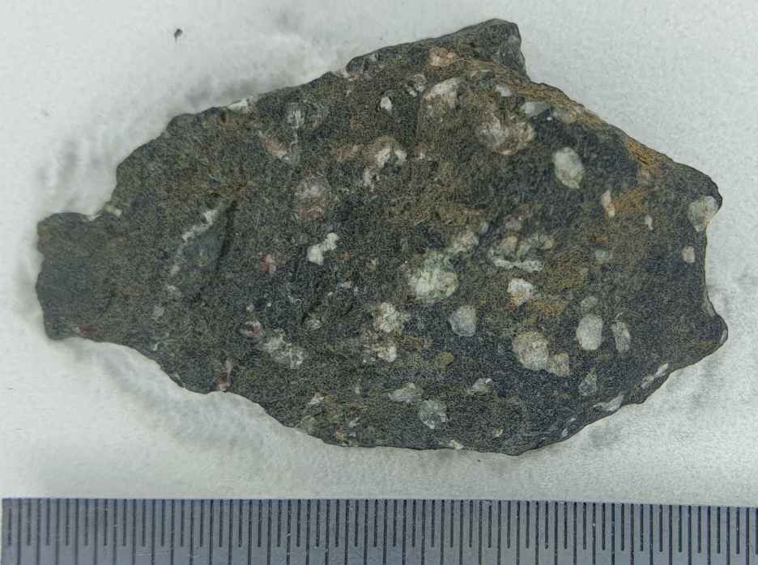
²⁶Al in fake meteorites
Not “Thurnau”
piece recently found in strewn field of fireball, Oberfranken, Germany
(4th Feb 2016)
“dark matrix”
²⁶Al/²⁷Al <7∙10⁻¹³
→ <2 dpm/kg
(7.5% (!!!) ²⁷Al)*
Strewn field of the Thurnau meteorite fall (based on wind profiles of the weather stations Kümmersbruck (blue) and Meiningen (yellow) ,plus mean (red) for fragments between 10 g and 1 kg. Expected main mass 300 g (data & figure by Pavel Spurný).
*priv.com. Dieter Heinlein (2021).

Slide 32
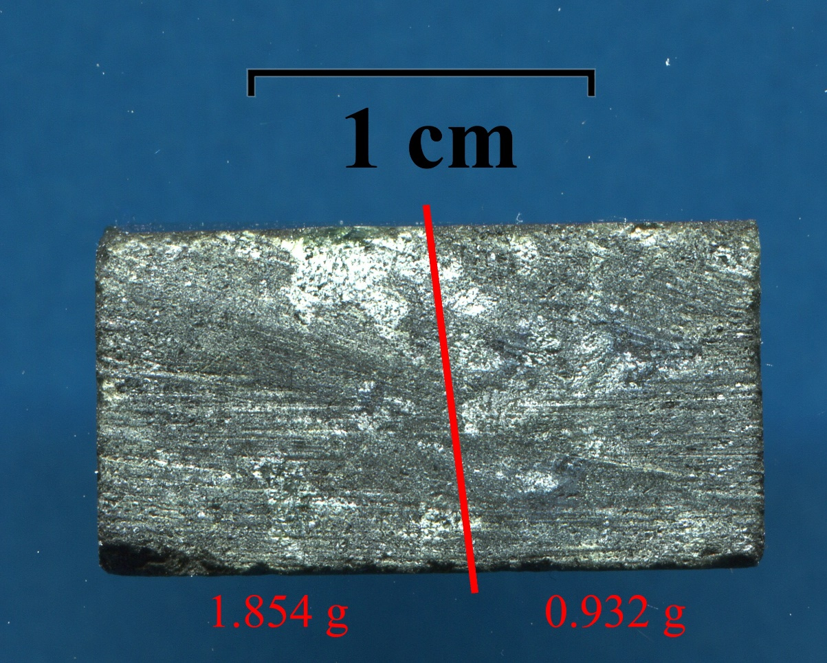
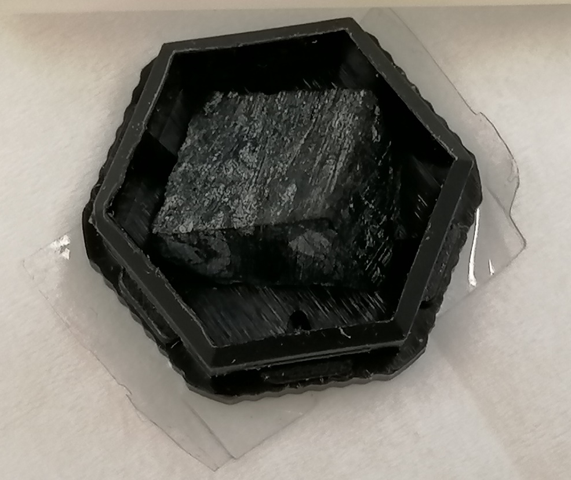
²⁶Al in fake meteorites
“FRH-1-2-2-C”
6 kg piece recently
found in Southern Germany
²⁶Al/²⁷Al <2.4∙10⁻¹³
→ <0.13 dpm/kg (no ²⁷Al data)
© Dieter Heinlein
1 cm
Notes:
All good things come in threes

Slide 33
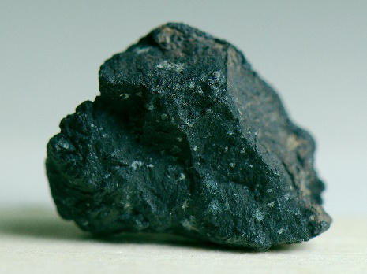
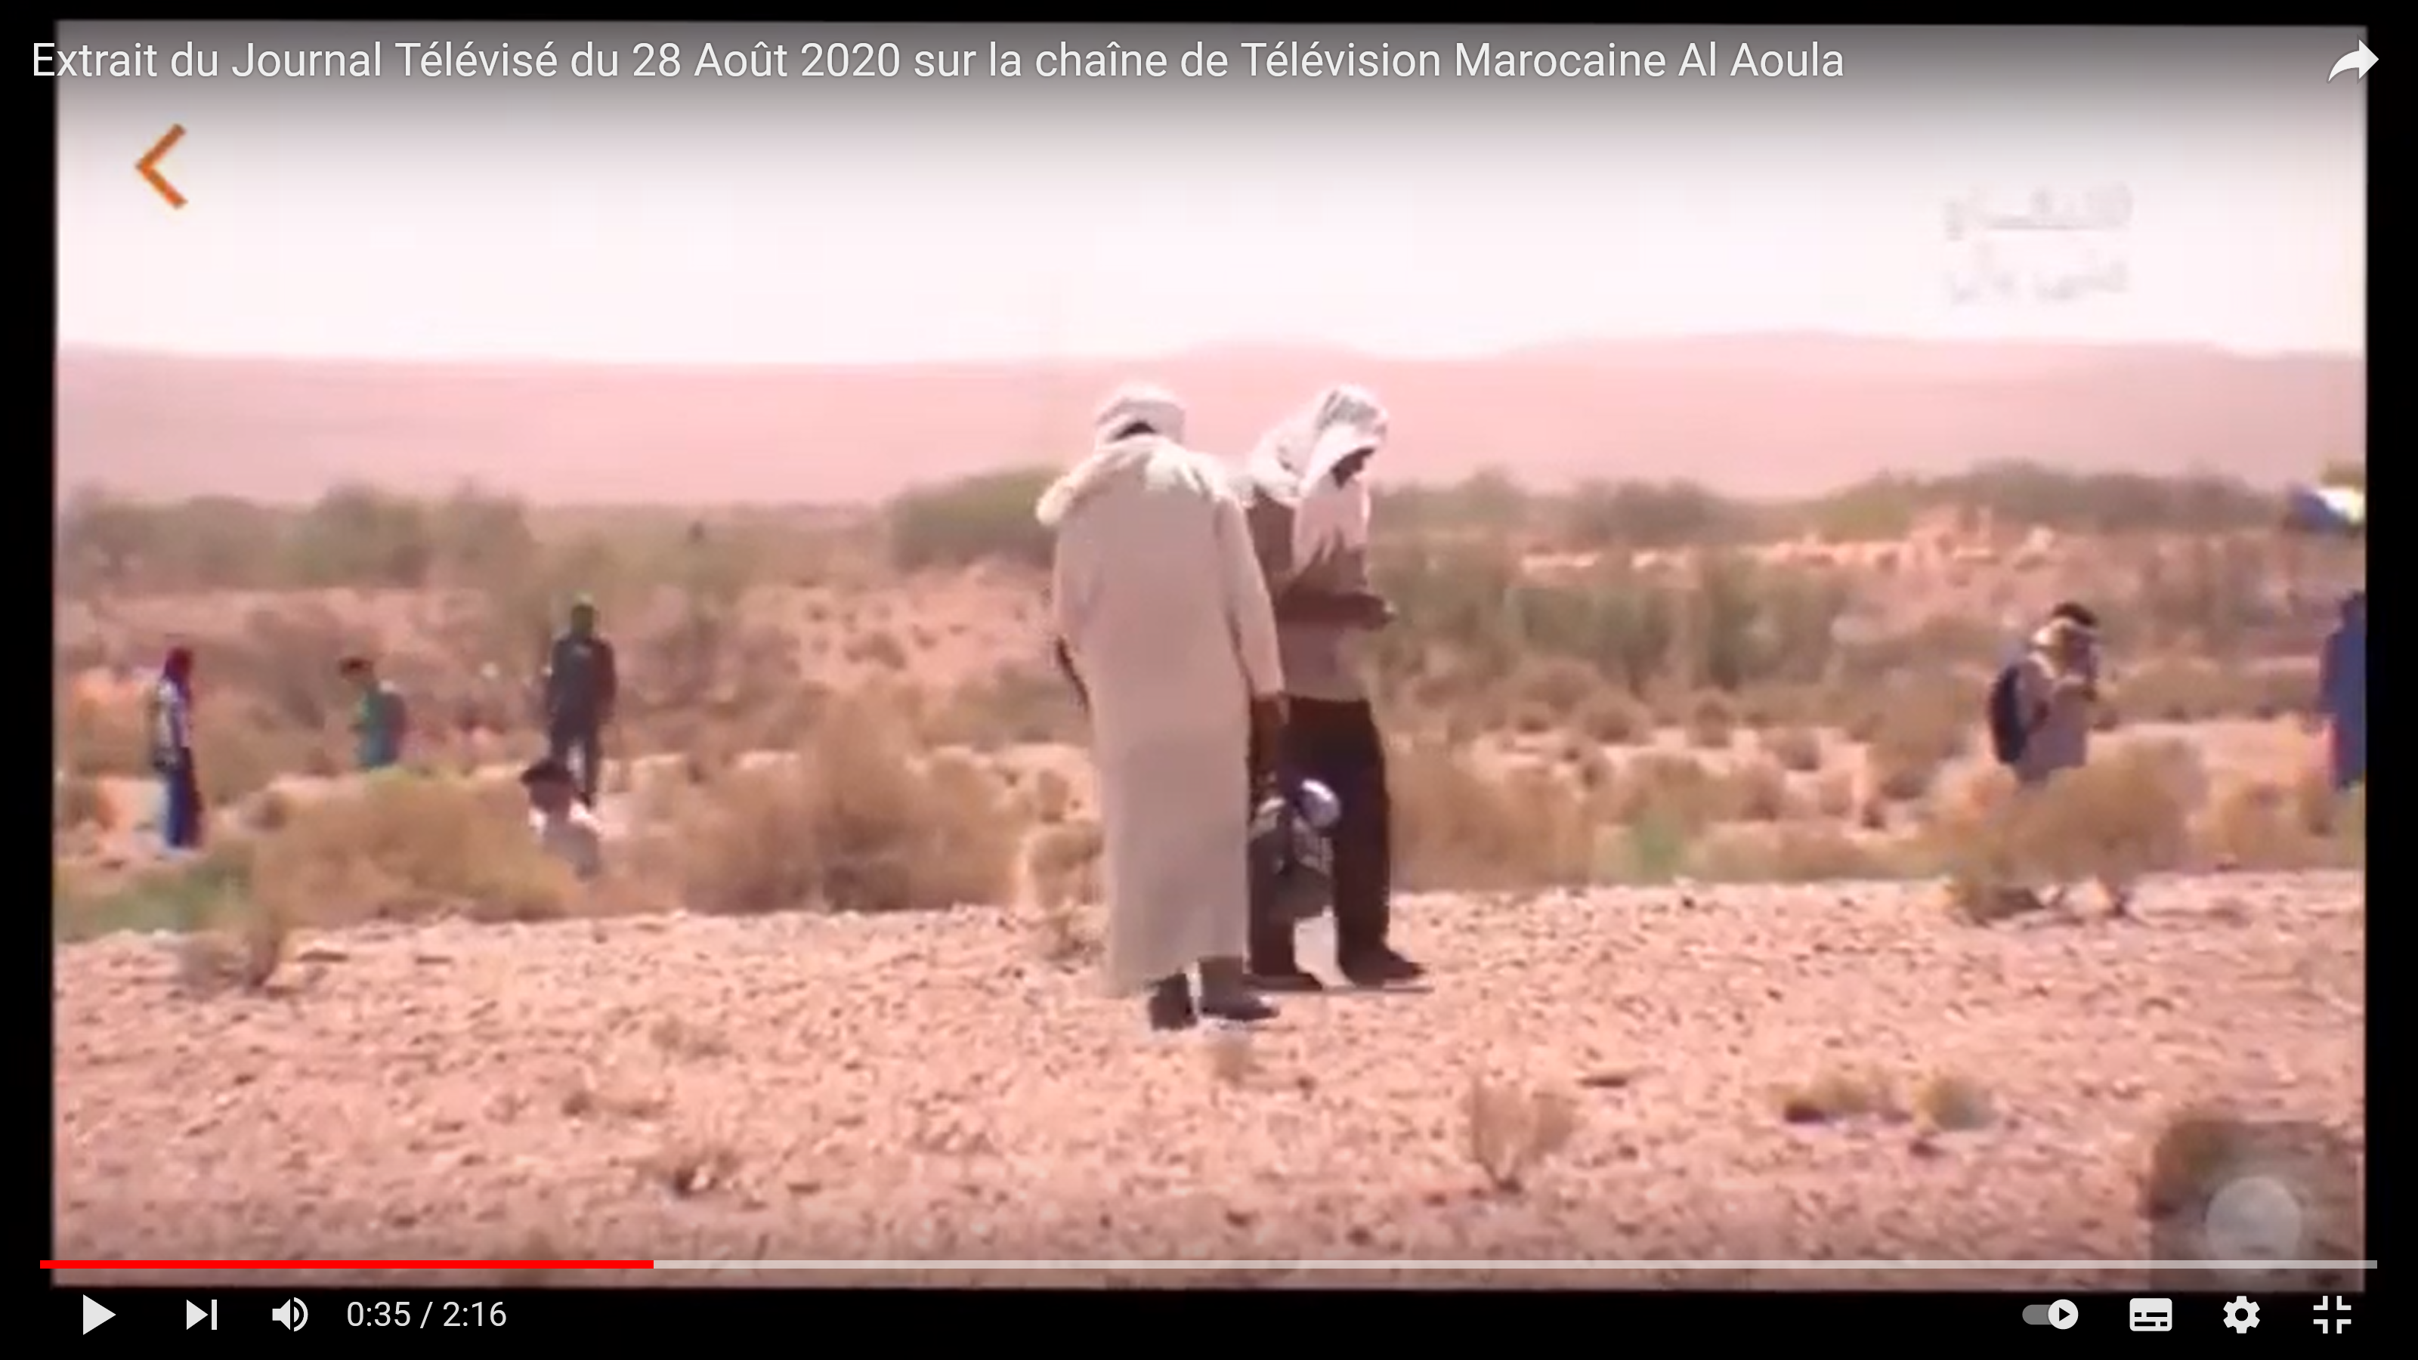
²⁶Al in meteorites
Tarda
C2 (ungrouped) carbonaceous chondrite
fall, Moroccan Sahara, 25th Aug 2020
strewn field, ∑ = 4 kg
~3000 ²⁶Al counts
→ ²⁶Al/²⁷Al = (7.7 ± 0.5)∙10⁻¹¹
→ (35.5 ± 2.3) dpm/kg (1.1% ²⁷Al)*
©
https://www.lpi.usra.edu/meteor/get_original_photo.php?recno=5677833
https://www.youtube.com/watch?v=Qj94c_YRNU0
*Marrocchi et al., ApJL 913 (2021) L9.

Slide 34
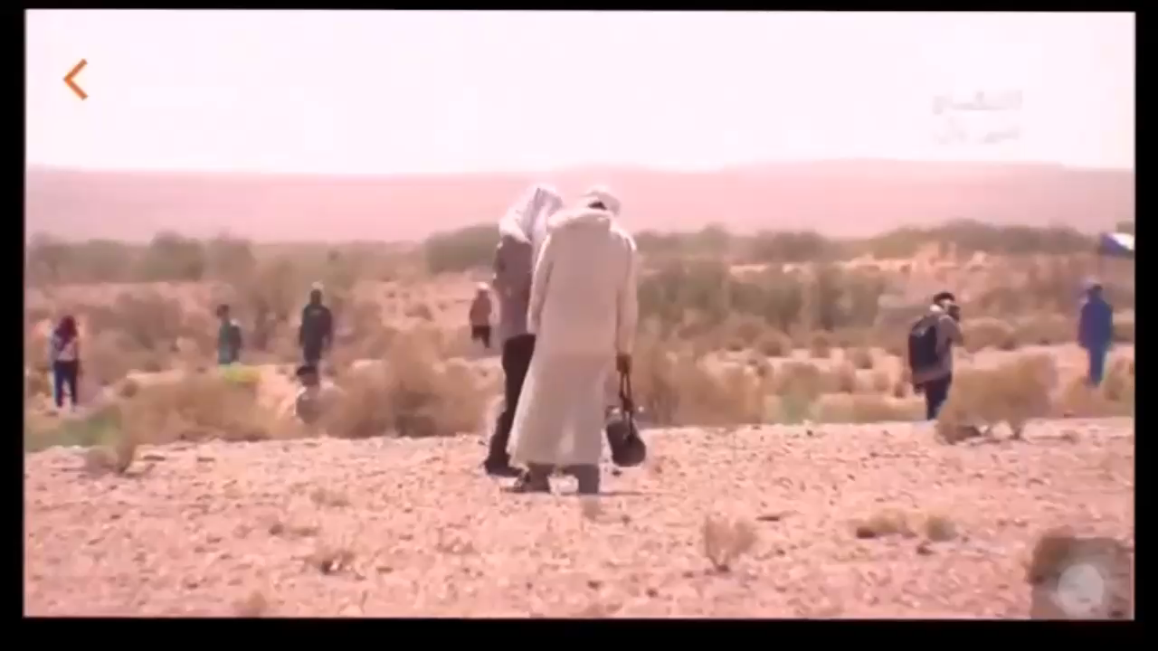
²⁶Al in meteorites
Tarda
C2 (ungrouped) carbonaceous chondrite
fall, Moroccan Sahara, 25th Aug 2020
strewn field, ∑ = 4 kg
~3000 ²⁶Al counts
→ ²⁶Al/²⁷Al = (7.7 ± 0.5)∙10⁻¹¹
→ (35.5 ± 2.3) dpm/kg (1.1% ²⁷Al)*
©
https://www.lpi.usra.edu/meteor/get_original_photo.php?recno=5677833
https://www.youtube.com/watch?v=Qj94c_YRNU0
*Marrocchi et al., ApJL 913 (2021) L9.

Slide 35
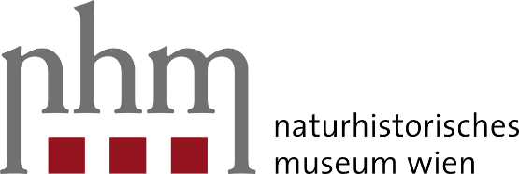

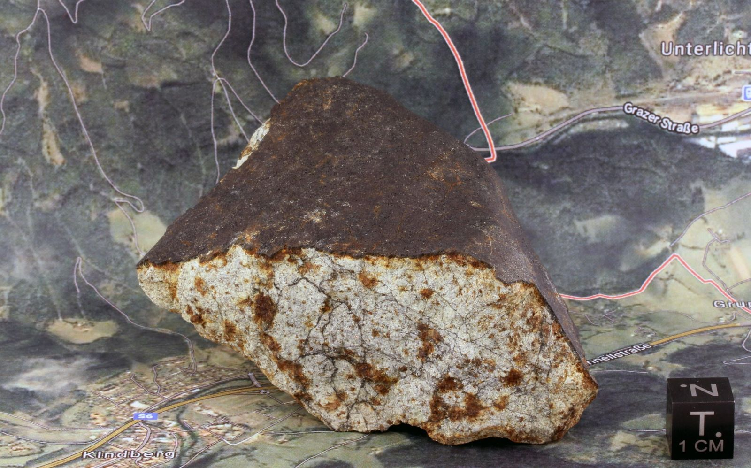
²⁶Al in meteorites
Kindberg
L6 ordinary chondrite
1st Austrian meteorites after 44 years
fall, Styria, Austria, 19th Nov 2020
single piece: 233 g (4th July 2021)
>9000 ²⁶Al counts ²⁶Al/²⁷Al = (1.33 ± 0.08)∙10⁻¹⁰
→ ??? dpm/kg (no ²⁷Al data yet)
©
https://www.nhm-wien.ac.at/ludovic_ferriere
https://www.lpi.usra.edu/meteor/metbull.php?code=75426
https://de.wikipedia.org/wiki/Kindberg_(Meteorit)

Slide 36
⁴¹Ca (t_{1/2}=0.1 Ma) in meteorites
Dhurmsala
~1‰ K (~60 µg/g ⁴¹K)
mixed with PbF₂ (1:9)
→ CaF₃⁻
  → 1 ⁴¹Ca count min⁻¹
*
  → Isobar suppression
  (⁴¹K)
  ~10¹¹
*https://fundus.uni-hamburg.de/de/
collection_records/26856#pfad
Martschini et al., Radiocarbon (2021).

Slide 37
⁴¹Ca (t_{1/2}=0.1 Ma) in meteorites
Dhurmsala
~1‰ K (~60 µg/g ⁴¹K)
mixed with PbF₂ (1:9)
→ CaF₃⁻
    → 1 ⁴¹Ca count min⁻¹
*
  → Isobar suppression
  (⁴¹K)
  ~10¹¹
*https://fundus.uni-hamburg.de/de/
collection_records/26856#pfad
Martschini et al., Radiocarbon (2021).

Slide 38
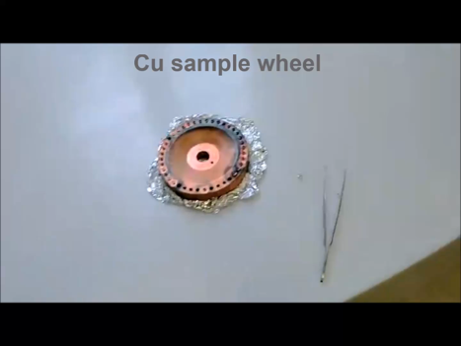

Other “interesting” stuff ?
¹⁰Be, ²⁶Al, ³⁶Cl, ⁴¹Ca data traceable to
primary AMS standards*
(help in) improving “routine” chemistry:
ice, in-situ, sediments, deep-sea MnFe…
further information see...
Conclusion:
I am getting rid of my chemist’s job (for meteorites)!
  We are grateful to Ludovic Ferrière,
  Dieter Heinlein & Erik Strub
  for providing (precious) samples.
*Merchel & Bremser 2004; Merchel et al. 2011, 2012, 2019a/b; Arnold et al. 2010, 2013; Akhmadaliev et al. 2013; Rugel et al. 2016 ,…
ChETEC-INFRA tour given by M. Martschini now @ https://isotopenphysik.univie.ac.at/oeffentlichkeitsarbeit/

Slide 40
“Stacked-foil absorber” (¹⁰Be)
5 mm x 5 mm (~13)* → 10 mm x 10 mm Si₃N₄ (~8) Σ = 7 µm
→ detector eff. (~85%)
3+ → 2+
→ 5% → 55%
stripper (Ar) yield
Schmidt, Master thesis, U Vienna (2013).
(now: 16 mm)
*Steier et al., Int. J. Mass Spectr. 444 (2019).
Notes:
13 foils; ~ 7 µm, , 5 x 5 mm2 (Steier et al., 2019), Silson
2+ stripper yield
after 2 h: 75% of BeO are used
after 1 h: 1/3 of BeO used

Slide 41
“Stacked-foil absorber” (¹⁰Be)
5 mm x 5 mm (~13)* → 10 mm x 10 mm Si₃N₄ (~8) Σ = 7 µm
→ detector eff. (~85%)
3+ → 2+
→ 5% → 55%
stripper (Ar) yield
+ ionis. eff. (~2%)
  → 1% total eff. ☺
*Steier et al., Int. J. Mass Spectr. 444 (2019).
Notes:
13 foils; ~ 7 µm, , 5 x 5 mm2 (Steier et al., 2019), Silson
2+ stripper yield
after 2 h: 75% of BeO are used
after 1 h: 1/3 of BeO used

Slide 42

ILIAMS

