Slide 1

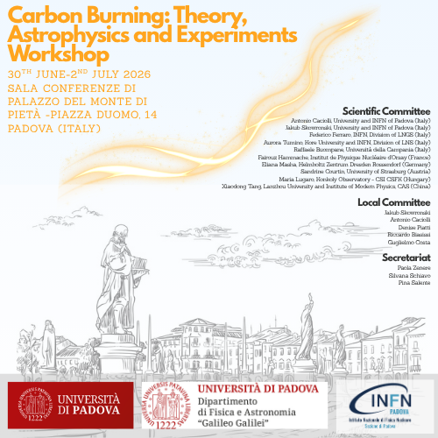
Review on the Astrophysics Importance
of the Carbon Burning reactions
Alessandro Chieffi
INPS – Istituto Nazionale di Previdenza Sociale – Italy
INFN – Istituto Nazionale di Fisica Nucleare – Sez. Perugia – Italy
INAF – Istituto di Astrofisica e Planetologia Spaziali - Italy
Centre for Stellar and Planetary Astrophysics Monash University – Australia
Institut d’Astronomie et Astrophysique - ULB – Bruxelles
alessandro.chieffi@inaf.it

Slide 2



In collaboration with
Marco Limongi – INAF
(Osservatorio astron. di Roma)
Lorenzo Roberti – INAF
(Osservatorio astron. di Palermo)
Agnese Falla
(Universita' la Sapienza)

Slide 3
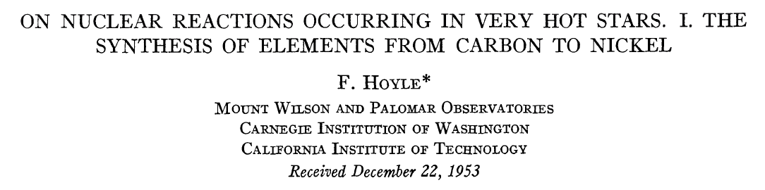
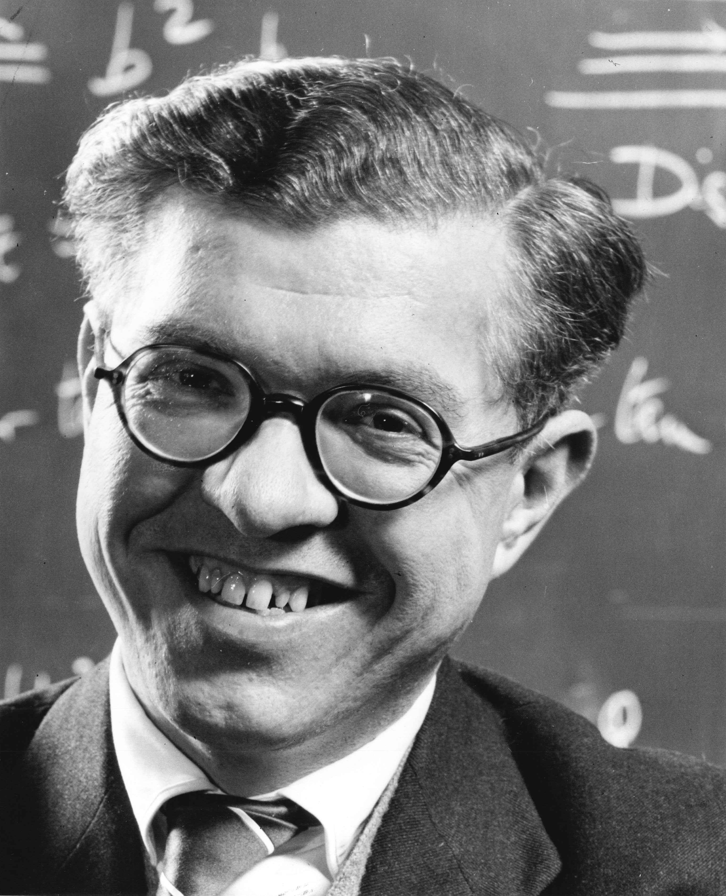
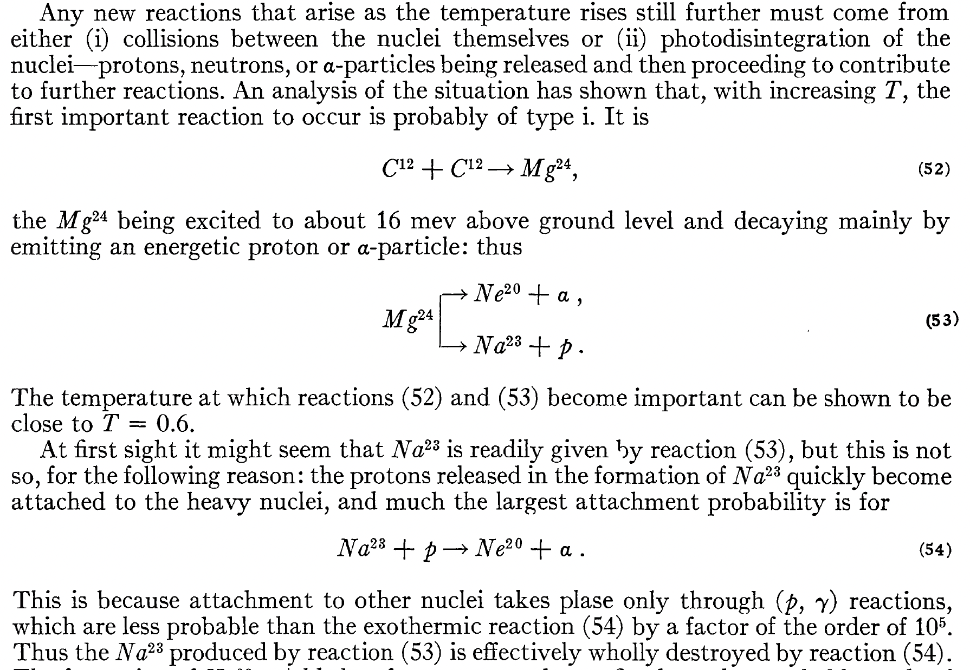
1954
Sir Fred Hoyle

Slide 4
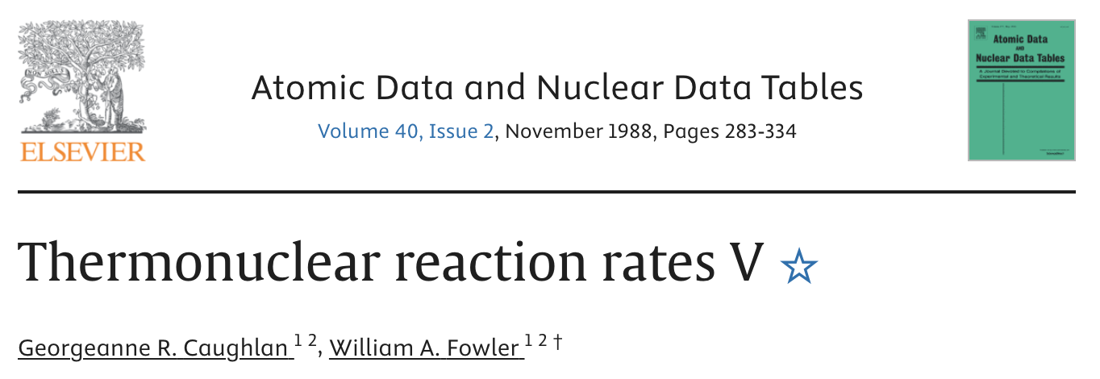
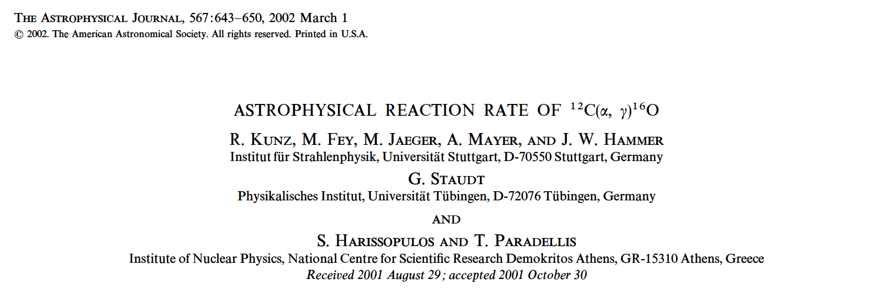
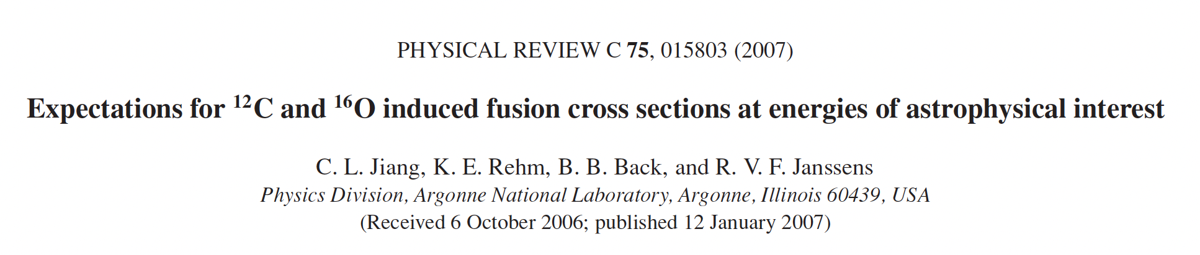
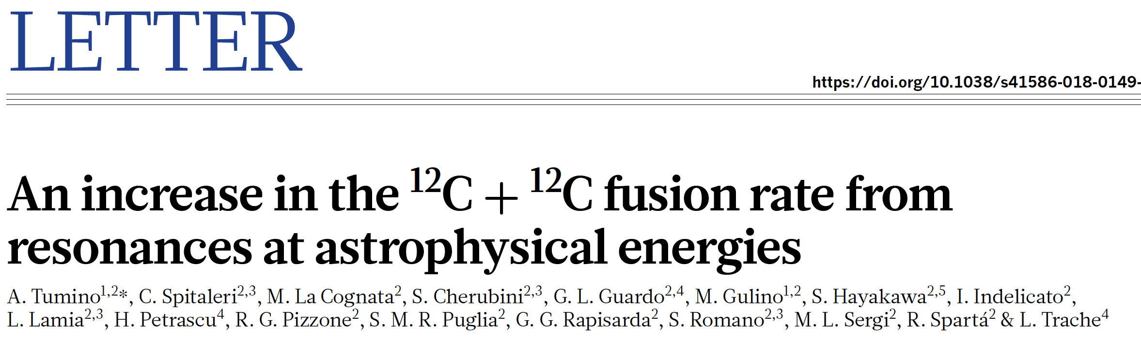
Adopted nuclear cross sections

Slide 5
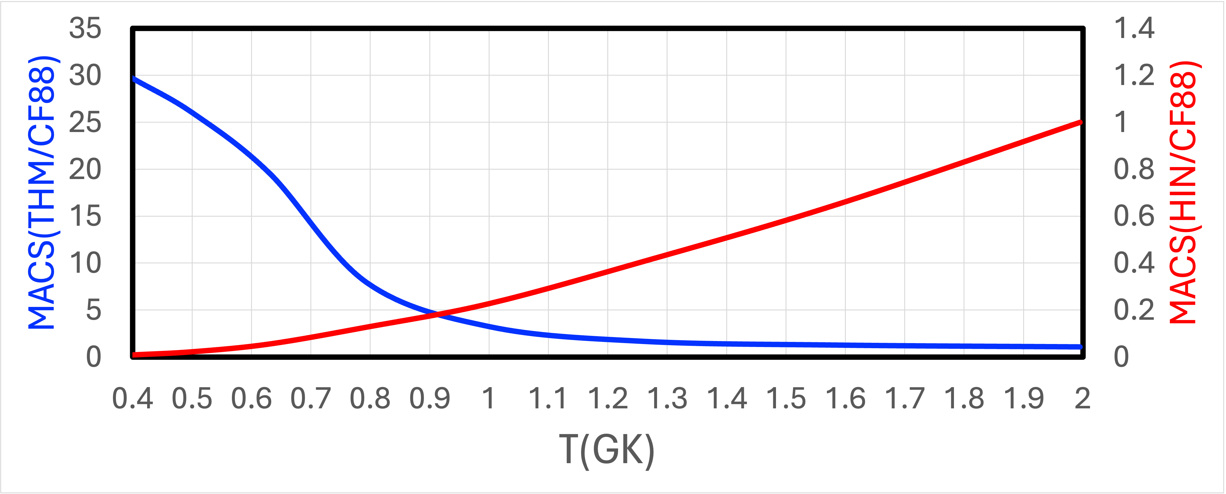

Slide 6
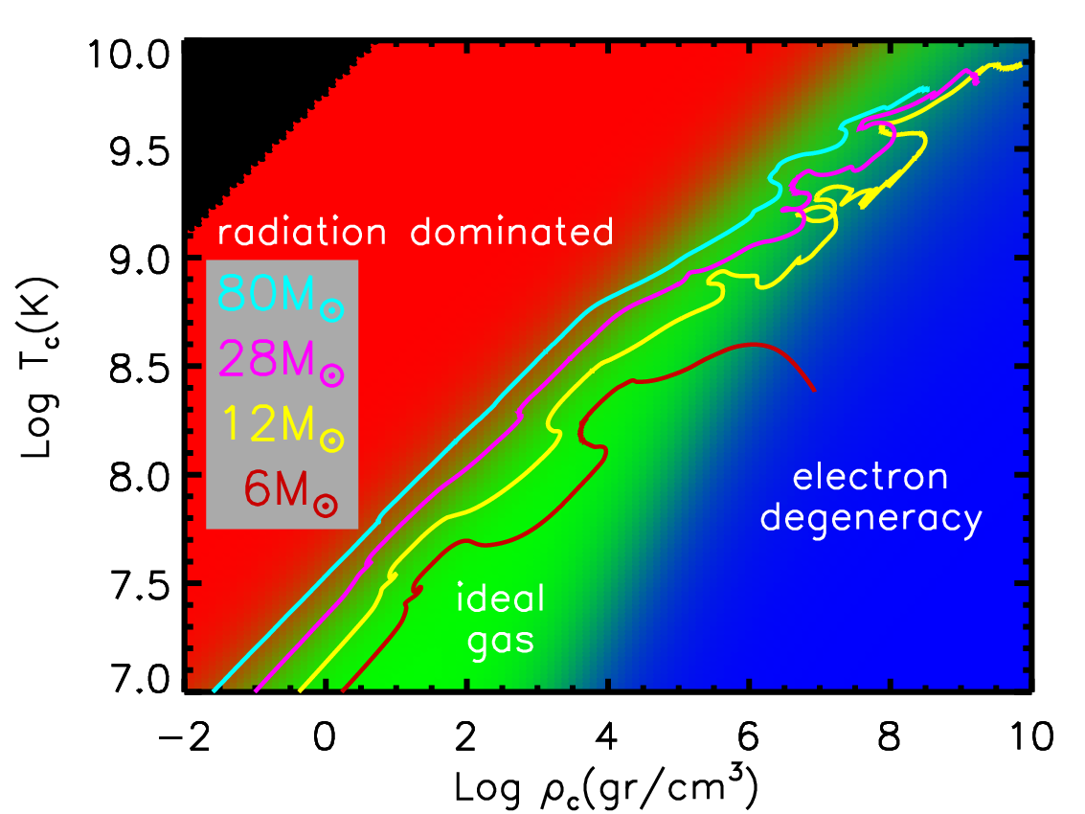
O
Ne
C
He
H

Slide 7
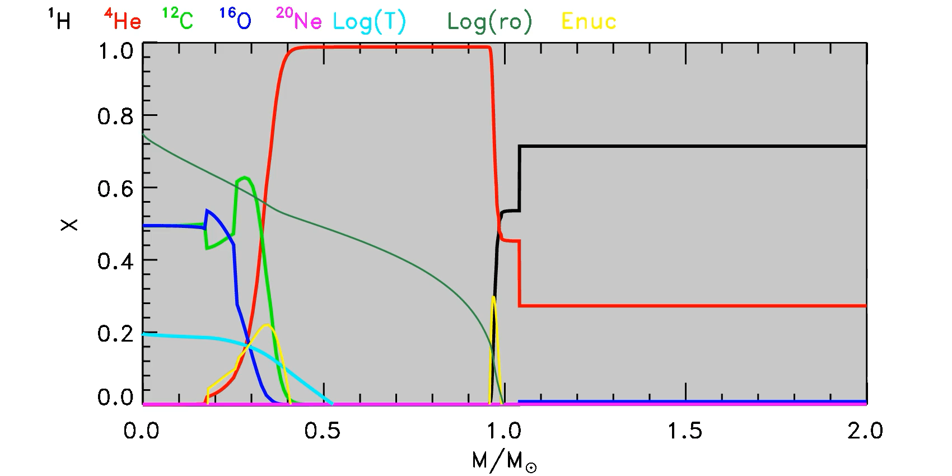

Slide 8
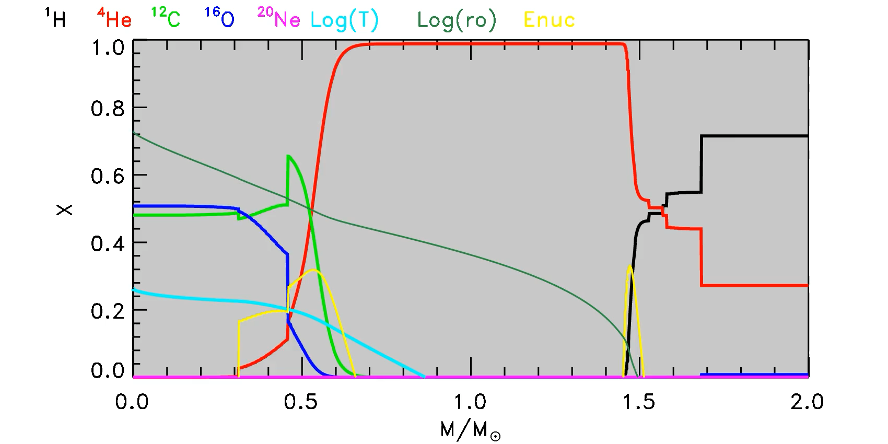

Slide 9
O
Ne
C
He
H
WD
EC-SN
CC-SN
CO
CONe
ONeMg
contract freely
(massive stars)
electron degenerate core
M_{UP}
M_{mass}
He core mass

Slide 10
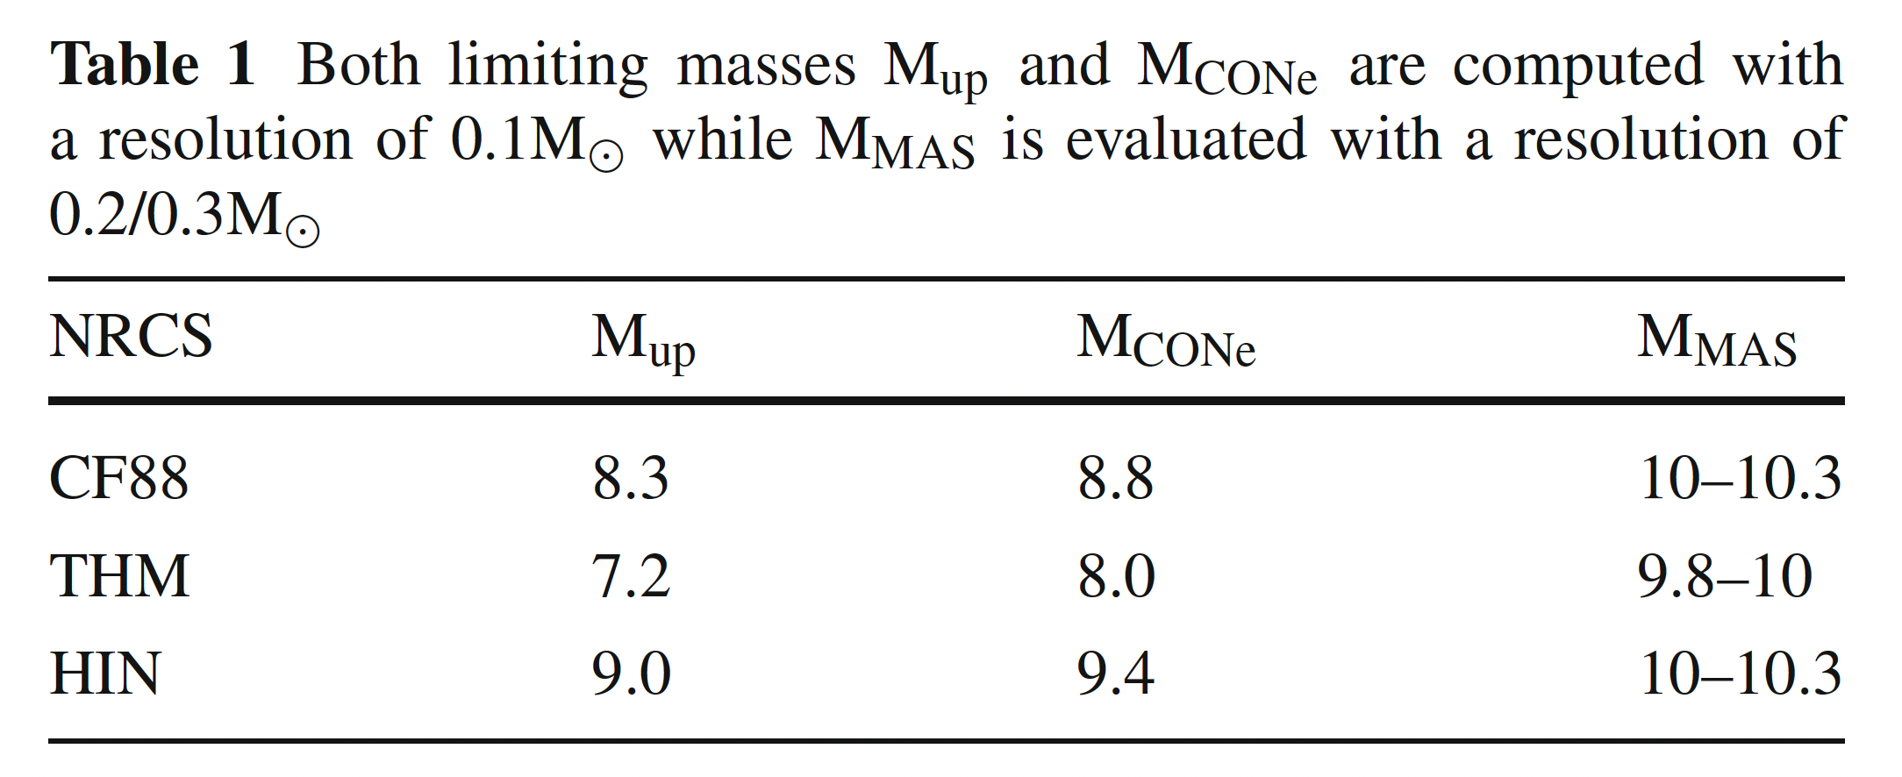
O
Ne
C
He
H
Chieffi + Eur. Phys. J. A (2025) 61:280
WD
EC-SN
CC-SN
CO
CONe
ONeMg
contract freely
(massive stars)
electron degenerate core
M_{UP}
M_{mass}
He core mass

Slide 11
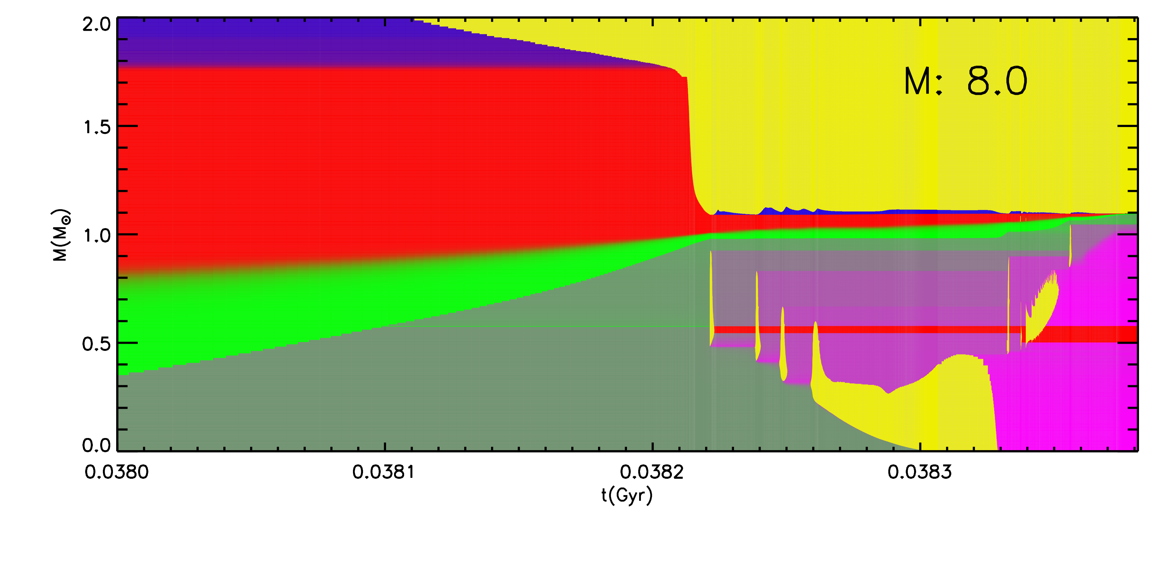
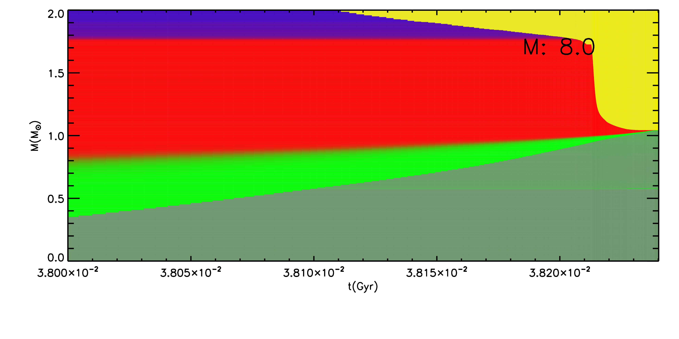
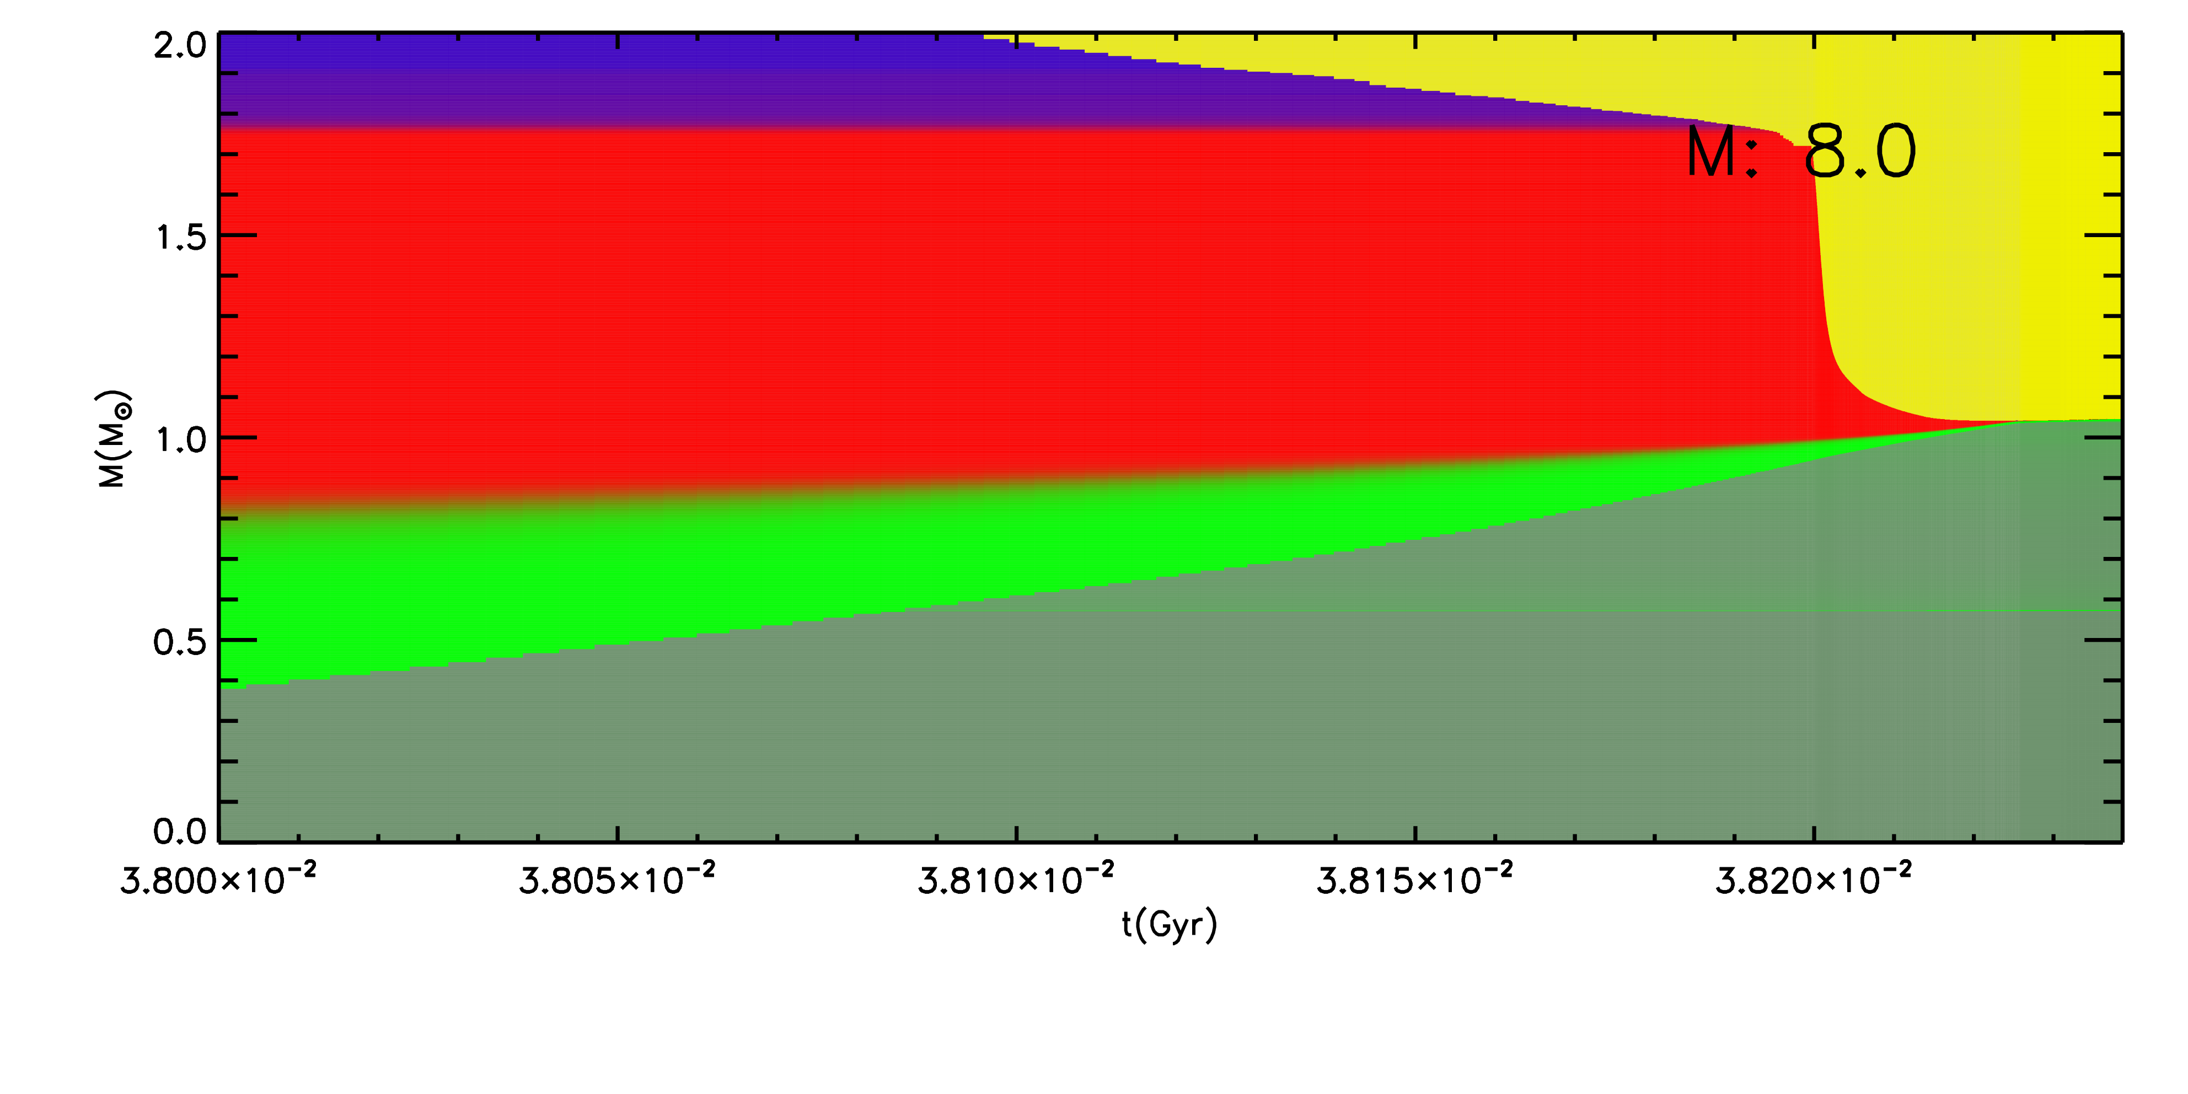
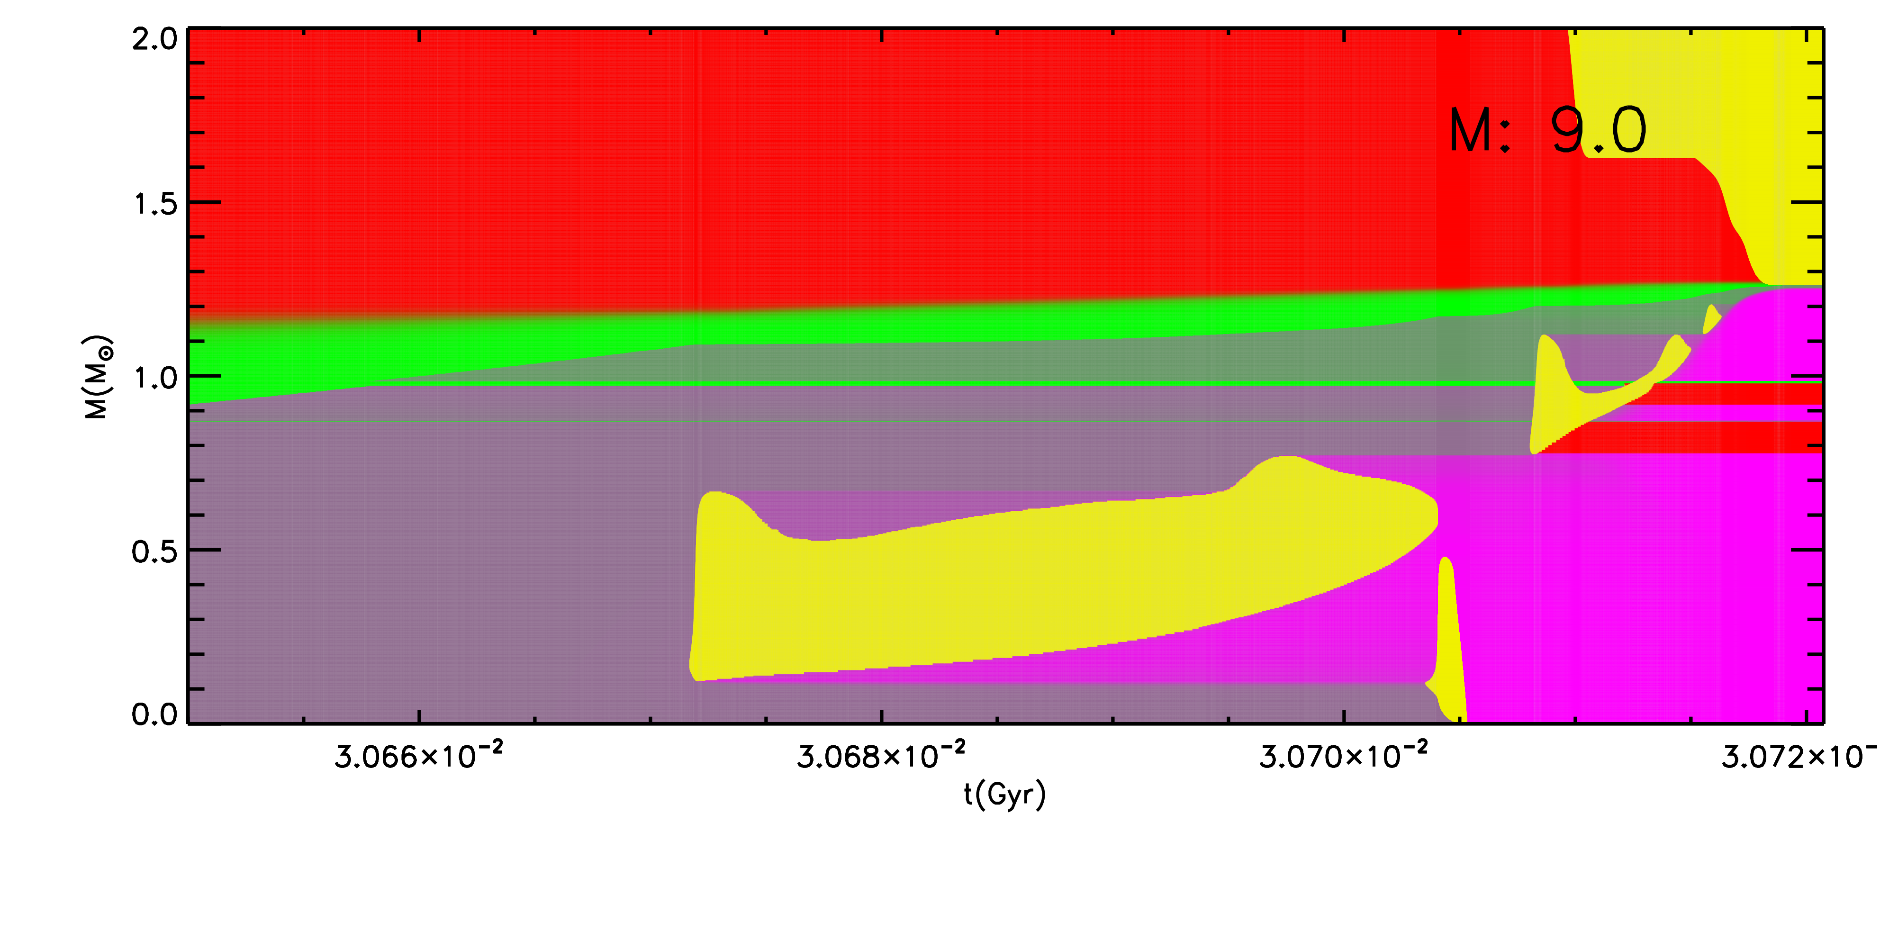
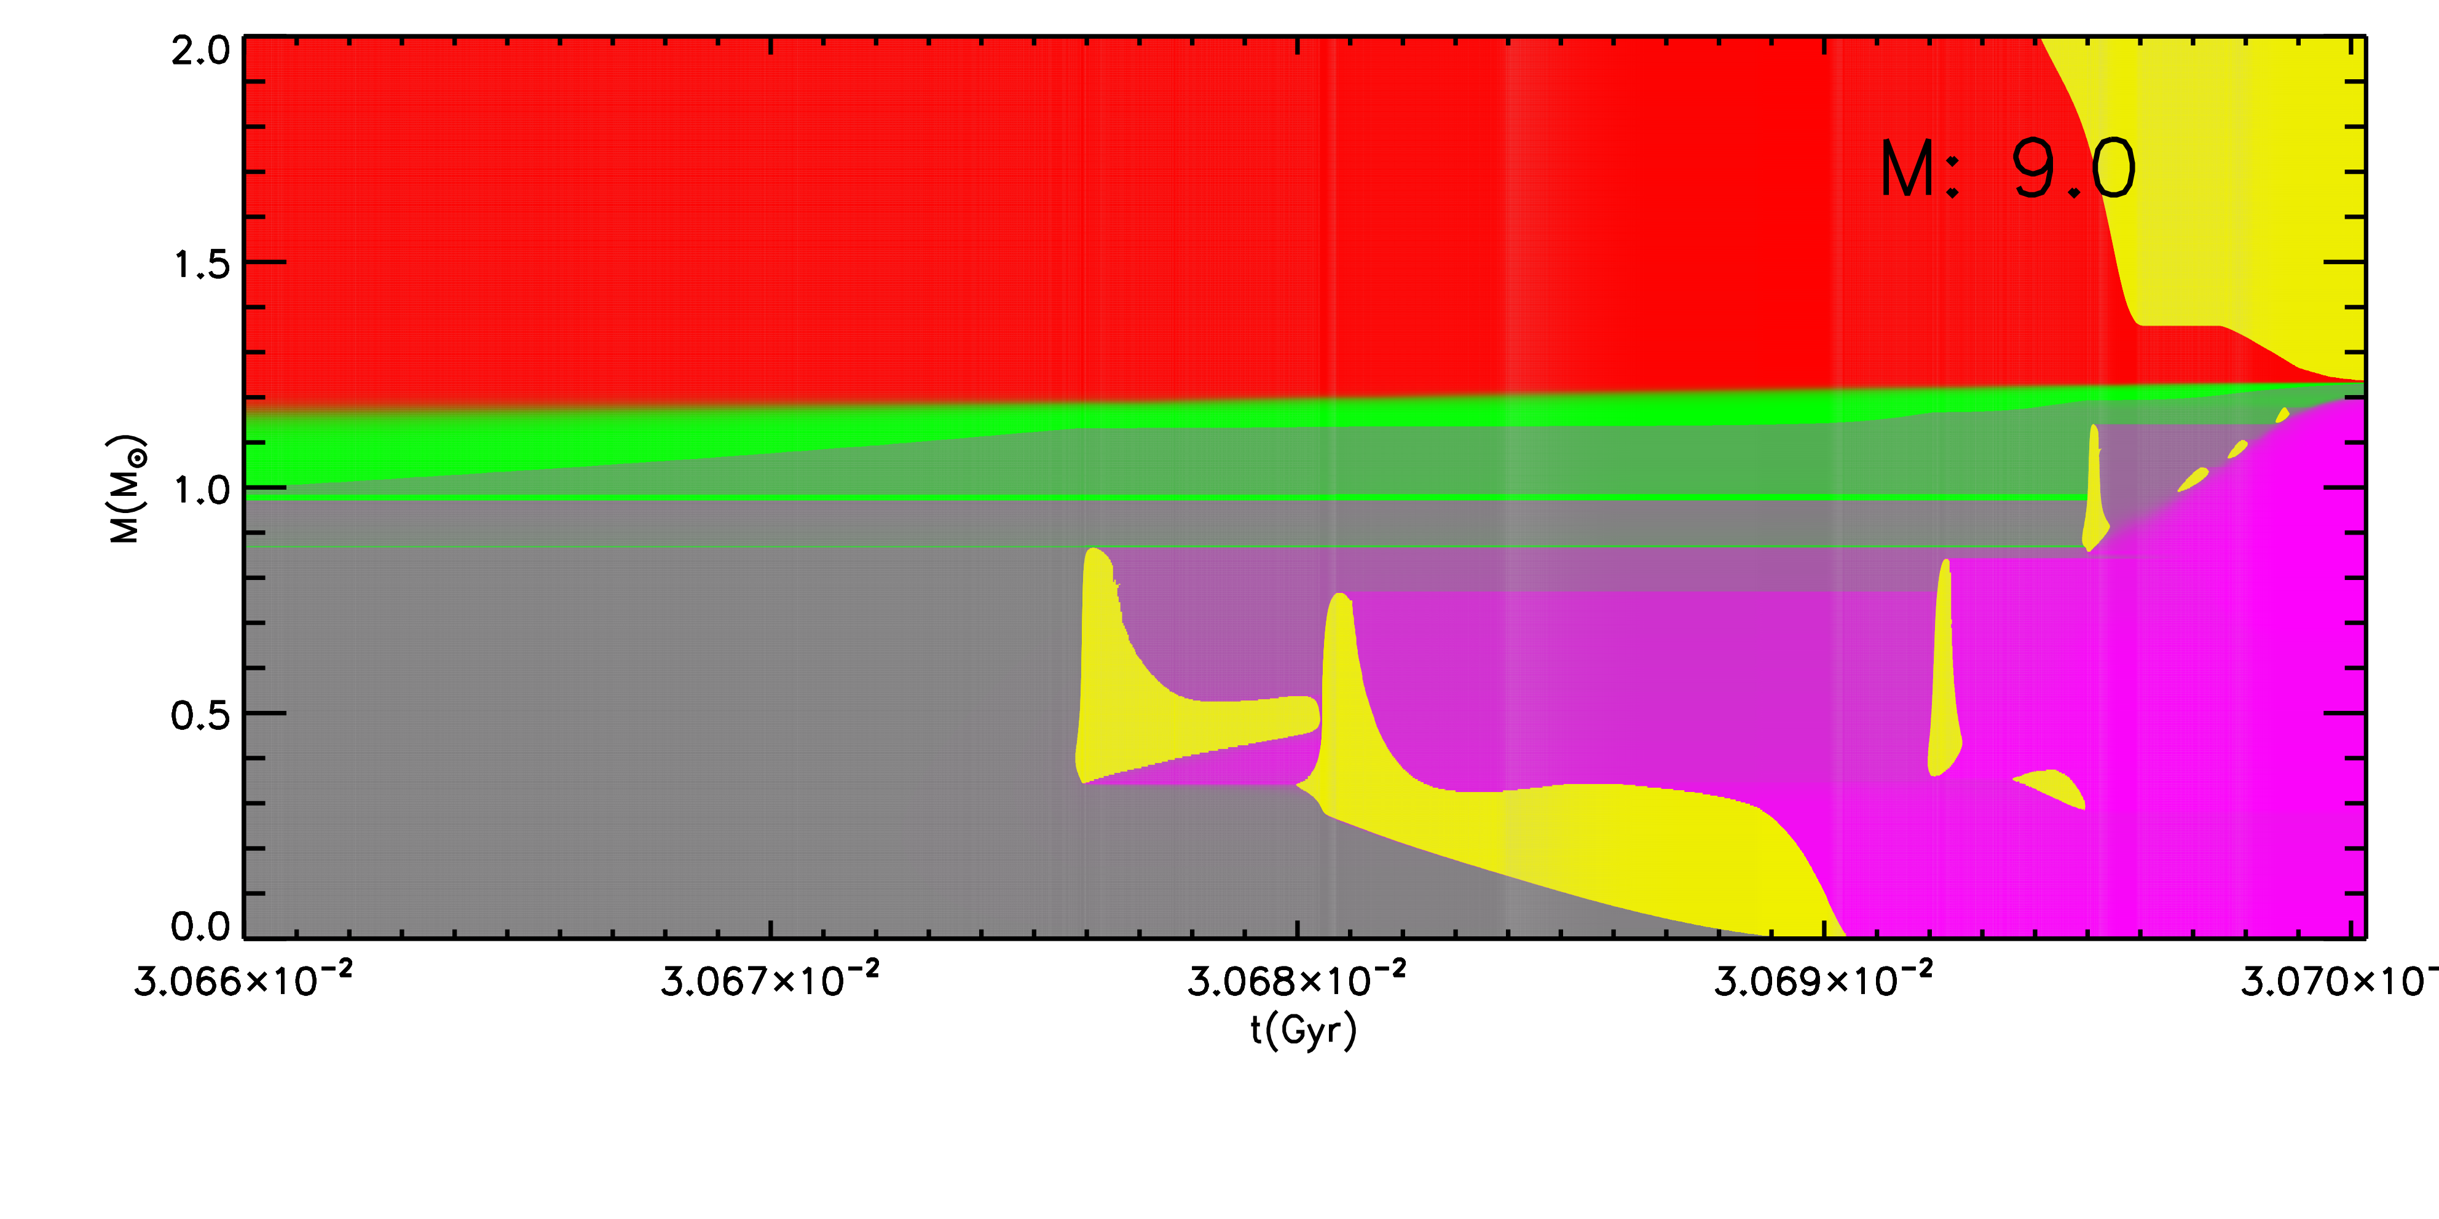
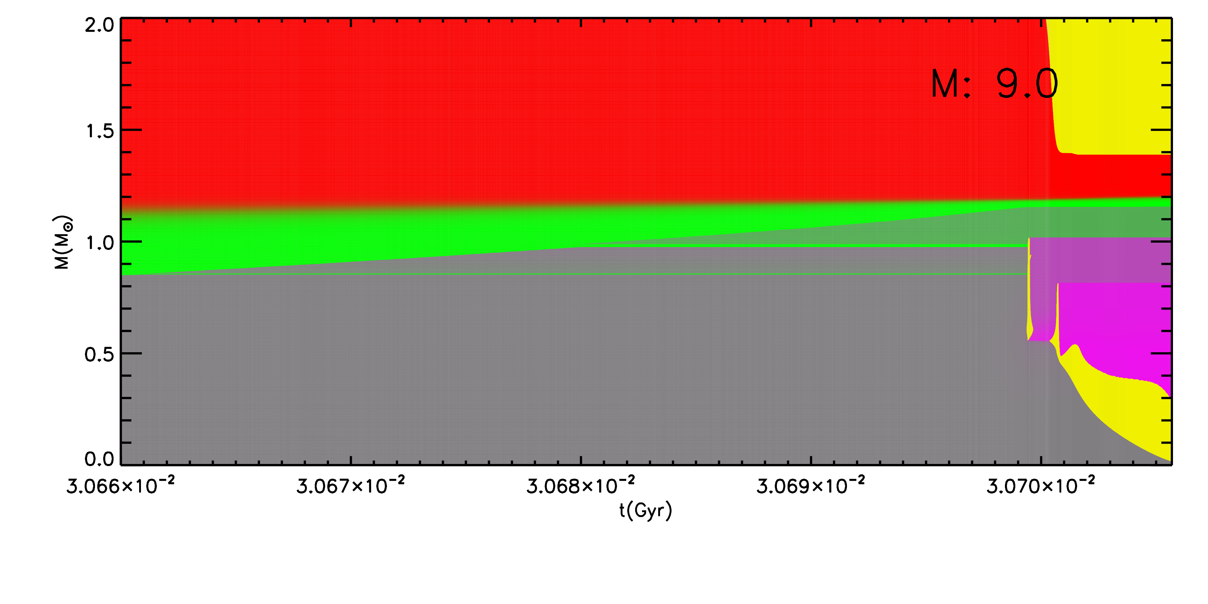
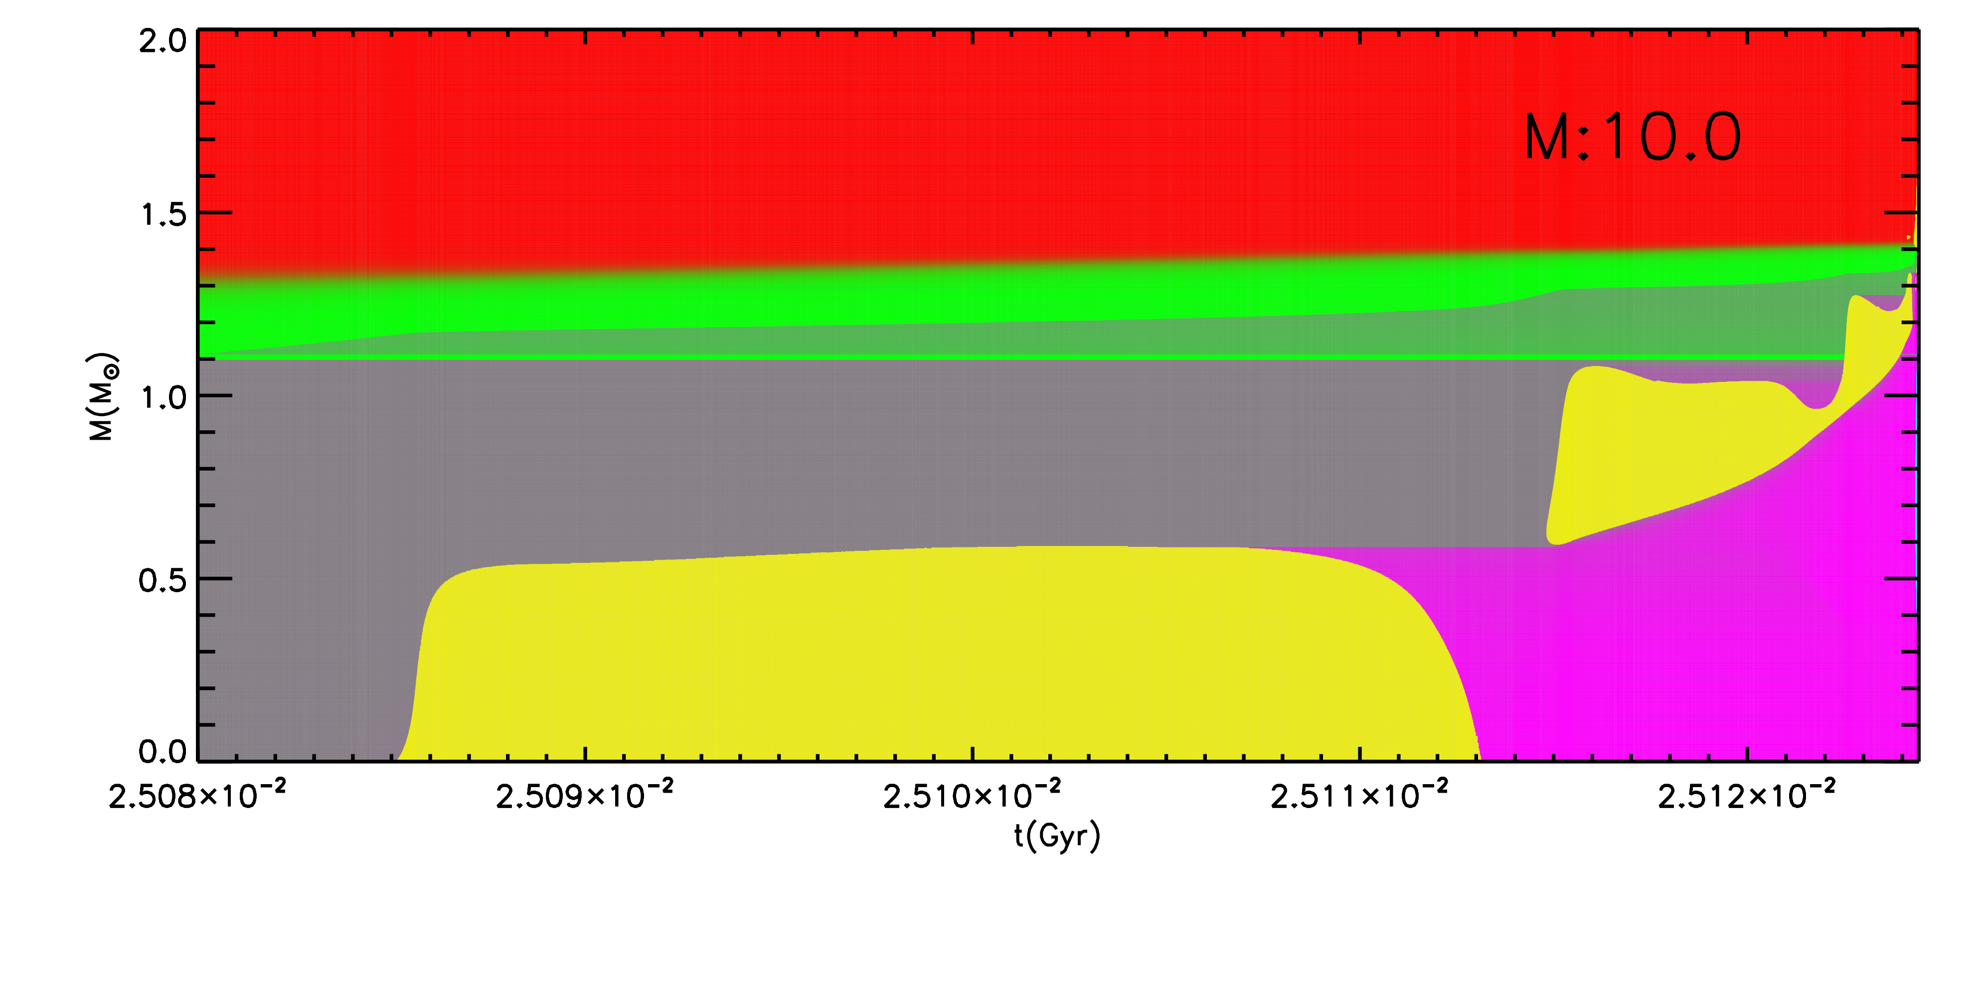
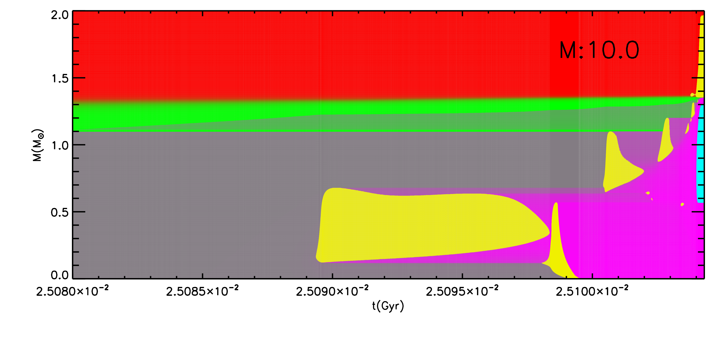
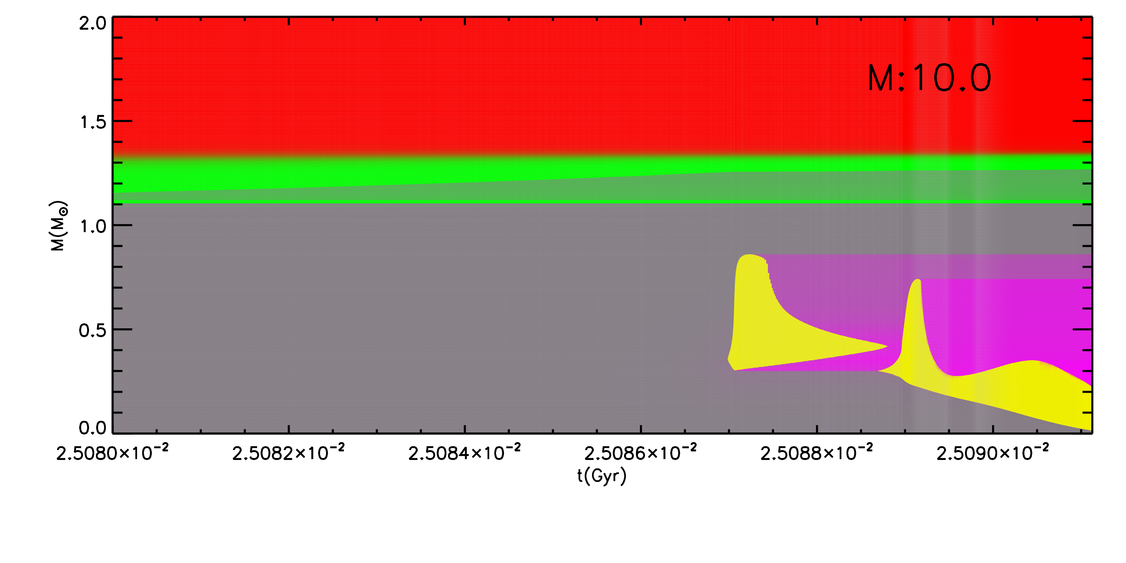
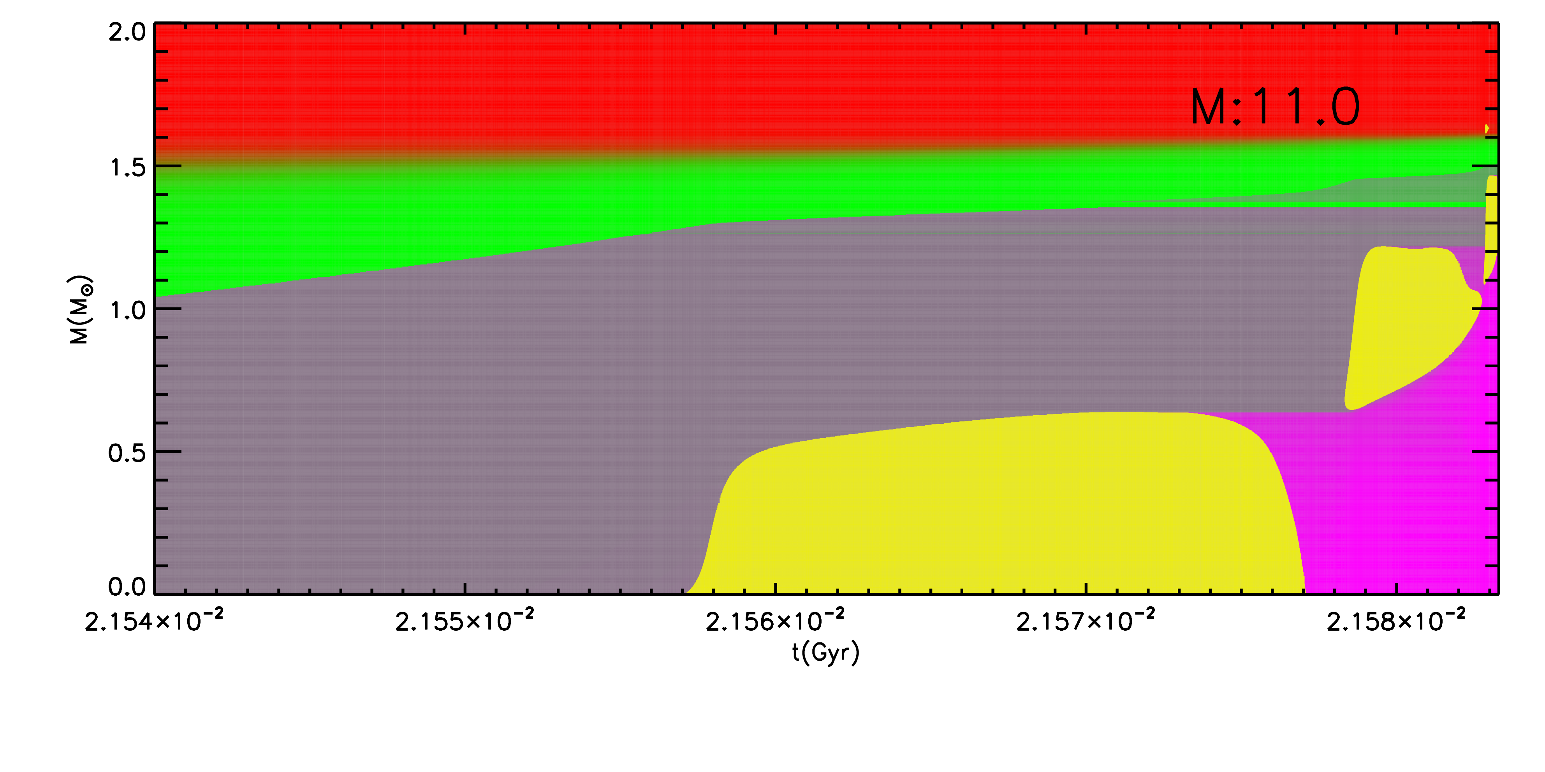
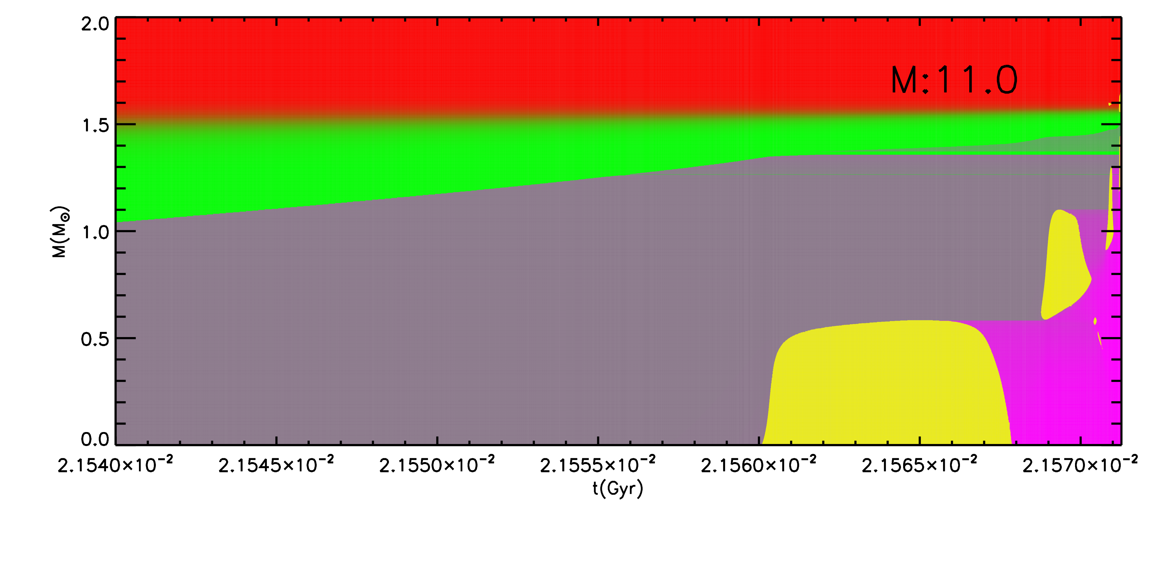
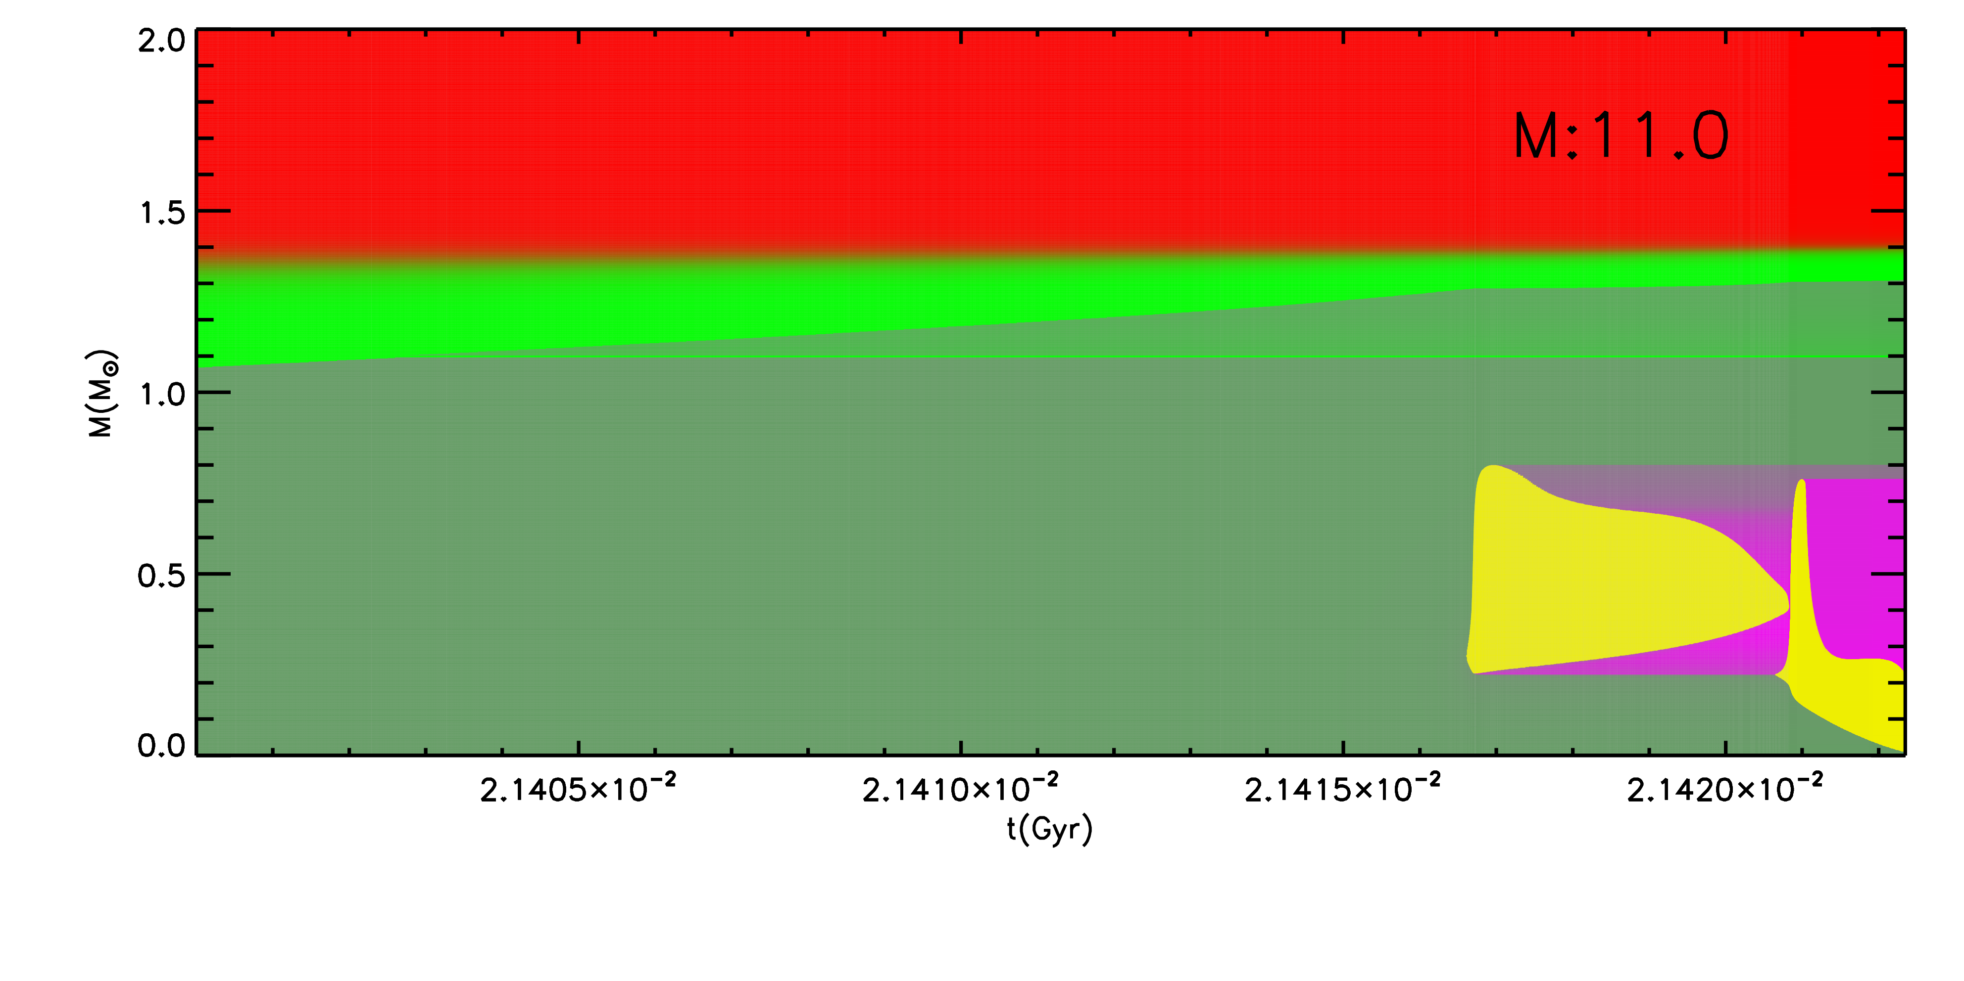
THM
CF88
HINDRANCE
¹²C¹²C
ONeMg-WD
CO-WD
CO-WD
8 M⊙
C.C.
ONeMg-WD
ONeMg-WD
9 M⊙
C.C.
ONeMg-WD
ONeMg-WD
10 M⊙
C.C.
C.C.
C.C.
11 M⊙

Slide 12
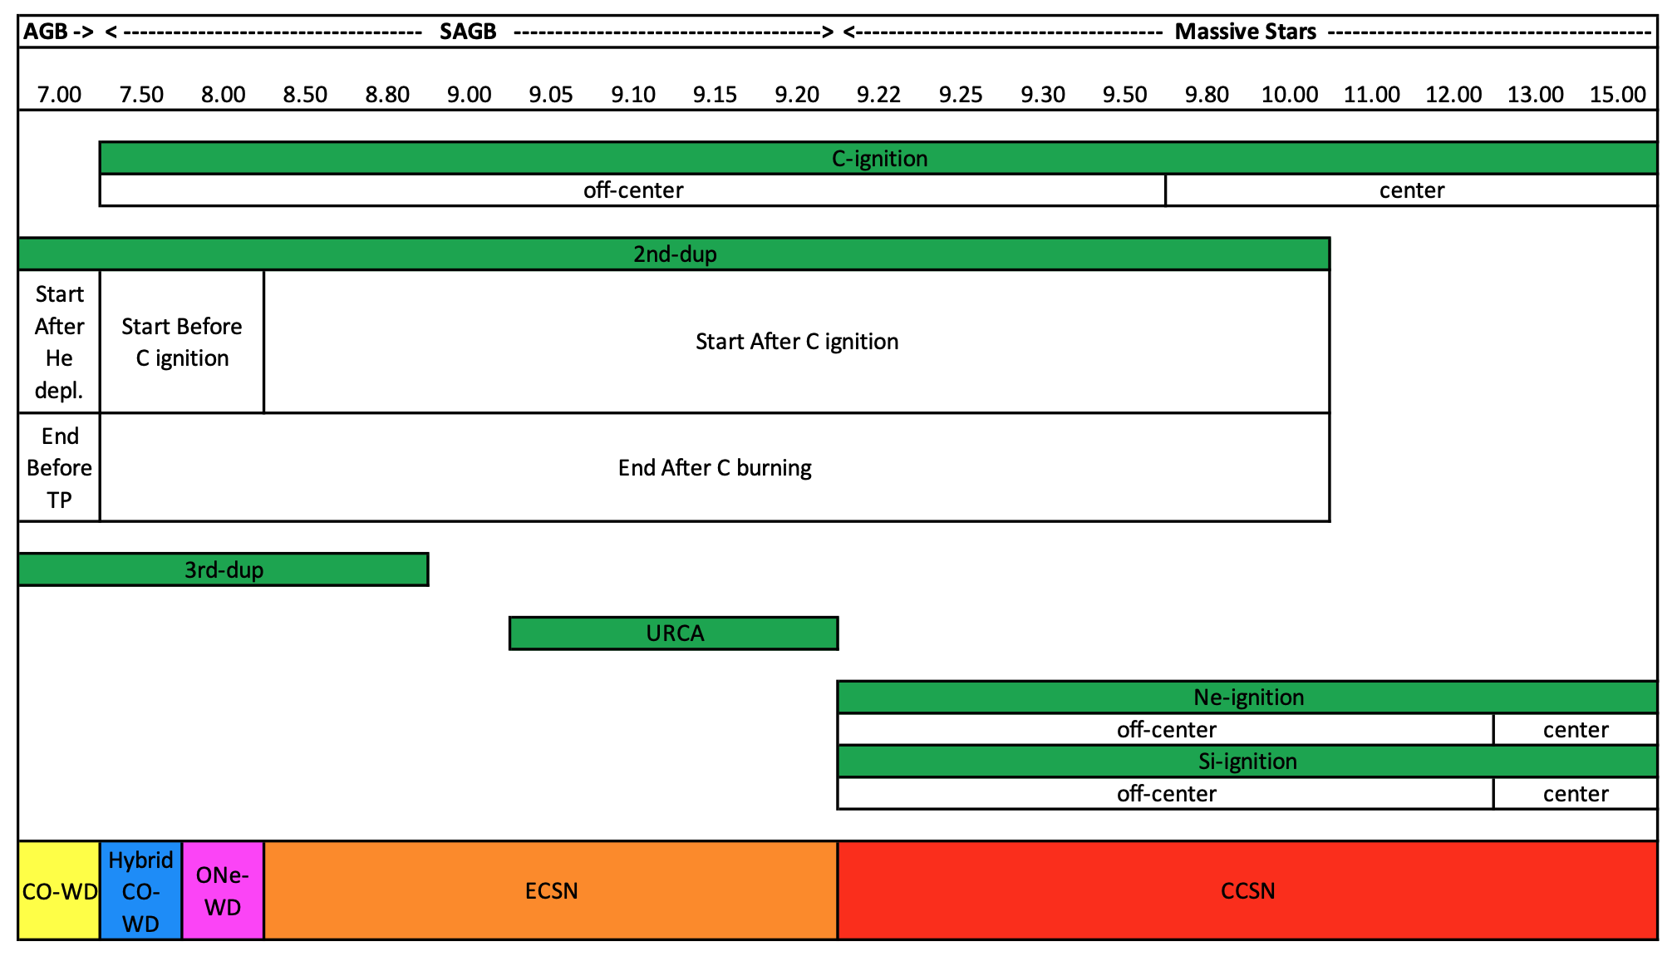
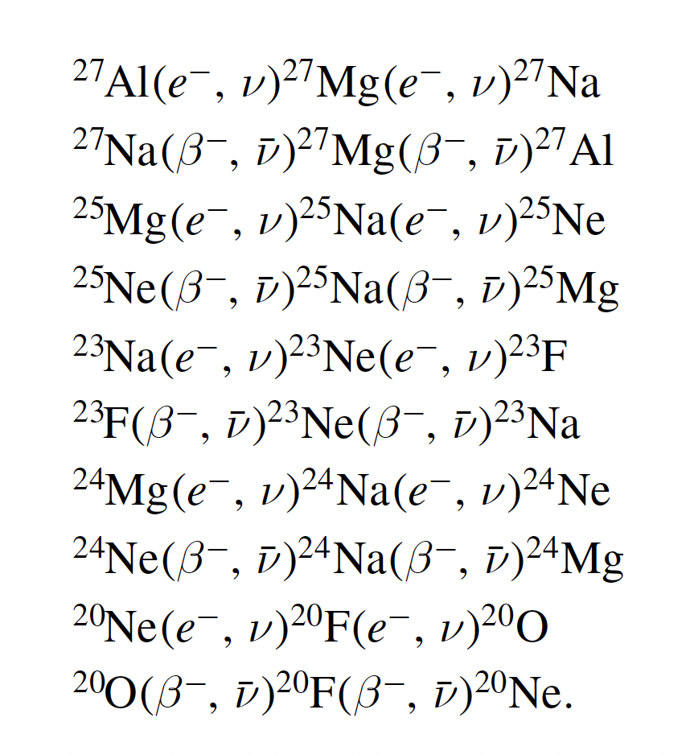
M_{UP}
TP-stars
Massive stars
CO
CONe
ONeMg
Limongi + 2024 ApJS 270,29

Slide 13
C burning in massive stars
The devastating impact of the combo ¹²C(α,γ)¹⁶O + ¹²C¹²C on the evolution of these stars
Massive stars do not need at all nuclear reactions to contract and heat up to their final collapse
But
nuclear reactions (and in particular C burning) sculpt the final shape of the binding energy at the onset of the c.c.
ATTENTION:
a refine grid of models is REQUIRED to understand the role of C burning

Slide 14
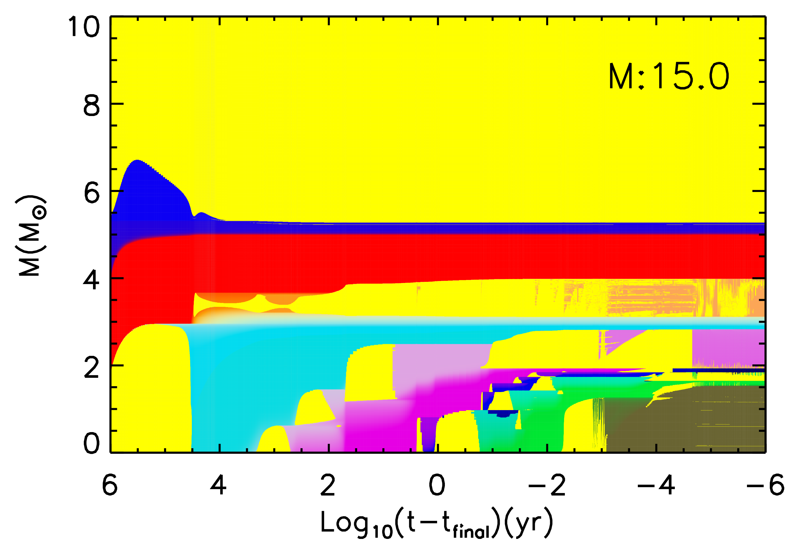
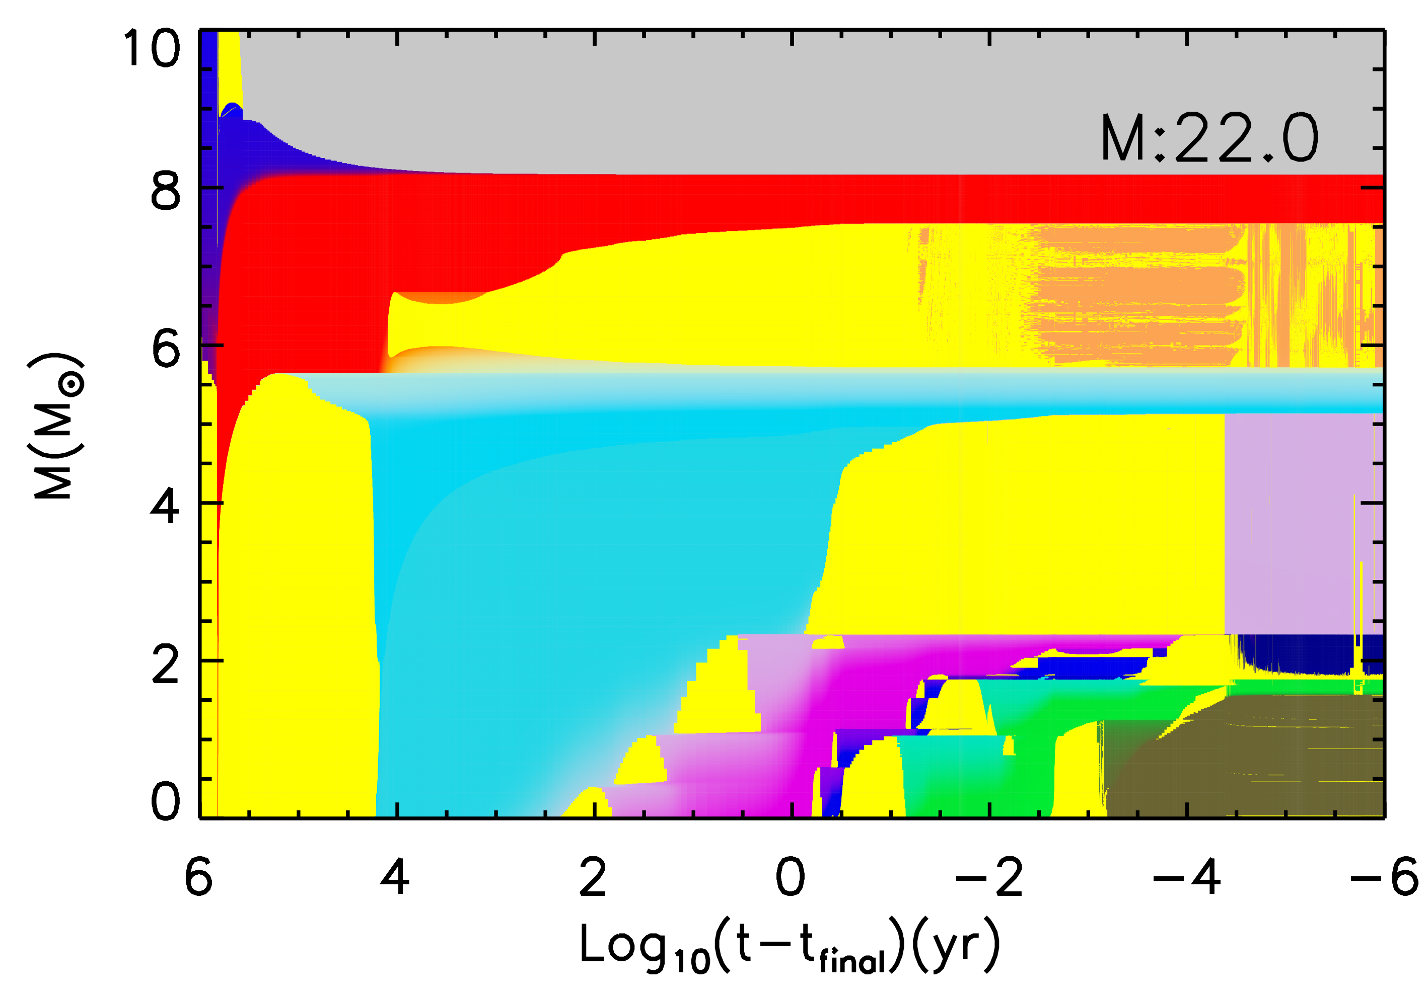
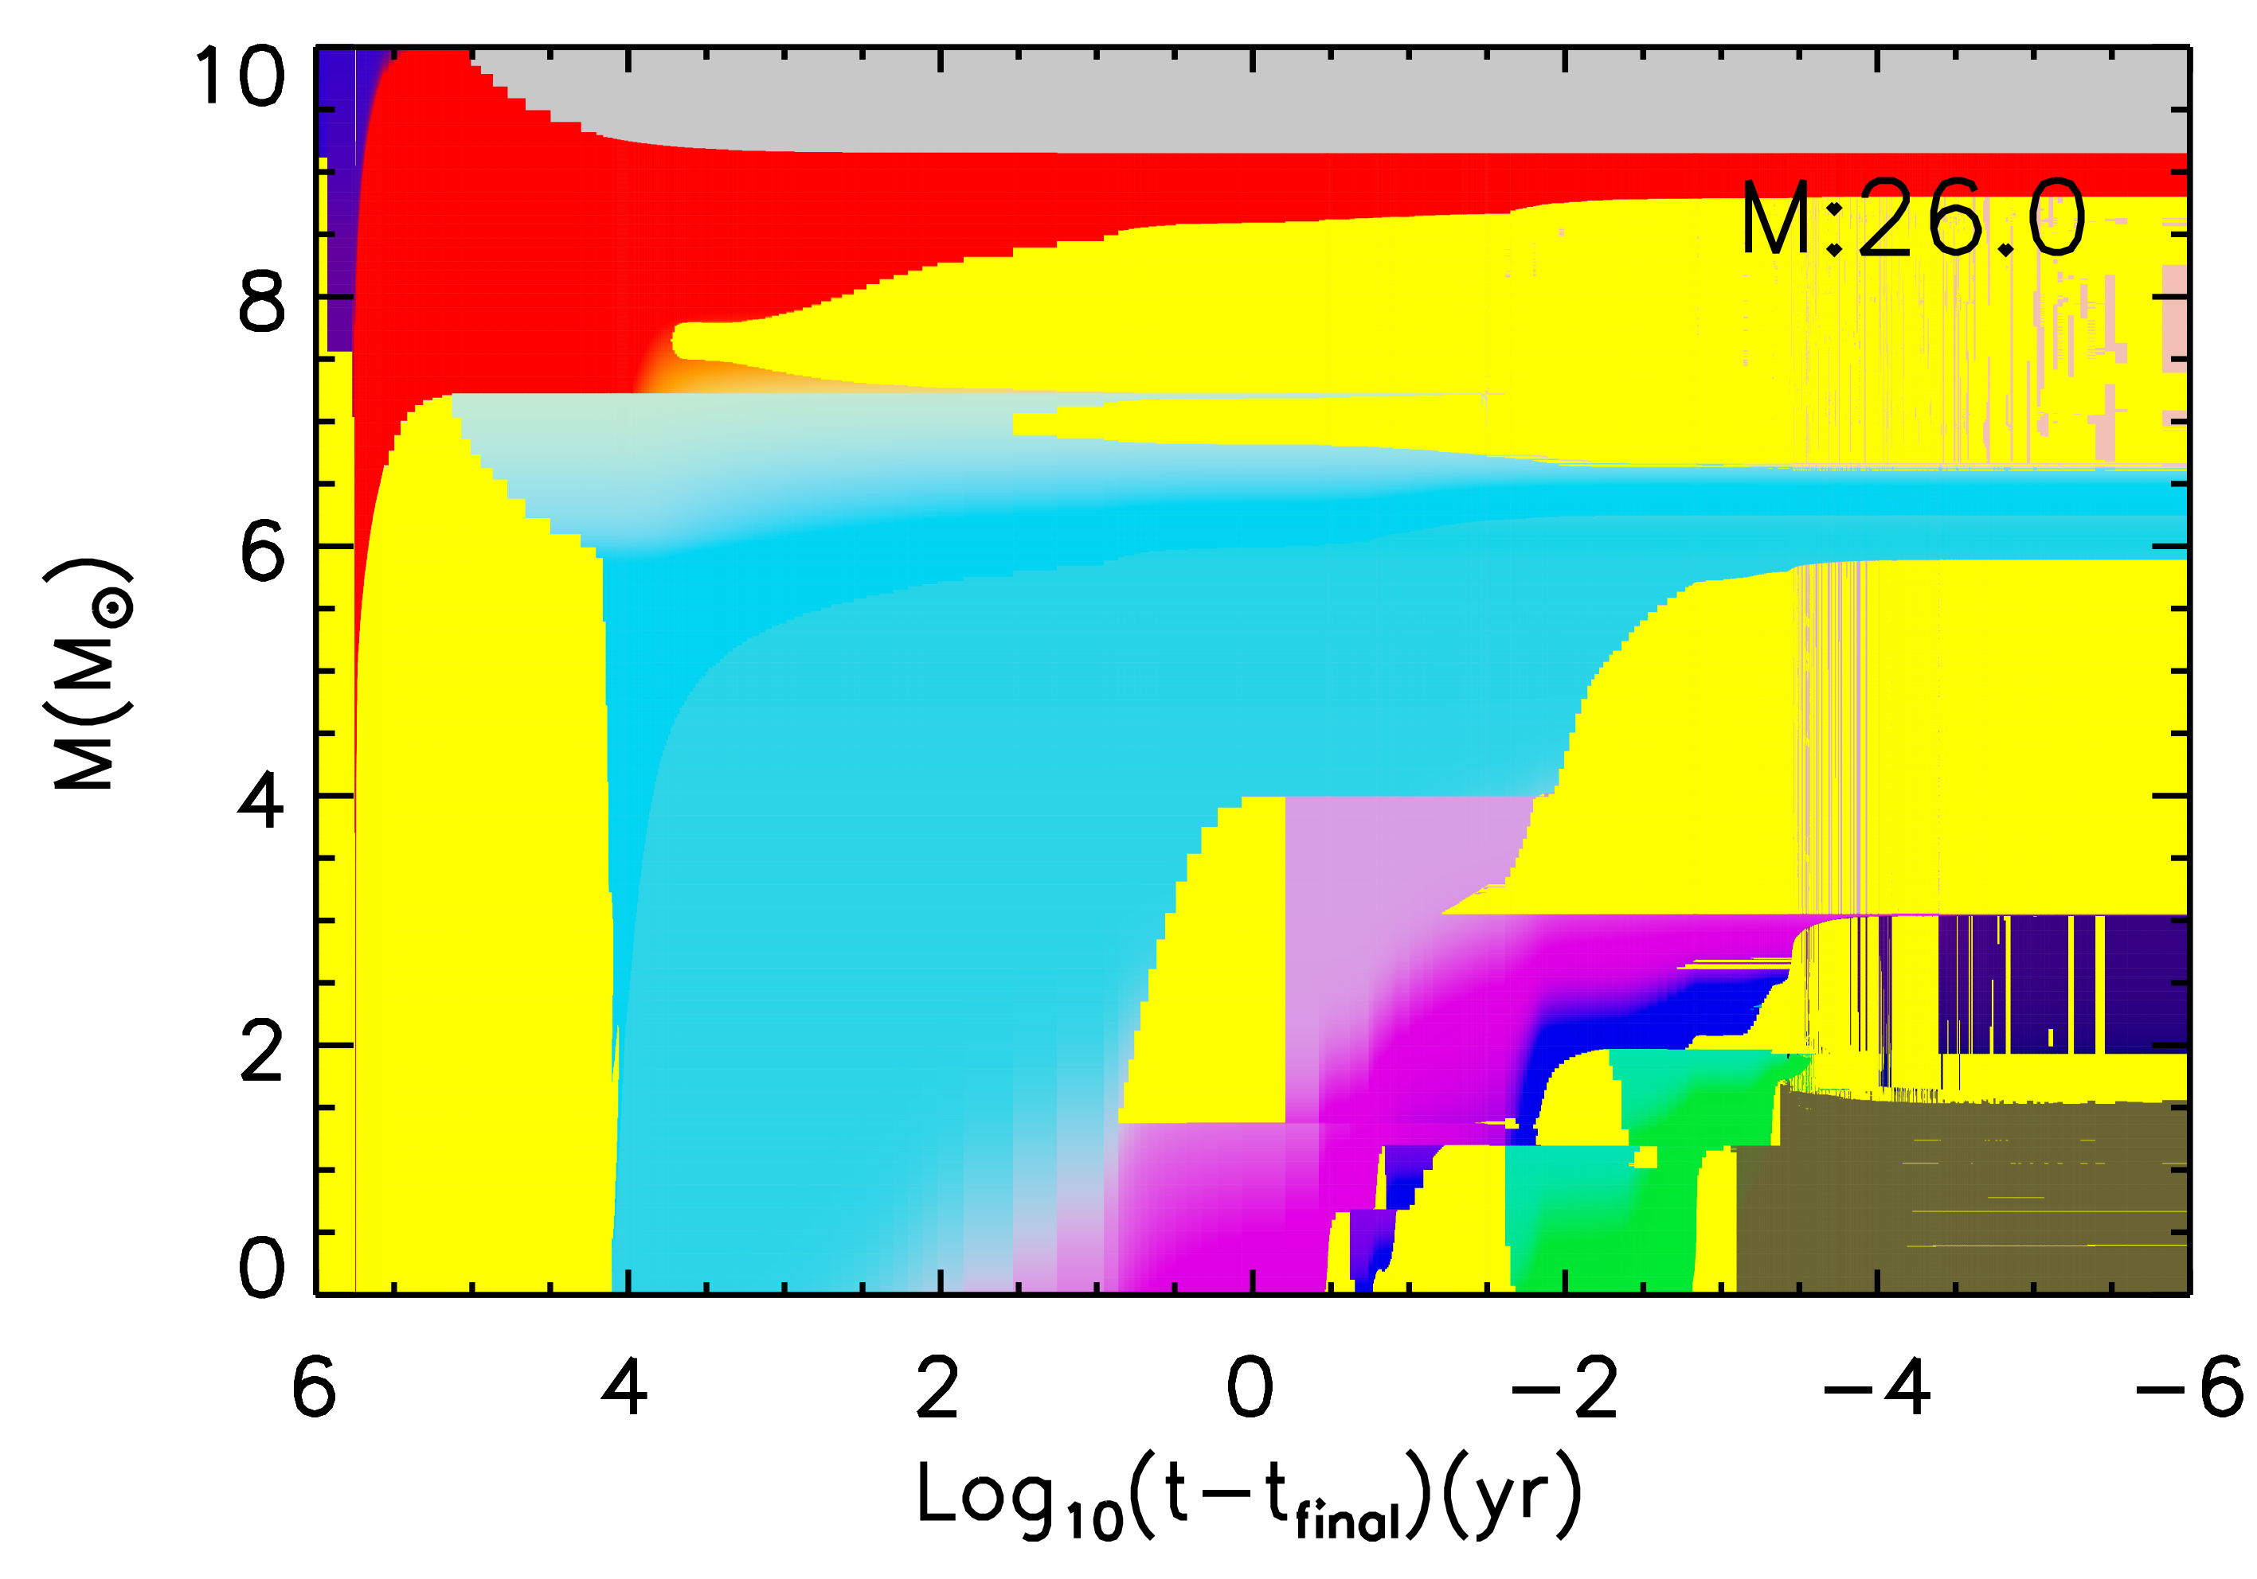
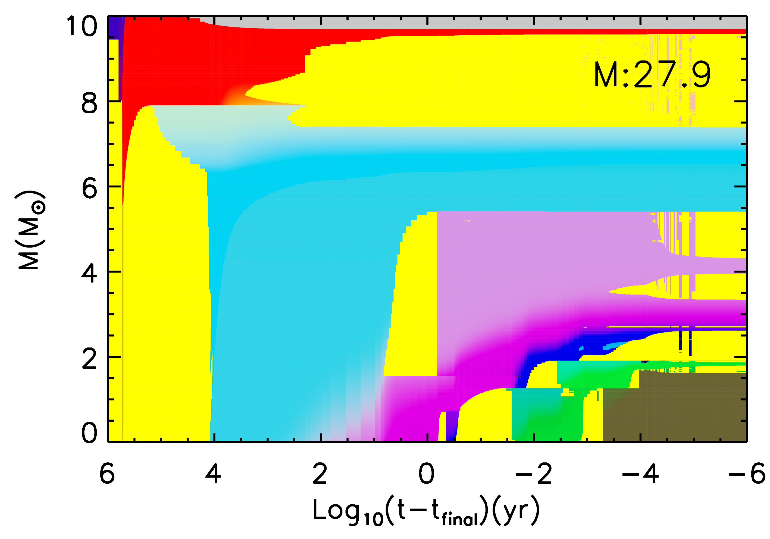
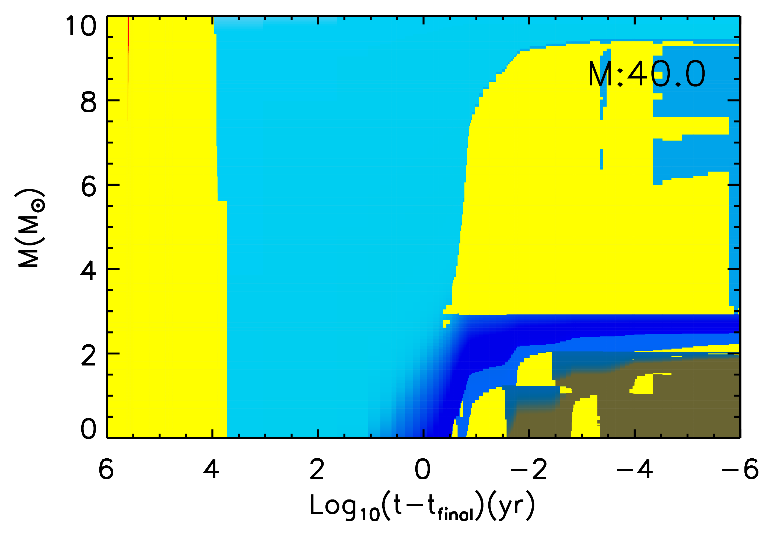
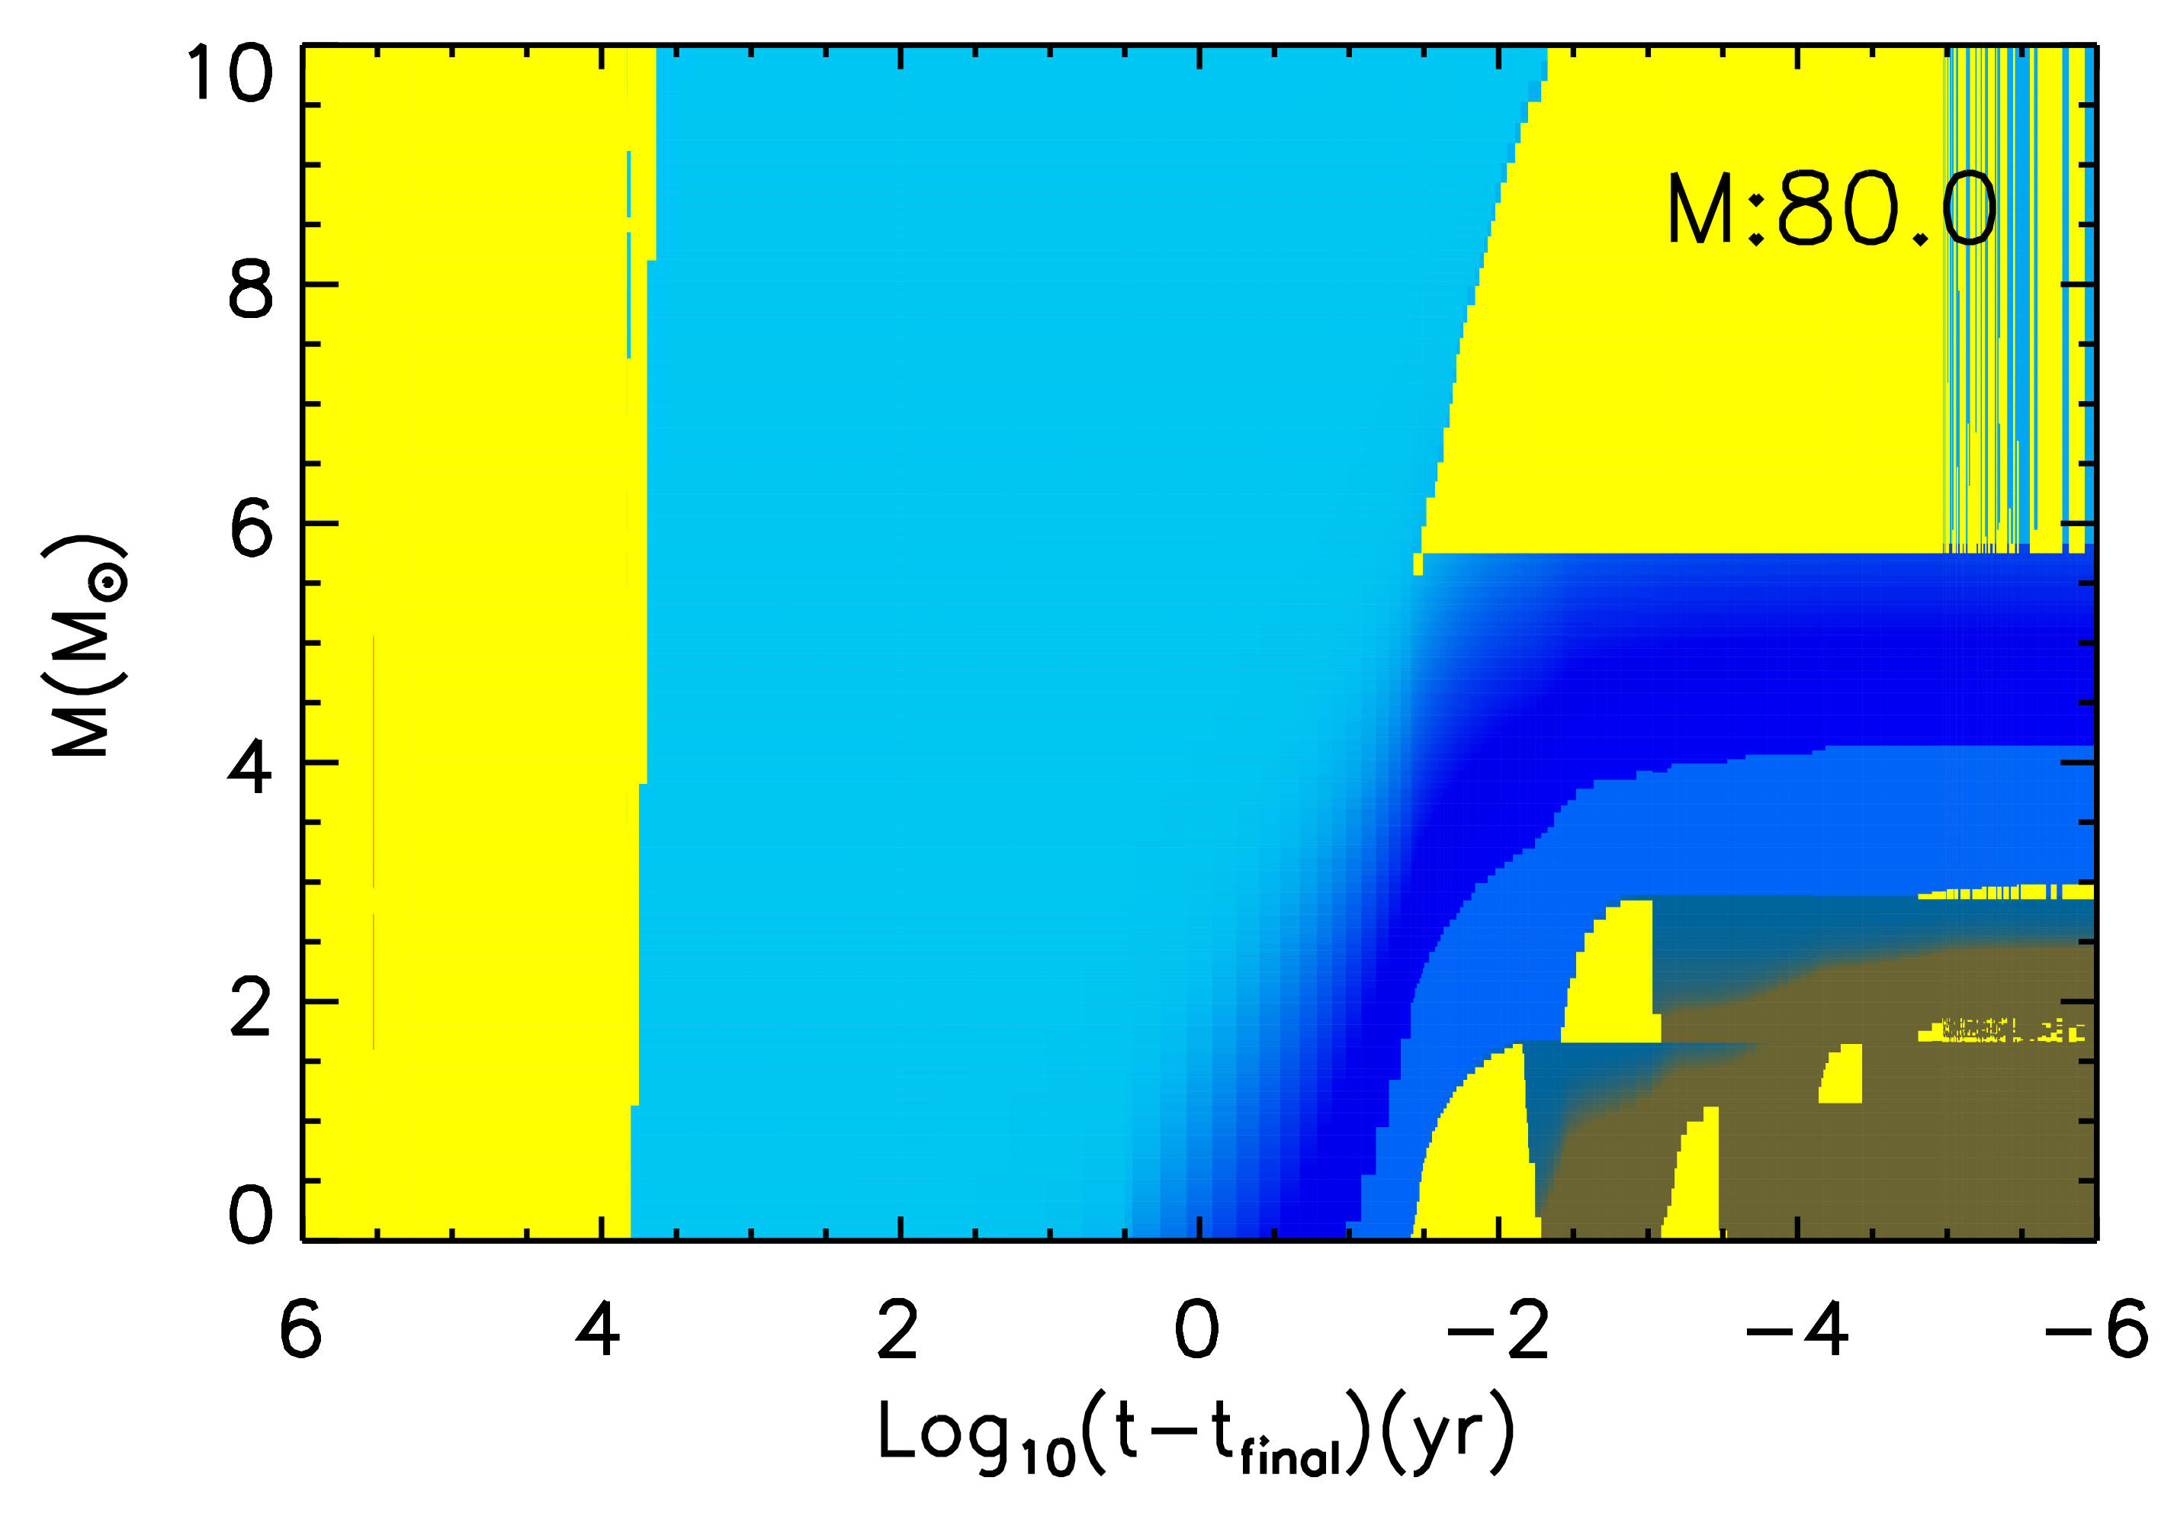
C burning
convective envelope
H
He
convective shell
conv.
core
CO
C
C
C
C
NeO
Chieffi & Limongi (2020) – ApJ 890,43

Slide 15
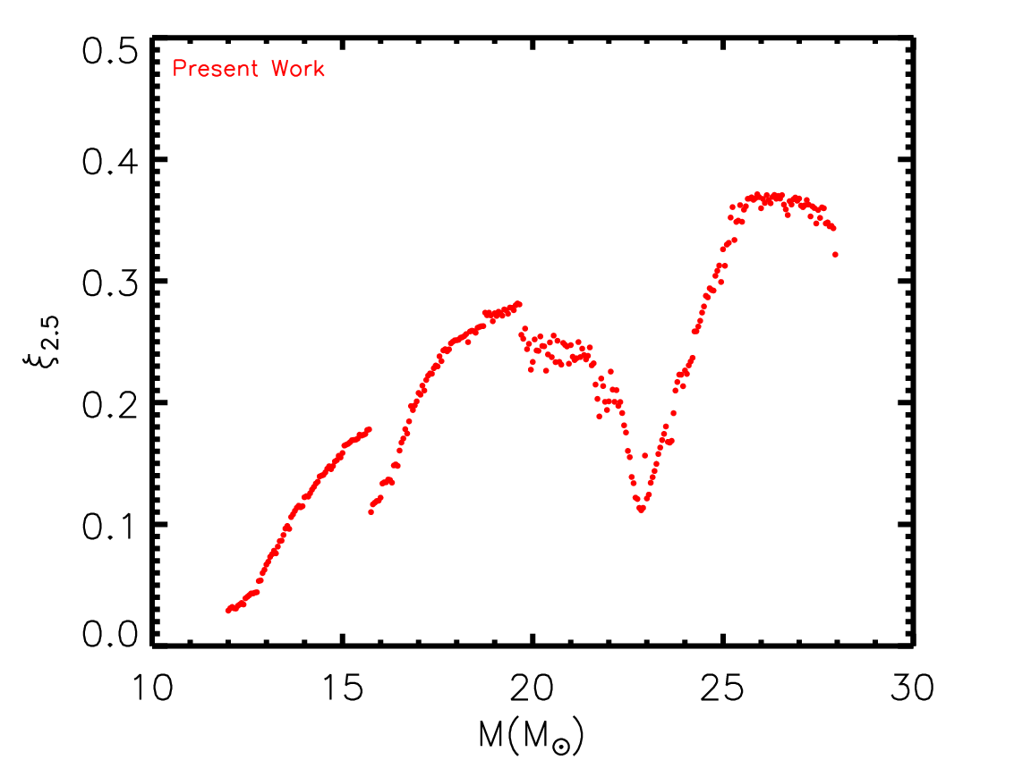

C burning
The final Mass-Radius relation is extremely important because it determines the final binding energy of a star (its compactness) at the beginning of the core collapse.
A simple way to determine how compact a star is at the onset of the core collapse has been proposed by O’ Connor & Ott in 2011 (ApJ 730,70)
Chieffi & Limongi (2020) – ApJ 890,43
Compactness parameter 𝝃
(O’ Connor & Ott 2011, ApJ 730,70)
$$ξi=\frac{Mi(M⦿)}{Ri(103 km)}$$
Best value ➔ i=2.5 M⦿

Slide 16
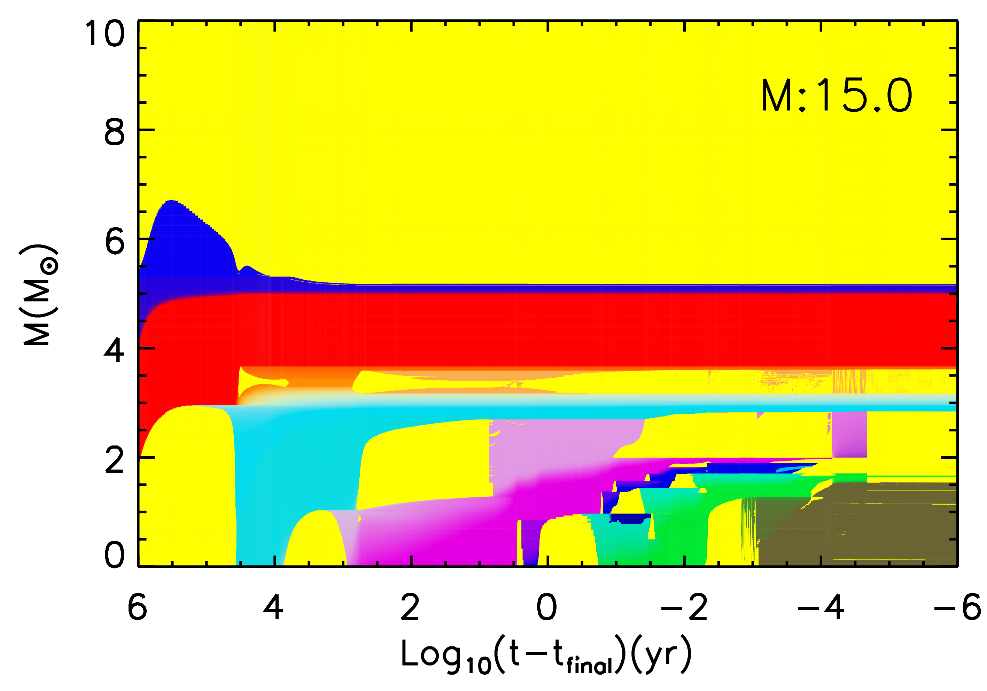
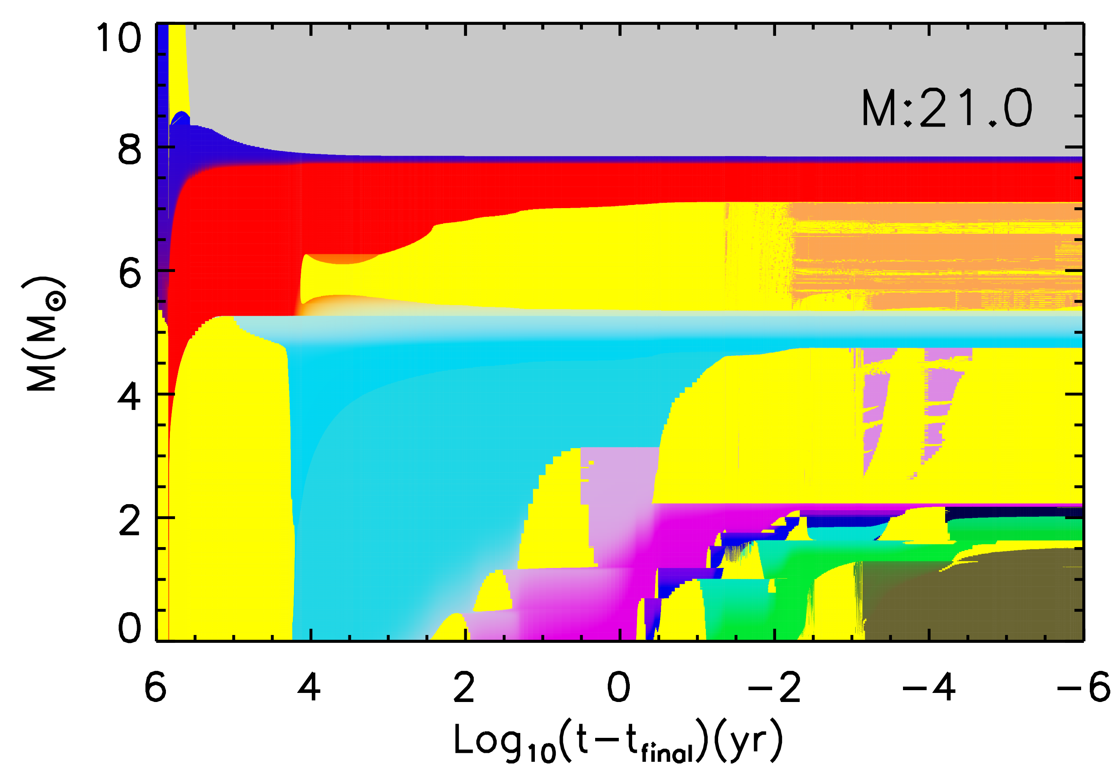
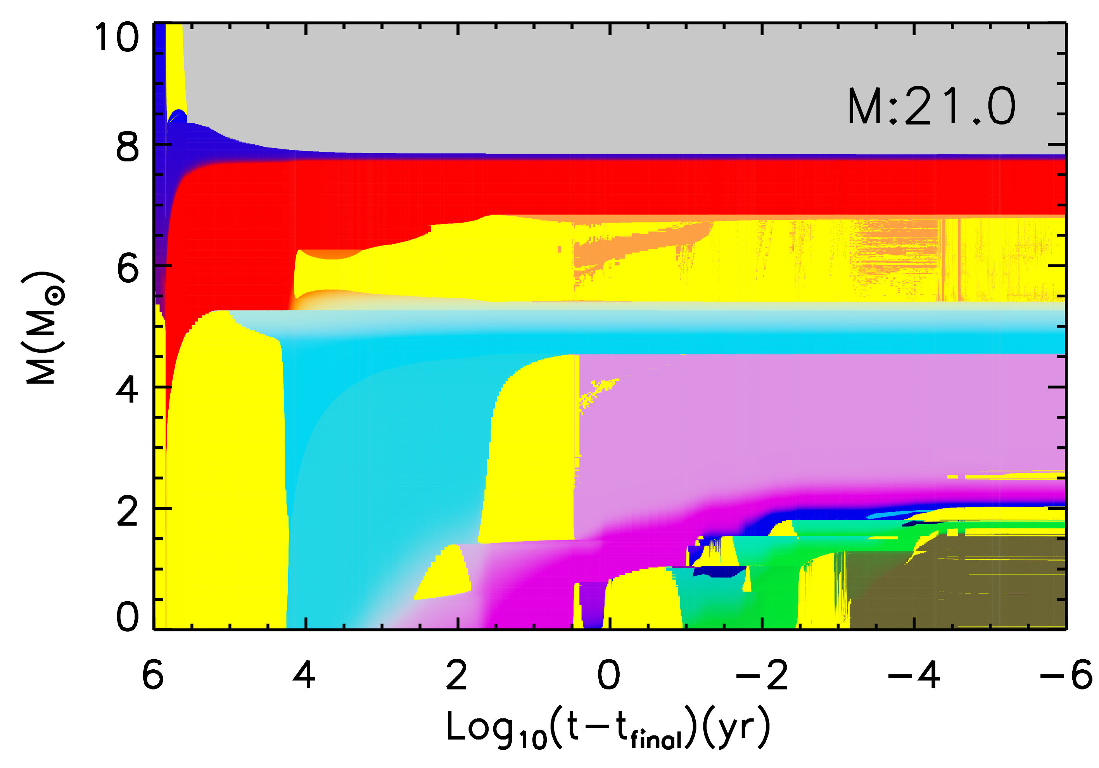
C burning
CF88
THM

Slide 17
C burning
CF88
THM

Slide 18
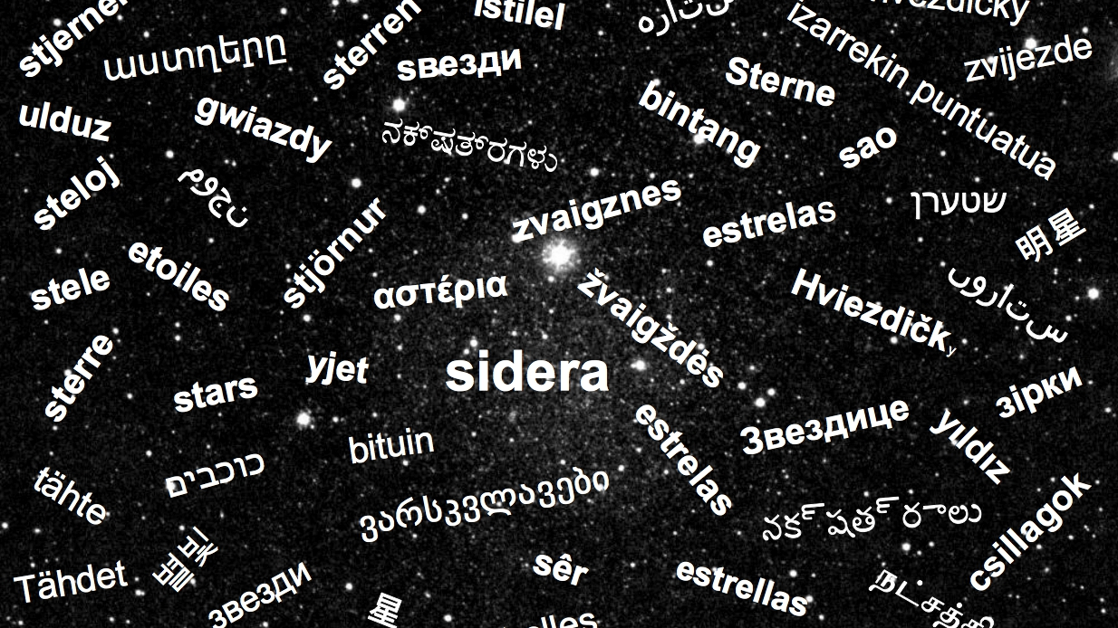
THANK YOU

Slide 19
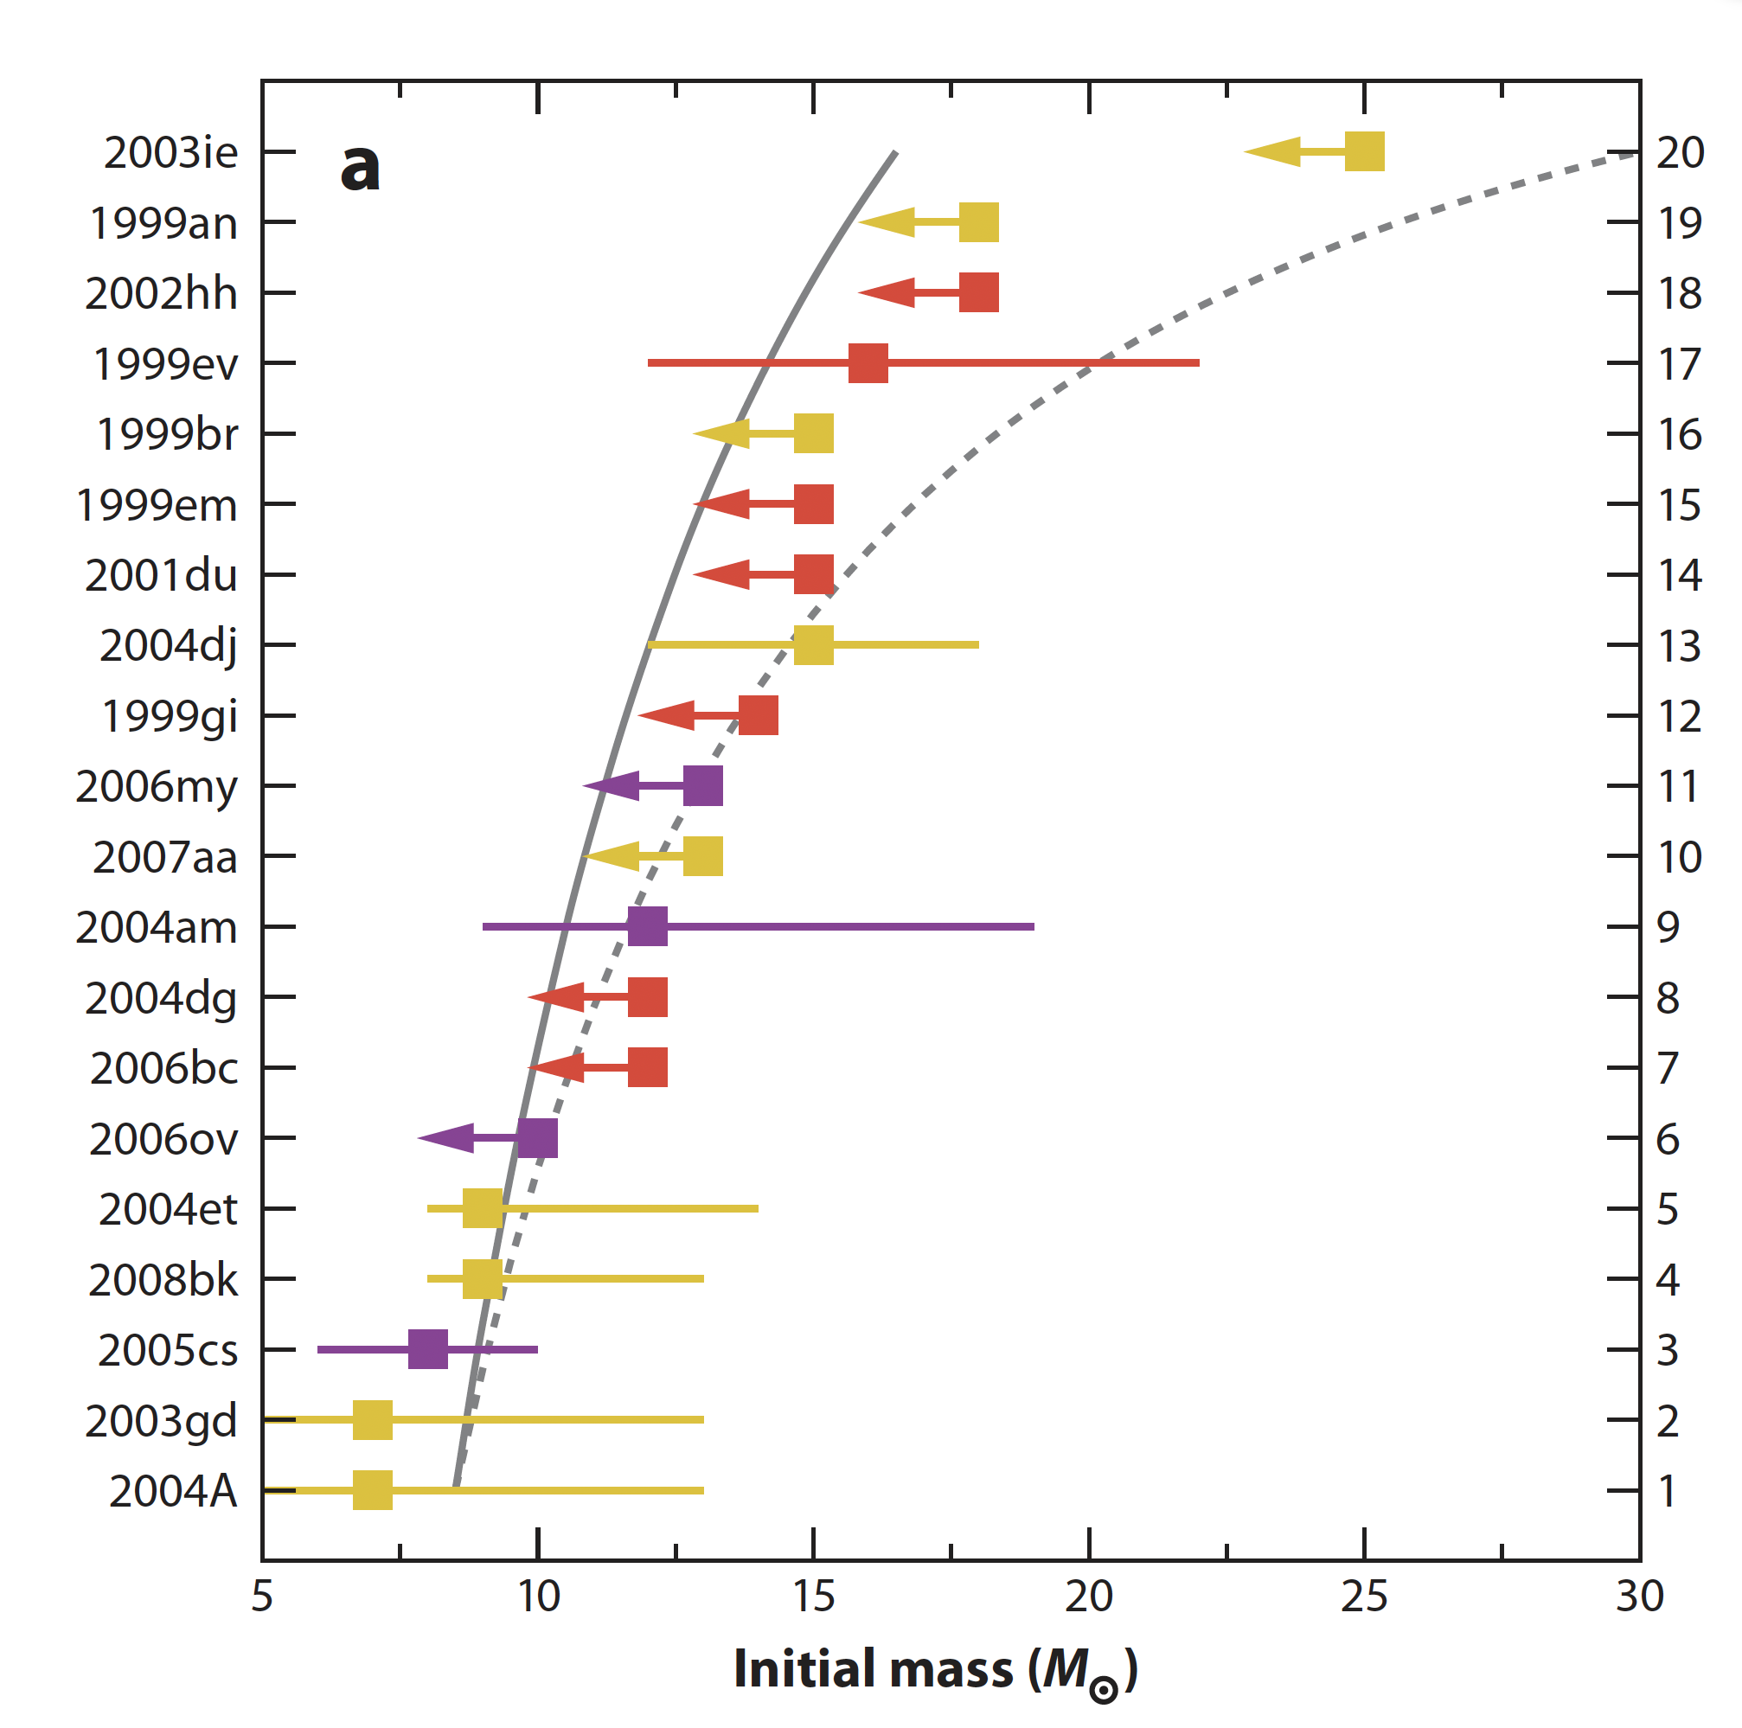
Masses of SN type II P
Smartt+ (2009) 47,63

Slide 20
C burning: who was it?
Carneade, chi era costui? (I promessi sposi – Alessandro Manzoni)
In order to understand the role of the ¹²C¹²C nuclear reaction rate we must first understand the pecularities of the C burning with respect to the other burnings
In both H and He burning the amount of fuel available for the burning does not depend on the mass: the only parameter that controls the H/He burning is the mass (the initial mass in H burning and the He core mass in He burning)
Uni-parametric family of models
In C burning the amount of fuel available for the burning depends on the mass (He core mass) because of the interplay among 3𝛼, ¹²C(𝛼,𝛾)¹⁶O and mixing: two parameters control the C burning: the CO core mass and the fraction of ¹²C left by the He burning
Bi-parametric family of models
The shell burning plays a CRUCIAL role in the evolution of the inner core

Slide 21
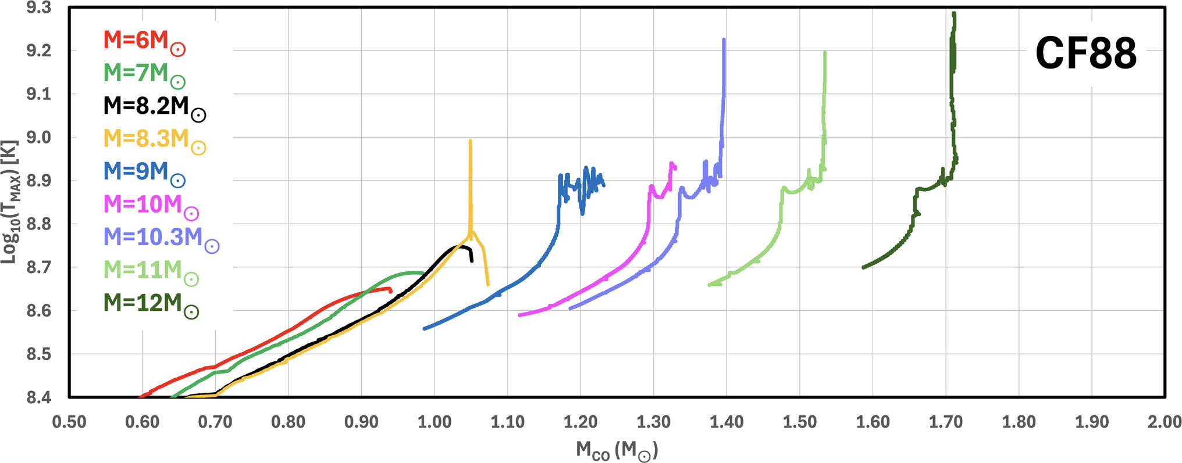
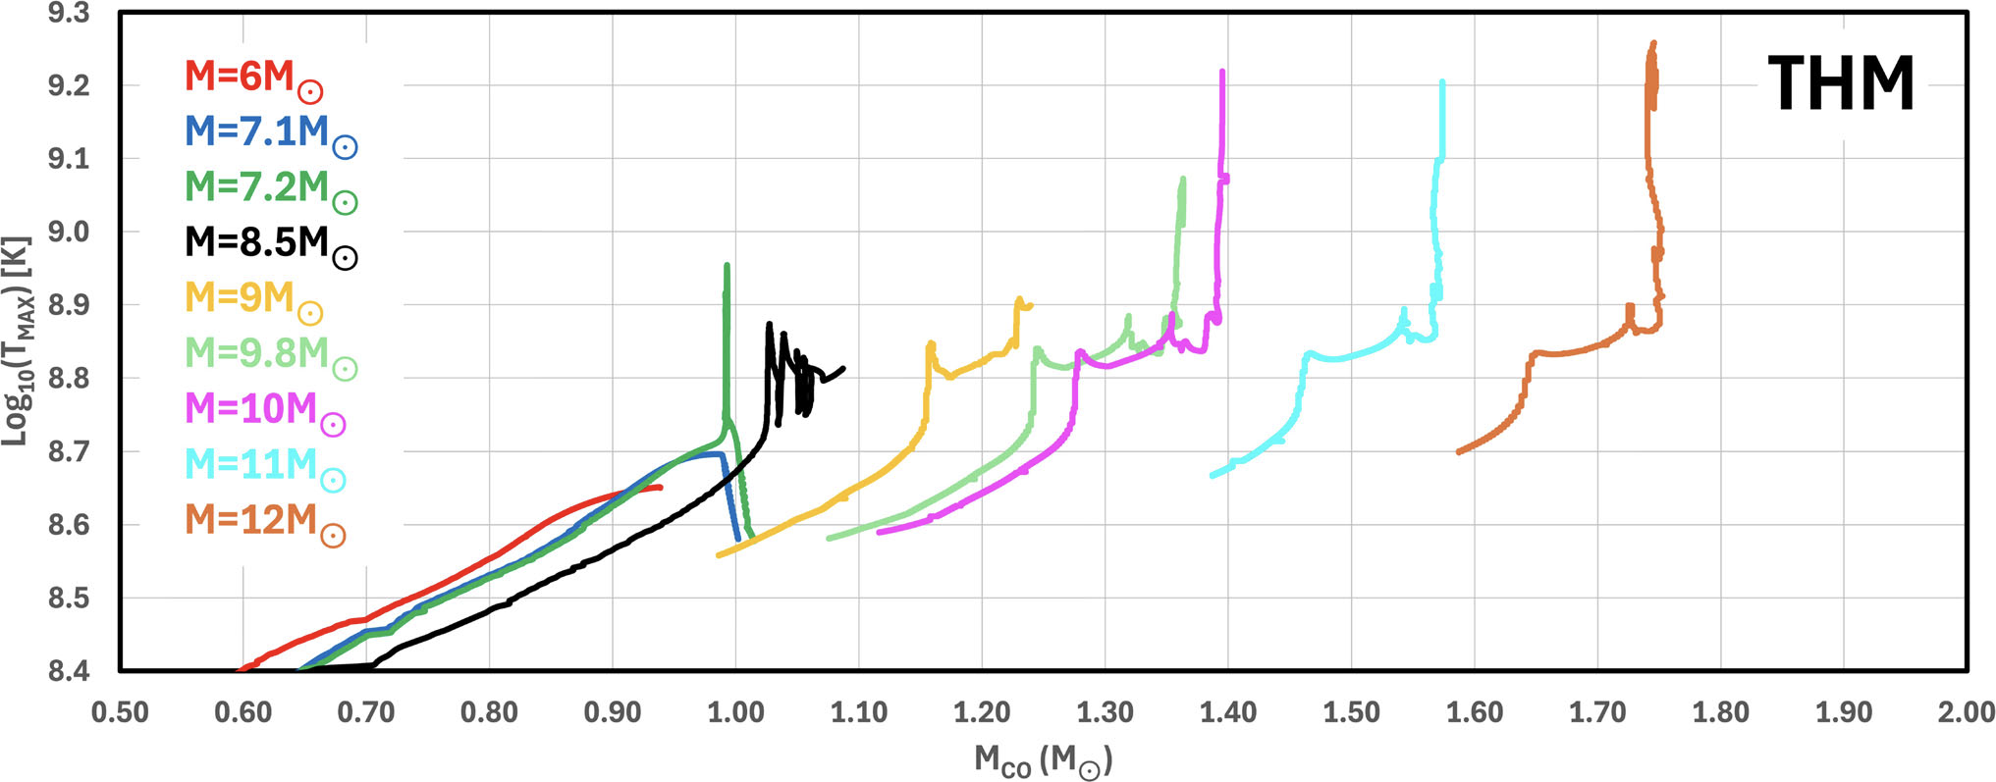
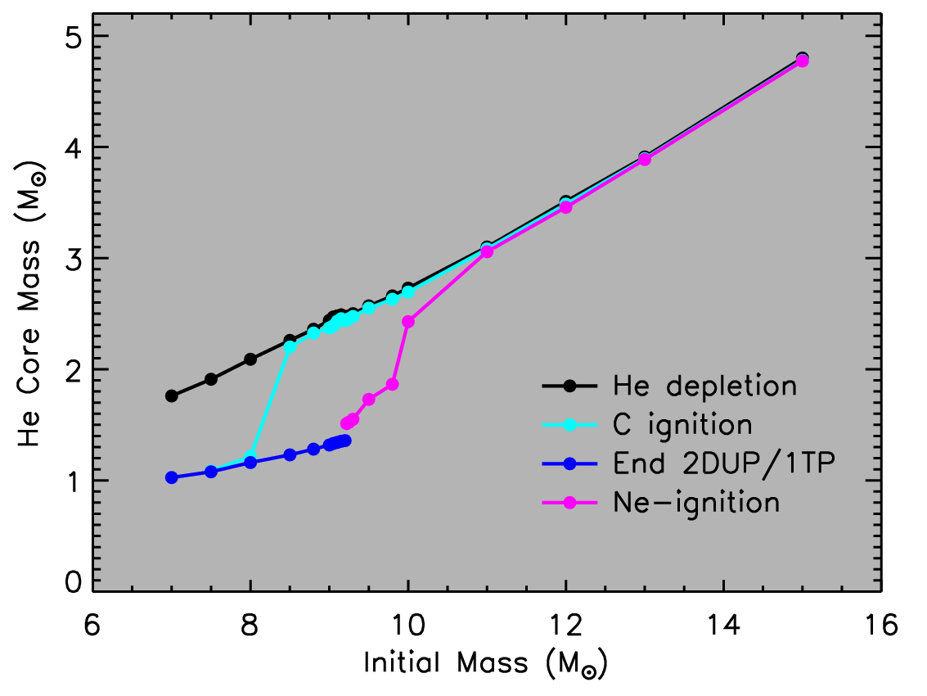
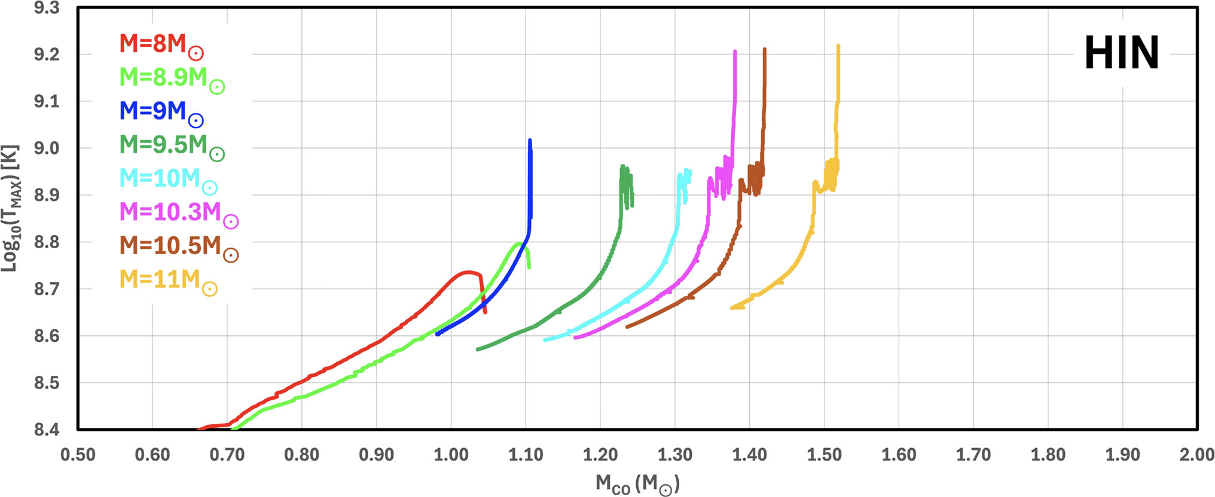
Chieffi + Eur. Phys. J. A (2025) 61:280
Limongi + 2024 ApJS 270,29
Chieffi + Eur. Phys. J. A (2025) 61:280

Slide 22
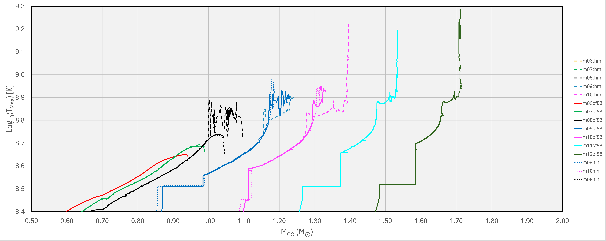
SOLID – CF88
DASHED – THM
DOTTED - HIN

Slide 23
Carbon burning and Type I a Supernova Luciano Piersanti
12C+12C and 12C+160 reaction rates and stellar evolution – Thibaud Dumont
Impact of 12C+12C on intermediate-mass stars and massive white dwarfs – Marcelo Bertolami
17. Impact of 12C+12C on massive stars nucleosynthesis of the elements heavier than iron Marco Pignatari
5. Impact of 12C+12C on massive stars nucleosynthesis in general – Lorenzo Roberti
The impact of the carbon fusion rate for superbursts – Martin Callejas
Low mass density deflagration burning led to premature type Iax supernovae – Amir Michaelis

Slide 24
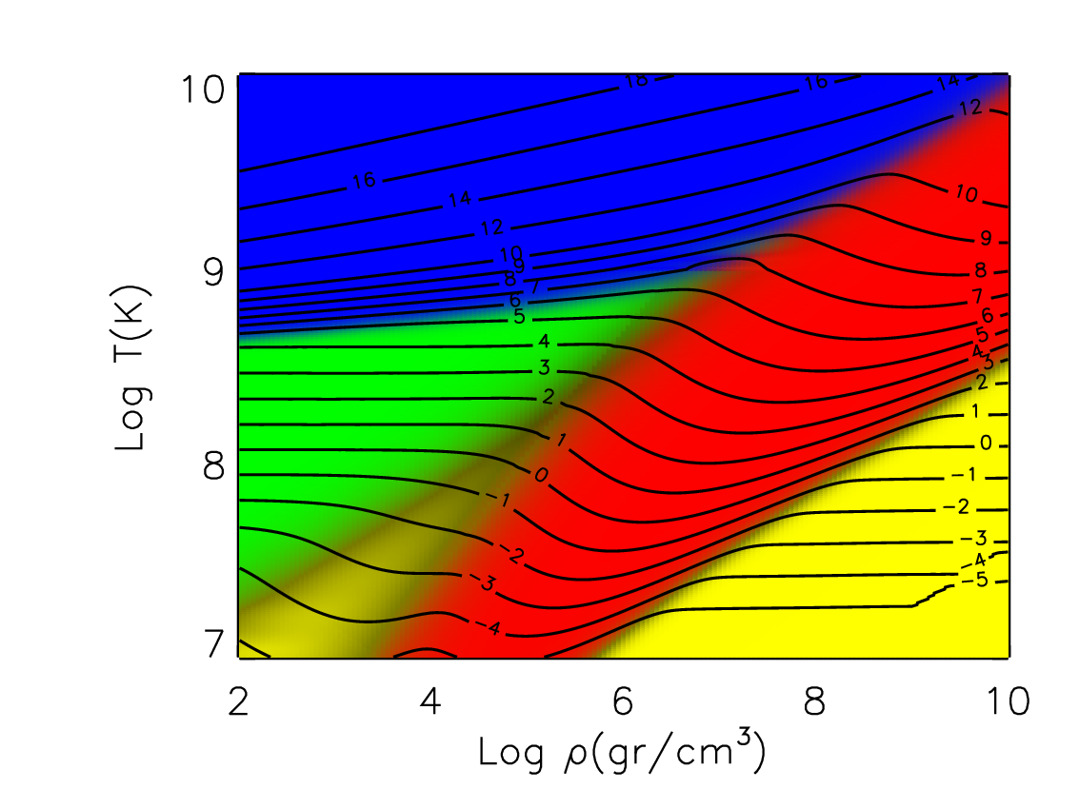




perdite di energia per neutrini
Plasma neutrinos
Photo neutrinos
Pair neutrinos
Bremstrahlung

