Slide 1
Radionuclide production technologies at INFN-LNL
The ISOLPHARM and LARAMED projects
Aurora Leso
UniFe, INFN-LNL

Slide 2
Outline
The ISOLPHARM project
Production of radionuclides of medical interest through the ISOL technique
The ISOLPHARM_EIRA experiment (2020-2022)
The ADMIRAL experiment (2023-2025)
The LARAMED project
The LARAMED facility

Slide 3
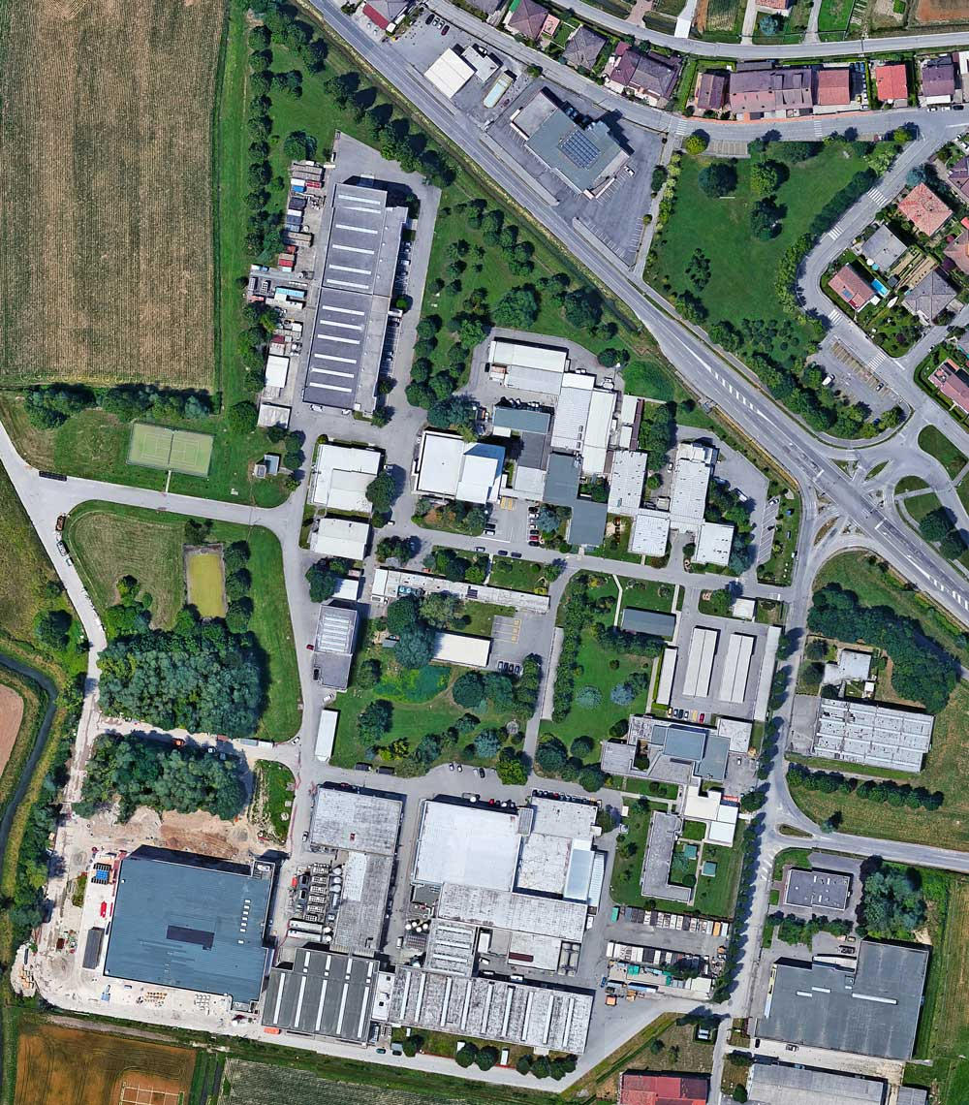
The “Radioisotopes for Medicine and Applied Physics” service
Led by LNL-INFN

Slide 4
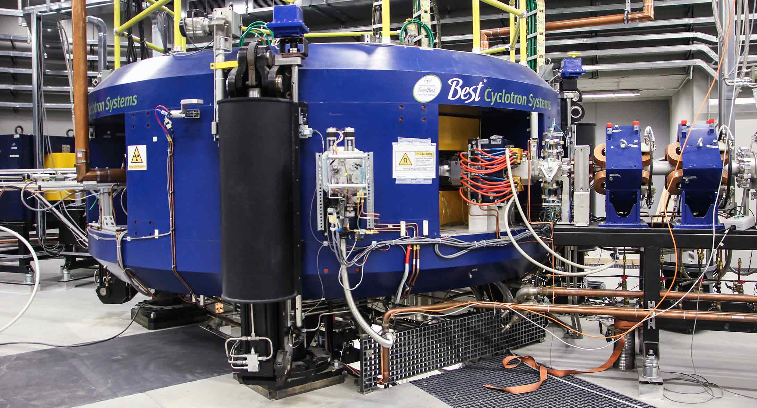
The “Radioisotopes for Medicine and Applied Physics” service
Led by LNL-INFN
Produce high-purity radioisotopes using the second-generation ISOL facility SPES.

Slide 5
The “Radioisotopes for Medicine and Applied Physics” service
ISOL technology
https://isolpharm.pd.infn.it/web//

Slide 6
The ISOLPHARM project
Led by LNL-INFN
Produce high-purity radioisotopes using the second-generation ISOL facility SPES.
3 experiments conducted up to now
2018-2019
2020-2022
2023-2025

Slide 7
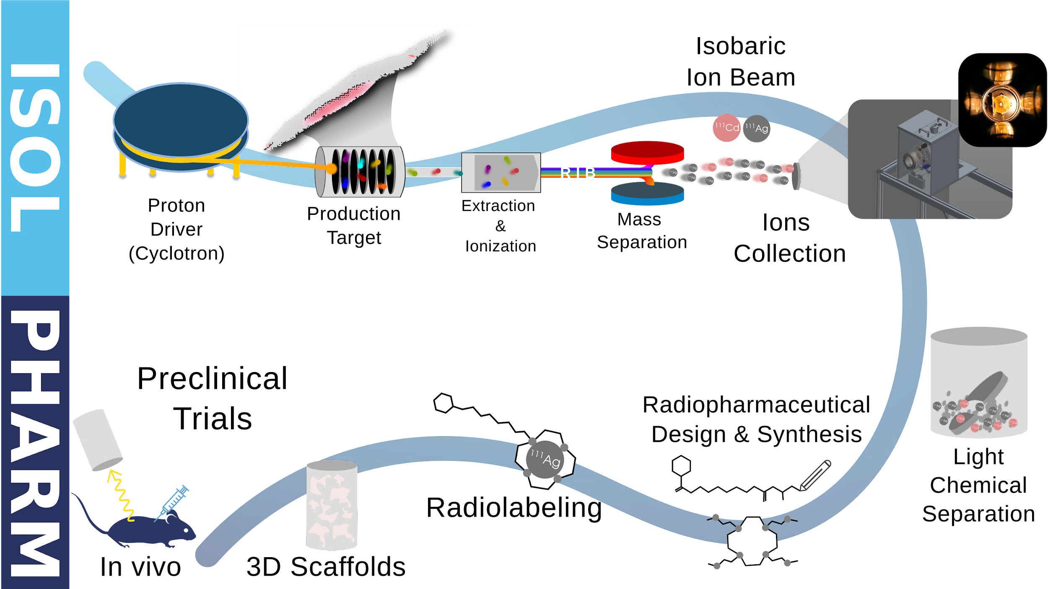
The ISOLPHARM method
The ISOLPHARM project aims to study innovative radiopharmaceuticals for targeted radionuclide therapy
The focus is on ¹¹¹Ag, a β-emitter with potential theranostic applications.

Slide 8
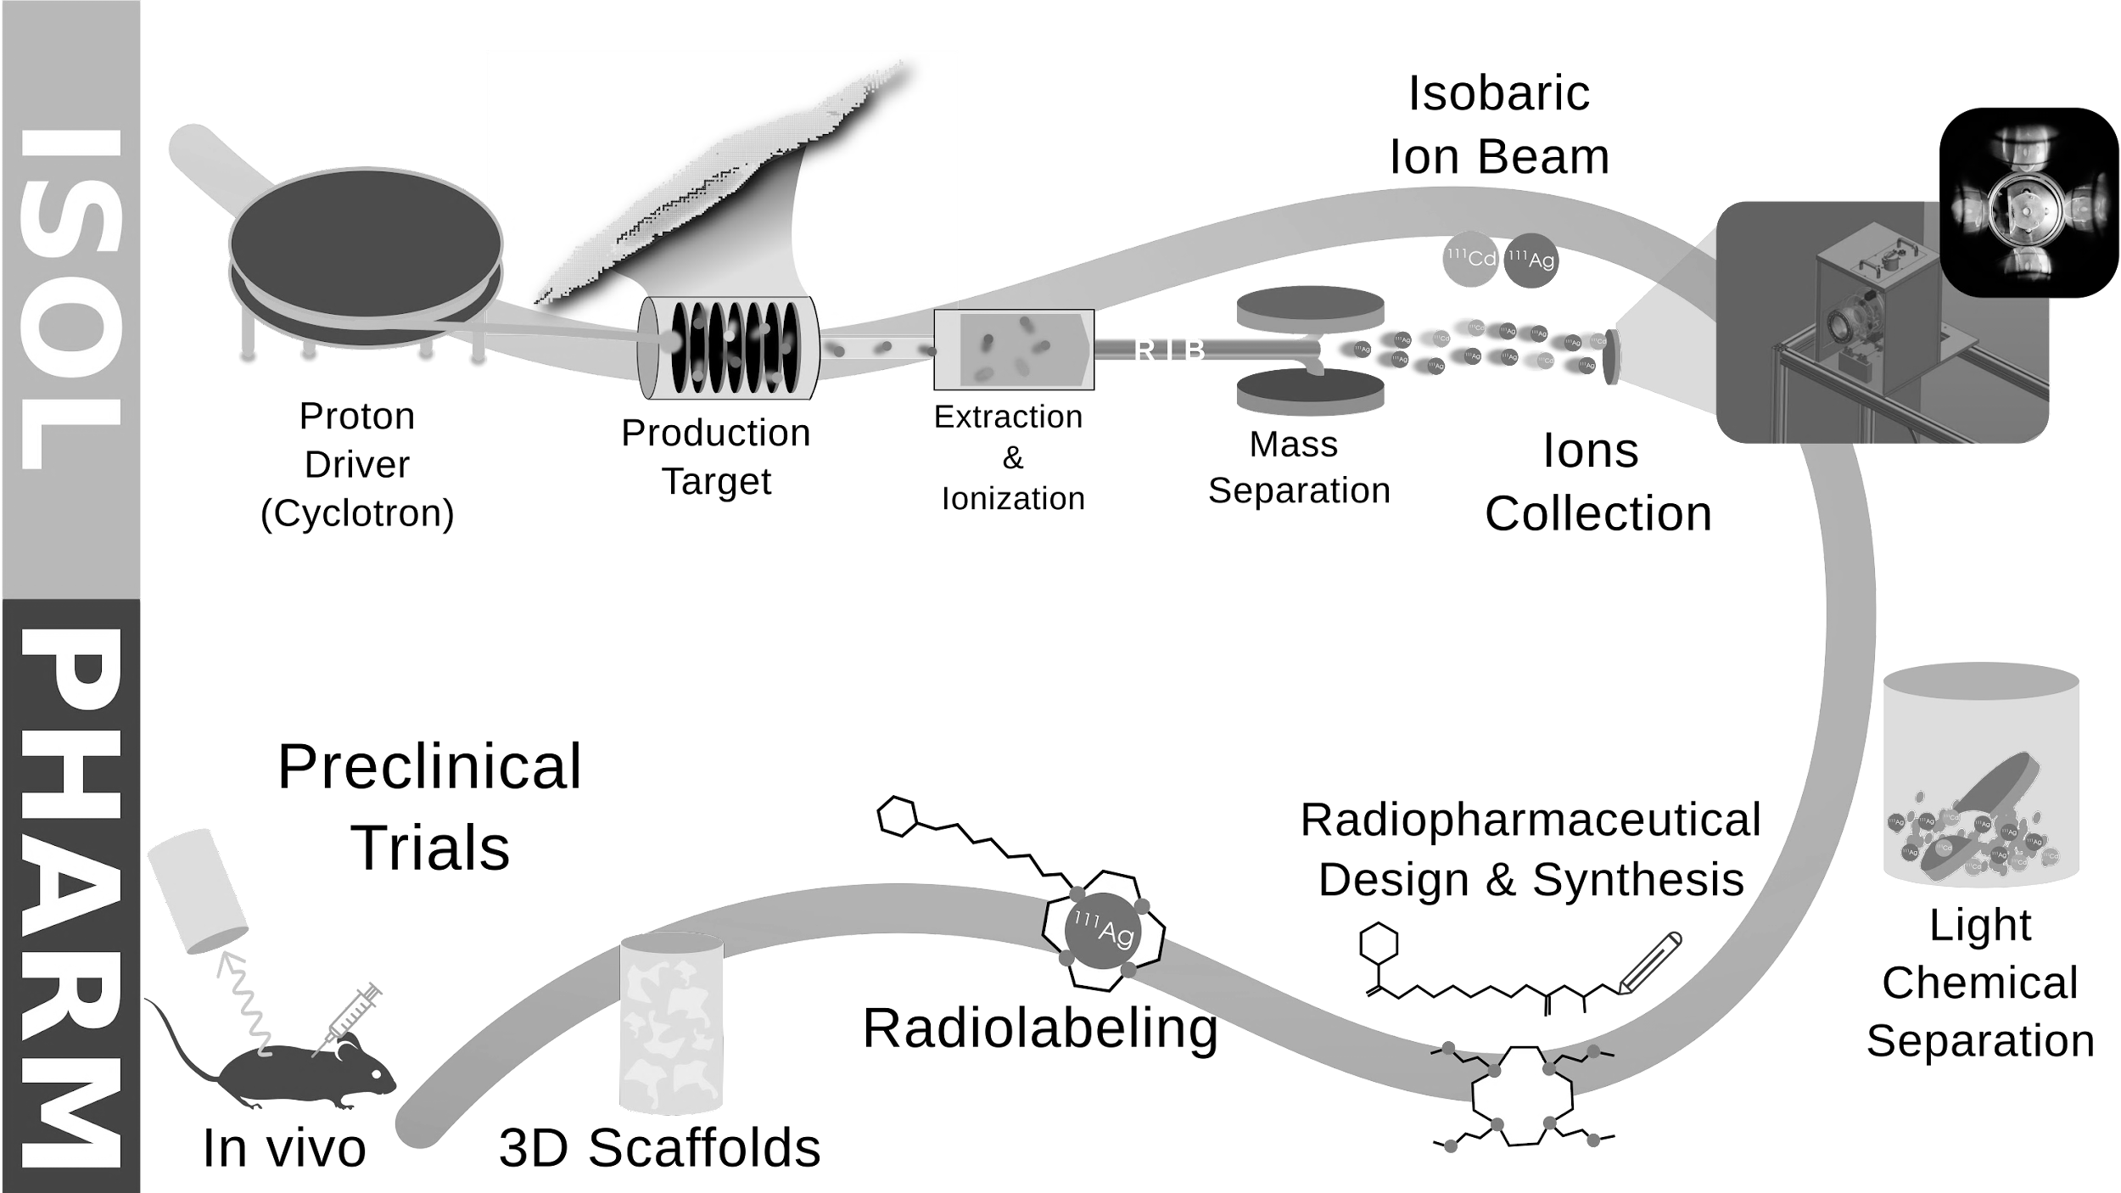

Slide 9
The primary proton driver is a B70 cyclotron produced by BEST Cyclotron System:
Protons of energy 30 – 70 MeV, max current intensity of 750 µA.​
Beam can be modulated and divided into two beams, extracted at the same energy.

Slide 10
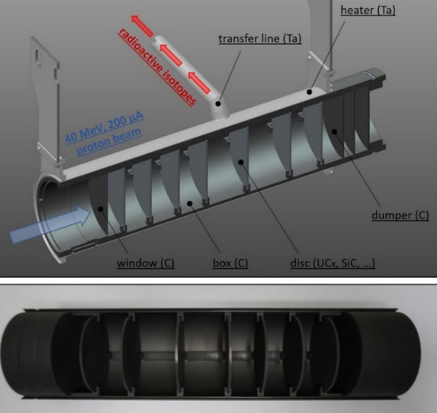
7 disk-shaped targets spaced to dissipate the energy deposited.
8 kW of power deposited using 200 µA 40 MeV beam, giving a temperature of almost 2000 °C.

Slide 11
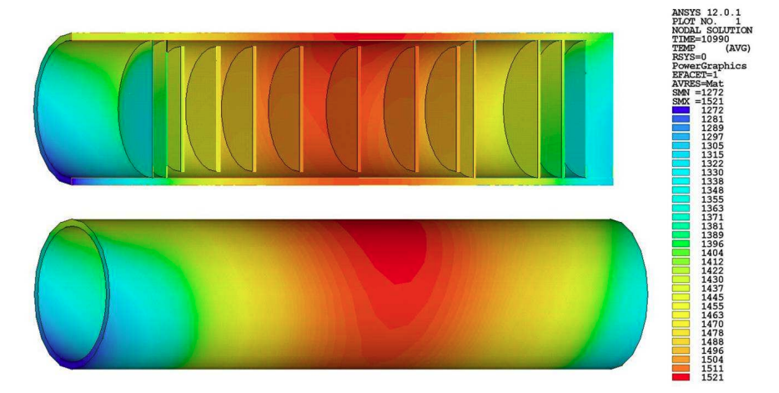
7 disk-shaped targets spaced to dissipate the energy deposited.
8 kW of power deposited using 200 µA 40 MeV beam, giving a temperature of almost 2000 °C.
Temperature distribution as calculated with ANSYS® when the target is impinged by
the proton beam.
Disk spacing was designed to guarantee a homogeneous temperature level in the target.

Slide 12
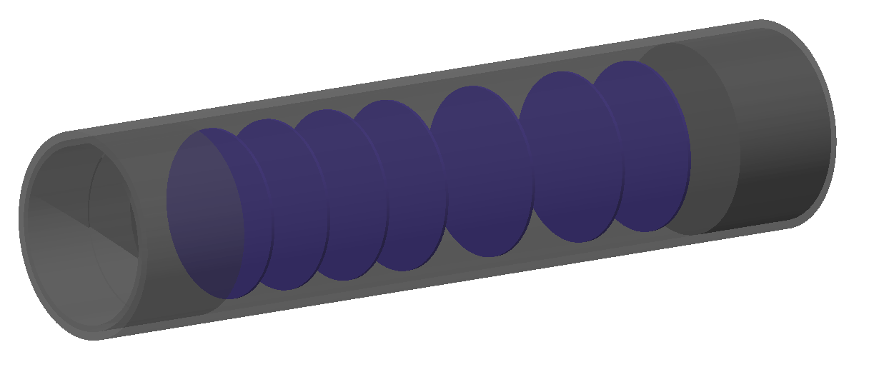
Changing primary target material allow to populate different regions of the nuclide chart.
Proton-induced fission of ²³⁸UC_{X} disks used to produce a wide range of neutron-rich radionuclides.
Protons
Neutrons
Nuclide | Yield [pps]
Silver-111 | 1.41 x 10⁸
Cesium-136 | 8.00 x 10⁹
Iodine-131 | 1.55 x 10¹⁰
Proton Beam
FLUKA Monte Carlo simulation of the target

Slide 13
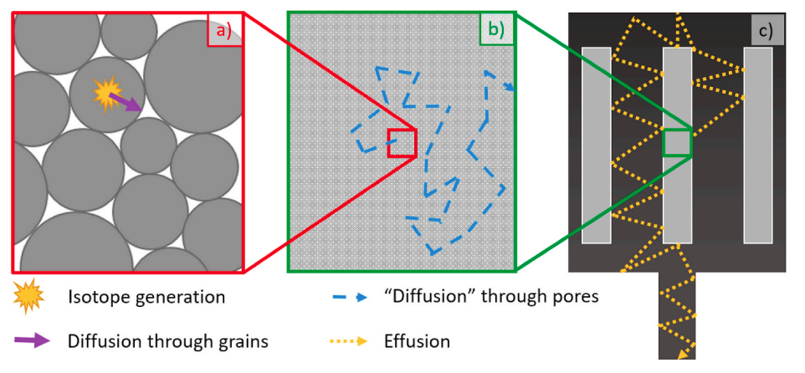
Nuclei diffuse through target grains and material pores up to target chamber, where it escapes through a dedicated cavity.
Diffusion and effusion processes mediated by the target high temperature.
The overall extraction efficiency is strongly influenced by the whole system geometry.

Slide 14
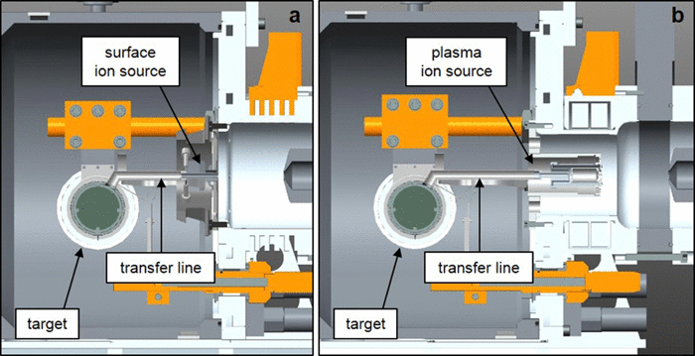
Before acceleration, nuclei are ionized.
Different ionization technologies:
Surface Ion Source (SIS)
Plasma Ion Source (PIS)
Laser Ion Source (LIS)
Selection of the ionization technology depends on the first ionization potential of the chemical element.

Slide 15
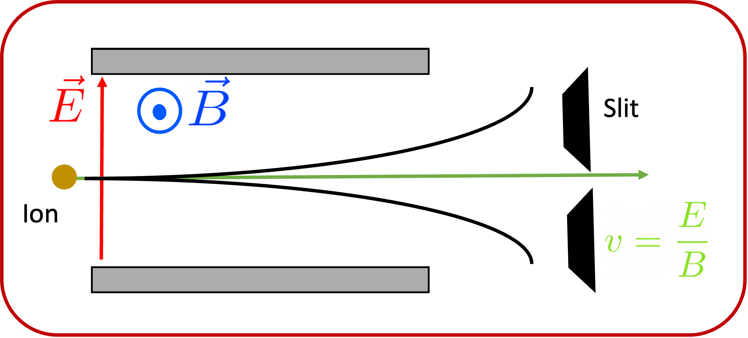
Exotic species are extracted by a potential difference between the Target-Ion-Source (25 kV) and an extraction electrode (ground potential).
Various masses are singly charged and accelerated at almost same energy, so the mass separation is done by a velocity filter.

Slide 17
The so obtained RIB is deposited onto a dedicated deposition target. Many non-metallic or salt-based materials were tested.
Optimizing radionuclide recovery
Reducing the amount of metallic impurities

Slide 18
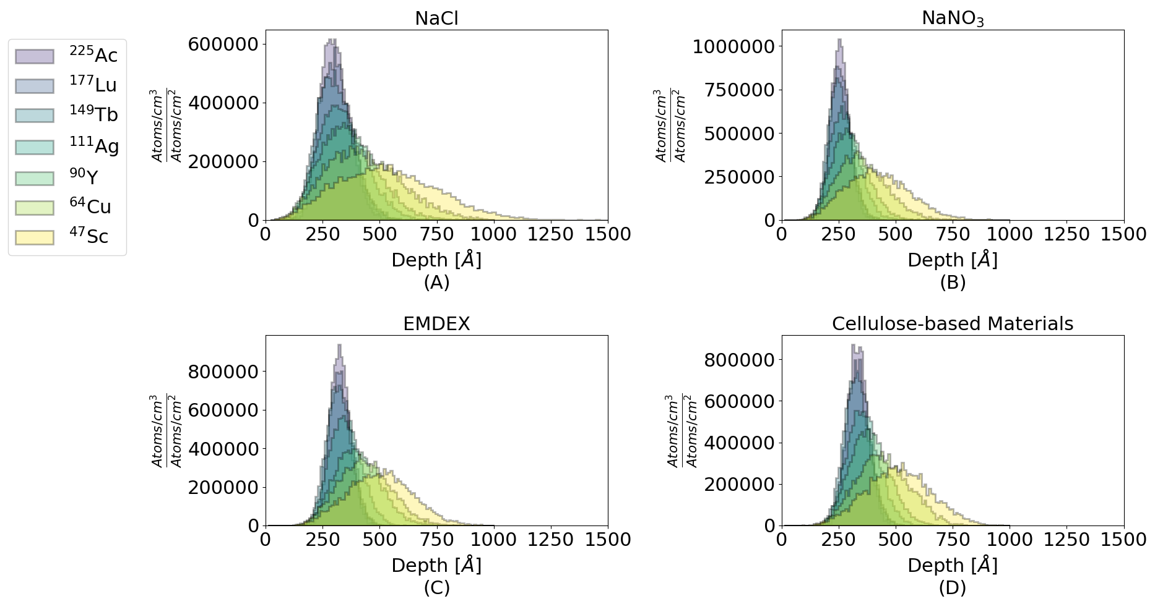
The so obtained RIB is deposited onto a dedicated deposition target. Many non-metallic or salt-based materials were tested.
Optimizing radionuclide recovery
Reducing the amount of metallic impurities
SRIM simulation of the ion distribution along the implantation axis for different target materials
M. Ballan, E. Vettorato et al. Applied Radiation and Isotopes, 2021

Slide 19
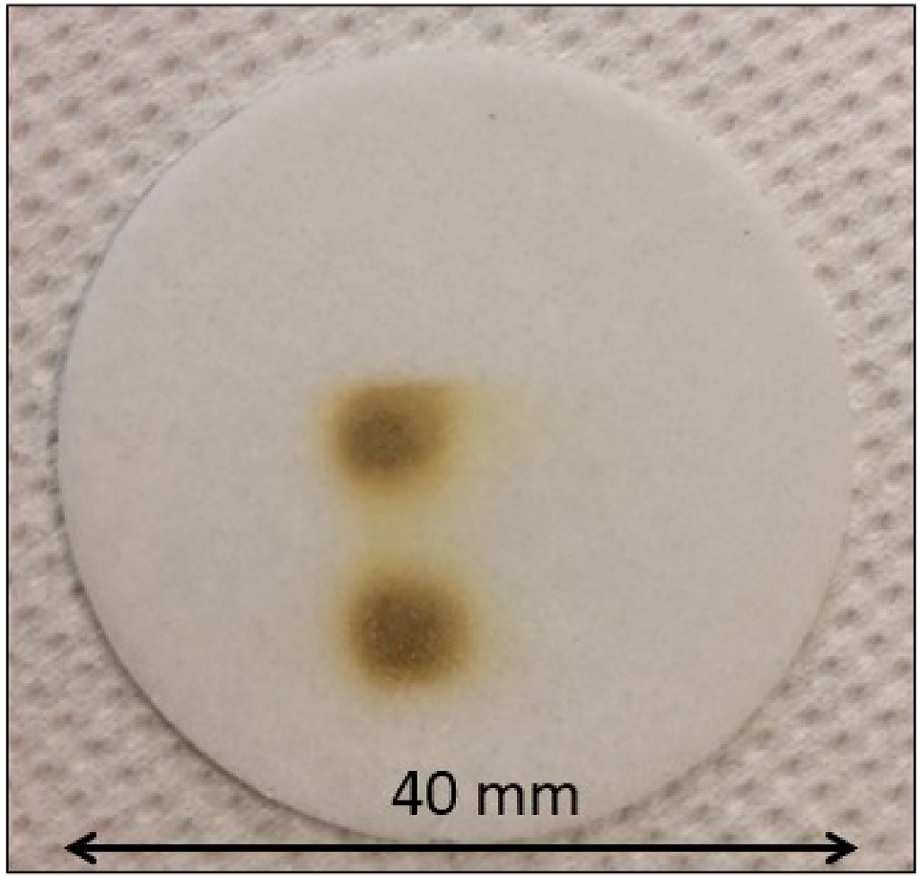
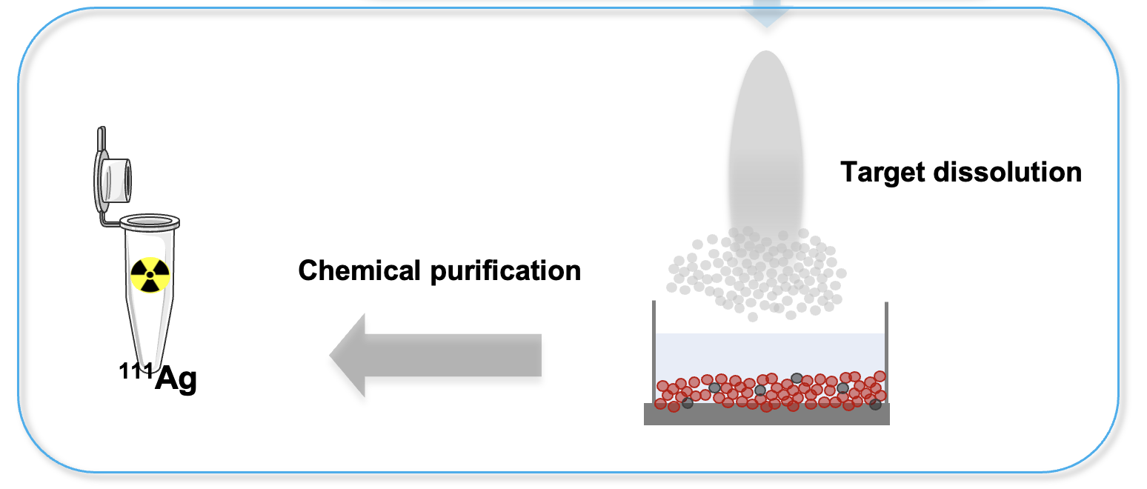
Different materials to get the highest resistance and the best radionuclide recovery
¹⁰⁷Ag and ¹⁰⁹Ag

Slide 20
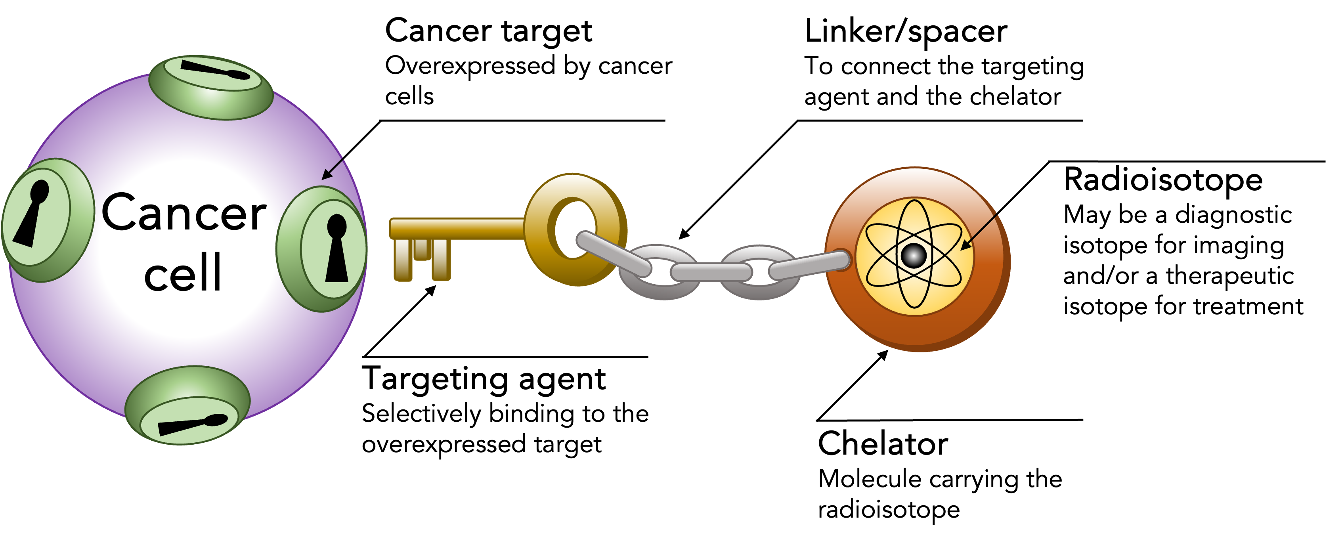

Slide 23
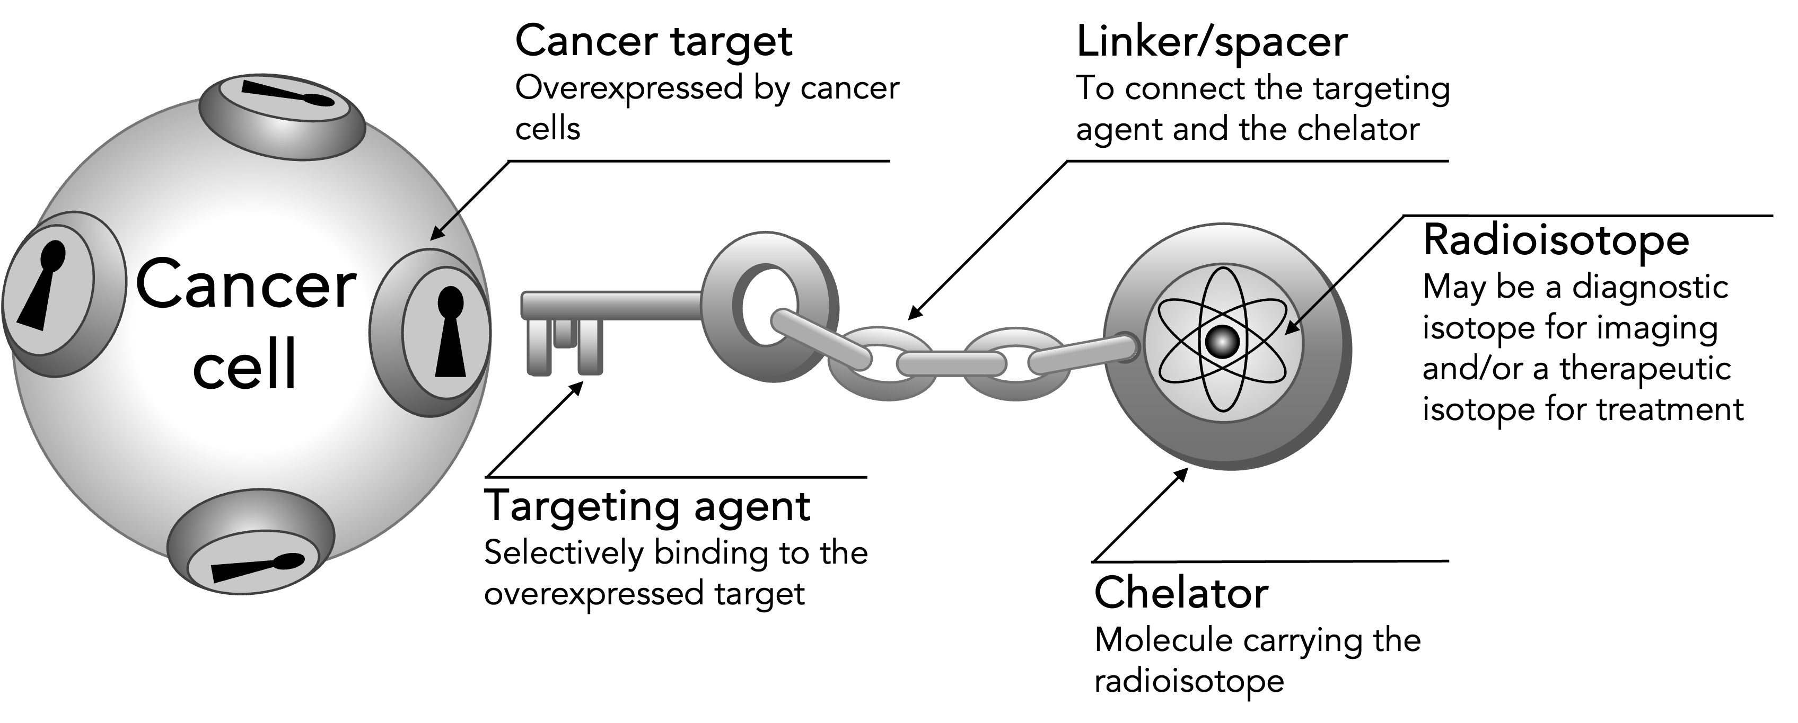
Radiopharmaceuticals

Slide 24
Radiopharmaceuticals

Slide 25
Radiopharmaceuticals

Slide 26
Radiopharmaceuticals

Slide 27
Radiopharmaceuticals

Slide 28
Radiopharmaceuticals

Slide 29
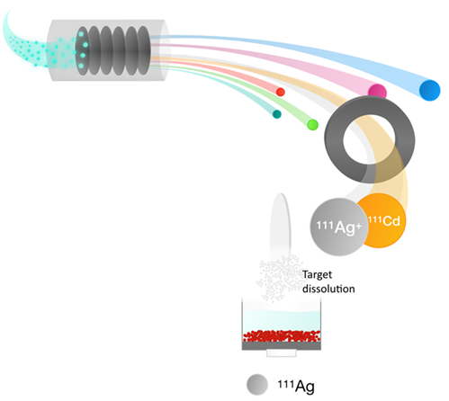
¹¹¹Ag: a challenging isotope
¹¹¹Ag properties
β─ emitter (average energy 360 keV)
Medium half-life (7.45 days)
Medium tissue penetration (~1.5 mm)
Low energy γ rays (SPECT?)
¹¹¹Ag can be produced not only at high purity, but also with high production rate;
All Ag isotopic contaminants will be removed using the online mass separation.
Only ¹¹¹Ag and low amounts of its stable daughter ¹¹¹Cd will be collected on the secondary target.
Cd is a toxic element: possible combined chemotherapeutic and radioactive effect?
111 isobaric chain | t_{½} | Decay | Target Yield
¹¹¹Cd | Stable |  | Low yield production
¹¹¹Ag | 7.45 days | β─ | Good yield production
¹¹¹Pd | 23.4 min | β─ | Bad release
¹¹¹Rh | 11 sec. | β─ | No release

Slide 30
Important outcomes from ISOLPHARM_EIRA experiment

Slide 31
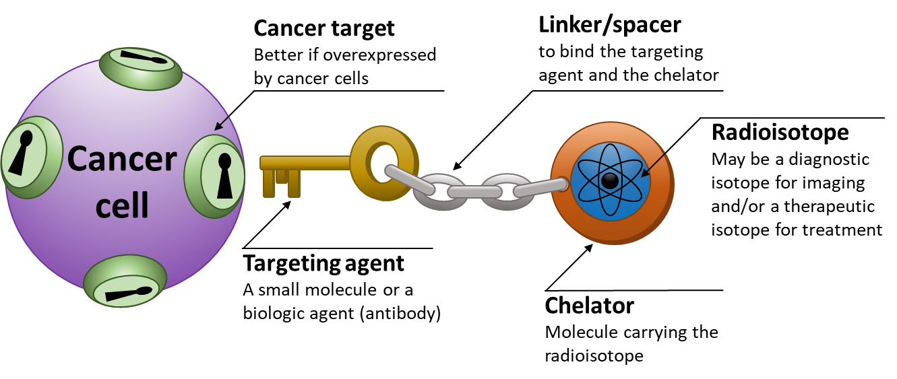
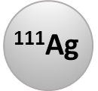
Production of ¹¹¹Ag

Slide 32
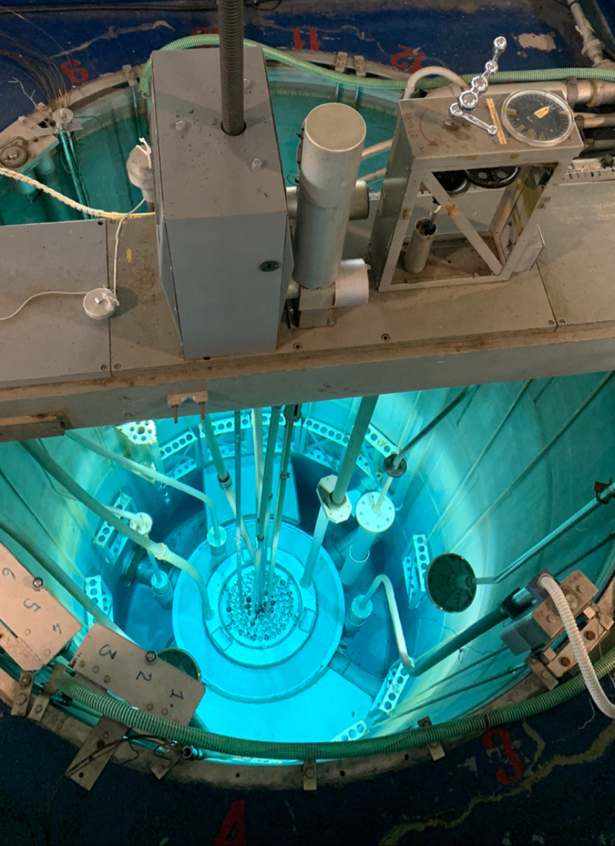
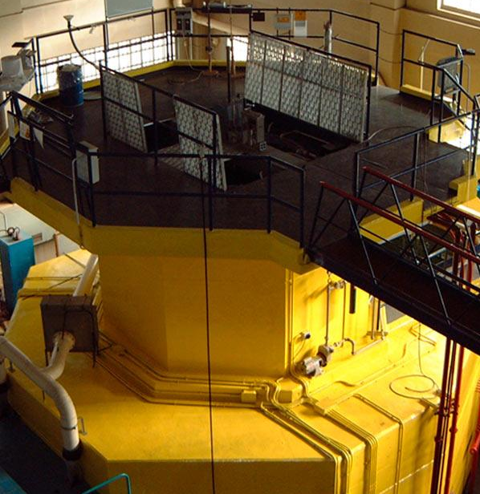
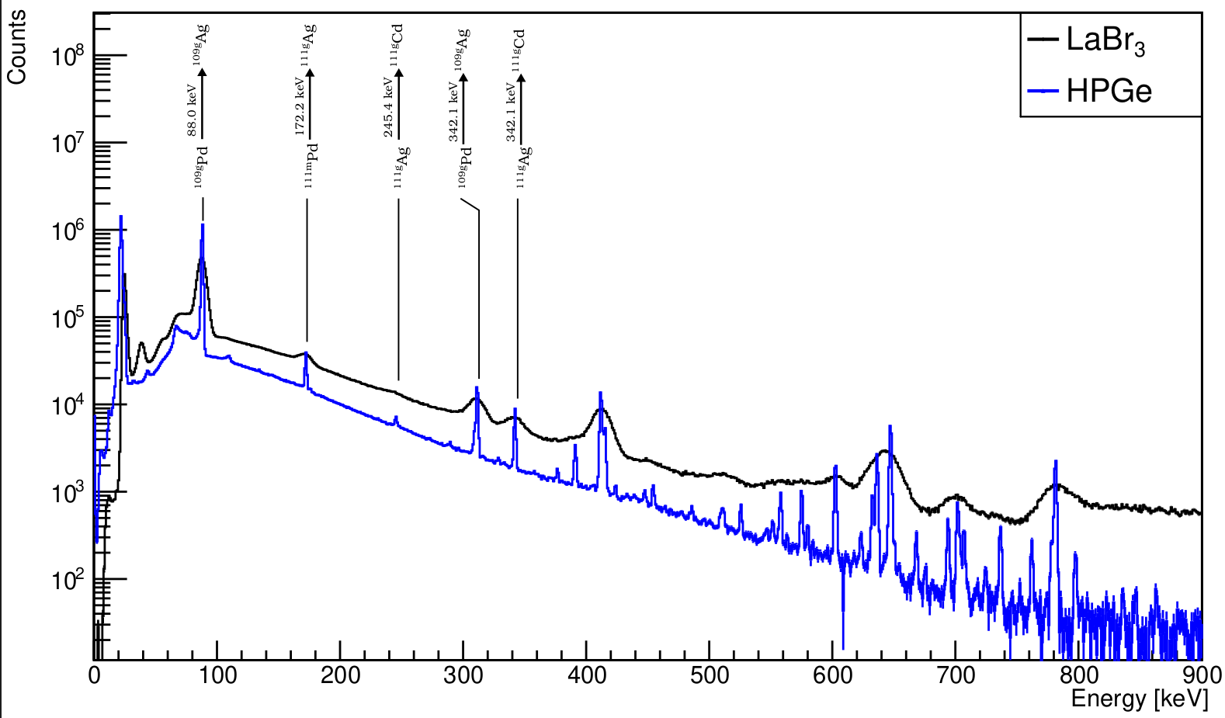
Production of ¹¹¹Ag
Silver-111 was produced at the LENA Triga Mark II reactor using samples of natural and 110-enriched palladium exploiting the radiative neutron capture reaction:
LENA Triga Mark II research reactor
Irradiated samples were spectroscopically characterized using a LaBr₃ and an HPGe detector.

Slide 33
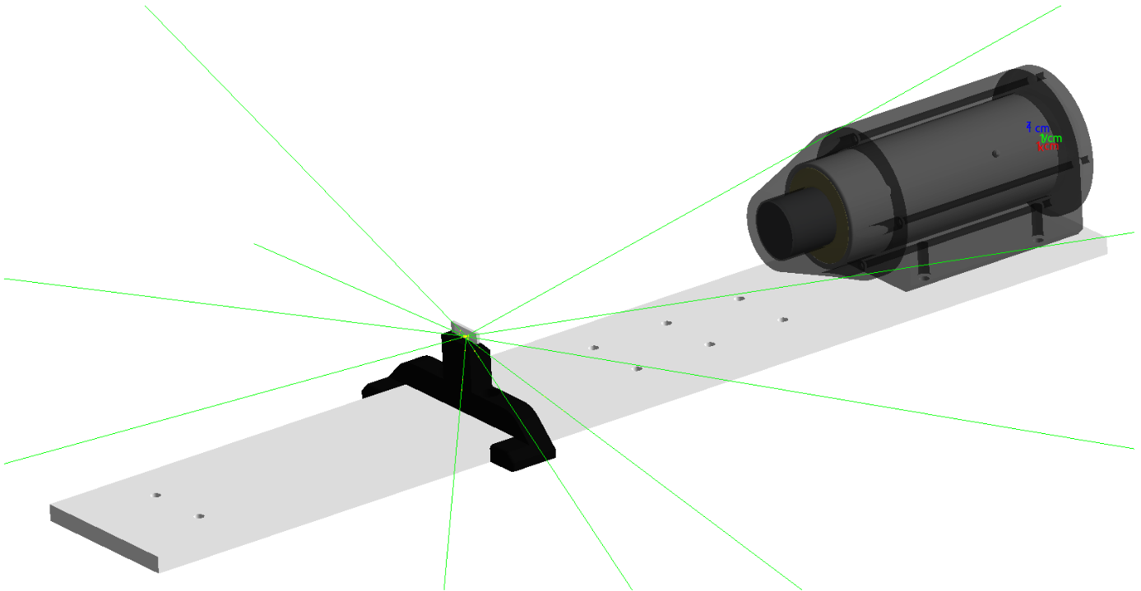
Monte Carlo simulations
All the nuclear measurements were compared to the results of Monte Carlo simulations using different codes, such as Geant4, FLUKA, MCNP and PHITS.
Geant4 simulation of the LaBr₃ detector used at LENA and in the ex-vivo studies (see below).

Slide 34
Production of ¹¹¹Ag

Slide 35
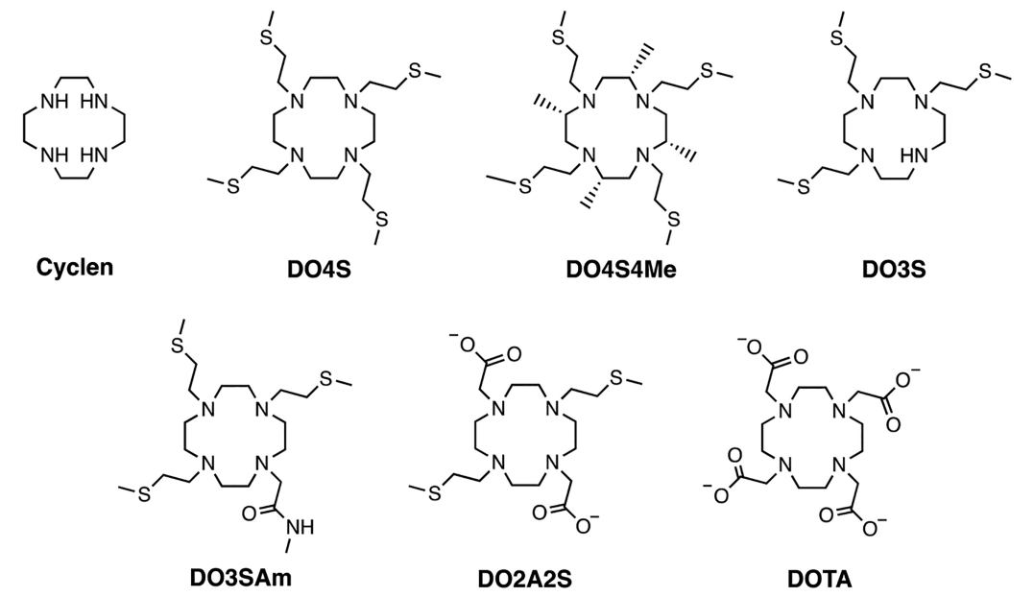
Design and synthesis of new chelators for Ag⁺
Tosato et al., 2020, Inorg. Chem., 59, 10907-10919
UNIPD DSC-DSF

Slide 36
Radiopharmaceuticals

Slide 37
Molecular target
The receptor CCK2R binds two principal hormones (gastrin and cholecystokinin) and is overexpressed by many cancers (e.g. lung, pancreas, liver…)
Possible candidate for ligand-targeted drug delivery
Targeting agents
Hydrophilic linker
CCK2R
Chelator
Notes:
Other tumours: (esophagus, colon, and gastrointestinal stromal tumors).

Slide 38
The latest updates: ADMIRAL experiment

Slide 39
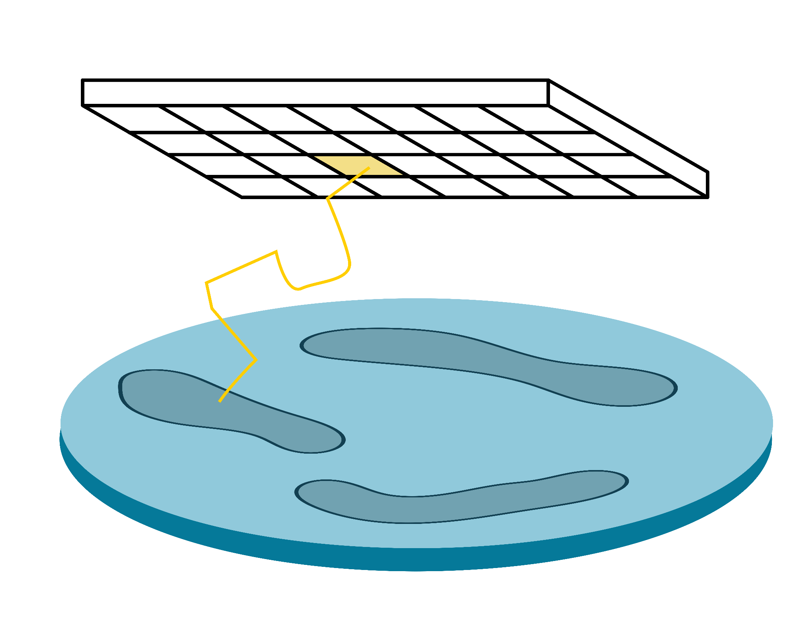
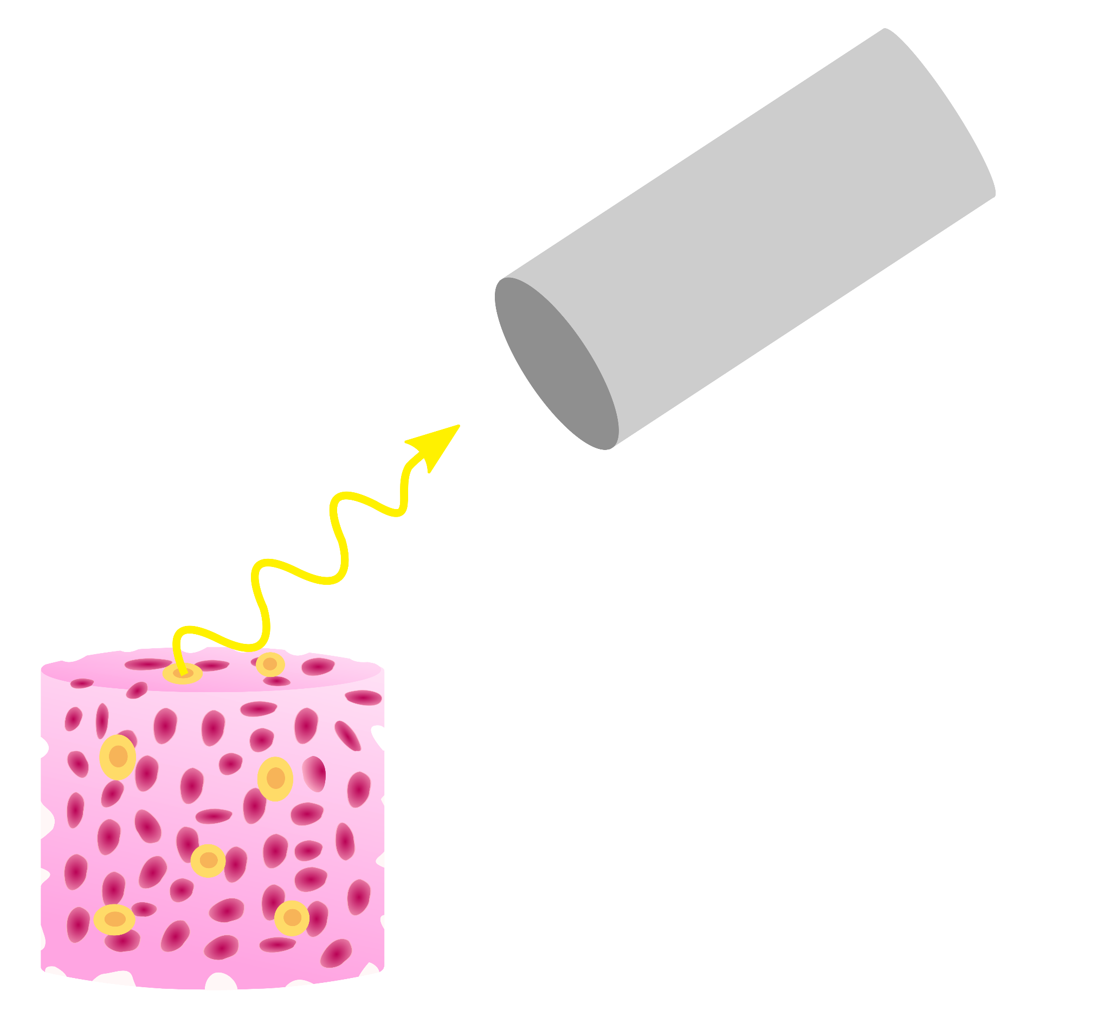
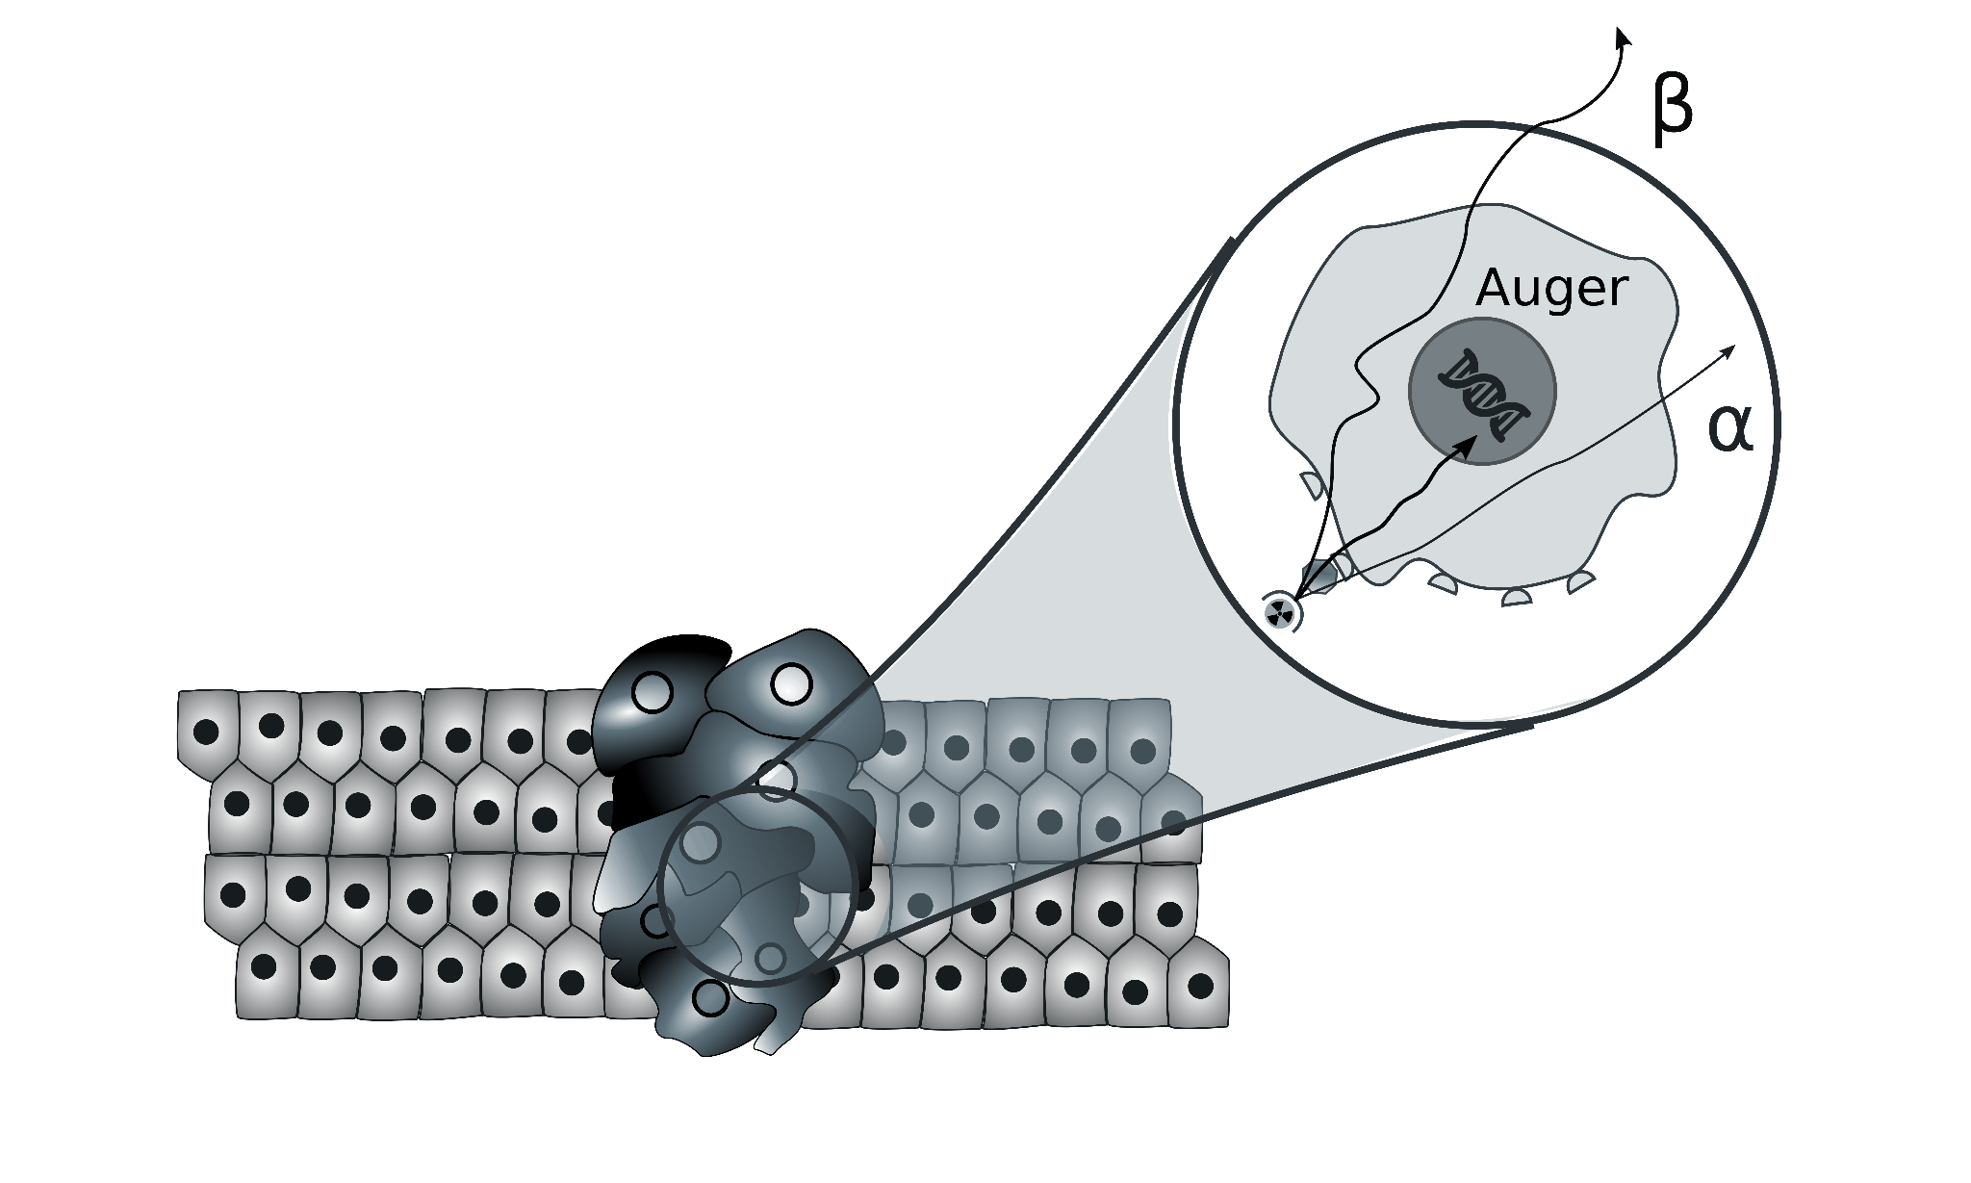
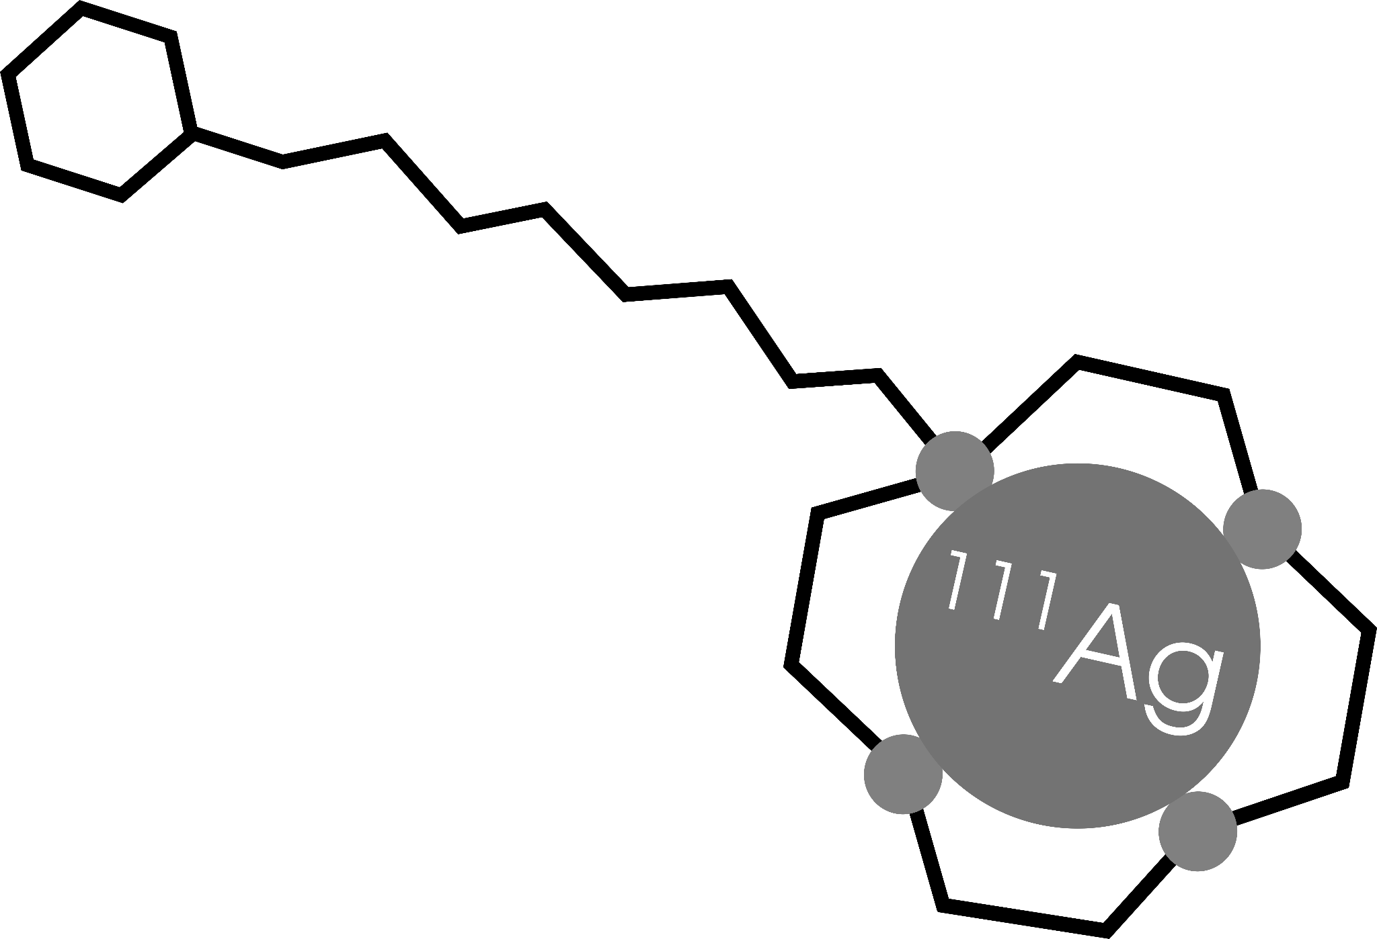
ADMIRAL organization
ISOLPHARM_EIRA
INSTRUMENTATION
RADIOBIOLOGY
WP1:
Radiopharmaceutical
Production
WP2:
β-imaging
WP3:
γ-imaging
WP4:
Targeted Radiobiology
Production of Ag-111 at the LENA facilities, purification and quality control
Radiochemistry of Ag-111
Pharmacology
In vivo testing
Mechanics & electronics design using ALPIDE chips
Monte Carlo simulations for mechanics and detector design
Detector characterization and tests with fluorescence
Monte Carlo simulations for detector design
Planar imaging detector construction for Ag-111 γ detection
Characterization and test of the planar system
Cell survival in 2D flask cultures
Cell survival in 3D scaffolds
Dose computation in cell cultures with different Monte Carlo codes

Slide 40
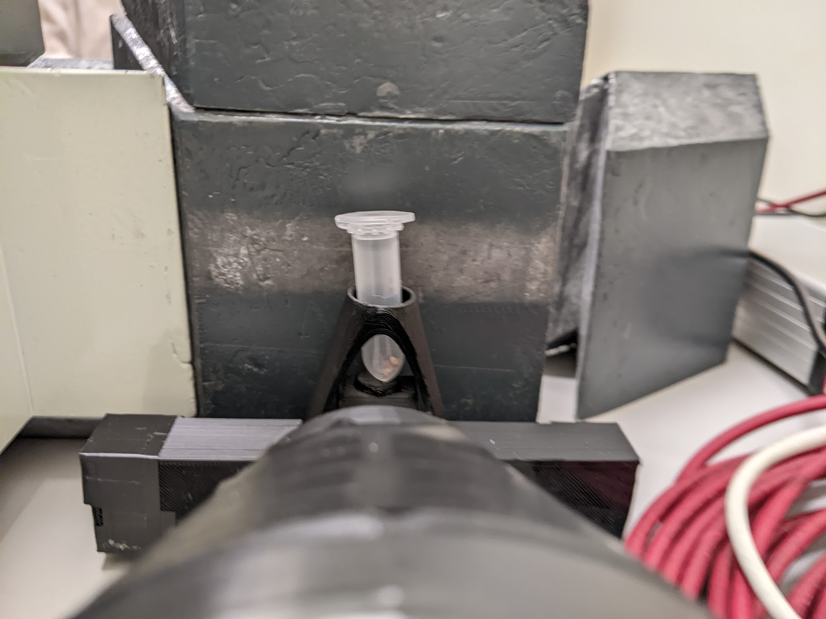
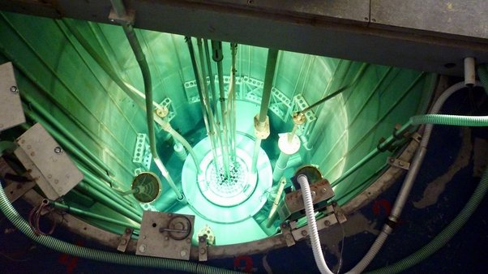
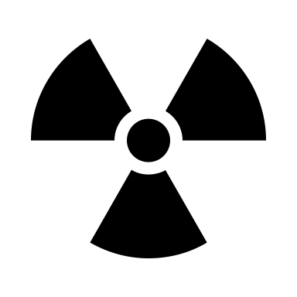
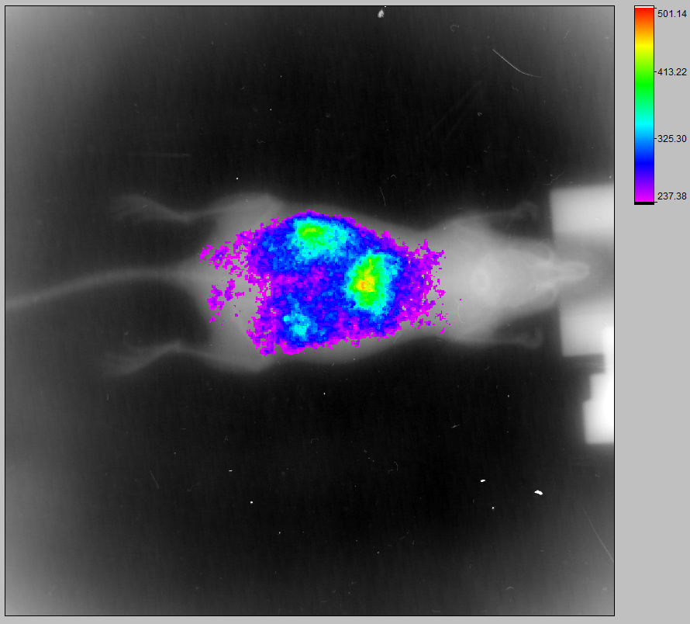
WP1: in vivo experiment
150 mg of ¹¹⁰Pd irradiated at L.E.N.A.
¹¹¹Ag
Biodistribution
In-vivo imaging
88 MBq of ¹¹¹Ag obtained and sent to CAPIR

Slide 41
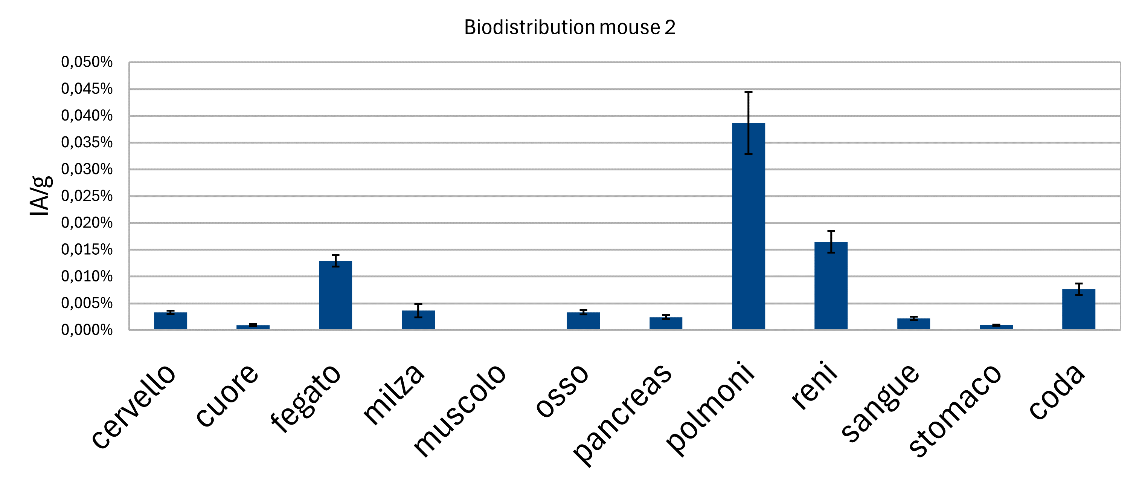
WP1: in vivo experiment
150 mg of ¹¹⁰Pd irradiated at L.E.N.A.
¹¹¹Ag
Biodistribution
In-vivo imaging
88 MBq of ¹¹¹Ag obtained and sent to CAPIR

Slide 42
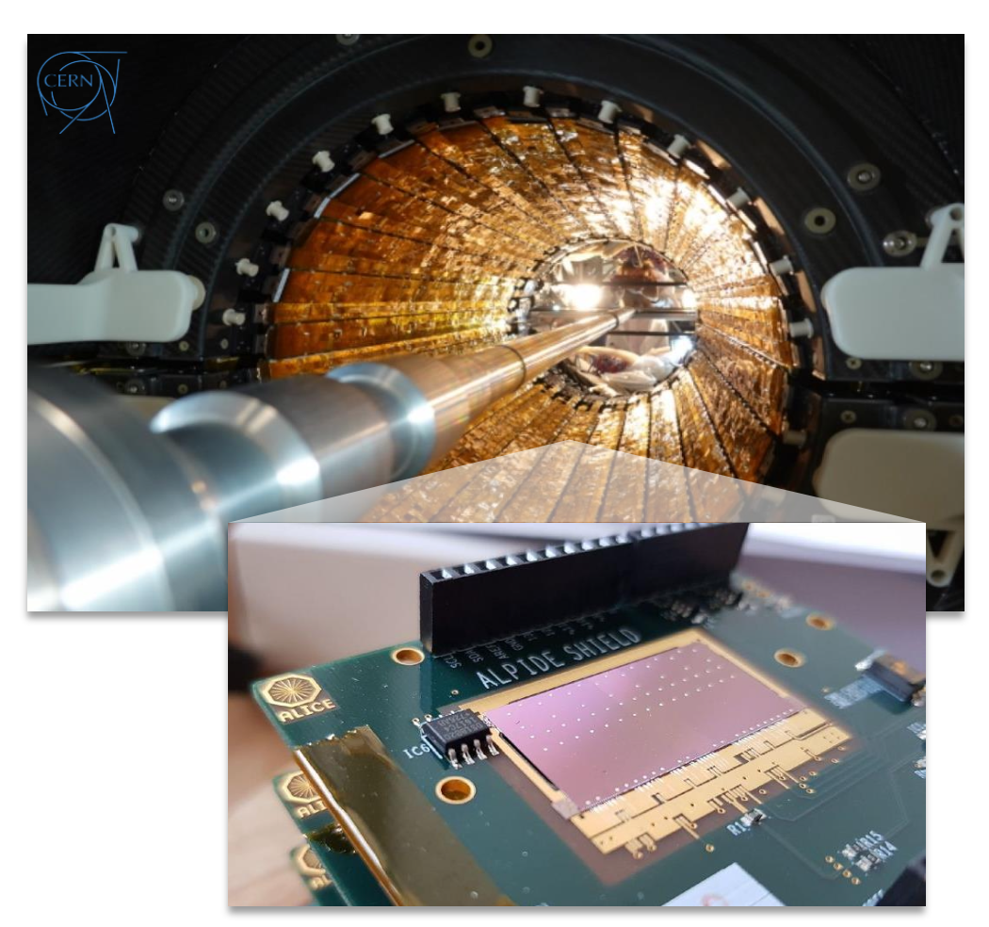
WP2: the Beta-detector
A high-resolution and cost-effective detector capable of detecting beta radiation emitted by ¹¹¹Ag is under development.

Slide 43
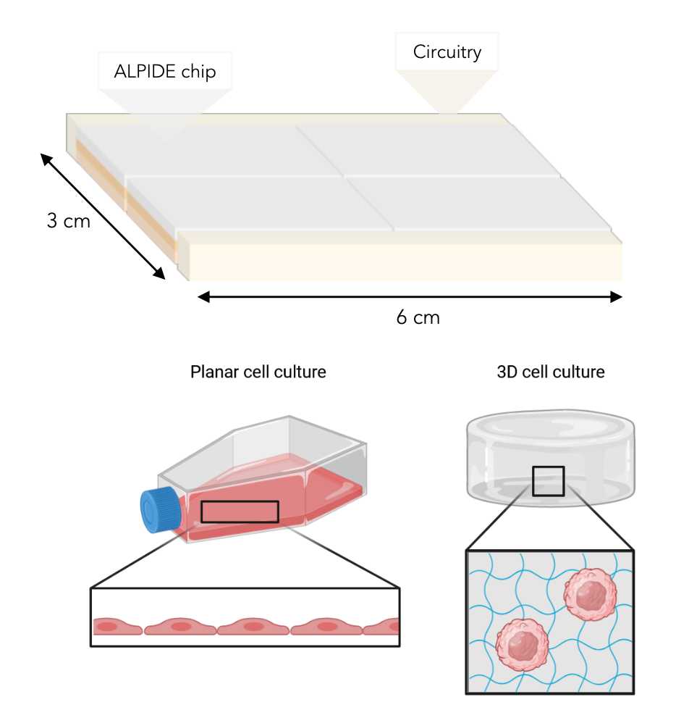
WP2: the Beta-detector
A high-resolution and cost-effective detector capable of detecting beta radiation emitted by ¹¹¹Ag is under development.
It will consist of 4 or potentially 8 ALPIDE chips arranged in a flat geometry.
This design will allow to adhere to the surface of the cell cultures involved in 2D and 3D in- vitro tests.

Slide 44
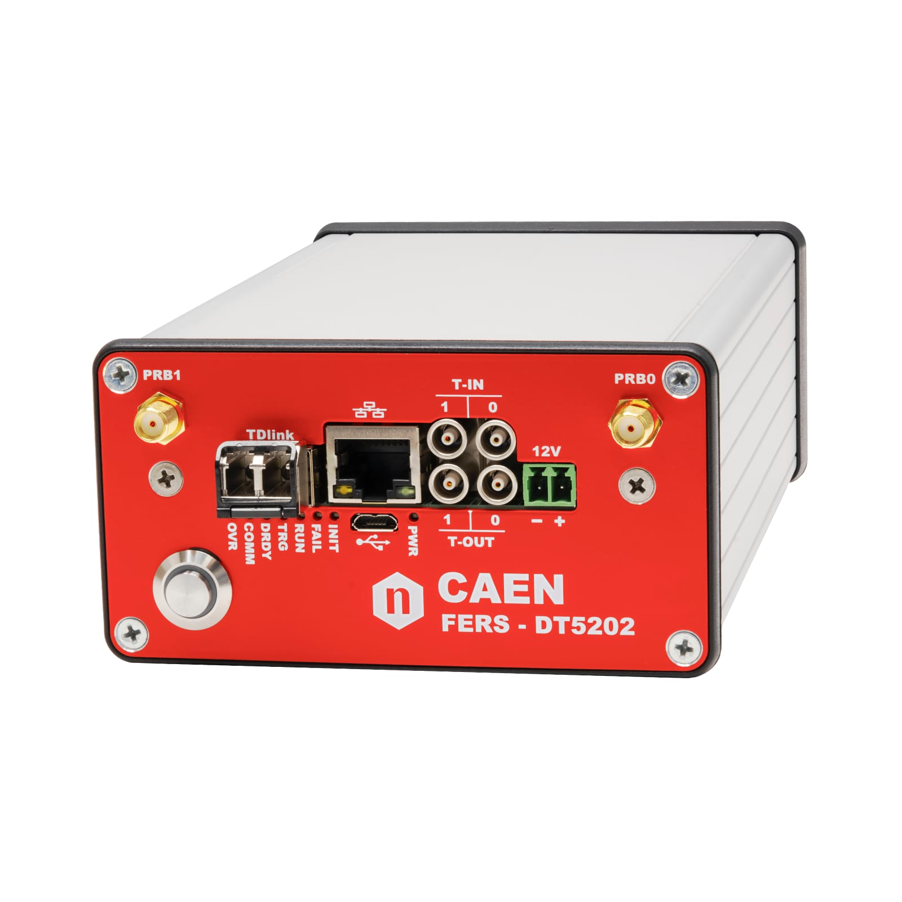
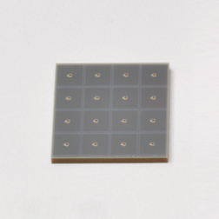
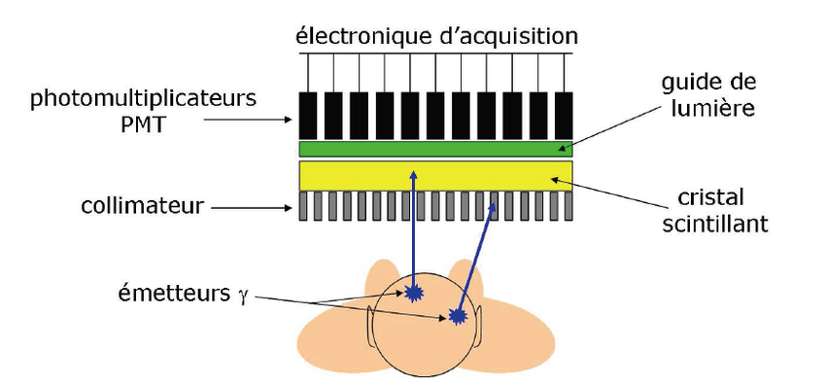
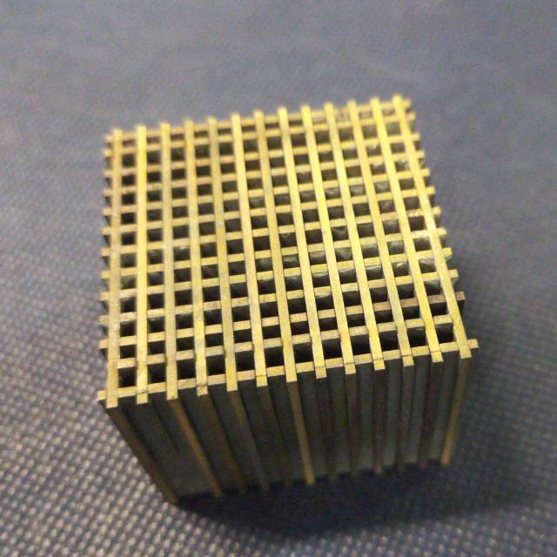
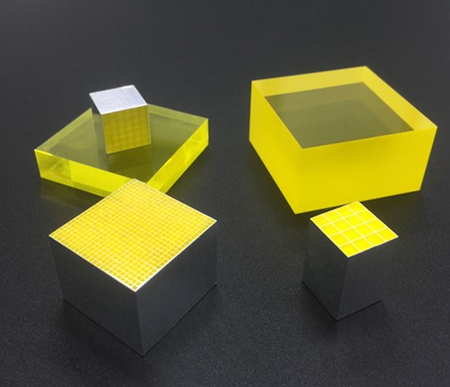
WP3: Gamma-detector
Device used to image γ radiation emitting radioisotopes;
Selected elements:
Electronics
CAEN FERS DT5202
Optical photon detectors (SiPM)
Hamamatsu S14161 8x8 ch 3x3 mm²
Collimator (tungsten)
2 mm holes, 1 mm septa, 30 mm length
Scintillating crystal (GAGG)
1x1x26 mm³ matrix

Slide 45
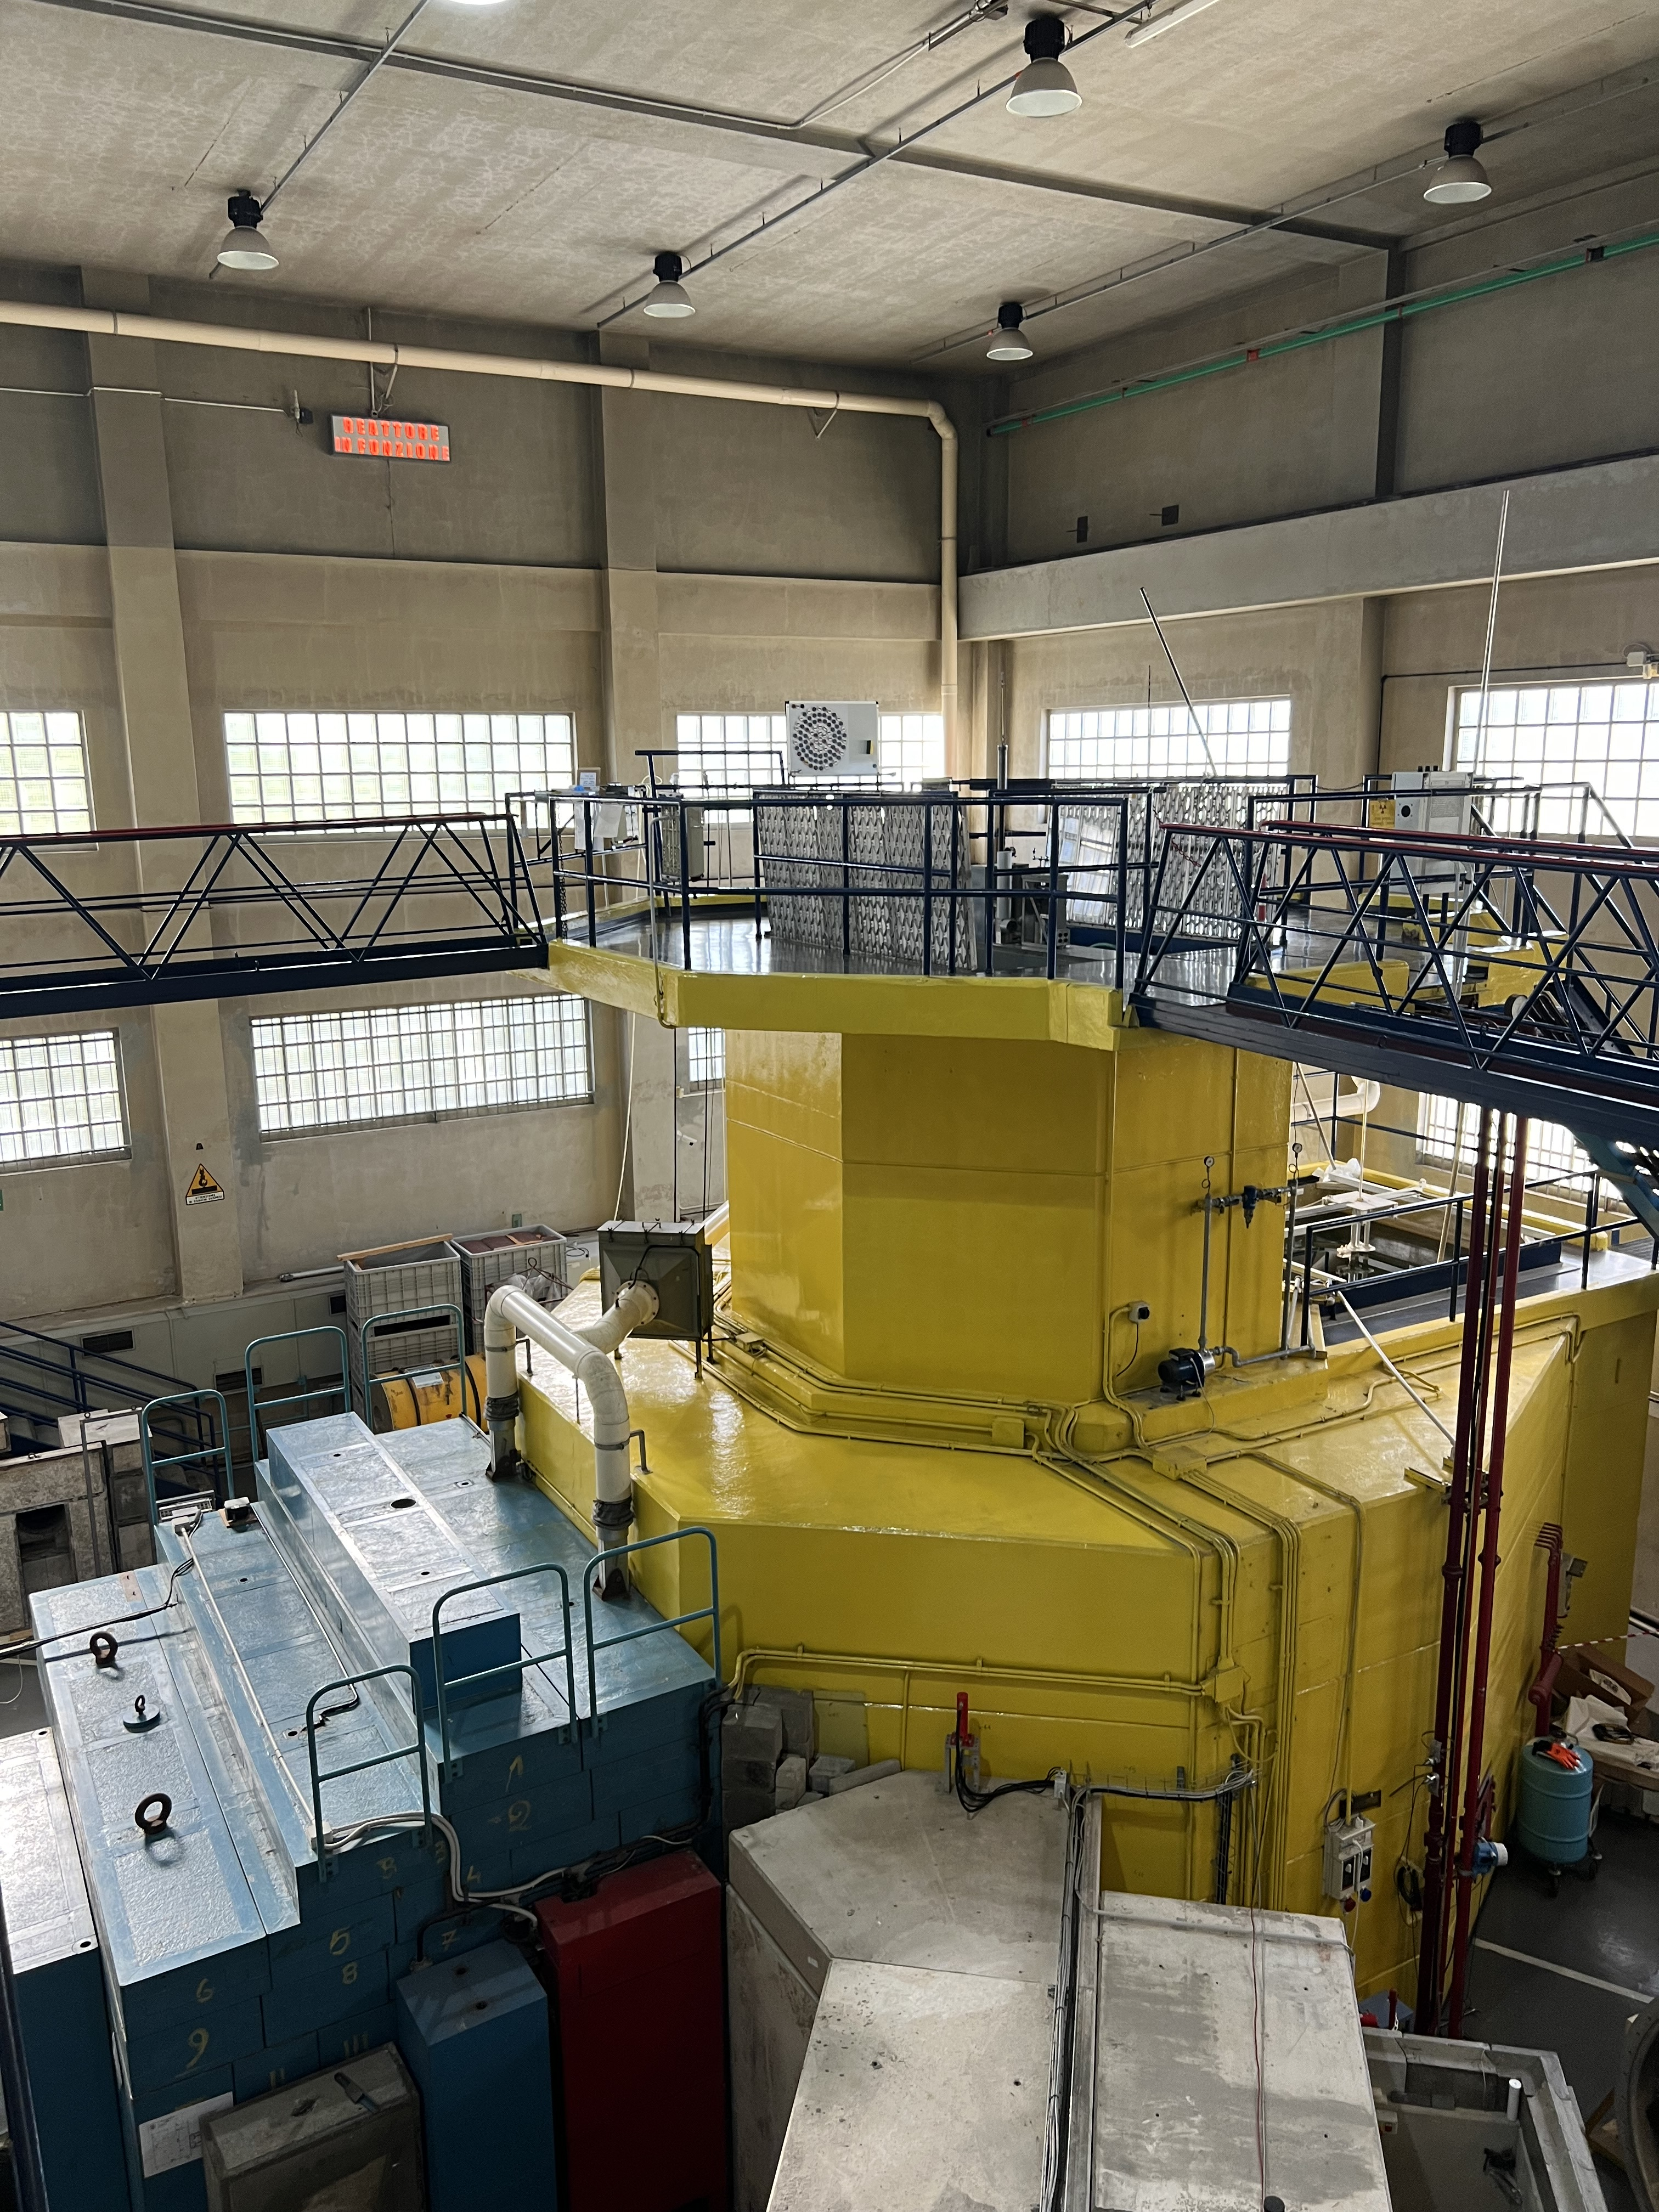
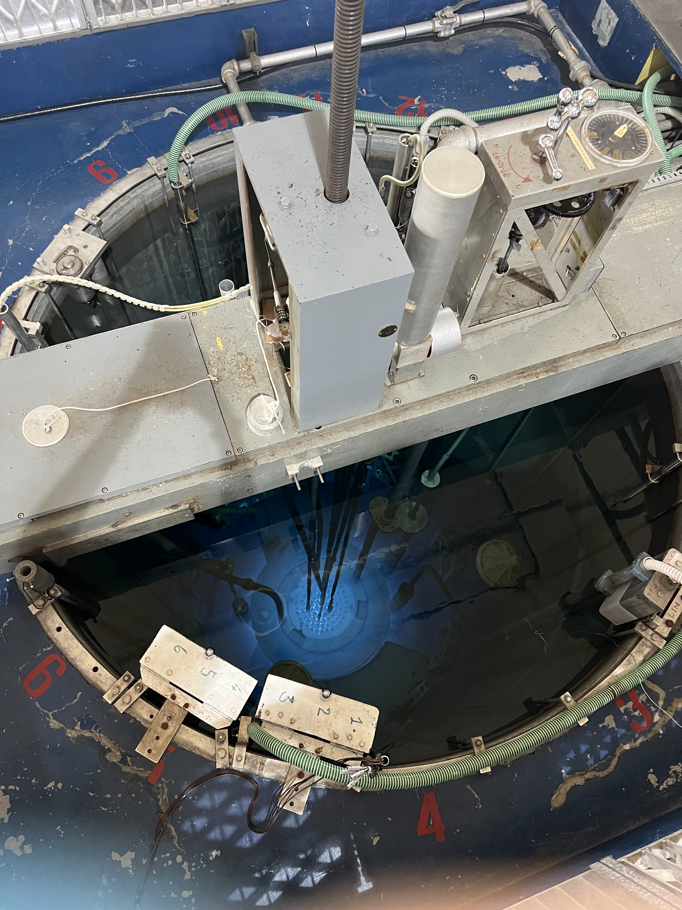
WP4: 2D In-vitro study
In April the 1st in vitro experiment with ¹¹¹Ag was conducted.
Enriched ¹¹⁰Pd was irradiated at L.E.N.A. (PV) and 23 MBq of ¹¹¹Ag were produced.

Slide 46
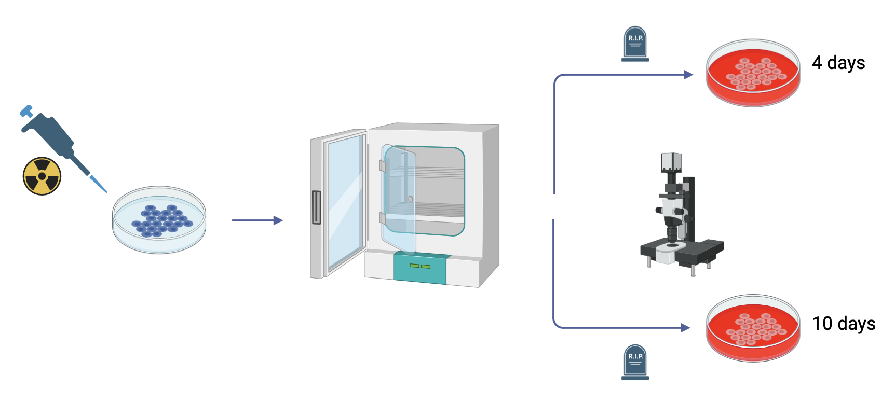
WP4: 2D In-vitro study
In April the 1st in vitro experiment with ¹¹¹Ag was conducted.
Enriched ¹¹⁰Pd was irradiated at L.E.N.A. (PV) and 23 MBq of ¹¹¹Ag were produced.
Then, the radioisotope was injected in petri dishes containing UMR-106 cells at various concentrations.

Slide 47
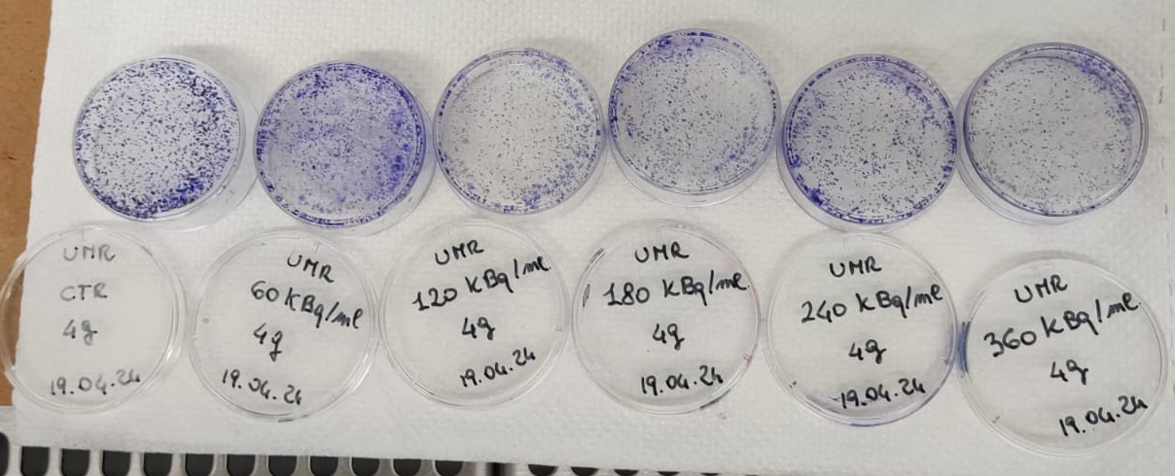
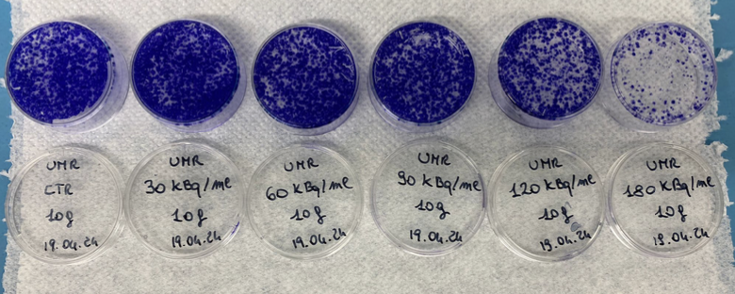
WP4: 2D In-vitro study
4 days
Some petri were used to fix cells with 70% ethanol and staining with Toluidine Blue in order to observe them macroscopically and microscopically;
Others were used in the Burker chamber for the count of cells present in the various conditions examined.
Survival data were then analyzed.
10 days

Slide 48
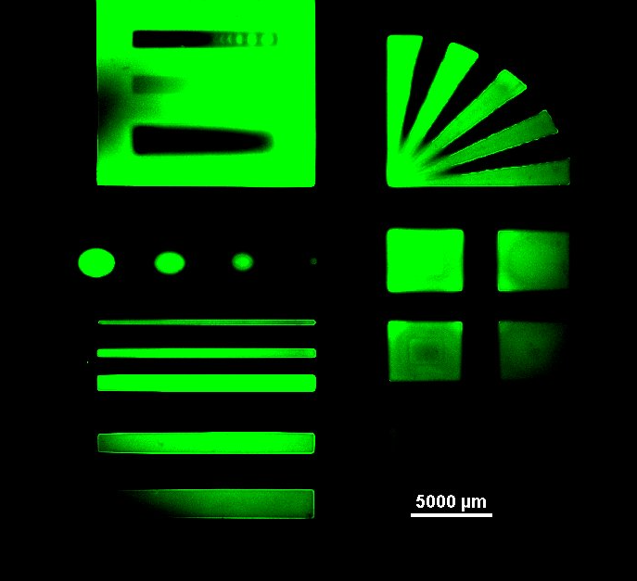
WP4: 3D In-vitro study
Printing tests (using a DLP printer) with GelMA (Gelatin Methacrylate) are being conducted at BIOtech, in Trento.

Slide 49
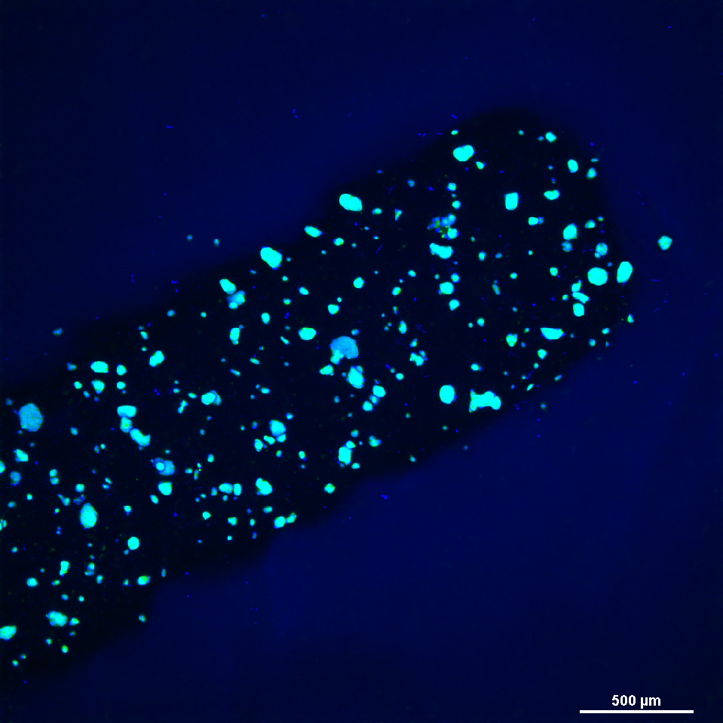
WP4: 3D In-vitro study
Printing tests (using a DLP printer) with GelMA (Gelatin Methacrylate) are being conducted at BIOtech, in Trento.
Same tests were recently performed inserting cells in the printing material.

Slide 50
WP4: 3D In-vitro study
Printing tests (using a DLP printer) with GelMA (Gelatin Methacrylate) are being conducted at BIOtech, in Trento.
Same tests were recently performed inserting cells in the printing material.
Other experiments will be conducted using cells irradiated with ¹¹¹Ag.
¹¹¹Ag

Slide 51
The LARAMED project

Slide 52
The direct activation method
https://web.infn.it/LARAMED/
2 (maybe soon 3) International INFN patents on production methods (⁶⁷Cu and ⁴⁷Sc) and targets manufacturing

Slide 53
The “Radioisotopes for Medicine and Applied Physics” service
RILAB
DIRECT technology
LAboratory of Radiouclides for MEDicine
https://web.infn.it/LARAMED/
ISOL technology
https://isolpharm.pd.infn.it/web//
Possible collaboration with industry for production
RIFAC

Slide 54
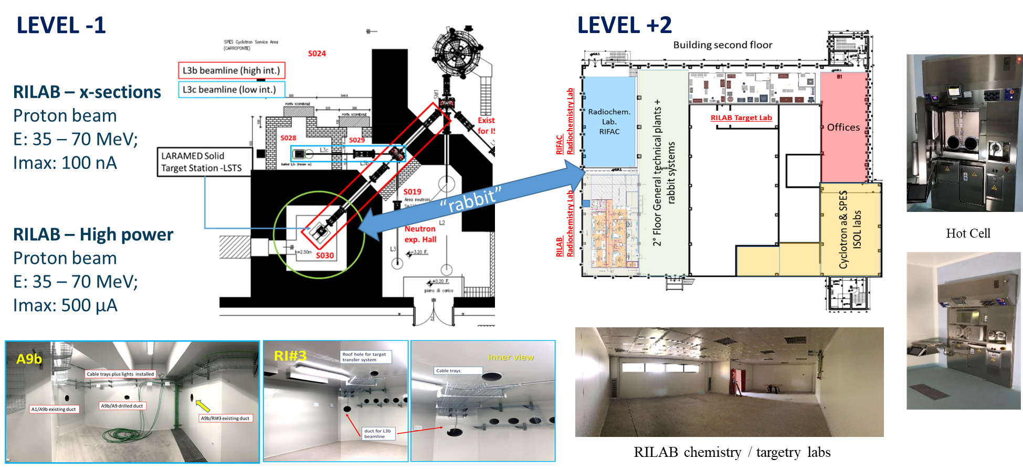
The LARAMED facility

Slide 55
The “Radioisotopes for Medicine and Applied Physics” service
RILAB
DIRECT technology
LAboratory of Radiouclides for MEDicine
https://web.infn.it/LARAMED/
ISOL technology
https://isolpharm.pd.infn.it/web//
Possible collaboration with industry for production
RIFAC

Slide 56
The “Radioisotopes for Medicine and Applied Physics” service
RILAB
DIRECT technology
LAboratory of Radiouclides for MEDicine
https://web.infn.it/LARAMED/
ISOL technology
https://isolpharm.pd.infn.it/web//
Possible collaboration with industry for production
RIFAC
ISOL-2 temporarily dedicated to nuclear cross section measurements

Slide 57
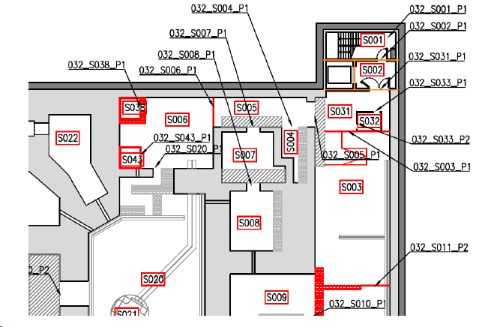
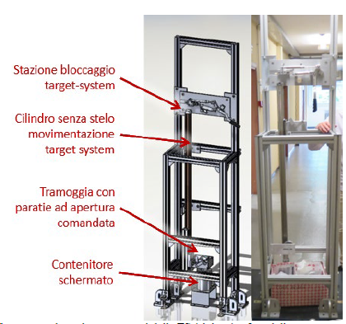
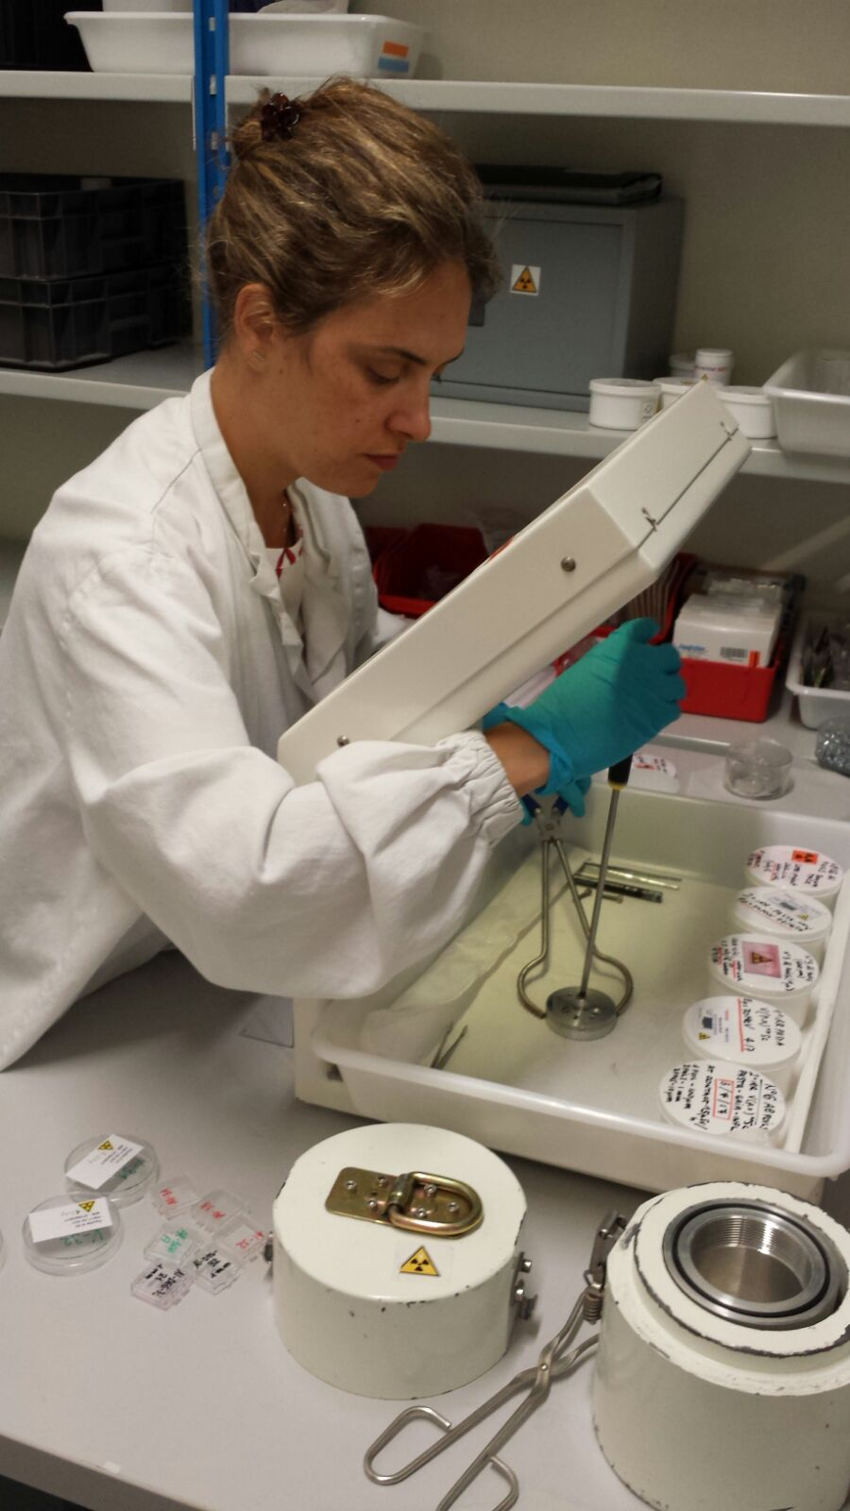
Cross section measurements in ISOL-2
Experimental area to recover the irradiated samples
Experimental area for
γ-spectrometry (2 HPGe detectors)
Target Station (TS)
Cyclotron

Slide 58
The end
Thank you for your attention!
Any questions?

Slide 59
Backup slides

Slide 60
ISOLPHARM production yield

Slide 61
Radionuclide production through ISOL
The yield of a specific isotope, Y, is a function of various parameters and can be expressed as:

Slide 62
Radionuclide production through ISOL
The yield of a specific isotope, Y, is a function of various parameters and can be expressed as:
Cross section

Slide 63
Radionuclide production through ISOL
The yield of a specific isotope, Y, is a function of various parameters and can be expressed as:
Particle flux

Slide 64
Radionuclide production through ISOL
The yield of a specific isotope, Y, is a function of various parameters and can be expressed as:
N of atoms in target

Slide 65
Radionuclide production through ISOL
The yield of a specific isotope, Y, is a function of various parameters and can be expressed as:
Diffusion efficience

Slide 66
Radionuclide production through ISOL
The yield of a specific isotope, Y, is a function of various parameters and can be expressed as:
Effusion efficience

Slide 67
Radionuclide production through ISOL
The yield of a specific isotope, Y, is a function of various parameters and can be expressed as:
Ionization efficience

Slide 68
Radionuclide production through ISOL
The yield of a specific isotope, Y, is a function of various parameters and can be expressed as:
Transfer efficience

