Slide 1
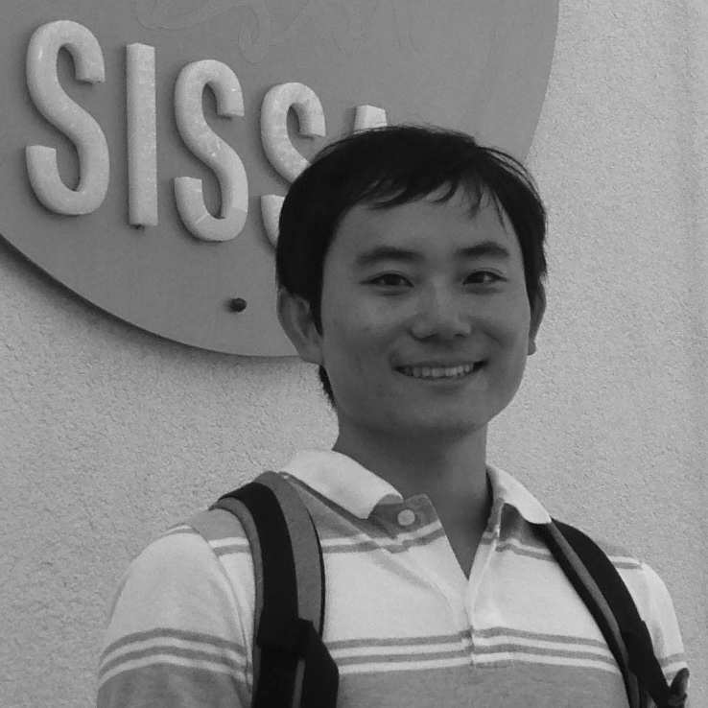
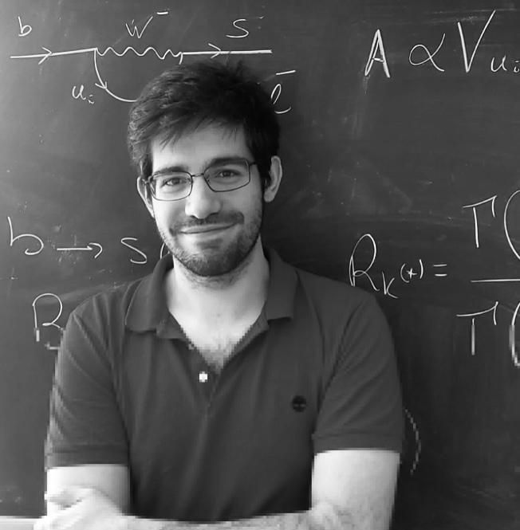
Magnetic Monopoles in Cosmic Magnetic Fields: Acceleration and Constraints
DP, K. Bondarenko, M. Doro,
T. Kobayashi
Phys. Dark Univ. 46 (2024), 101704
DP, M. Doro, T. Kobayashi
arXiv:2505.xxxxx
Michele Doro (University of Padova) Takeshi Kobayashi (SISSA), Daniele Perri (SISSA, U. Warsaw)

Slide 2
Question?
Are cosmic magnetic fields relevant for terrestrial experimental bounds on MMs?

Slide 3
#1 MM intro and Experiments

Slide 4
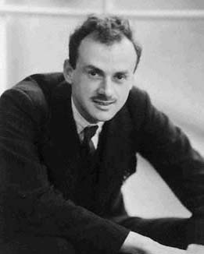
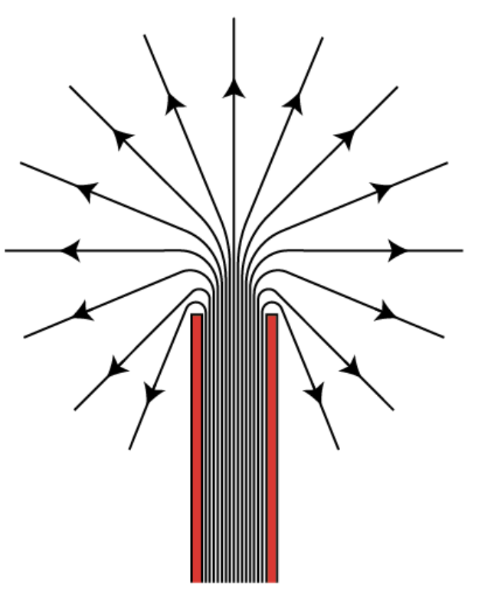
Quick intro: DIRAC’s CLASSIC MONOPOLE
He was trying to find a way to have a natural explanation for the quantization of the electric charge
In 1948 he proposed a model for a monopole made of one semi-infinite string solenoid
Magnetic charge:
Maxwell’s equations become symmetric
Dirac himself said of MM “One would be surprised if Nature had made no use of it”

Slide 5
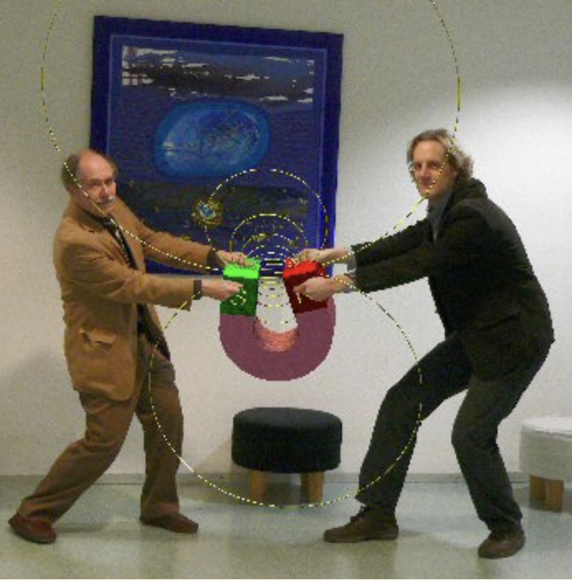
MMs are common: T’HOOFT anD POLiAKOV
In 1974 ’T Hooft and Poliakov proposed a model of monopoles as topological defects, which was naturally appearing during phase transitions
Monopoles are inevitable predictions of Grand Unified Theories: SU(5) → SU(3) × SU(2) × U(1) → SU(3) × U(1)
MM
GUT (early Universe) M>10^16 GeV
Intermediate Mass (later) M>10^6 GeV
The ’t Hooft–Polyakov monopole is a finite-energy, topological soliton arising due to the non-trivial topology of the vacuum manifold.

Slide 6
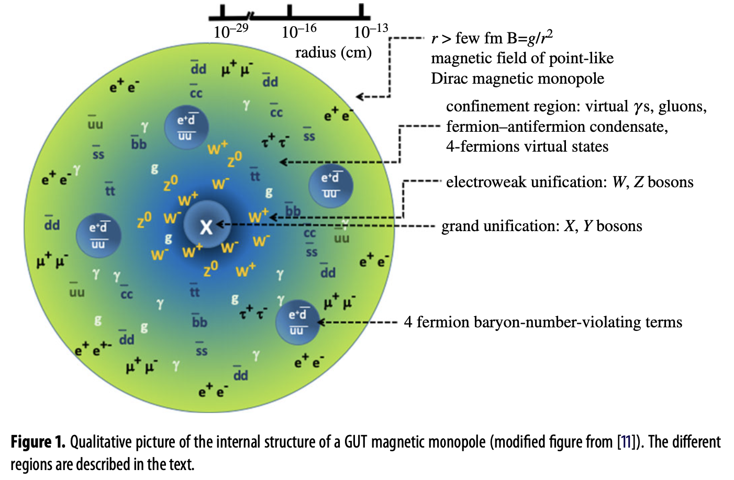
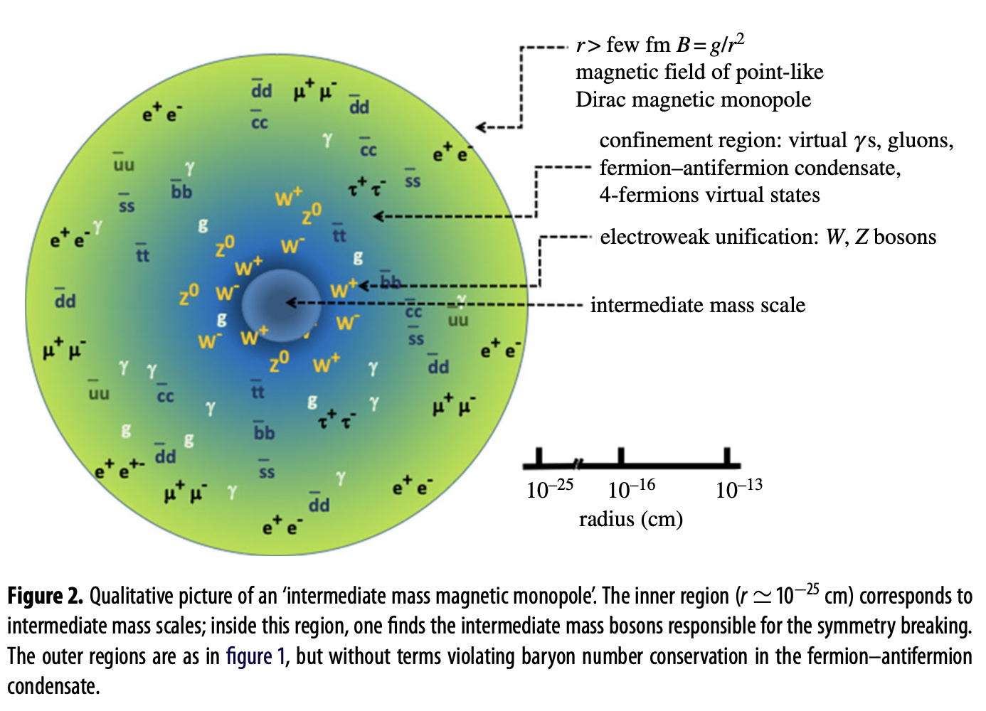
GUT and Intermediate MM
Patrizii+ Ann.Rev.Nucl.Part.Sci. 65 (2015)
GUT MM foresees proton decay
Inside the core, all the states of the GUT are excited.

Slide 7
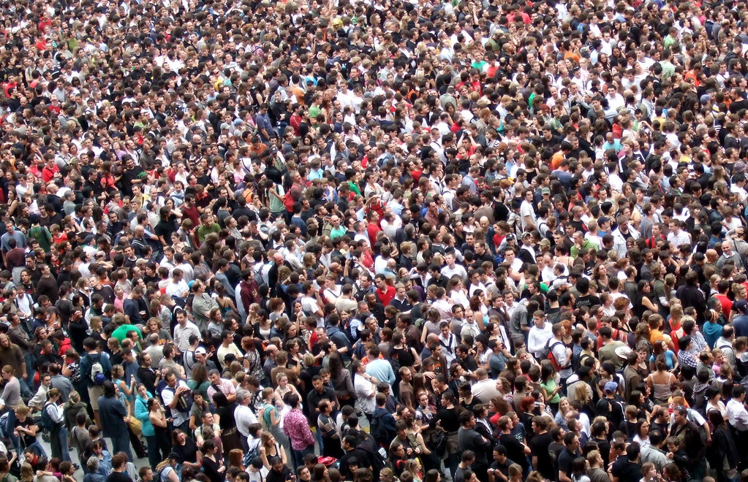
ACTUALLY, TOO MANY MAGNETIC MONOPOLES
COSMOLOGICAL MONOPOLES crowd
GALACTIC MONOPOLES crowd/PARKER BOUND
Monopoles are produced in the early universe during phase transition.
The abundance of produced monopoles can easily over- dominate the energy density of the universe.
Inflation provides a good solution to the problem.
The Galaxy presents a magnetic field of ~muG
The Galactic magnetic field accelerates the monopoles losing its energy;
The survival of the field provides a bound on the monopole flux today

Slide 8
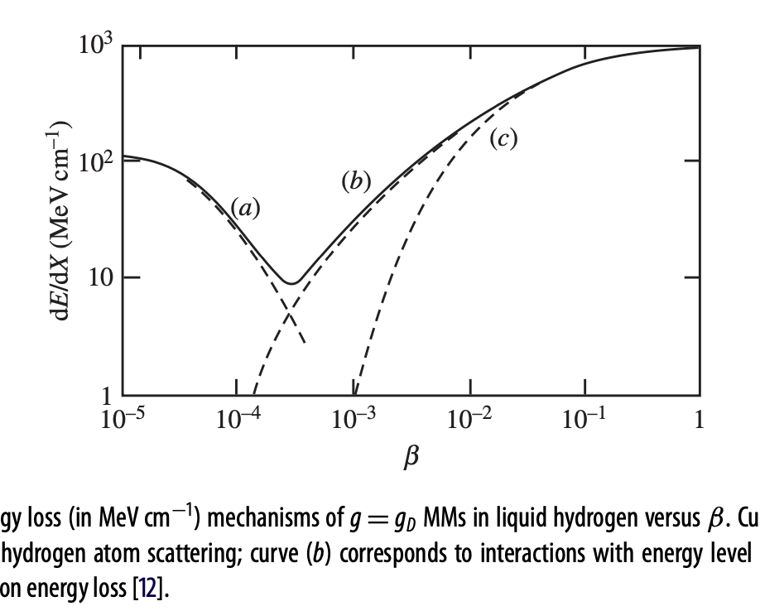
How to get them: ENERGY LOSS IN MATTER
When MMs cross a medium, the time-varying magnetic field induces a strong electric field. MMs are treated as electrically charged particles with an equivalent speed-dependent electric charge proportional to gβ.
The search for MMs is naturally based on their speed at the detector.
For β ≲ 10⁻³ the energy loss is mostly through elastic collisions with atoms.
For 10⁻³ ≲ β ≲ 10⁻², the medium behaves like a free degenerate gas of electrons (energy level crossings)
Relativistic MMs with β ≥ 0.1 ionize atoms. The yield is ∼ (g/e)^2=4700 times that of a minimum ionizing particle.
Ultra-relativistic MMs, with γ > 10⁴, lose energy mostly by pair production and photo-nuclear radiative processes
Scattering
Pair-prod
Ionization
Patrizii+ Ann.Rev.Nucl.Part.Sci. 65 (2015)

Slide 9
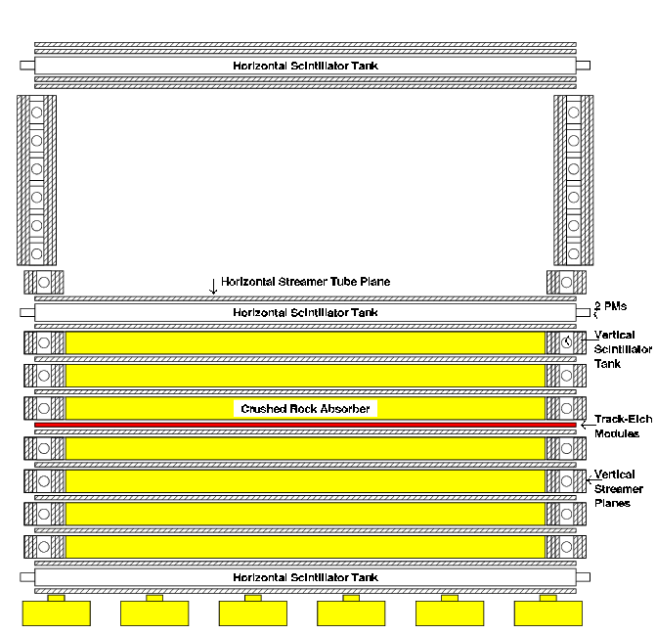
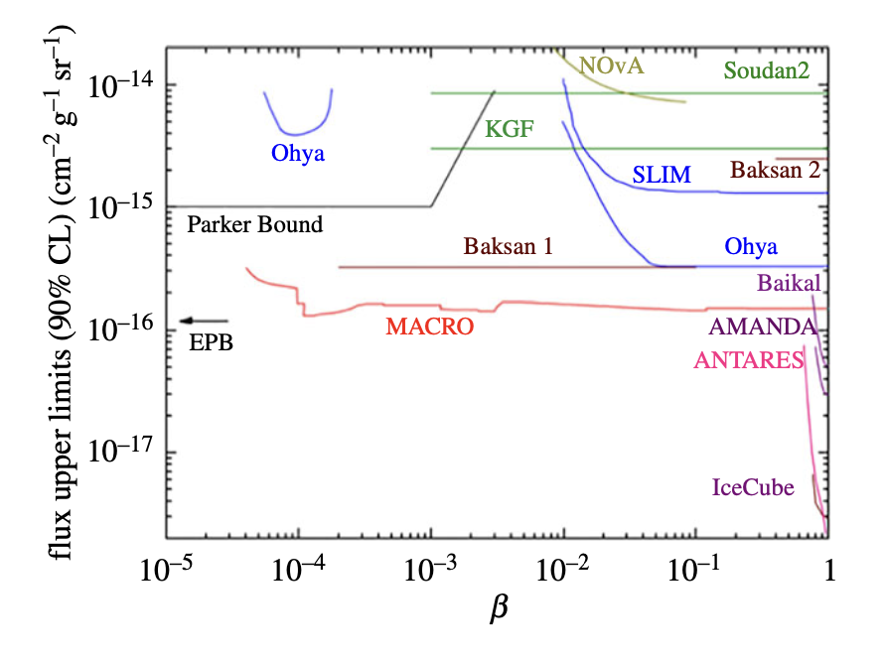
How to get them
Direct Detection of Monopoles
Induction of electric currents into a coil;
Energy loss by ionization (Ex. MACRO, IceCube);
Catalysis of nucleon decays (only for GUT monopoles).
The Monopole, Astrophysics and Cosmic Ray Observatory (MACRO) was a dedicated instrument for MMs at LNGS until 2000.
MACRO was composed of three sub-detectors, sensitive to different MM speeds, operated in combination:
scintillation counters
limited streamer tubes
nuclear track detectors
Upper bounds between 4 × 10⁻⁵ ≤ β < 0.99 at around 1.4 × 10⁻¹⁶ cm−2s−1sr−1 for masses ≳ 10¹⁶ GeV.
https://pdg.lbl.gov/

Slide 10
Searches at accelerators
The ATLAS experiment sought gD MMs with masses of up to 2.5 TeV .
MM masses as large as 6 TeV have been explored by the MoEDAL experiment*, which has set upper limits to the production of MMs with charges as large as 5gD considering Drell-Yan process
*MoEDAL (Monopole and Exotics Detector at the LHC) is a particle physics experiment at the Large Hadron Collider (LHC)

Slide 11
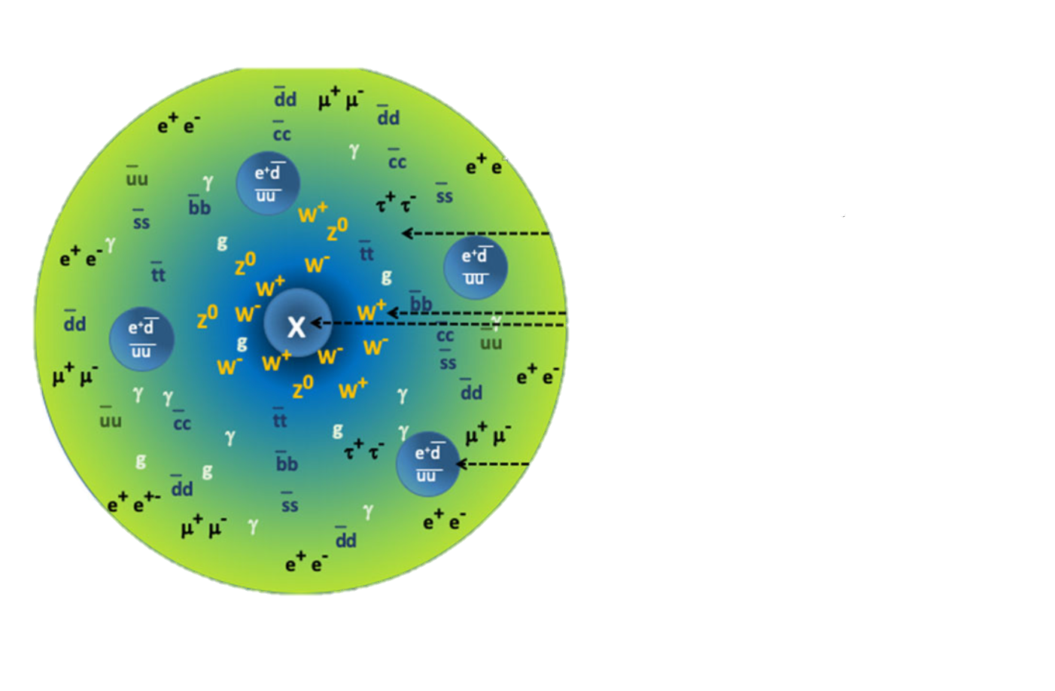
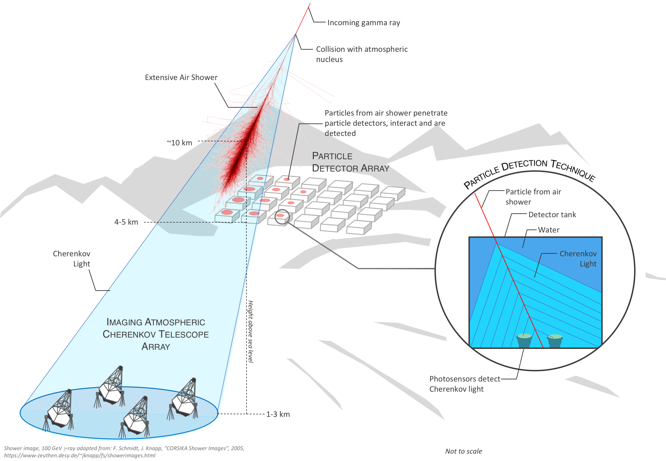
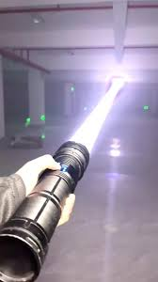
Indirect detection of mm
A MM acts as a super-ionizing muon
the ionization yield of a relativistic unit charge MM is (g/e)^2 ∼ 4700 times that of a MIP
Also 4700 times more Cherenkov light than that of a muon with the same speed
MM
https://pdg.lbl.gov/

Slide 12
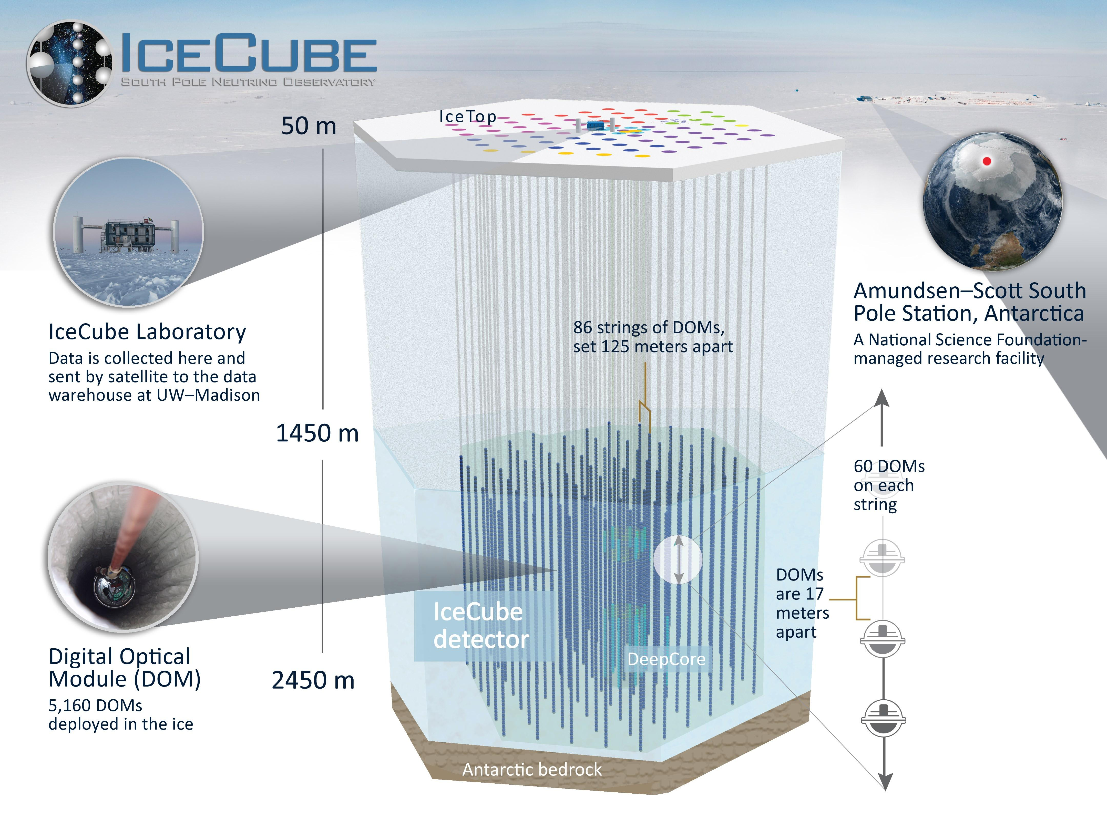
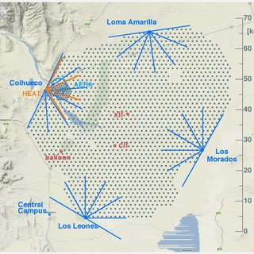
IceCube
Pierre Auger
Observatory (PAO)
Located at the South Pole in Antarctica, the IceCube detector is an array of 5160 optical modules arranged in 86 vertical strings deployed into the ice between 1500 m and 2500 m below the surface, with a total volume of 1 km³.
A charged particle can emit Cherenkov light in ice
Core science: astrophysical neutrinos, but can see MMs above beta>0.5
Several publications assuming supermassive MMs
PAO is the largest (3, 000 km2 ) ultra-high-energy cosmic-ray detector currently in operation.
Surface-detector array of water tanks that samples the charged particles from atmospheric showers and 24 fluorescence detectors with a field-of-view of 30◦.
PAO is sensitive to ultra-relativistic gamma>10^8 MMs
Several papers published assuming light enough MMs

Slide 13
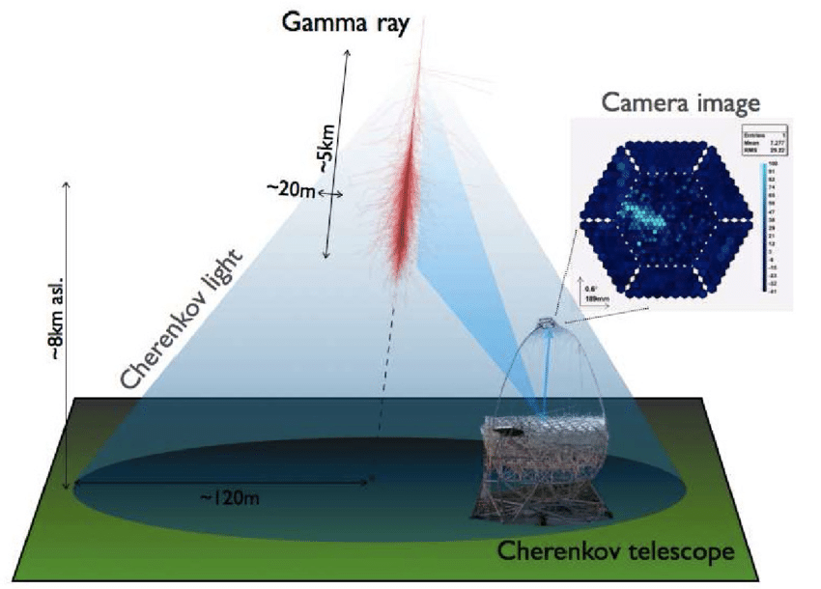
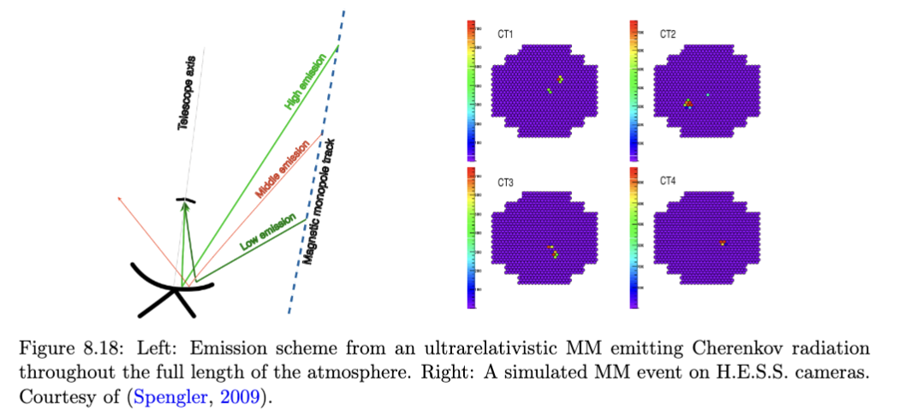
IACTs
Very peculiar signature from MM in IACTs:
Super-bright events
Sometimes Double signals (from different zone of the atmosphere)
No confusion wrt gamma-rays
Only preliminary studies from MSc thesis of Gerrit Spengler

Slide 14
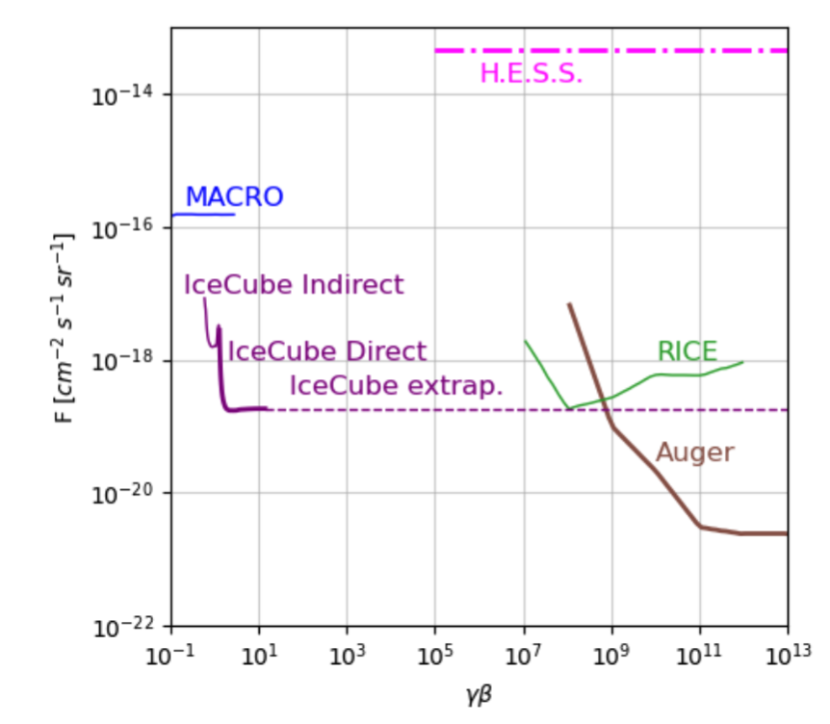
Current world-best limits
IceCube = Relativistic MMs
PAO=Ultra Relativistic MMs
← In terms of speed

Slide 15
#2 ACCELERATION OF MM IN COSMIC FIELDS

Slide 16
MM and magnetic fields
The evolutions of magnetic monopoles and cosmic magnetic fields are strictly coupled throughout the universe's history.
Cosmic magnetic fields accelerate the monopoles
Accelerated monopoles extract energy from cosmic magnetic fields
If one defines a model for cosmic MFs, one can compute the acceleration of MMs in function of the MM mass (and considering the back-reactions)
$$m\frac{d}{dt}(γv)=gB$$
The survival of cosmic magnetic fields might lead to new bounds
Monopole bounds are affected by the acceleration

Slide 17
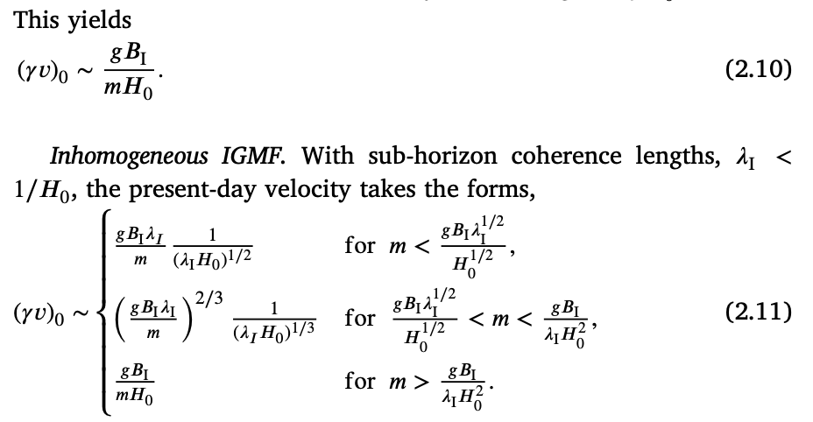
ACceleration
https://arxiv.org/abs/2401.00560
In short:
Define B strengths and coherence length
Compute acceleration in function of MM mass
Consider back-reaction on B field (flux dependent)
Check which dominates!
We have explored IGMF/GMF:
IGMF: current bounds on intensity, $λ_{I}=1Mpc or>1/H_{0}$
GMF: Jannson and Farrar models

Slide 18
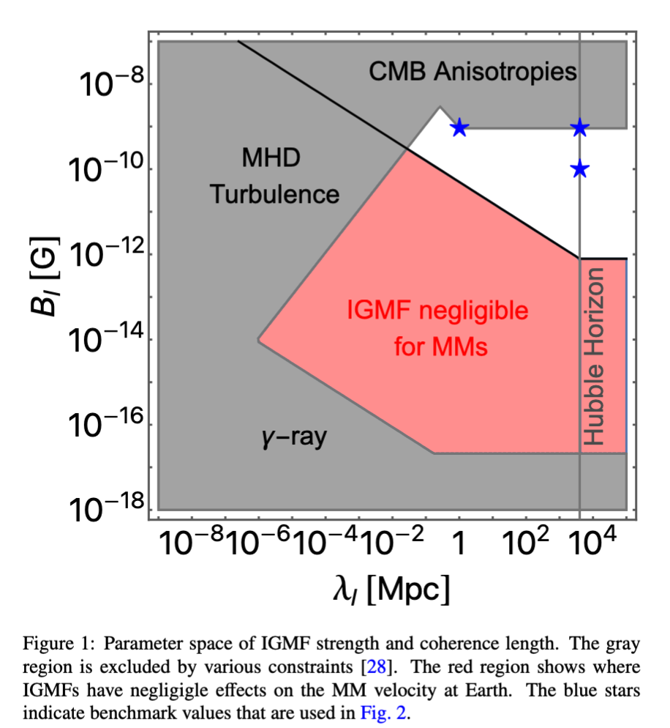
IGMF limits
Current limits on intensity
From above, mostly by CMB anisotropies (~1e-9 G)
From below by gamma-ray experiments
G-ray halos around blazars,
TeV→ GeV signal reprocess (due to pair production+synchrotron)
Delayed signal emission
On coherent lengths
Small values excludes by turbulence
Durrer:2013pga,AlvesBatista:2021sln,Neronov:2021xua

Slide 19
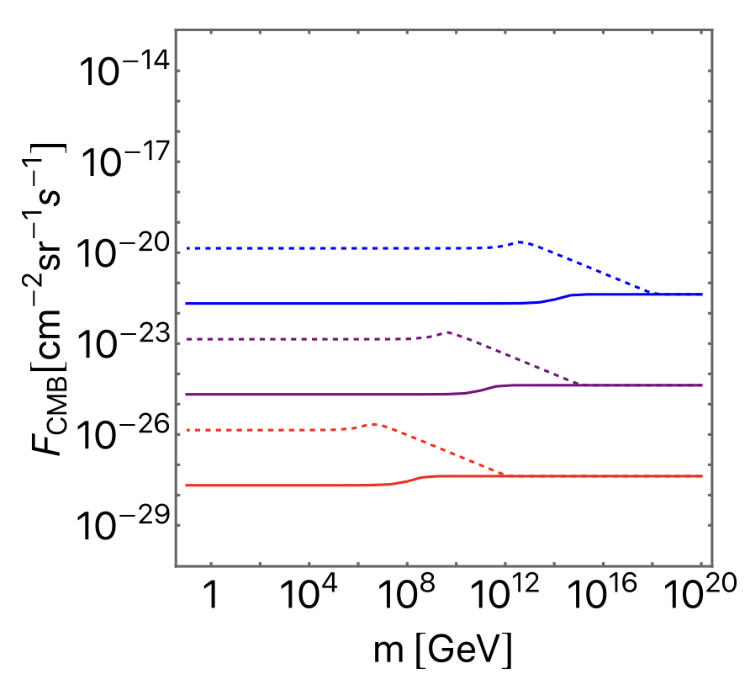
BACK reaction
MM extracts energy from B.
This depends on their flux / their mass
𝐵 = 10⁻⁹ G (blue), 10⁻¹² G (purple), 10⁻¹⁵ G (red),
𝜆I > 1𝐻0 (solid) and 𝜆I = 1 Mpc
(dashed).
← Threshold for back-reaction
Higher B allows for larger MM fluxes
Larger $λ_{I}$ allows for larger fluxes
As a result, the maximum speed depends on flux:
$$max⁡(v_{MW},v_{IGMF},v_{GMF})$$

Slide 20
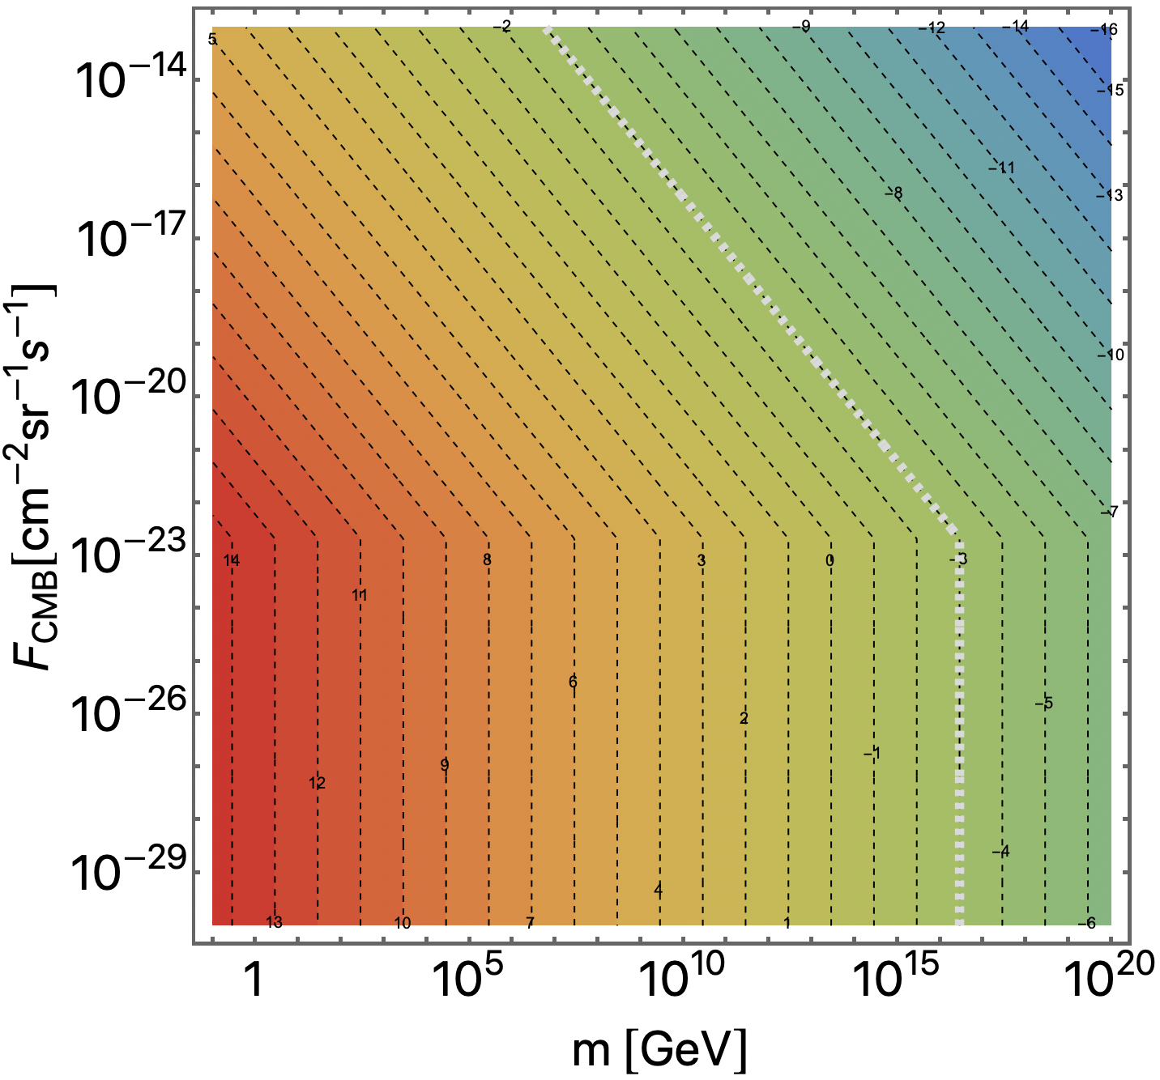
Acceleration in IGMF
$$B={10}^{−10}G, λ=∞$$
Back reaction
Free Acceleration
IGMF alone can accelerate MM to ultra-relativistic speeds

Slide 21
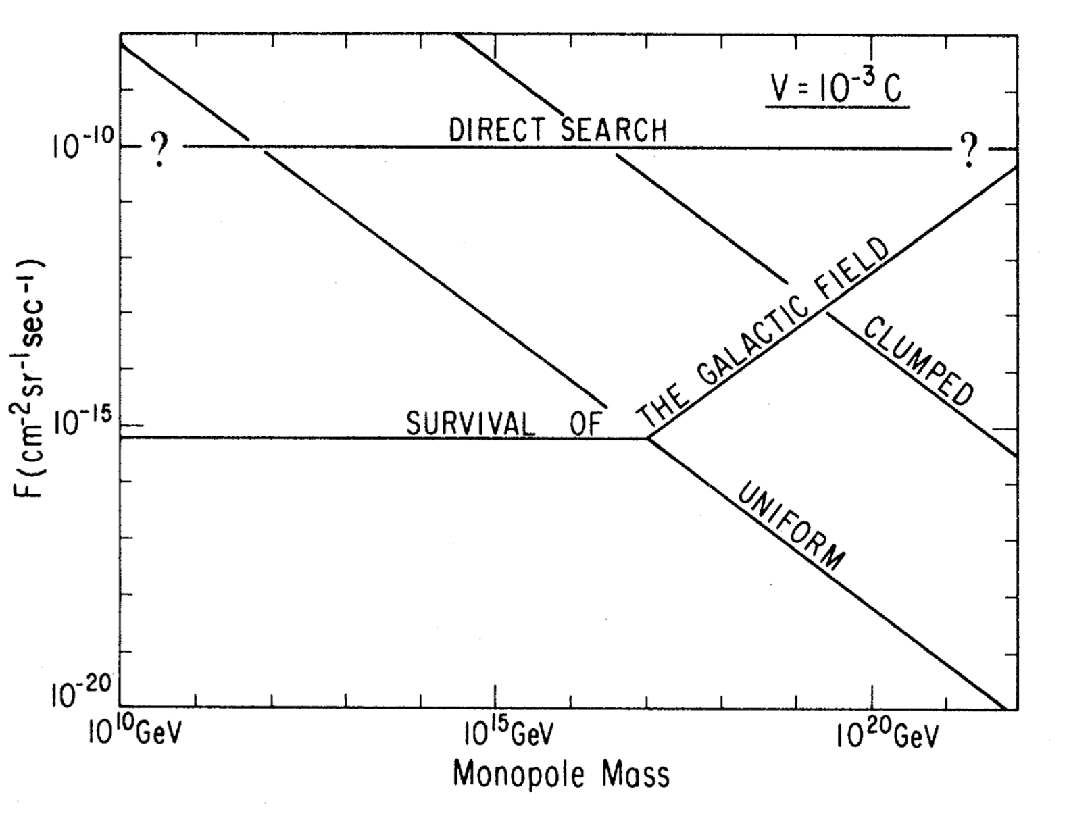
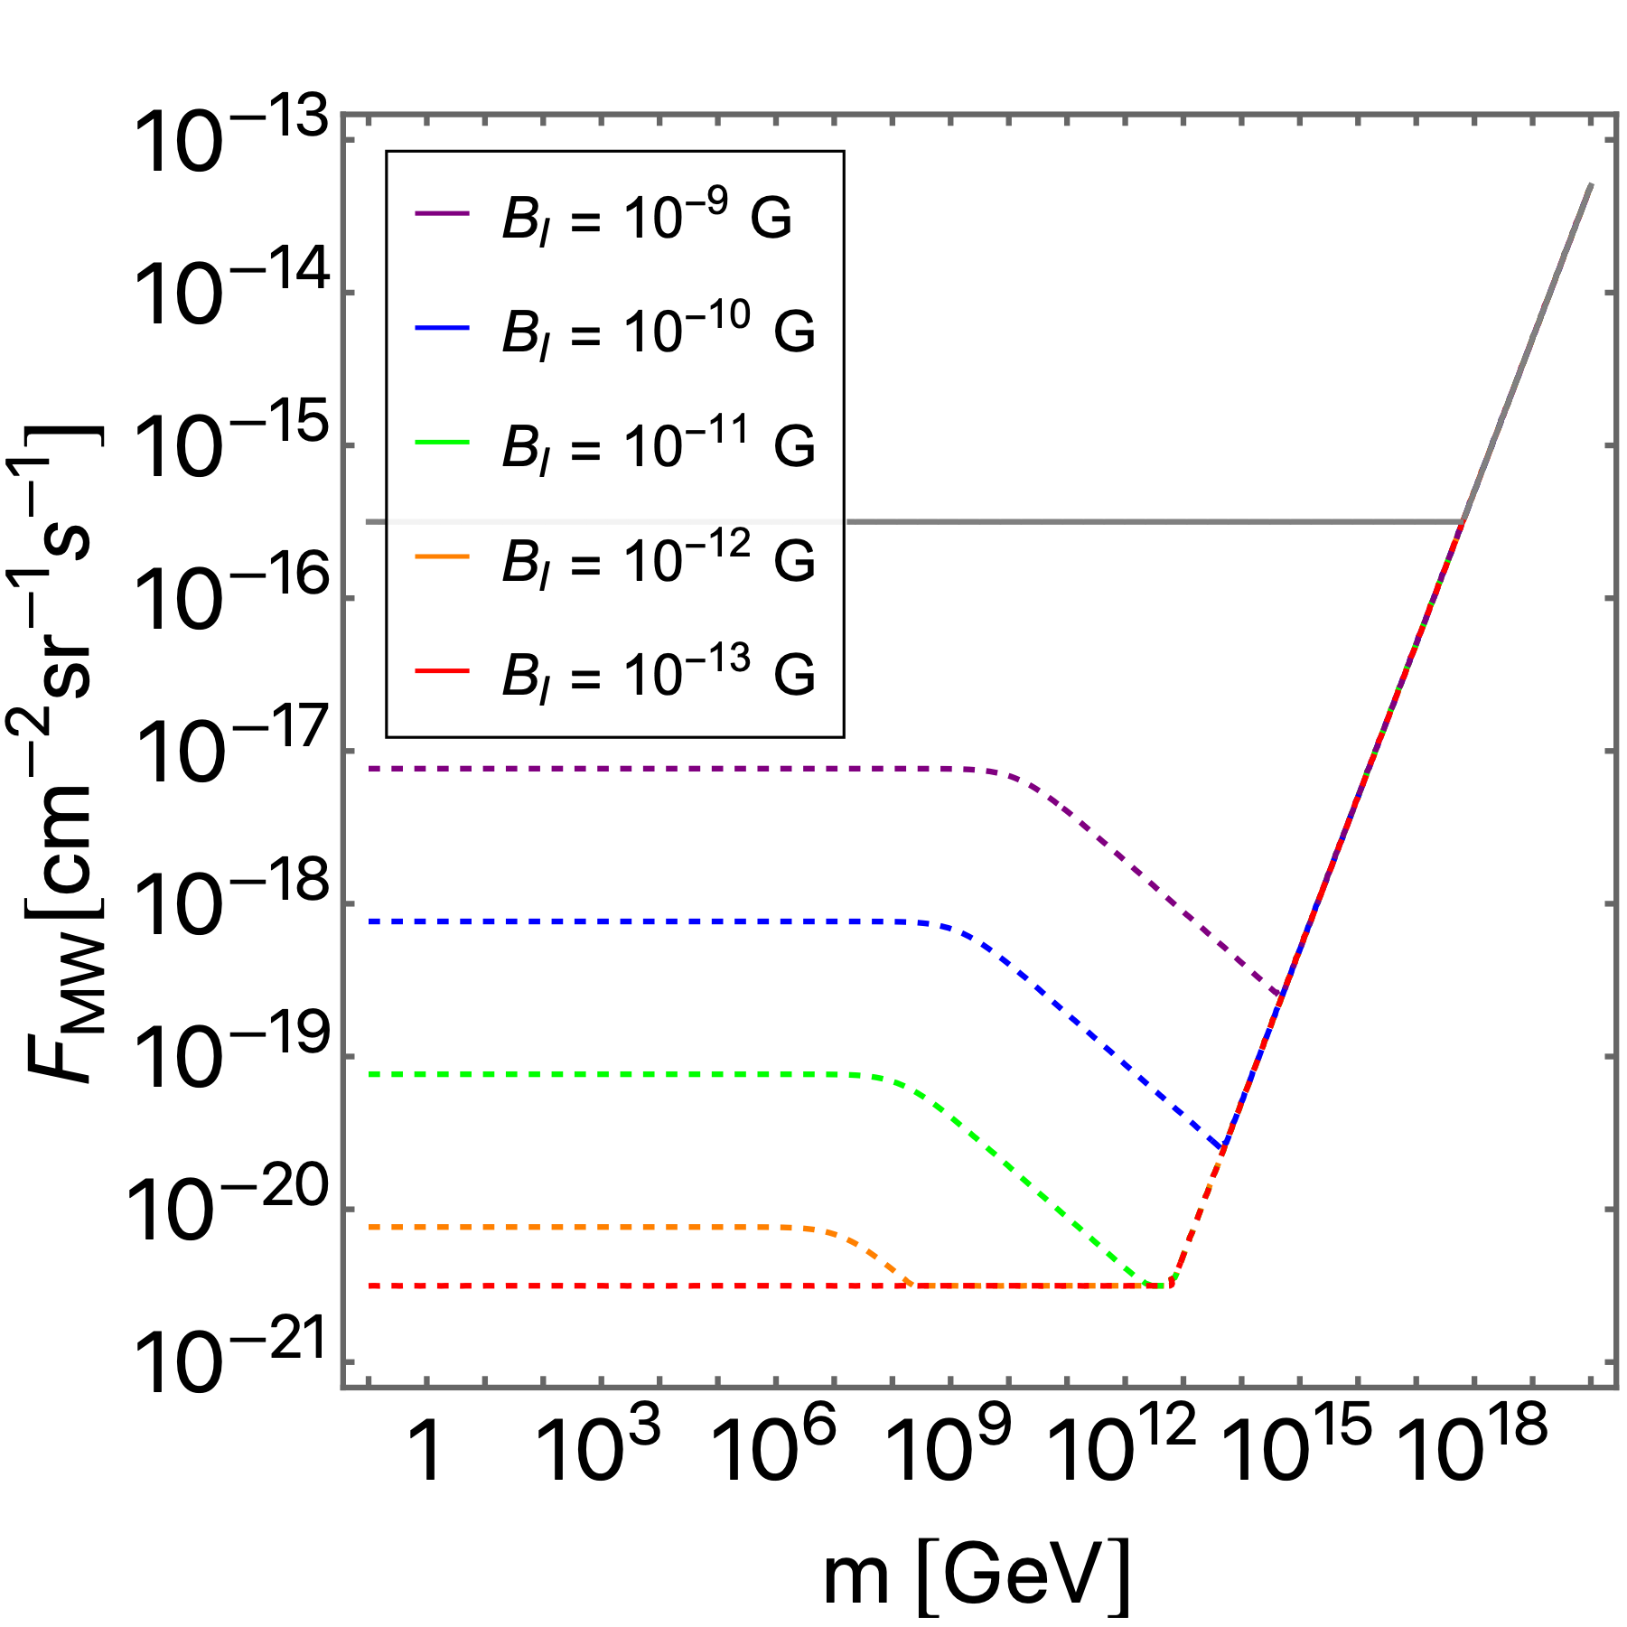
GALACTIC MAGNETIC FIELDS
In 1970 Parker proposed a bound on the monopole flux today inside our Galaxy:
The Galaxy presents a magnetic field of∼2×10^(−6) G;
The Galactic magnetic field accelerates the monopoles losing its energy;
The survival of the field provides a bound on the monopole flux today.
The bound can be even extended considering the seed field of the Galaxy.
← Seed Parker bounds are weakened by acceleration into IGMF
Acceleration in GMF

Slide 22
Speed-mass relation (dep. Flux)
One can compute the speed-mass relation for different scenarios of IGMF (and flux)
Weak IGFM
GMF dominates
No back-reaction
Strong IGMF →
IGMF contributes
Back-reaction matter

Slide 23
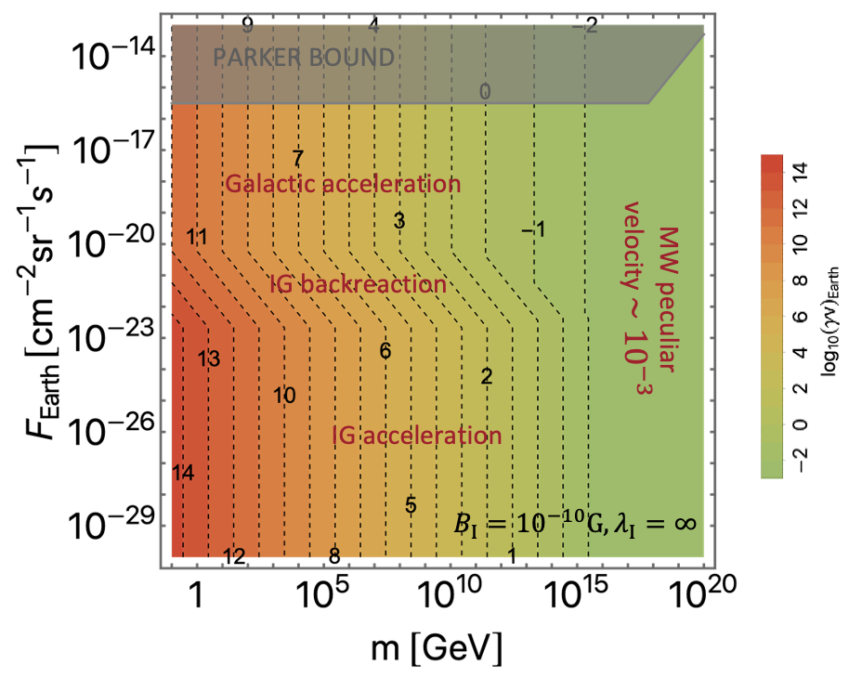
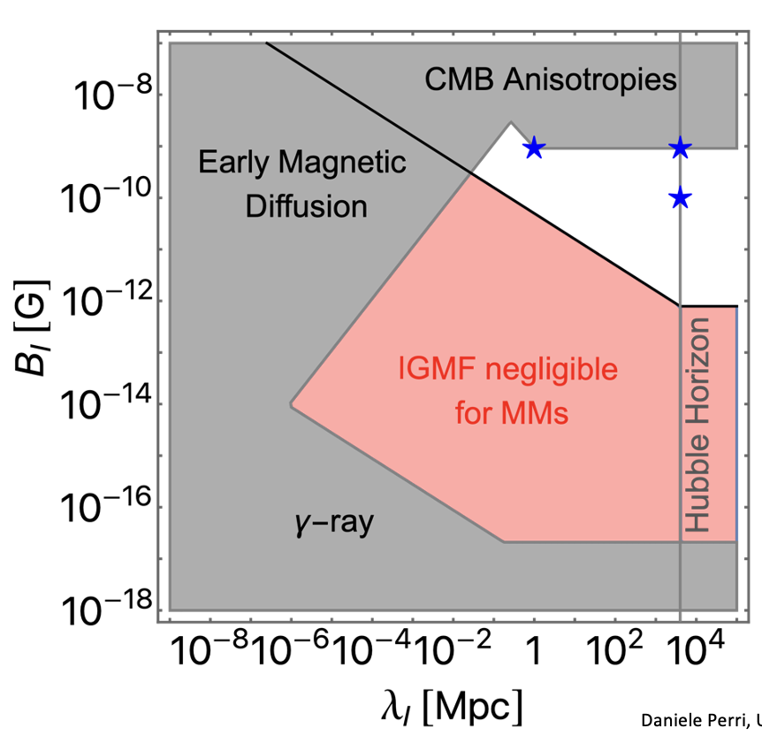
All considerered

Slide 24
#3 RE-cast experimental bounds

Slide 25
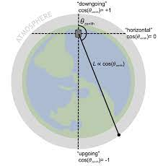
From speed-limits to mass-limits
Assuming a model of IGMF one can related speed to mass
Terrestrial experiments required relativistic and ultra-relativistic speeds
One should consider ‘kinetic energy at the detector’
Compute energy loss in matter (if required)
Acceptance direction depedent
E.g. MMs are clearly seen by IC only if coming from below
Small kinetic energy MMs are lost (and this depends on the angle)
Similar argument for MACRO
We carefully checked Icecube and MACRO acceptance

Slide 26
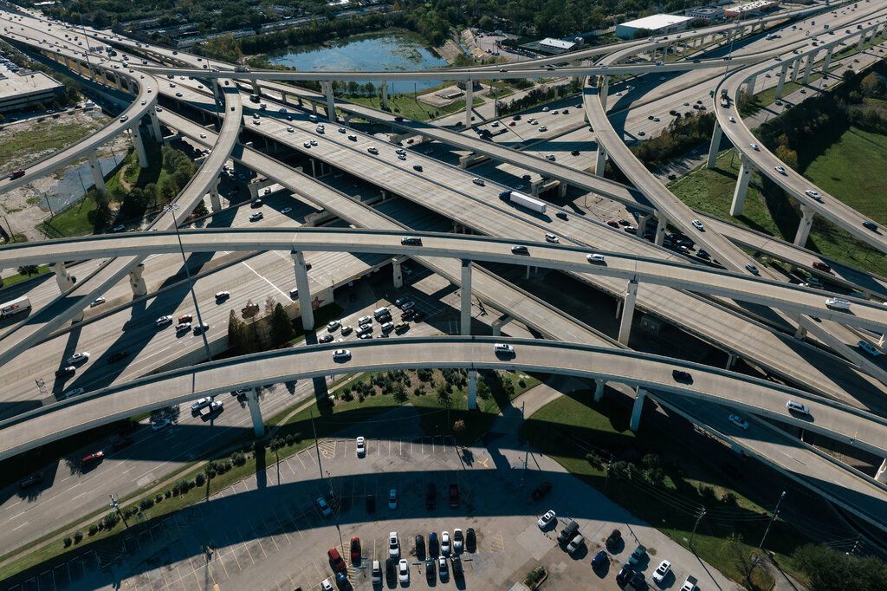
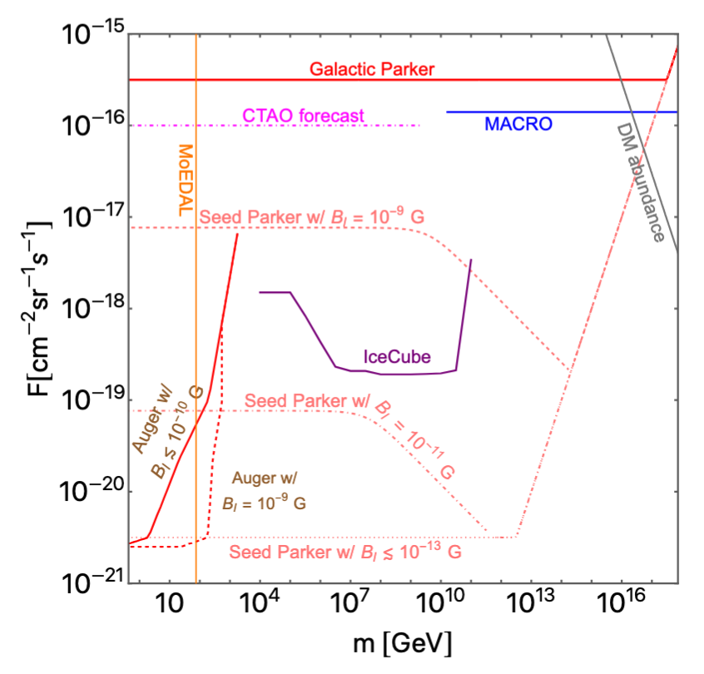
Results
Ah! I need a navigator!
1/ Instruments have different mass sensitivity
2/ Seed Parker bounds significantly modulated by IGMF strength
3/ For small fluxes, IGMFs must be considered
In terms of mass →

Slide 27
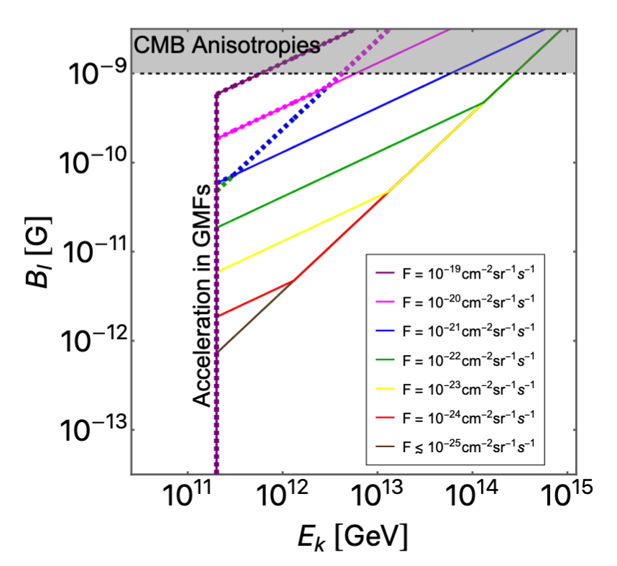
BONUS
The argument can be reversed
A MM flux limit, assuming a certain kinetic energy, could be translated into an IGMF limit

Slide 28
Conclusions

Slide 29
Take-home
MM
We have developed a framework that computes the relation MM mass-speed in cosmic MFs (that includes back-reaction)
We have made assumptions on MFs, if better models come out, more accurate estimations can be made
Strong IGMFs impact MM acceleration (could contribute, could dominate)
Terrestrial instruments are sensitive to different MM mass (related to their formation mechanisms)
Thanks!

Slide 30
BACKUPS

Slide 31
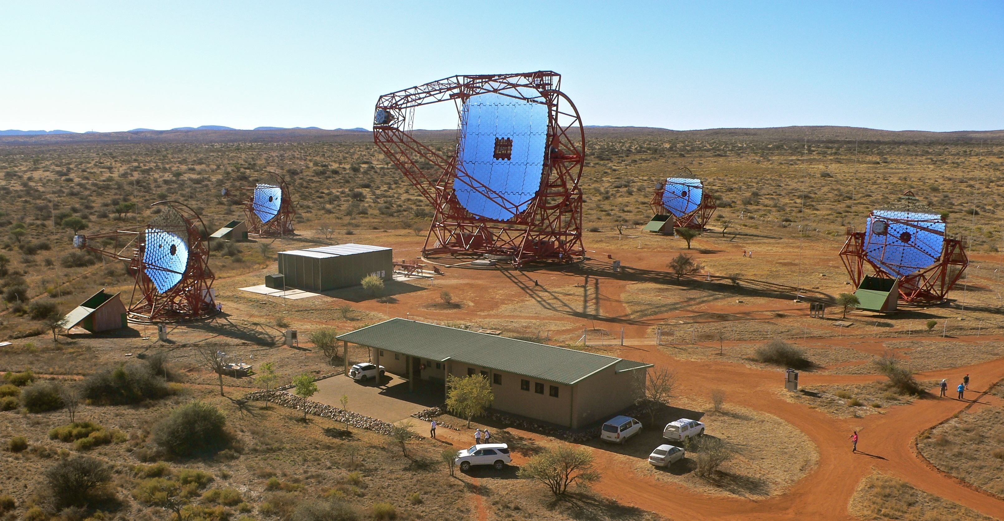
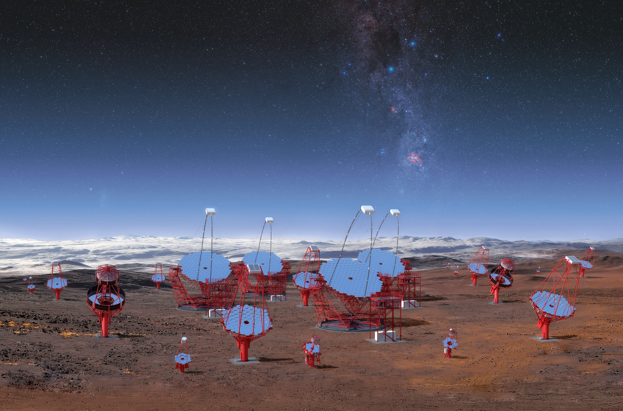
FOCUS on IACTs
Only MSc work from Gerrit Spengler (2009) for H.E.S.S. data
Simplified Monte Carlo, strong data selection
Cherenkov Telescope Array Observatory will improve
Larger FOV
Larger effective area
Longer exposure
All considered, sensitivity can improve 200 times wrt H.E.S.S. and on wider MM speed range
A topic so far not investigated by current IACTs

