Slide 1
Charging a Quantum Spin Network with Superextensive Precision
Padova, 3rd June 2025

Slide 2
Quantum battery - Charging a state
Hamiltonian describing the quantum battery, with a minimum eigenstate (discharged battery) and a maximum eigenstate (charged battery)
Charging Hamiltonian,
It is a time-dependent interaction that is turned on at time t=0 and off at final time
F. Campaioli, S. Gherardini, J. Q. Quach, M. Polini, and G. M. Andolina, ‘‘Colloquium: Quantum batteries’’,
Rev. Mod. Phys. 96, 031001 (2024)

Slide 3
Superextensive precision
Superextensive scaling $\sim N^{α}$, $α>1$
where $N$ is the system size
Average magnetization
We looked for super-extensive precision in reaching the charged state
Variance of magnetization
$$σ^{2}=$$
We consider a spin network, thus our charging is identified in the magnetization $μ$ and the precision in its variance $σ$
$$H_{0}\sim S_{z}$$

Slide 4
?
Is it possible to achieve superextensive precision, even reaching Heisenberg-limited behavior, in the charging of a quantum spin network?
?
Can such a protocol be implemented not just in simulation, but on real, imperfect, noisy hardware like the D-Wave Advantage quantum annealer?
Notes:
We show that we reach it if we generate correlations thanks to the application of a cooperative protocol that uses the crossing of a critical point. Local protocols do not suffices.

Slide 5
Local vs Cooperative charging
Precision scaling as $N$
Standard Quantum Limit
Precision scaling as $N^{2}$
Heisenberg Limit
No need of entanglement
Notes:
flippo ogni singolo spin? Noooooooo, flippo collettivamente il sistema. No need of entanglement to reach Heisenberg precision

Slide 6
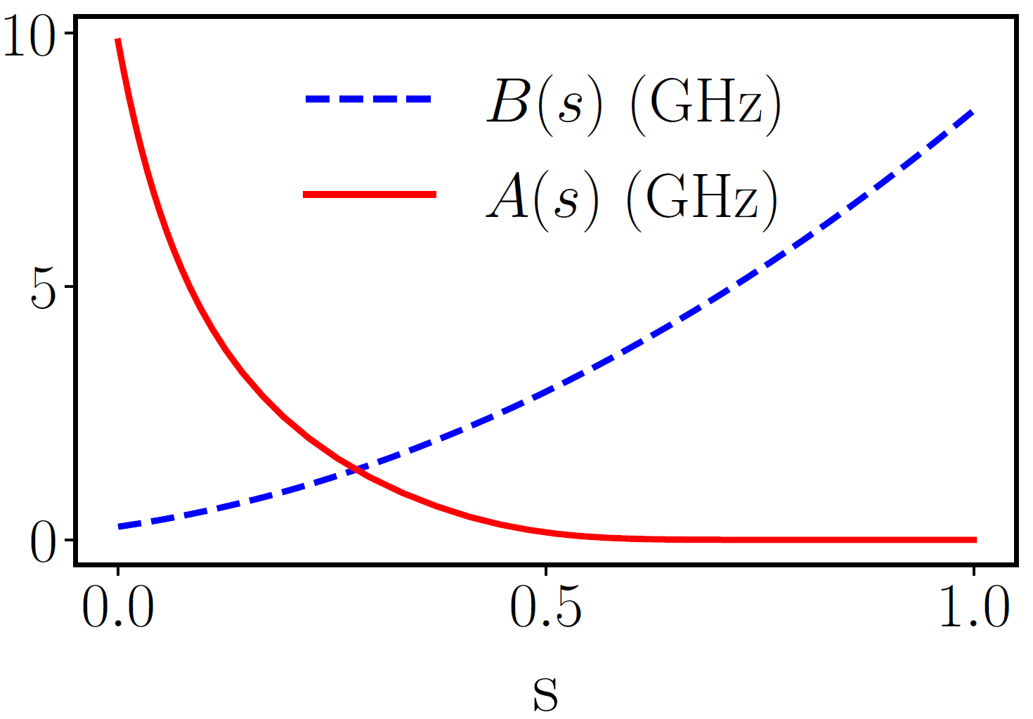
D-Wave’s Advantage 6.4 quantum annealer consists of an ensemble of 5,612 superconducting qubits that can be controlled via the time-dependent Hamiltonian
s
schedule parameter
Transverse field
Magnetization
field
Interaction
https://www.dwavequantum.com/

Slide 7
Local protocol
No interaction in the local protocol: J=0
Flip every spin independently
B. Donelli, S. Gherardini, R. Marino, F. Campaioli and L. Buffoni, ‘‘Charging a Quantum Spin Network with Superextensive Precision’’, Phys. Rev. E, Accepted 22 May, 2025

Slide 8
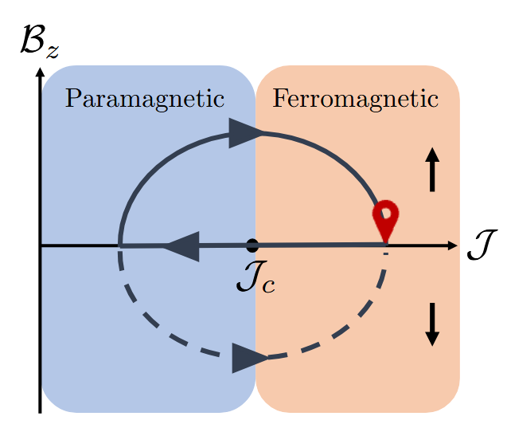
Cooperative erasure protocol
Start from all spins down
Go into the disordered phase
Scramble all spins
Go back to ordered phase aligning all spins up
Idea: pass through the disordered phase in order to induce high-performance charging
Disordered
phase
Ordered
phase
L. Buffoni and M. Campisi, ‘‘Cooperative quantum information erasure’’, Quantum 7, 961 (2023)

Slide 9
Cooperative DWave protocol
B. Donelli, S. Gherardini, R. Marino, F. Campaioli and L. Buffoni, Phys. Rev. E, Accepted 22 May, 2025

Slide 10
Charging – Average magnetization
$ν$ repetitions
$μ_{i}$ magnetization measurement
Filled = Dwave
Empty = Numerical simulations
Small N up to 12: exact simulation,
$N∈[12,300]$: tensor network simulation,
$N>300:$ only Dwave expreiments
B. Donelli, S. Gherardini, R. Marino, F. Campaioli and L. Buffoni, Phys. Rev. E, Accepted 22 May, 2025

Slide 11
Precision – variance of magnetization
2
$ν$ repetitions
$μ_{i}$ magnetisation measurement
$\overline{μ}$ mean magnetisation
$$α=1$$
Standard quantum limit
$$α=2$$
Heisenberg limit
B. Donelli, S. Gherardini, R. Marino, F. Campaioli and L. Buffoni, Phys. Rev. E, Accepted 22 May, 2025

Slide 12
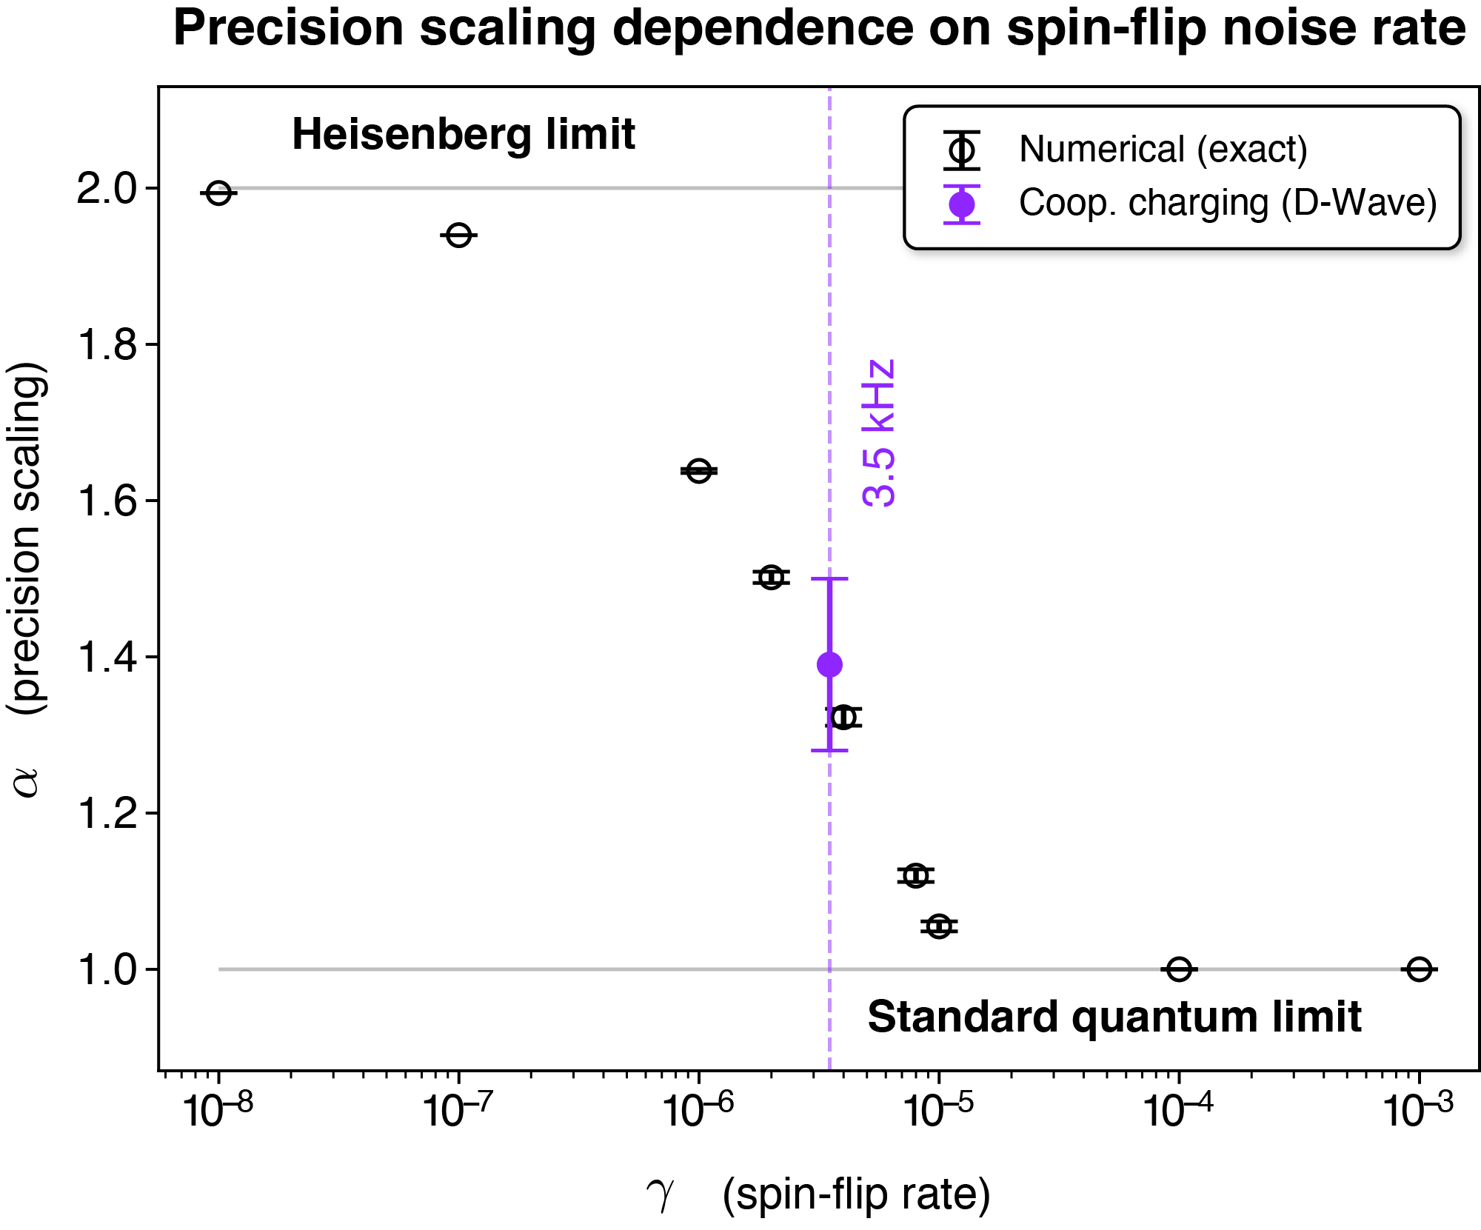
Open battery
Lindblad Master equation
The Lindblad operator $L_{k}$ models the effects of local spin-flip noise with decoherence rate $γ>0$ due to local fluctuations of the transverse field $B_{x}$.
B. Donelli, S. Gherardini, R. Marino, F. Campaioli and L. Buffoni, Phys. Rev. E, Accepted 22 May, 2025

Slide 13
Summary
We show that we reach superextensive precision in charging a quantum spin network if we generate correlations by applying a cooperative protocol that uses the crossing of a critical point. Cooperative protocols significantly outperforms local ones.
We have implemented such a cooperative protocol on a real device, the Dwave Advantage quantum annealer, reaching a superextensive precision even in the presence of noise.

Slide 14
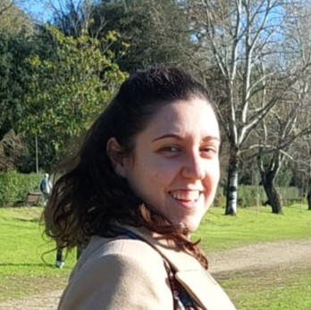
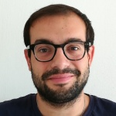
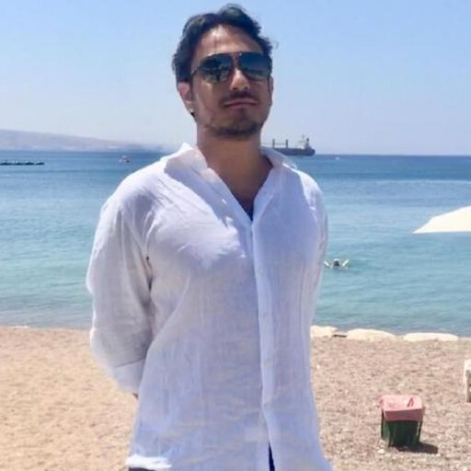
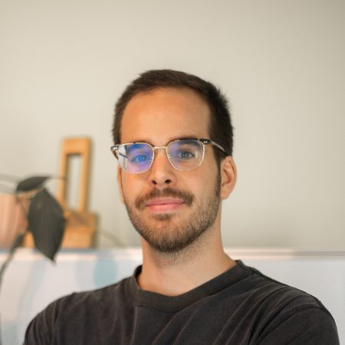
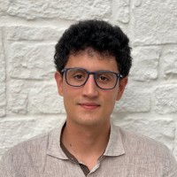
Thank you!!

Slide 15
Backup slides

Slide 16
Local charging
$$p∈[0,1]$$
depolarisation from unit purity
$$θ∈[0,π/2]$$
local rotation angle from the magnetization axis
$$σ_{\left(L\right)}^{2}=\frac{1}{N} \left[1−{\left(1−p\right)}^{2}\cos^{2}\left(2θ\right)\right]$$
Notes:
flippo ogni singolo spin? Noooooooo, flippo collettivamente il sistema

Slide 17
Cooperative charging
$$P∈[0,1]$$
global depolarisation from unit purity
$$Θ∈[0,π/2]$$
global depolarisation
$$σ_{\left(C\right)}^{2}=\frac{P}{N}+(1−P)\left[1−\left(1−P\right)\cos^{2}\left(2Θ\right)\right]$$
Notes:
flippo ogni singolo spin? Noooooooo, flippo collettivamente il sistema

