Slide 1




Exploring the Dark Universe with the Euclid space mission
Speaker: Prof. Chiara Sirignano
Group: Stefano Dusini, Alessandro Renzi, Luca Stanco, Stefano Anselmi, Filippo Oppizzi, Antonino Troja, Andrea Begnoni, Francesca Passalacqua,

Slide 2
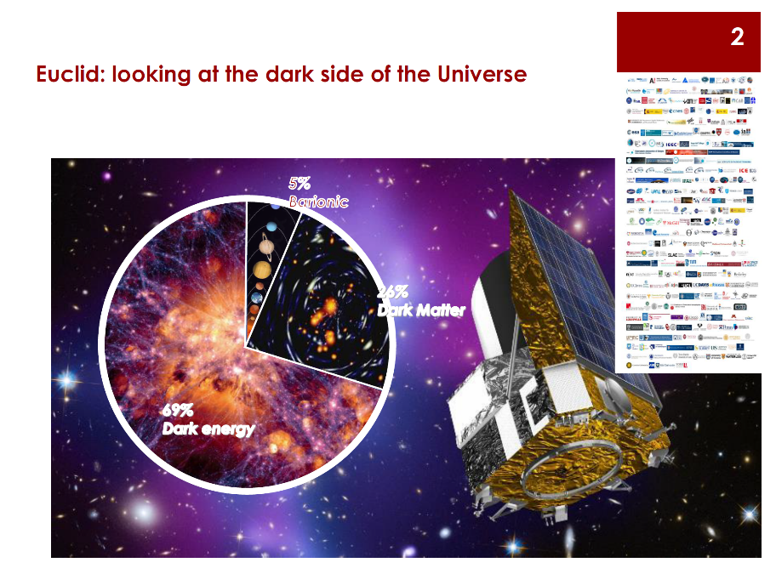

Slide 3
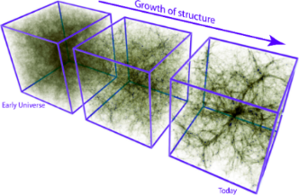
The Euclid mission will use two probes to study dark matter
and dark energy 3D distribution.
The aim is to trace the structure of the Universe,
both visible (galaxies) and invisible (dark matter).
Weak Lensing – provides the total matter distribution
requires photo-z + morphometry of ~30 gal/arcmin²
Galaxy Clustering – provides the distribution of galaxies, the luminous matter
requires slitless spectroscopy dz/(z+1) ~0.001 of ~1700 gal/deg² with 0.9 < z < 1.8
For a sky area coverage of ~15,000 deg²
In addition to the two primary probes the Euclid data sample will provide unique opportunity to study
Galaxy evolution - provides the physical properties of galaxies ( e.g. stellar mass, star formation rate) exploiting the combination of photometry + spectroscopy
CMB cross correlation with LSS, GW cross correlation with LSS
Constraints on Modified Gravity
Probing initial conditions of the Early Universe

Slide 4
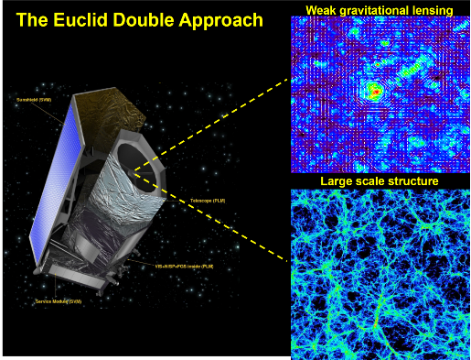
Double approach to look at the Invisible
Wavelength Coverage: 550nm–2000nm
Weak Lensing: (Optical + NIR photometry)
measurement of the distortion of the galaxy shapes due to the gravitational lensing caused by the dark matter distribution between distant galaxies and the observer. From the resulting galaxy shear can be deducted matter distribution. 2 billions of galaxies over 15,000 deg².
Galaxy Clustering: (NIR Slitless Spectroscopy)
3D mapping of about 40 million galaxies over 15,000 deg² with slitless spectroscopy in space, redshift distribution of galaxies from their Hα emission line.
Larger application of slitless spectroscopy ever.

Slide 5
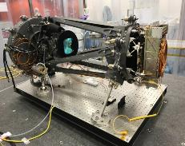
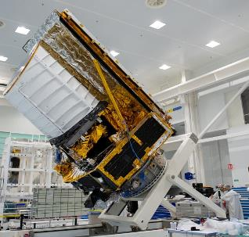
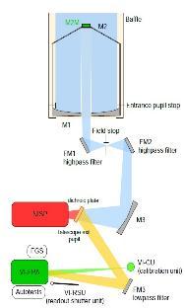
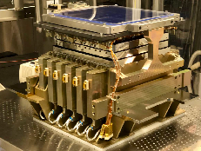
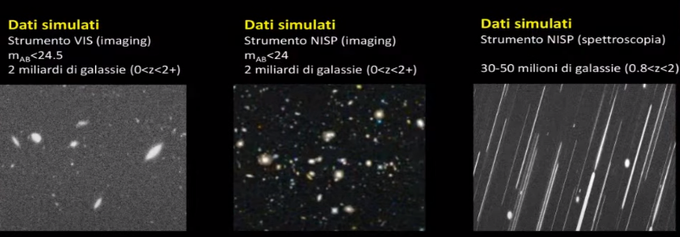
The telescope and the two “cameras”

Slide 6
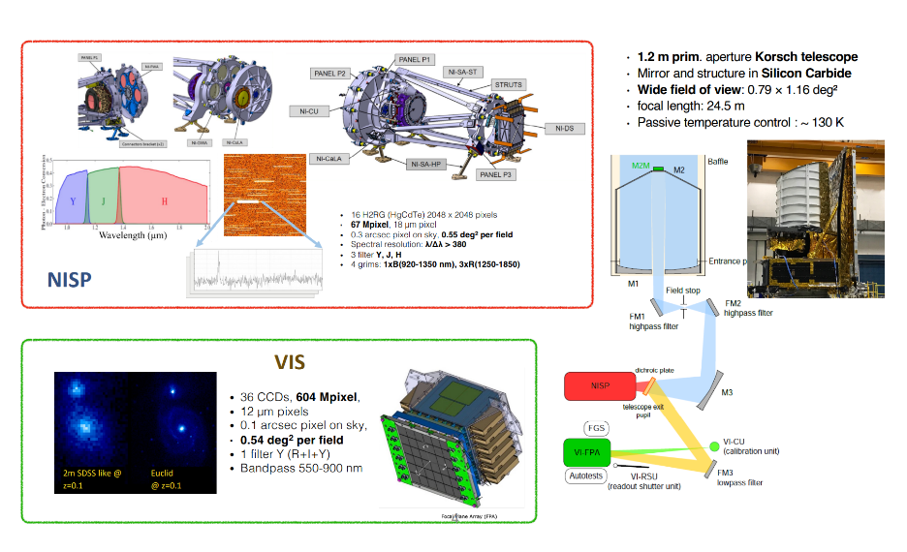
Double approach to look at the Invisible

Slide 7
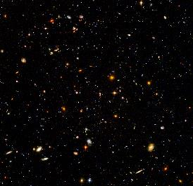
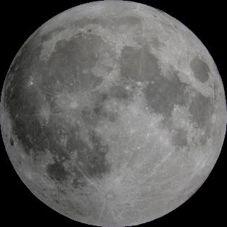
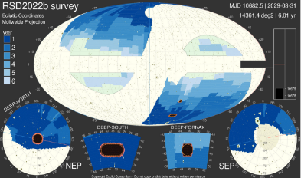
Optimised for wide-field imaging & spectroscopy
Euclid Fov 0.7 x 0.7 deg
Hubble Ultra Deep Field in Fornax, 2.6 x 2.6 arcmin (29 AB mag)
Euclid full survey area

Slide 8
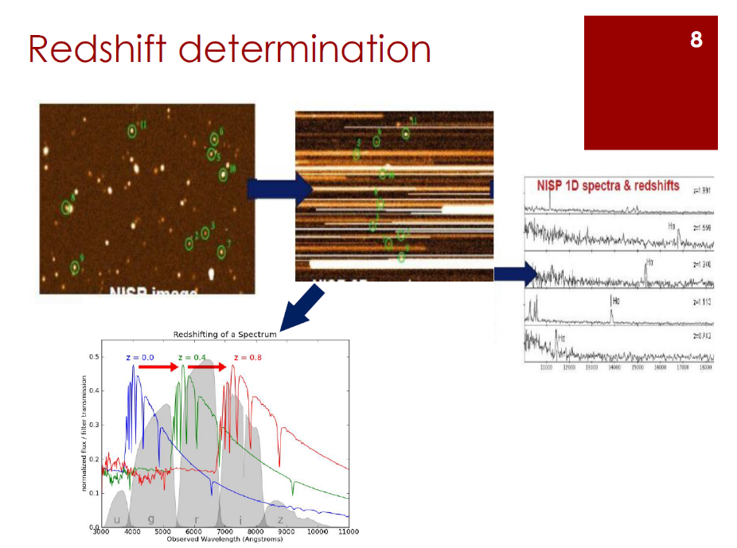

Slide 9
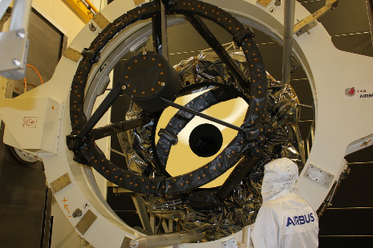
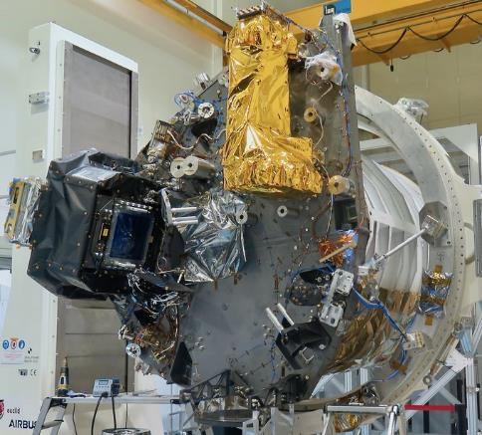
Euclid pictures

Slide 10
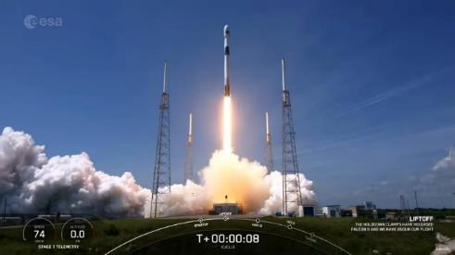
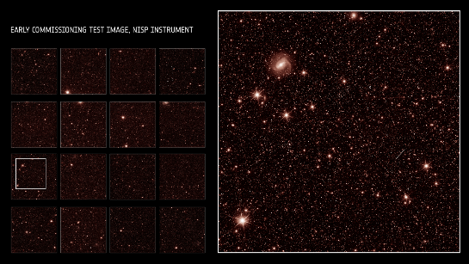
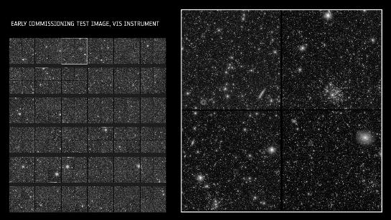
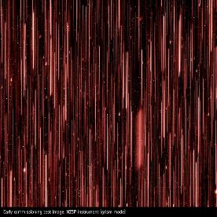
Euclid Highlights
July 1st 2023
July 31st 2023

Slide 11
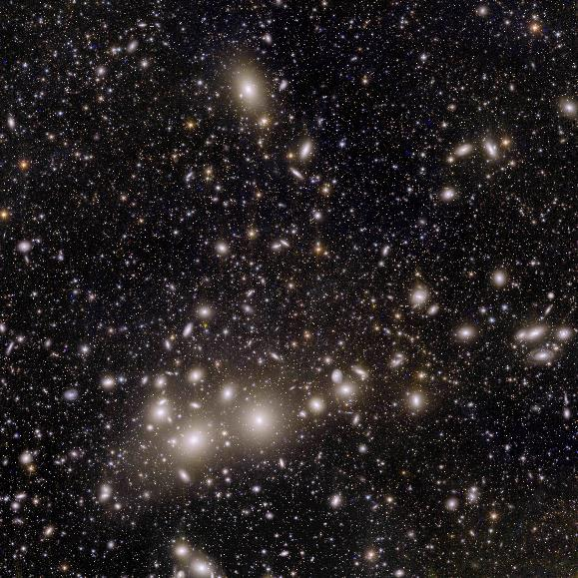
First demonstrative data unveil – Nov 7th 2023
Combined visible + NIR
Image of Perseus Cluster
More than 100 000 sources
in a single view

Slide 12
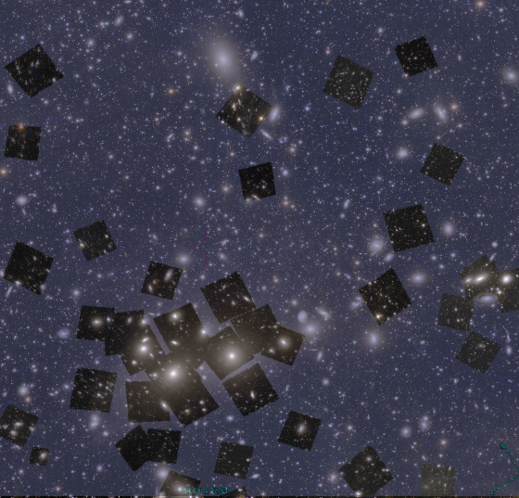
First demonstrative data unveil – Nov 7th 2023
Comparison with existing
telescopes

Slide 13
First demonstrative data unveil – Nov 7th 2023
HST – like image quality

Slide 14
Activities @DFA
Our group was active on the Spectrograph assembly and on the On Board Image analysis data validation since 2015
We followed all the ground test campaigns and we took part in launch campaign in summer 2023
Lead in the NISP instrument Operations during the mission lifetime
Analysis of the impact of high energy cosmic rays on the NIR detectors (dedicated test beam @LNL)
Simulation of the Spectroscopic data trough the official Euclid framework
Validation of the Spectroscopic data reconstruction algorithm
Development of efficient data analysis algorithms (big data)
Estimation of cosmological parameters from Euclid data seta
Joint analysis of CMB and Euclid data
Implementation of innovative methodologies to estimate cosmic distances, detect the late time acceleration of the Universe and neutrino mass, and characterize the Dark Energy dynamics.

Slide 15
Contacts
Speaker: Office n. 173 ( Via Marzolo, 8)
Email chiara.sirignano@unipd.it
Group: alessandro.renzi@unipd.it, stefano.dusini@pd.infn.it, luca.stanco@pd.infn.it

