Slide 1


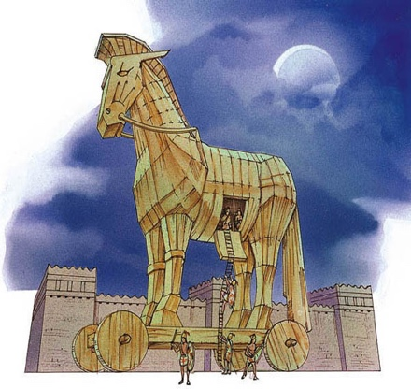

Nuclear Astrophysics with Indirect Methods
Marco Mazzocco

Slide 2

Nuclear Astrophysics
Nuclear Astrophysics investigates how nuclear processes generate the energy of stars over their lifetime and, in doing so, synthesize heavier elements from the primordial hydrogen and helium produced in the Big Bang.
We humans are mostly (83%) oxygen and carbon. We understand in a general way the chemistry and biology involved, but we certainly do not understand the nuclear astrophysics which produced the oxygen and carbon in our bodies.
Each of us, in a sense, has been inside a star and truly and literally consists of stardust. Every molecule in our bodies contains matter that once was subjected to the tremendous temperatures and pressures at the center of a star.
This is where the iron in our blood cells originated, the oxygen we breathe, the carbon and nitrogen in our tissues and the calcium in our bones.
(W.A. Fowler – Nobel Price in Physics 1983)

Slide 3
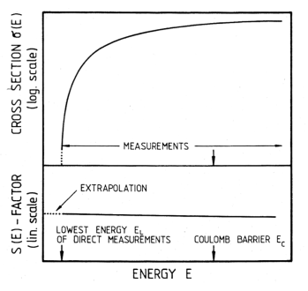
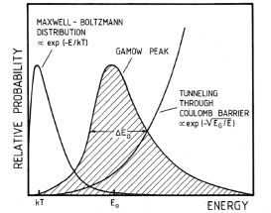
ThermoNuclear Reactions
Gamow Energy Peak
Nuclear reactions of astrophysical interest occur at energies deeply below the Coulomb barrier, their cross sections (i.e. probabilities) might be extremely small and background might be very high.

Slide 4
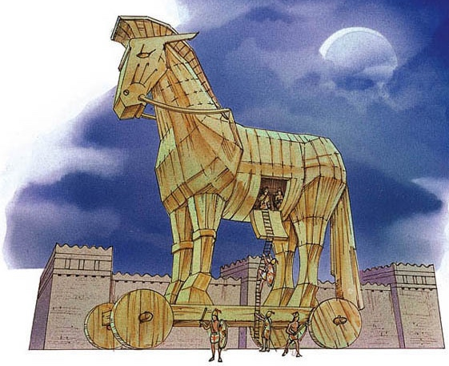
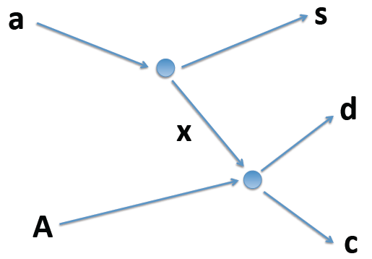
Trojan Horse Method
Basic Concept:
It it possible to extract the astrophysically relevant two-body cross section:
A + x → c +d
from the quasi-free contribution of a suitable three-body reaction:
A + a → c + d + s
Method: to hide the projectile x inside a Trojan Horse Nucleus a, with a prominent cluster structure x + s, and to make sure that particle s acts as a spectator in the nuclear reaction (quasi-free mechanism)

Slide 5
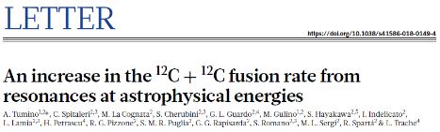
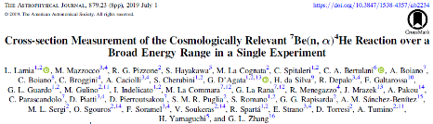
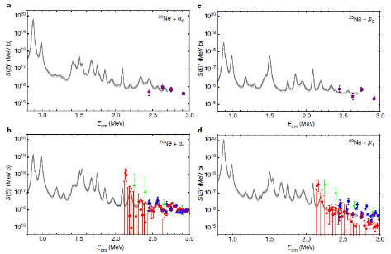
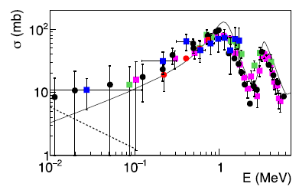
Recent Measurements
Massive Star Evolution (LNS)
Big-Bang Nucleosynthesis (LNL)

Slide 6
Thesis Activity (I)
Setup design and construction,
Setup characterization,
Data taking,
Data analysis,
Study the impact of the cross section results in astrophysical models.
Join experimental runs performed at the RIB facility EXOTIC located at the Legnaro National Laboratories, Laboratori Nazionali del Sud (Catania) or abroad (France, Czech Republic, Canada, Romania, Japan, …)

Slide 7
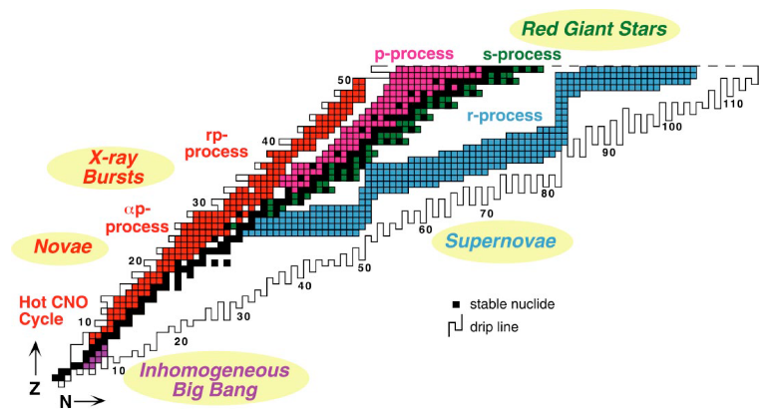
Nuclear Astrophysics and Radioactive Ion Beams
M.S. Smith and K.E. Rehm, Annu. Rev.
Nucl. Part. Sci. 2001. 51:91–130
Radioactive Ion Beams (RIBs) are deeply involved in several scenarios of interest for Nuclear Astrophysics.

Slide 8
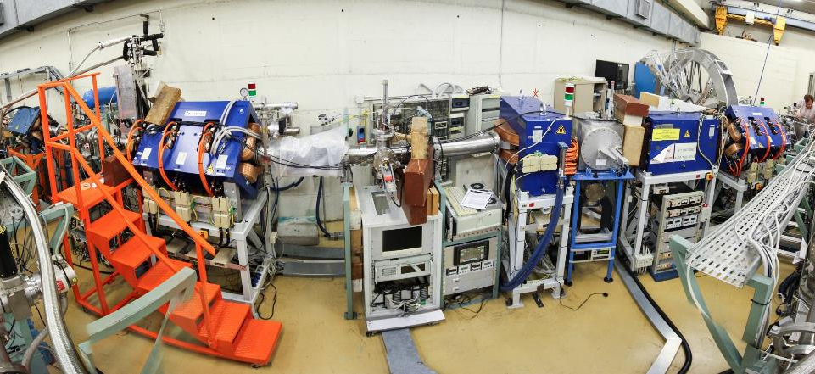
Thesis Activity (II)
Study of the ion-optics for the connection of EXOTIC and AGATA
1st Quadrupole Triplet
Wien Filter
Gas Target
2nd Quadrupole Triplet
30°-Dipole Magnet
PRIMARY
BEAM
SECONDARY BEAM

Slide 9
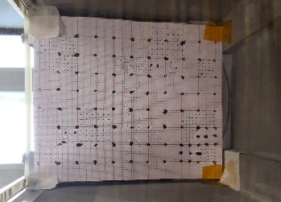
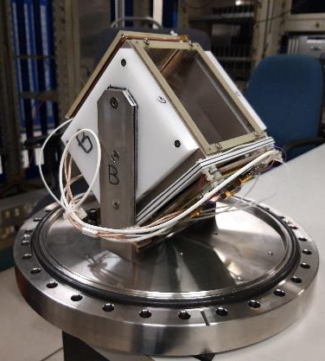
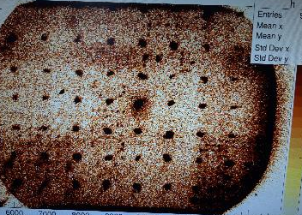
Thesis Activity (III)
Development and characterization of a MCP tracking detector.

Slide 10















ASFIN partnerships and collaborations
@ Catania/LNS: A. Bonasera, S. Cherubini, G. D’Agata, A. Di Pietro, P. Figuera, G.L. Guardo, M. Gulino, M. La Cognata, L. Lamia, D. Lattuada, A.A. Oliva, G.G. Rapisarda, R.G. Pizzone, S. Romano, D. Santonocito, M.L. Sergi, R. Spartà, A. Tumino
@ Padova M. Mazzocco, S. Pigliapoco, F. Soramel
@ Perugia M. Busso, S. Palmerini, M. Limongi, A. Chieffi, M.C. Nucci. N. Vukman
@ Napoli M. La Commara
International Collaborations
  Notre Dame University USA: M. Wiescher, M. Couder
  Cyclotron Institute, Texas A&M, USA: R. Tribble, V. Goldberg
  Texas A&M Commerce USA: C. Bertulani
  Florida State University USA: I. Wiedenhofer
  C.N.S. Riken, Wako, Japan: S. Kubono, H. Yamaguchi, S. Hayakawa
  University of Taskent: B. Irgaziev, R. Yarmukhanmedov
  CIAE, Beijing, China: S. Zhou, C. Li, Q. Wen
  Nuclear Physics Institute, ASCR, Rez, Czech Rep.: V. Kroha, V. Burjan, J. Mrazek
  Nipne IFIN Bucharest: L. Trache
  ELI-NP Bucharest: C. Matei, D. Balabanski
  Atomki, Debrecen, Hungary: G. Kiss
  CSNSM, Orsay, France : A. Coc , F. Hammache, N. De Sereville
  University of Catalunya: J. Jose
  Rudjer Boskovic Institute Zagreb Croatia: N. Soic, M. Milin
  INFN Sez. Napoli e UniNA: D. Pierroutsakou, C. Parascandolo
  University of Pisa: S. Degl’Innoccenti, P. Prada Moroni

