Slide 1


Germanium crystals for gamma ray detection and production
Davide De Salvador
UNIPD – DFA
Semiconductor physics group
INFN – LNL
Material science for nuclear physics laboratory
mail: davide.desalvador@unipd.it
Notes:
After a brief introduction and state of the art on germanium detectors for gamma spectroscopy, I will illustrate some examples of the application of recently developed PLM technologies. Finally, the response of neutron damage of this detectors.

Slide 2
Outline
Gamma ray production and detection, a huge amount of applications
Why germanium ?
How to improve gamma detection performances (N3G – INFN PROJECT)
Proposal for an innovative gamma source (TECHNOCLS - EU-PROJECT)
Davide De Salvador JoinUs@Thesis 2024
Notes:
After a brief introduction and state of the art on germanium detectors for gamma spectroscopy, I will illustrate some examples of the application of recently developed PLM technologies. Finally, the response of neutron damage of this detectors.

Slide 3
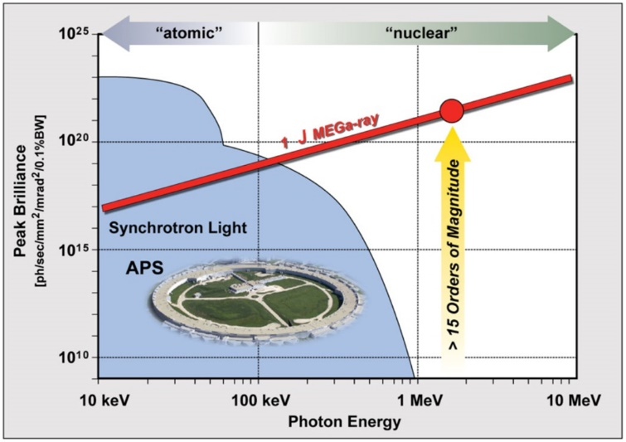
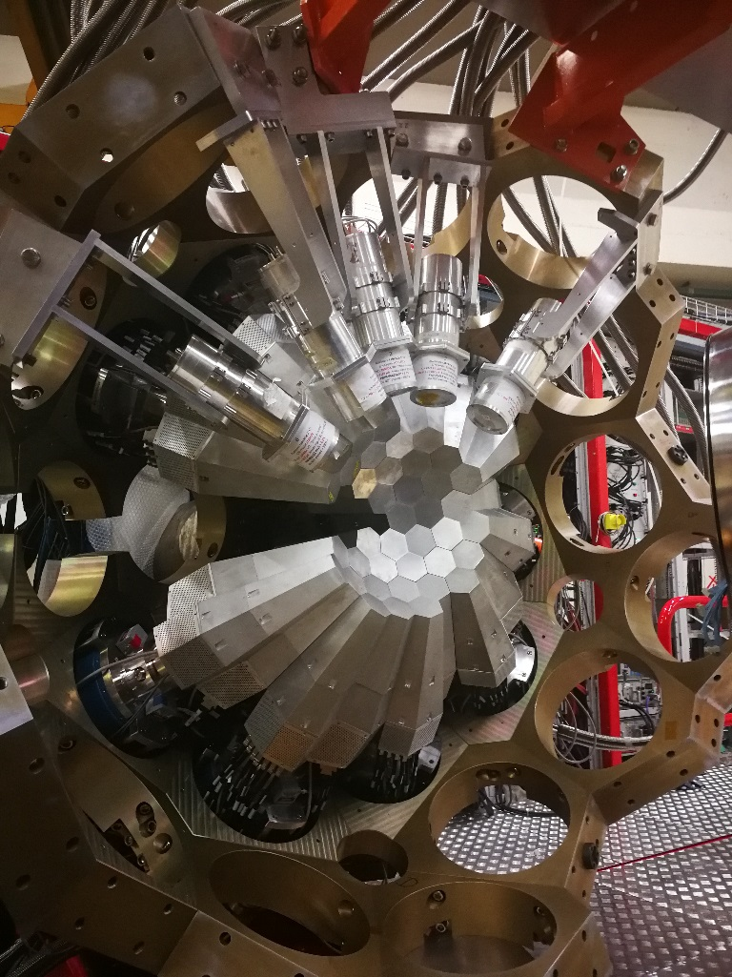
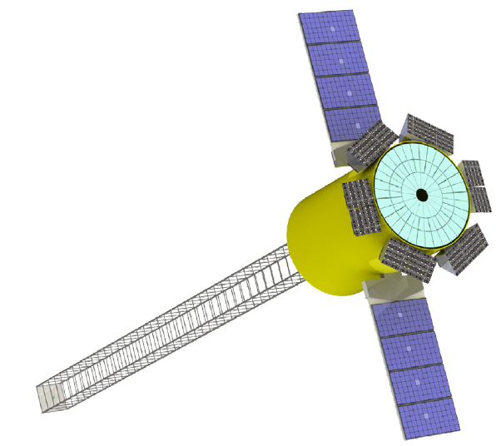
Applications of gamma-rays
Nuclear spectroscopy
Medical diagnosis and treatment
Nuclear photonics
Agata
Astronomy
Safety/security
Astena
Integral
Davide De Salvador JoinUs@Thesis 2024
Notes:
After a brief introduction and state of the art on germanium detectors for gamma spectroscopy, I will illustrate some examples of the application of recently developed PLM technologies. Finally, the response of neutron damage of this detectors.

Slide 4
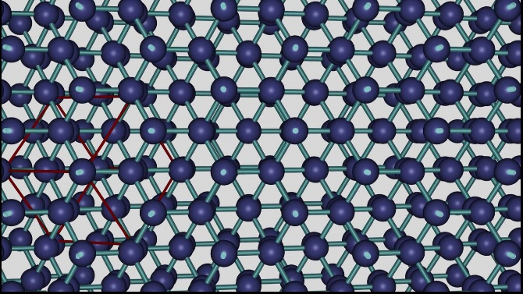
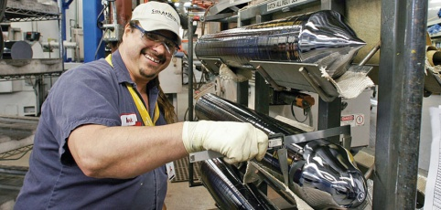
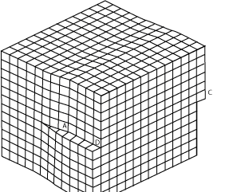
WHY GERMANIUM ?
Highest crystalline perfection (with Silicon, zero dislocations)
Highest purity
Relatively high z
Mature processing technology (not so much as Silicon…)
Davide De Salvador JoinUs@Thesis 2024
Notes:
In gamma spectroscopy, hyperpure germanium is commonly used. Traditionally there is a p+ thin boron implanted contact and a n+ thick lithium diffused contact. The lateral surfaces are passivated. Passivation has a dual function, acting as a chemical barrier and reducing leakage currents. A good passivation should also avoid surface charge that may deform the field.

Slide 5
WHY GERMANIUM ?
Highest crystalline perfection (with Silicon, zero dislocations)
Highest purity
Relatively high z
Mature processing technology (not so much as Silicon…)
Si -> 10¹² cm⁻³ 0.1 ppb of doping impurity
Ge -> 10¹⁰ cm⁻³ 0.001 ppb of doping impurity
Davide De Salvador JoinUs@Thesis 2024
Notes:
In gamma spectroscopy, hyperpure germanium is commonly used. Traditionally there is a p+ thin boron implanted contact and a n+ thick lithium diffused contact. The lateral surfaces are passivated. Passivation has a dual function, acting as a chemical barrier and reducing leakage currents. A good passivation should also avoid surface charge that may deform the field.

Slide 6
WHY GERMANIUM ?
Highest crystalline perfection (with Silicon, zero dislocations)
Highest purity
Relatively high z
Mature processing technology (not so much as Silicon…)
Photoelectric
Z=14
Z=32
<Z>=50
Compton
Pairs
Photon energy (MeV)
Davide De Salvador JoinUs@Thesis 2024
Notes:
In gamma spectroscopy, hyperpure germanium is commonly used. Traditionally there is a p+ thin boron implanted contact and a n+ thick lithium diffused contact. The lateral surfaces are passivated. Passivation has a dual function, acting as a chemical barrier and reducing leakage currents. A good passivation should also avoid surface charge that may deform the field.

Slide 7
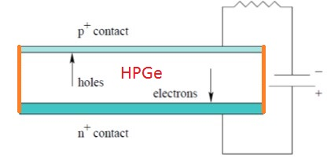
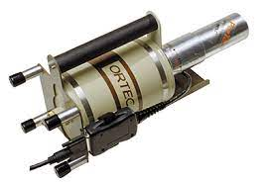
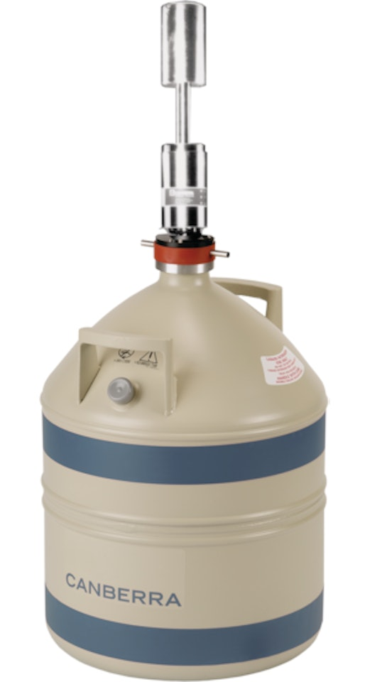

Schematic HPGe planar gamma detector
B doped = 0.3 µm (implantation)
HPGe
Residual doping: 10¹⁰ cm⁻³
Carrier concertation at RT:
2 10¹³ cm⁻³
Surface passivation:
Liquid Nitrogen operations, cryostats:
ϒ
Li doped = 0.9 mm (diffusion)
Davide De Salvador JoinUs@Thesis 2024
Notes:
In gamma spectroscopy, hyperpure germanium is commonly used. Traditionally there is a p+ thin boron implanted contact and a n+ thick lithium diffused contact. The lateral surfaces are passivated. Passivation has a dual function, acting as a chemical barrier and reducing leakage currents. A good passivation should also avoid surface charge that may deform the field.

Slide 8
HPGe detector resolution
B doped = 0.3 µm (implantation)
Surface passivation:
I. Meleshenkovskiiet al. ESARDA Symposium 2017
Li doped = 0.9 mm (diffusion)
HPGe FWHM ~ 1.6 KeV
Davide De Salvador JoinUs@Thesis 2024
Notes:
In gamma spectroscopy, hyperpure germanium is commonly used. Traditionally there is a p+ thin boron implanted contact and a n+ thick lithium diffused contact. The lateral surfaces are passivated. Passivation has a dual function, acting as a chemical barrier and reducing leakage currents. A good passivation should also avoid surface charge that may deform the field.

Slide 9
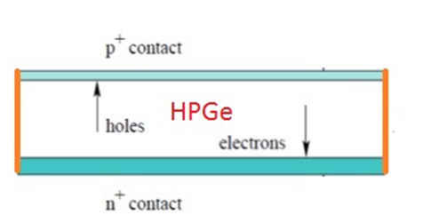
HPGe radiation damage
B doped = 0.3 µm (implantation)
1.5GeV 1.2 10⁸cm⁻² Protons
5 MeV 1.2 10⁹cm⁻² Neutrons
Neutrons
Surface passivation:
Protons
Li doped = 0.9 mm (diffusion)
Davide De Salvador JoinUs@Thesis 2024
Notes:
In gamma spectroscopy, hyperpure germanium is commonly used. Traditionally there is a p+ thin boron implanted contact and a n+ thick lithium diffused contact. The lateral surfaces are passivated. Passivation has a dual function, acting as a chemical barrier and reducing leakage currents. A good passivation should also avoid surface charge that may deform the field.

Slide 10
INTEGRAL- SPI annealing cycles
Annealing 103°C 40h every about 6 months for almost 20 years
E. Kuulkers et al. New Astronomy reviews 93 (2021) 101629
Davide De Salvador FERRARA - AHEAD - 2024
Davide De Salvador JoinUs@Thesis 2024

Slide 11
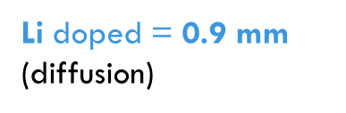
Planar segmented amorphous -Ge
Mihailescu et al. NIMA 570 (2007) 89.
C. Sleator, UC Berkeley Electronic Theses and Dissertations (2019)
P+
N+
amorphous Ge thin film contacts
Leakage current after 48h at 72C° -> damage recovering is not possible

Slide 12
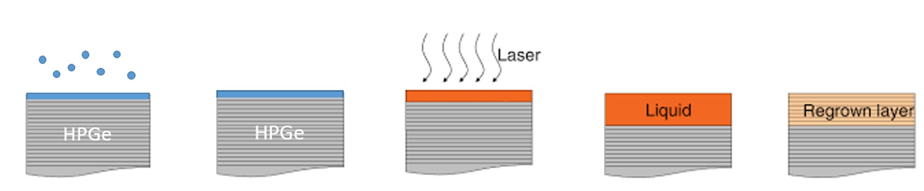
New contact/junction on HPGe: PLM (Pulse Laser Melting)
Deposition
Doping precursor layer
pulse < 20ns
~100 ns
Doped layer
Advantages:
Melting temperature is reached - short time (<100 ns)
Only the surface (< 200 nm) is melted, the bulk is at room temperature
High dopant concentrations with very sharp dopant profile
Doping with heavy elements without crystal damage
Very clean process suitable for preserving the Ge hyperpurity
Suitable for complex contact geometries (segmentation)
Notes:
The PLM (Pulse Laser Melting) process involves a deposition phase with magnetron sputtering using PVD (Physical Vapor Deposition), creating a doping layer. Subsequently, there is the diffusion of the dopant in the liquid phase with a subsequent crystalline regrowth. Using the pulse laser melting technique, the melting temperature is rapidly reached in a short time span of less than 100 nanoseconds. Only a thin surface layer, less than 200 nanometers thick, melts, while the bulk of the material remains at room temperature. This process allows for high concentrations of dopants with a very precise doping profile, including doping with heavy elements, without causing crystal damage. The very rapid process prevent that contaminats can enter the bulk and hinder the Ge purity.. Additionally, the technique is in principle, suitable for complex contact geometries, enabling segmentation according to project needs

Slide 13
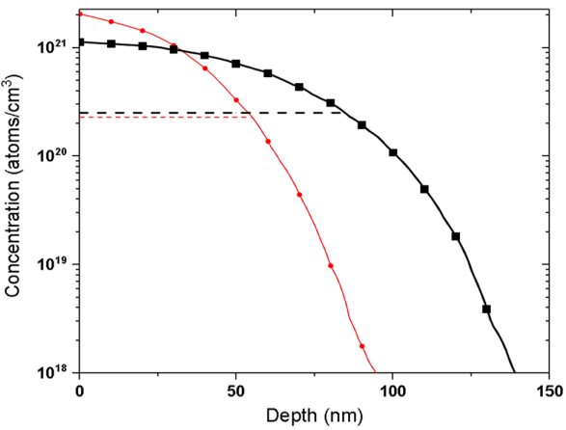
New contact/junction on HPGe: PLM on HPGe crystal
SIMS (Secondary Ions Mass Spectrometry)
1 pulse Sb
- - - 1 pls electrons
4 pulses
- - - 4 pls electrons
Impurities concentration in Ge bulk
V. Boldrini et al., Journal of Physics D: Applied Physics (2018) volume 52, 3
Davide De Salvador JoinUs@Thesis 2024
Notes:
The contact made by PLM process, tested through Van Der Paw Hall measurements, has demonstrated the ability to maintain the purity of a hyperpure germanium (HPGe) crystal compare with HPGe raw crystal, This confirms its suitability as an applicable process to made gamma detectors.

Slide 14
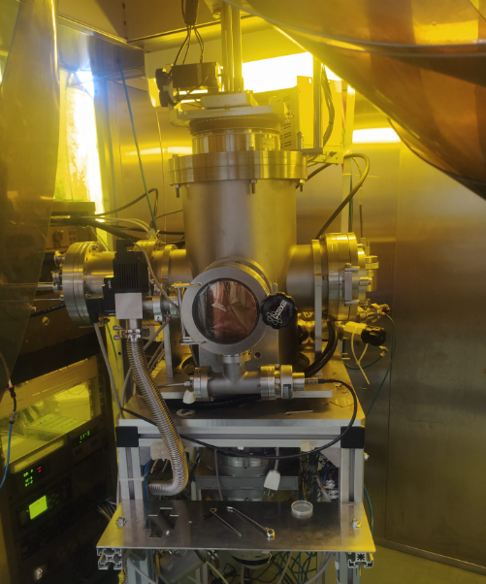
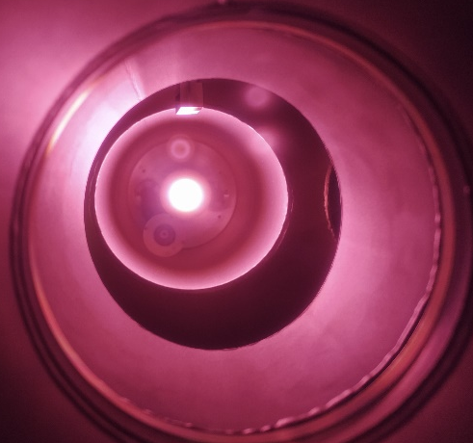
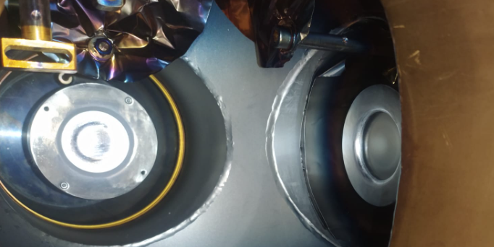
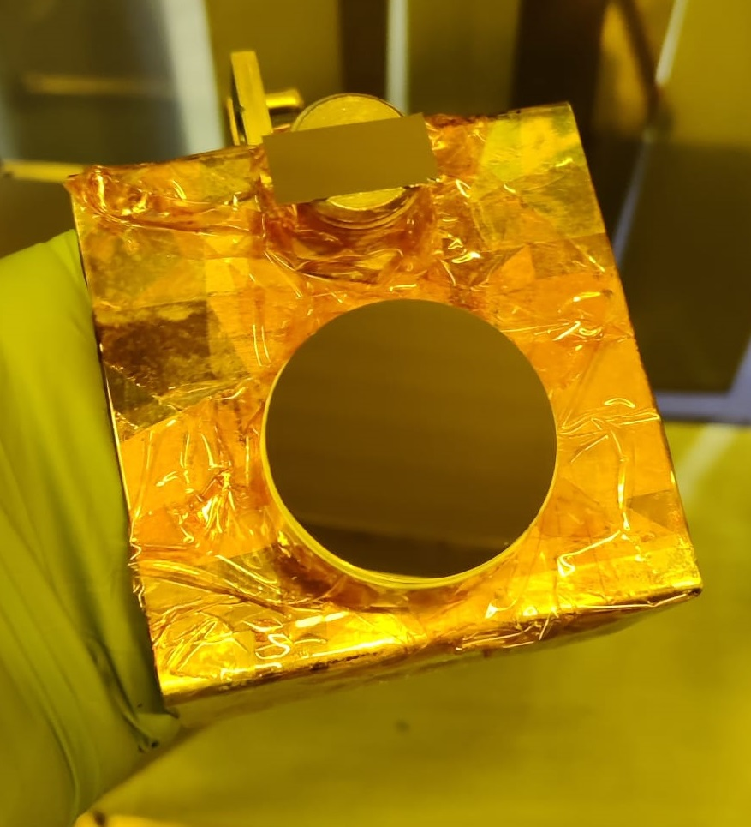
New contact/junction on HPGe: PVD Sputtering deposition
Magnetron Sputtering deposition
Sb material
Al / Ge material
Sb
Al
Ge
n⁺ | Sb | 2 nm
p⁺ | Al (Ge cap) | 4 nm (10 nm)
Davide De Salvador JoinUs@Thesis 2024
Notes:
After the surface preparation, the hyperpure germanium (HPGe) crystals are coated with thin layers of antimony (Sb) or aluminum/germanium (Al/Ge) using a physical vapor deposition (PVD) system with magnetron sputtering technology. This process takes place within a decontaminated environment.

Slide 15
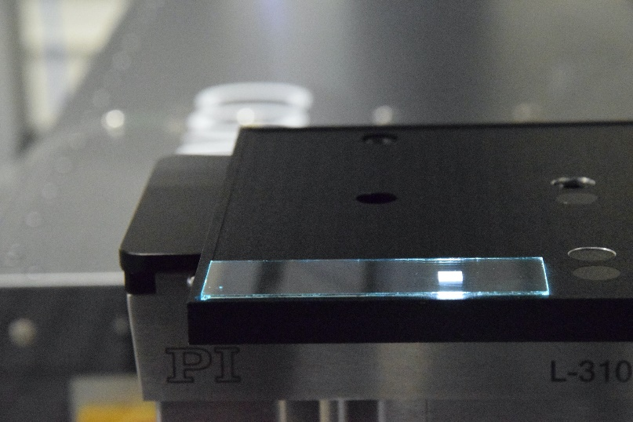
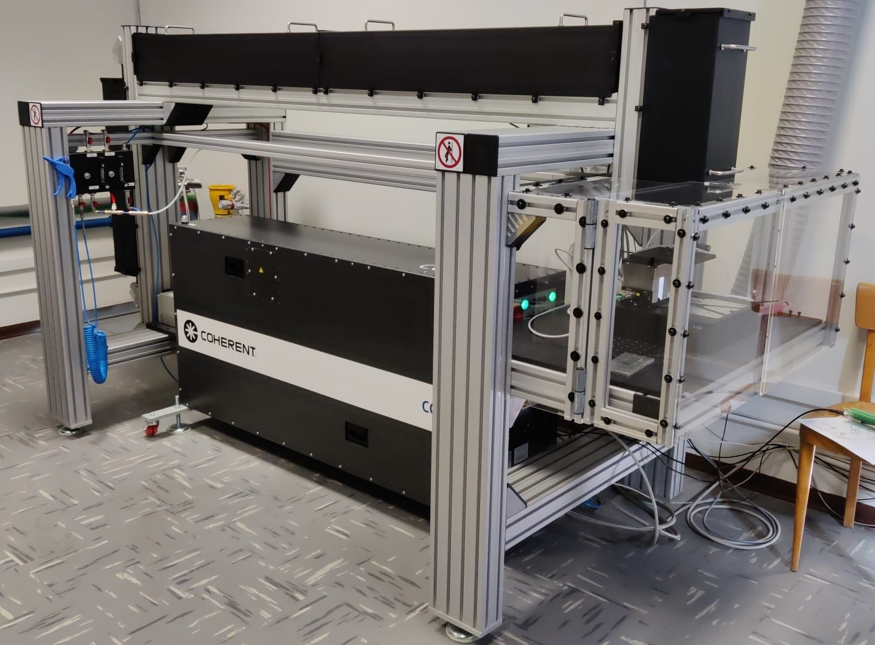

New contact/junction on HPGe: PLM Laser tecnology
Excimer KrF laser
5 mm
𝜆=248 nm, 22 ns
Frequency: 1-10 Hz
ED= 50-1300 mJ/cm²
Square 5x5mm² spot
Homogeneity: < 2%
lateral resolution <30 µm
Motorized XYZ stage
Davide De Salvador FERRARA - AHEAD - 2024
Notes:
The laser used for the Pulse Laser Melting (PLM) process is located at the Department of Physics at the University of Padua, and the pulsed laser spot utilized measures 5x5 mm² with a in the ultraviolet (UV) range.

Slide 16
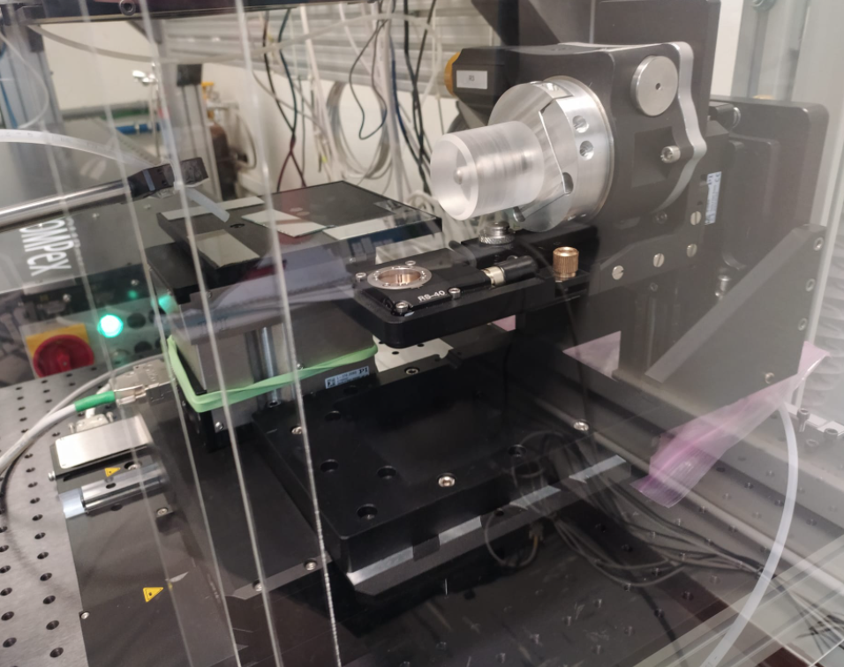
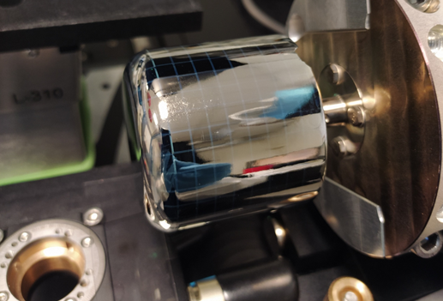
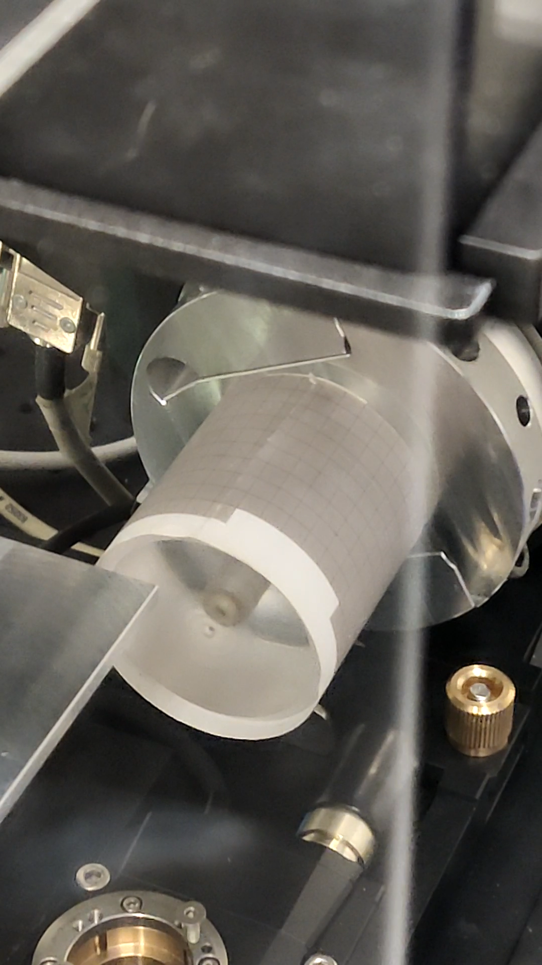
New contact/juntion on HPGe: PLM Laser tecnology
Laser beam
Rotor
Planar samples
Rotor
Coaxial samples
Z-axis
Z-axis
XY-axes
Davide De Salvador JoinUs@Thesis 2024
Notes:
A multi-axis handler has been developed to process planar detectors and coaxial detectors using laser scans.

Slide 17
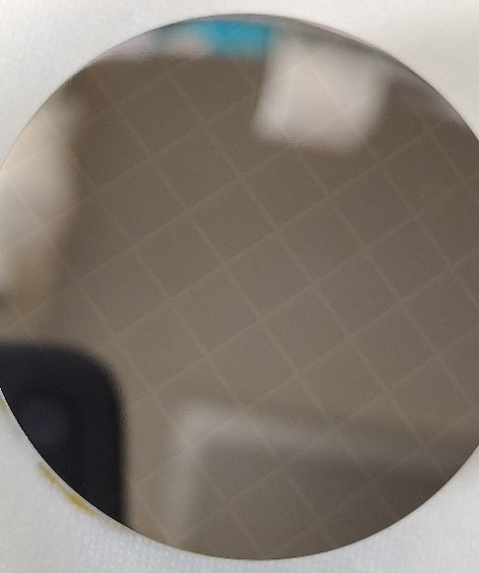
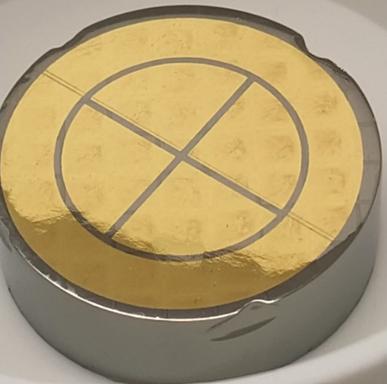
PLM contact/junction: Segmentation
Full area
PLM
Au target
Au deposition
100 nm PVD deposition of Au in Ar plasma with ultrapure target in vacuum (10⁻⁶ mbar)
Photolithography
Photoresist deposition, baking, exposure and development, followed by Au stripping and resist removal.
Intercontact gaps passivation
(3:1) HNO₃ : HF etching followed by chemical quenching passivation.
Davide De Salvador JoinUs@Thesis 2024
Notes:
The segmentation of PLM contacts was carried out in two different ways. The first method involved coating the contact with a layer of gold and then using photolithography to create the segments, followed by subsequent etching and chemical passivation.

Slide 18
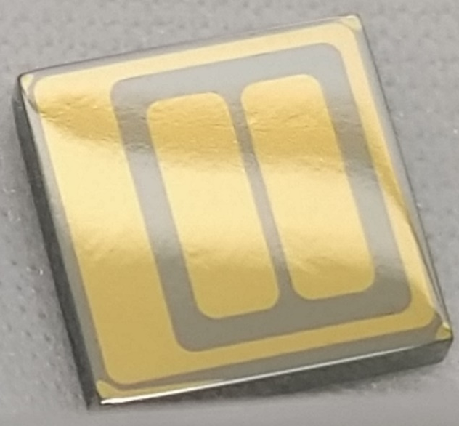

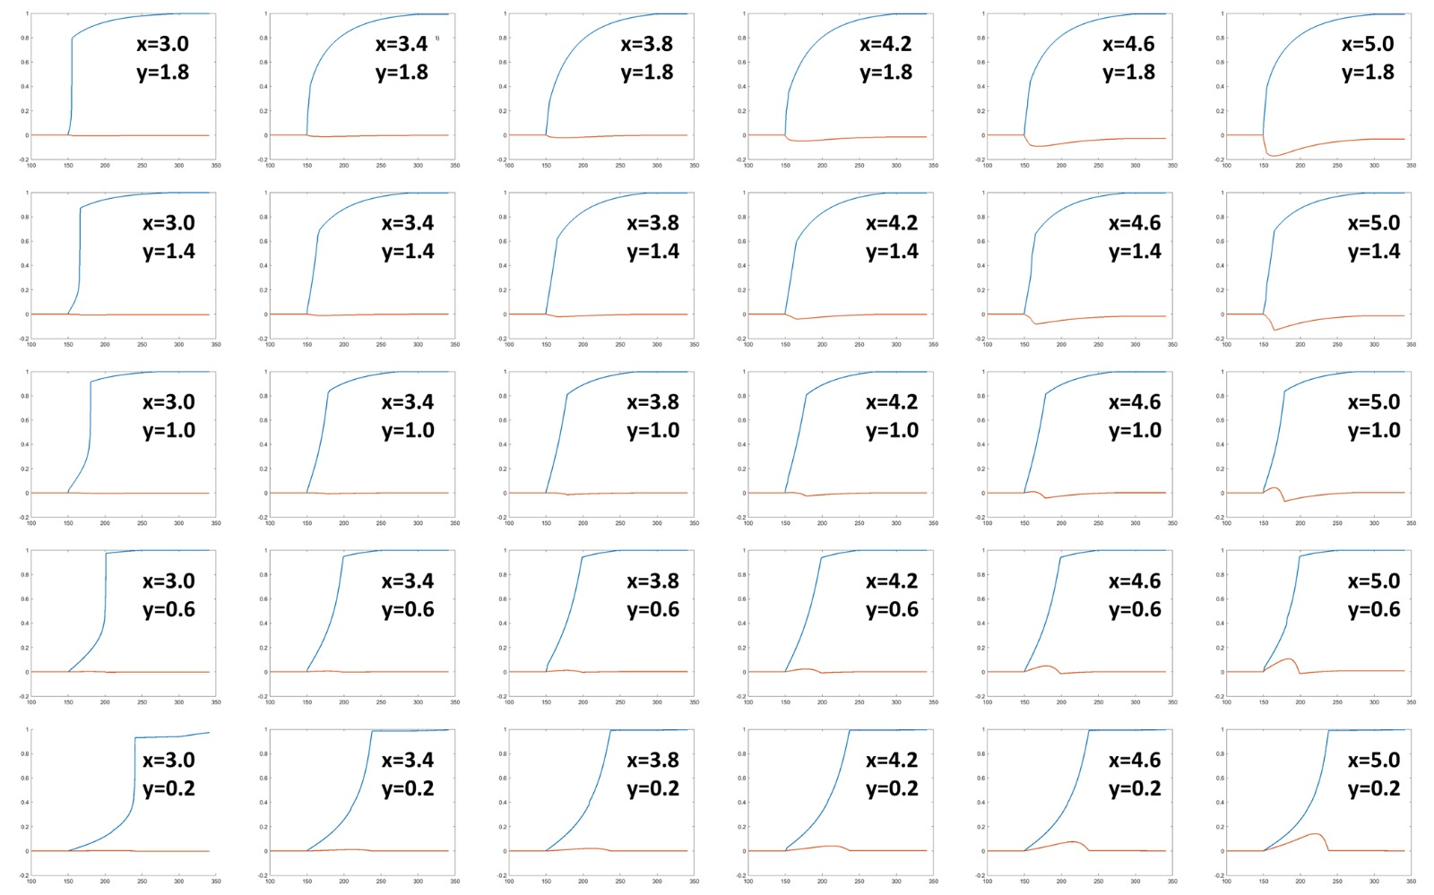
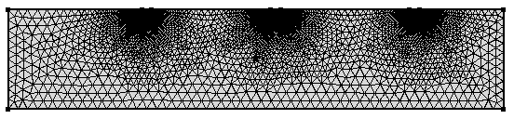
Event localization “exercise”, signal simulation on a small HPGe detectors
10 mm
10 mm
Ground
C1
C2
Ground
Passivation
Passivation
Polarization voltage
Davide De Salvador JoinUs@Thesis 2024

Slide 19
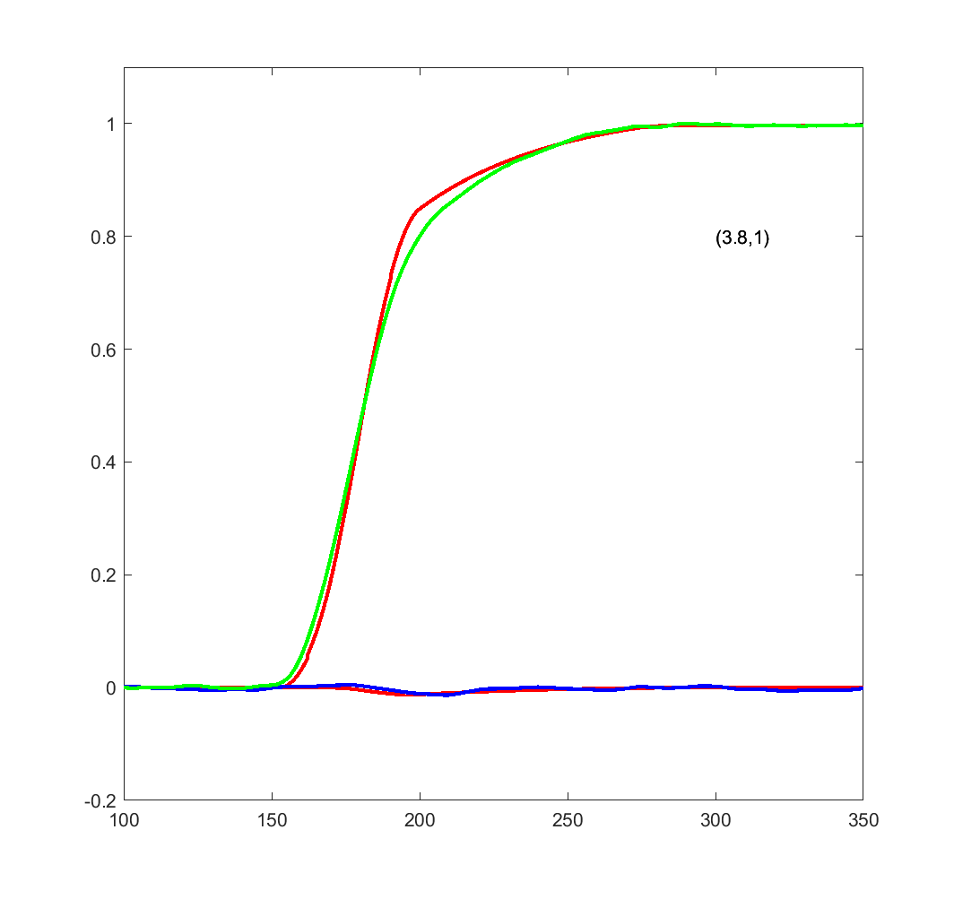

C1 data
C2 data
Simulated
Signals are located on a 0.4x0.4 mm 2D grid using 2 signals.
y
x
Normalized charge
t (ns)
Davide De Salvador JoinUs@Thesis 2024

Slide 20
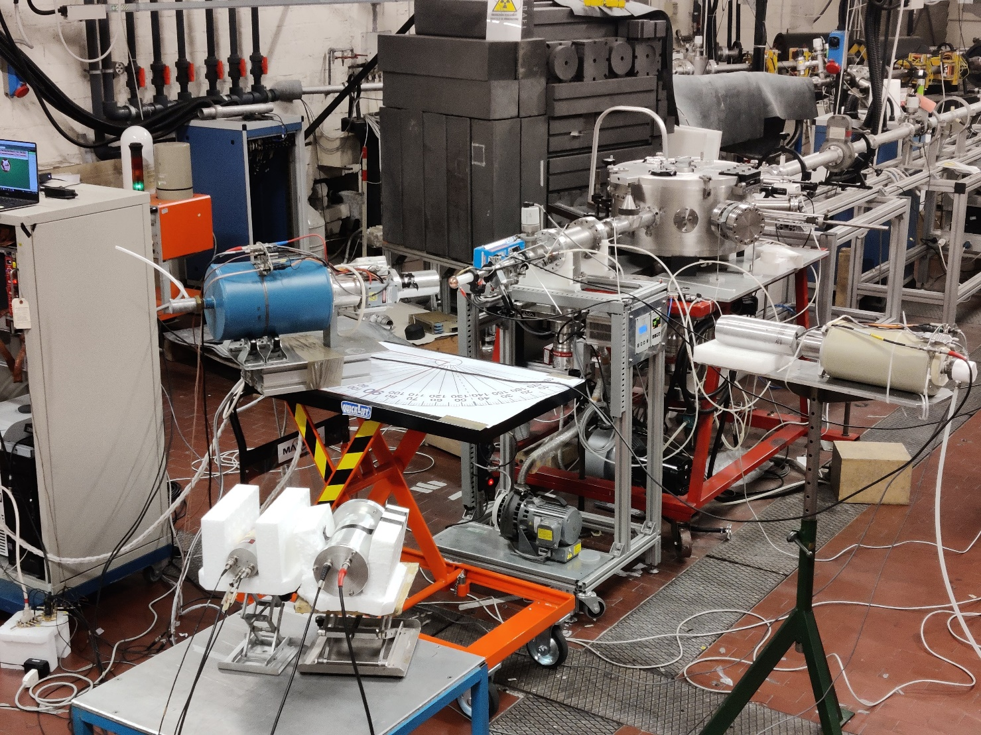

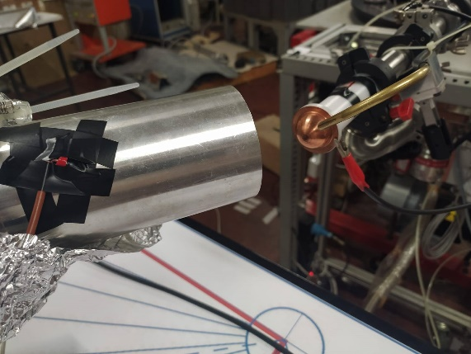
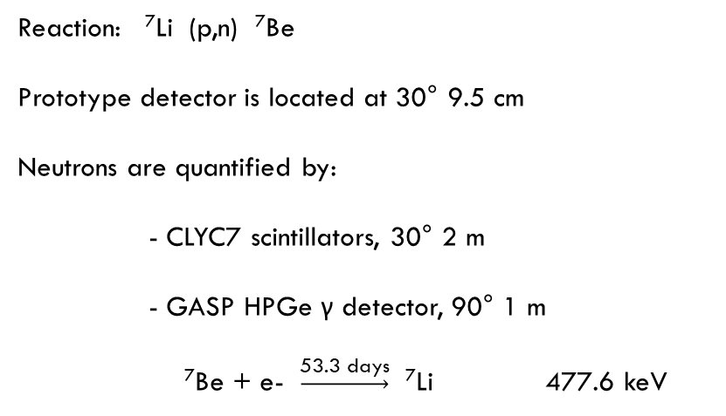
Neutrons damage on planar PLM segmented detector
N3G Planar HPGe
380nA 4MeV proton beam
⁷Li target, 100µm
Target
Beam
Reaction: ⁷Li (p,n) ⁷Be
Prototype detector is located at 30° 9.5 cm
Neutrons are quantified by:
- CLYC7 scintillators, 30° 2 m
- GASP HPGe γ detector, 90° 1 m
⁷Be + e- $\underset{→}{\text{5}\text{3.3 }\text{days}}$ ⁷Li 477.6 keV
HPGe GASP
CLYC7
R. Escudeiro at all. “Neutron radiation damage on a planar segmented germanium detector” proceeding Presented at the XXXVII Mazurian Lakes Conference on Physics, Piaski, Poland, September 3-9, 2023
Davide De Salvador JoinUs@Thesis 2024
Notes:
Measurement setup at the CN facility at LNL. The proton beam hits a lithium target 100 microns thick. The target is located at the end of the beamline in a dedicated vacuum system. The reaction produces beryllium-7 and a flux of fast neutrons. Our prototype is situated at 9.5cm, and neutrons are directly measured using CLYC scintillators. Beryllium undergoes electron capture with a half-life of 53 days, reverting back to lithium-7 and emitting a characteristic gamma-ray. This radiation is monitored by another HPGe detector positioned and is used as a double check.

Slide 21
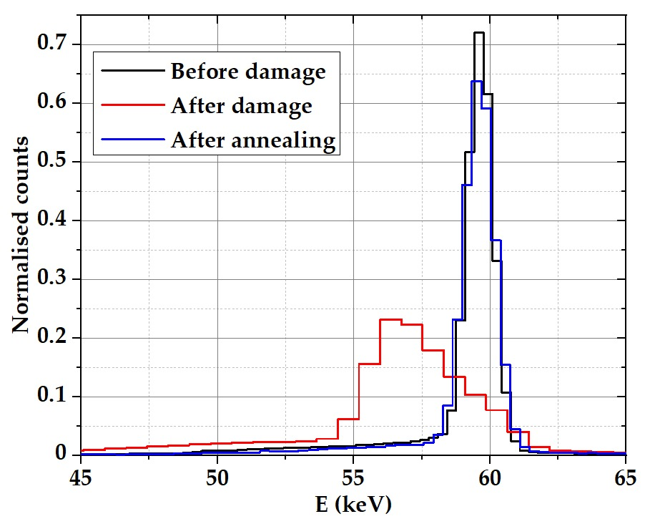
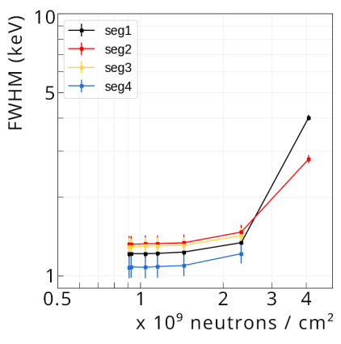
Neutrons damage on planar PLM segmented detector: after 1° run
Operational Voltage 80V
Neutron irradiation for increasing time intervals alternated to 5 min runs with ²⁴¹Am and ⁶⁰Co leads to increasing resolution worsening
²⁴¹Am
E = 59,5 keV
FWHM < 1,6 keV
After 4 hours of irradiation time,
≈ 4∙10⁹ neutrons/cm², detector is no longer operable
Davide De Salvador JoinUs@Thesis 2024
Notes:
During the first run, we monitored the progressive deterioration of the detector resolution. After 4 hours of irradiation and a flux of 4*10^9 the detector was no longer operable.

Slide 22
Outline
Gamma ray production and detection, a huge amount of applications
Why germanium ?
How to improve gamma detection performances (N3G – INFN PROJECT)
Proposal for an innovative gamma source (TECHNOCLS - EU-PROJECT)
Davide De Salvador JoinUs@Thesis 2024
Notes:
After a brief introduction and state of the art on germanium detectors for gamma spectroscopy, I will illustrate some examples of the application of recently developed PLM technologies. Finally, the response of neutron damage of this detectors.

Slide 23
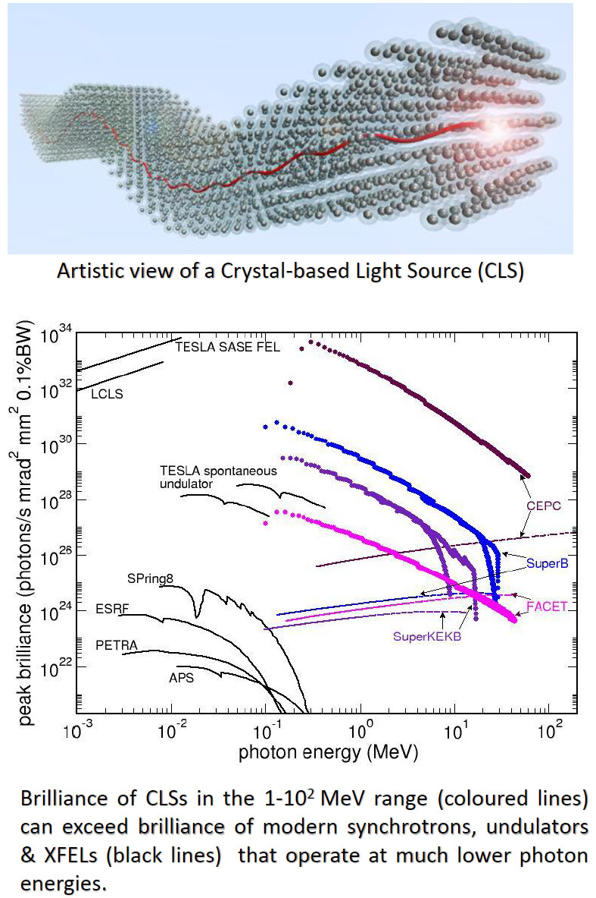
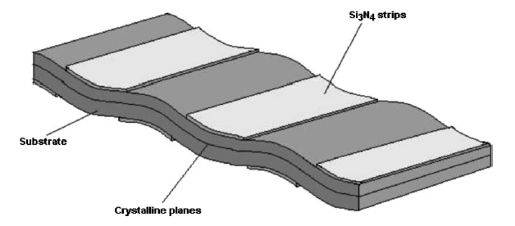
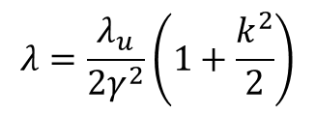

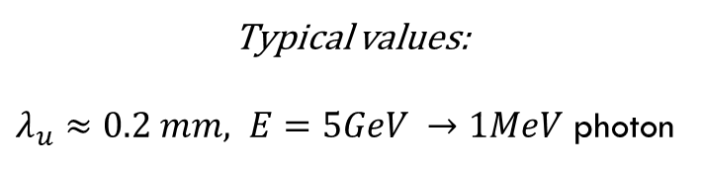

Crystalline light source undulator gamma ray emission
Channeled particle trajectory
Emitted photons
Beam
TECHNO-CLS
EU PROJECT: FET-OPEN 2022-2026
$$λ_{u}$$
$$λ=\frac{λ_{u}}{2γ^{2}}\left(1+\frac{k^{2}}{2}\right)$$
$$γ≈\frac{E}{m_{0}c^{2}}$$
Typical values:
$λ_{u}≈0.2 mm, E=5GeV →1MeV$ photon
Davide De Salvador JoinUs@Thesis 2024
Notes:
During the first run, we monitored the progressive deterioration of the detector resolution. After 4 hours of irradiation and a flux of 4*10^9 the detector was no longer operable.

Slide 24

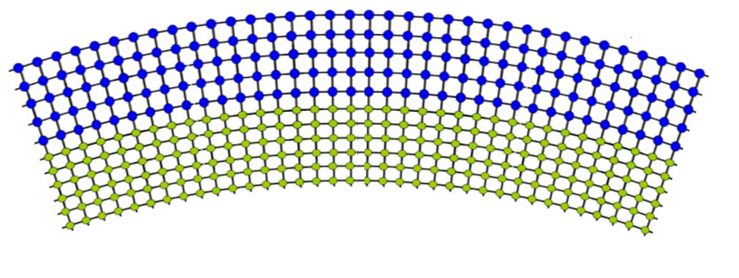
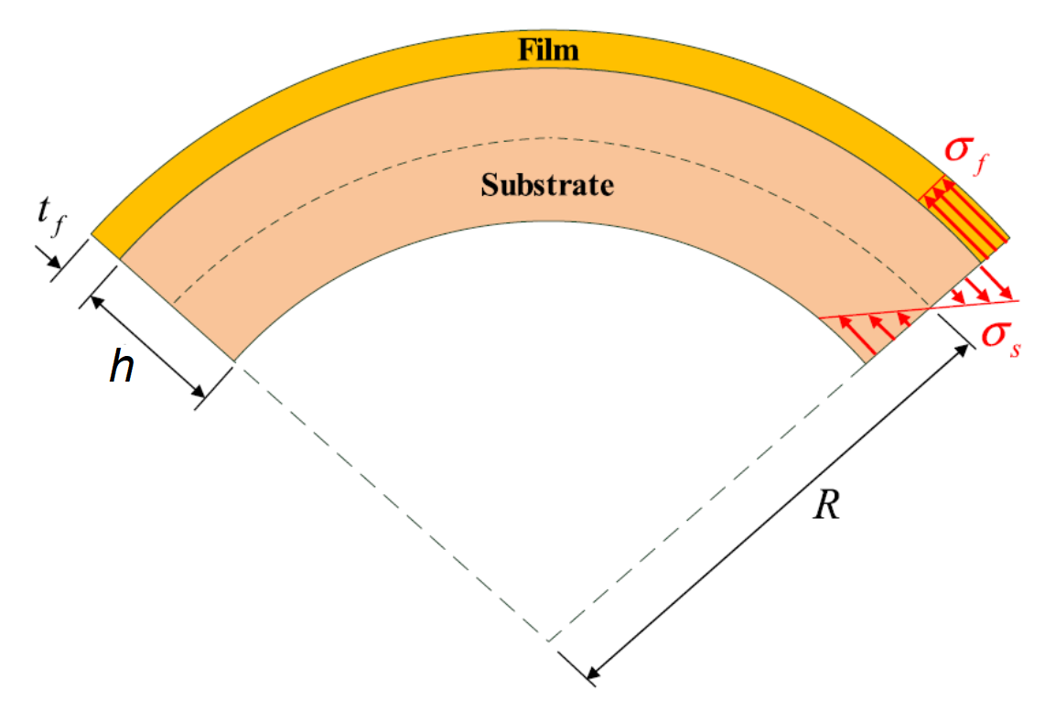
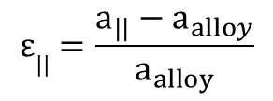
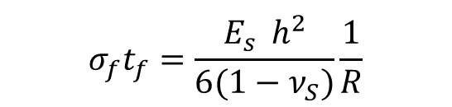
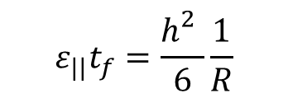
Synthesis of bent Ge crystals by PLM
Sn/Sb deposition
Sn/Sb
Sn/Sb incorporation
Ge
Sputtering deposition
Pulsed laser melting
Stoney formula:
Ge alloy: stressor film
$$σ_{f}t_{f}=\frac{{E_{s}^{}h}^{2}}{6(1−ν_{S})}\frac{1}{R}$$
Ge bulk
For a pseudomorphic film with elastic properties similar to the bulk:
$$ε||=\frac{a_{||}−a_{alloy}}{a_{alloy}}$$
$$ε_{||}t_{f}=\frac{h_{}^{2}}{6}\frac{1}{R}$$
Davide De Salvador JoinUs@Thesis 2024
Notes:
During the first run, we monitored the progressive deterioration of the detector resolution. After 4 hours of irradiation and a flux of 4*10^9 the detector was no longer operable.

Slide 25
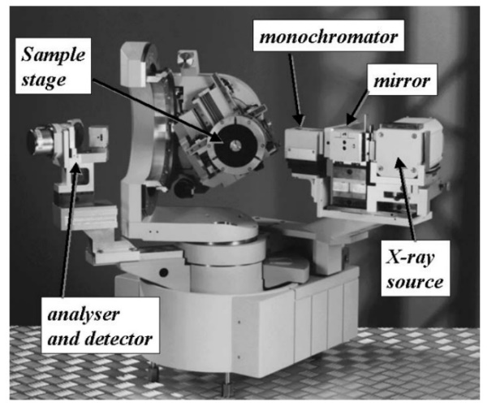
Process optimization – High resolution x-ray diffraction
Davide De Salvador JoinUs@Thesis 2024
Notes:
During the first run, we monitored the progressive deterioration of the detector resolution. After 4 hours of irradiation and a flux of 4*10^9 the detector was no longer operable.

Slide 26
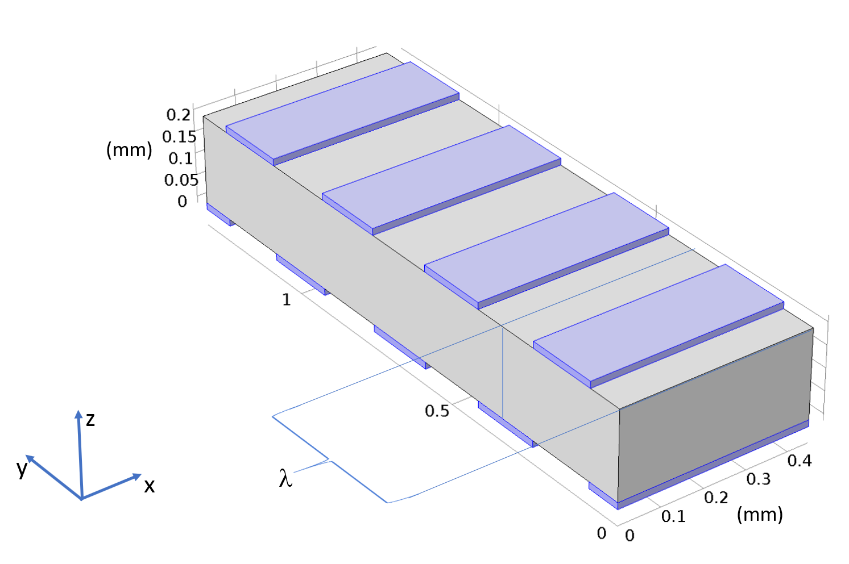
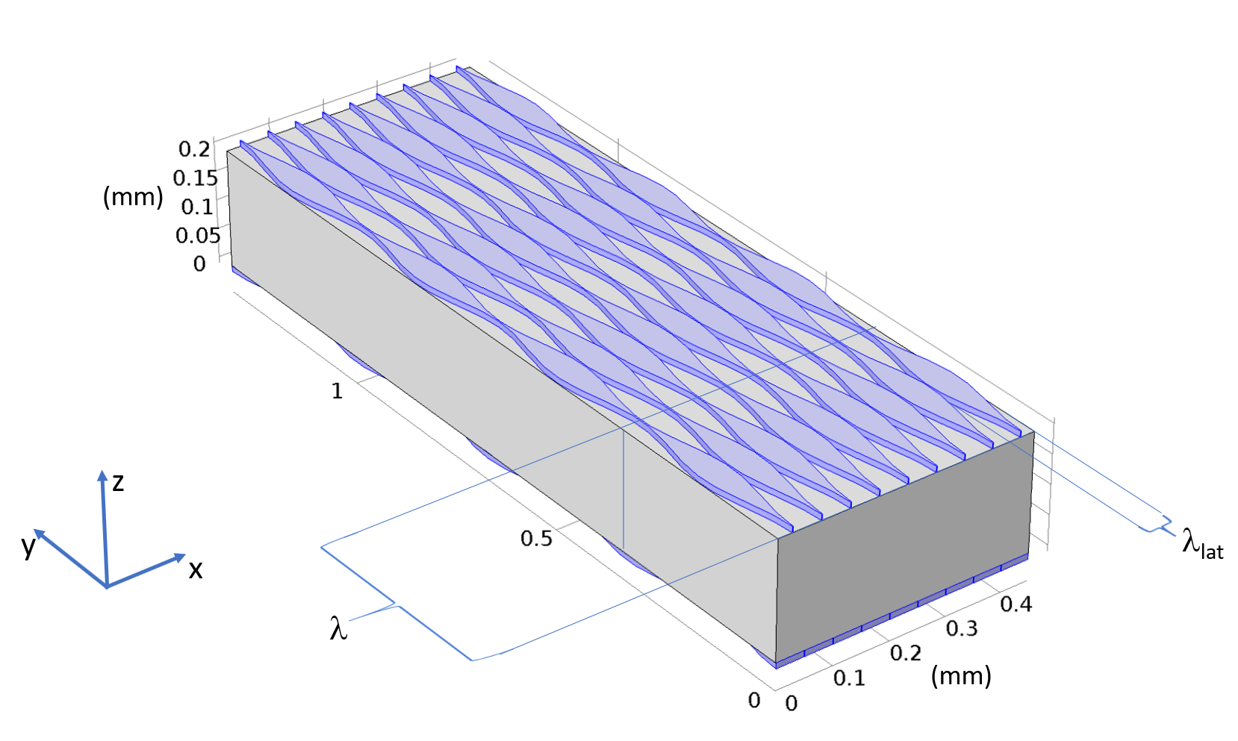
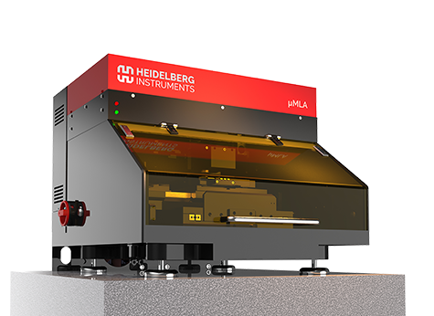
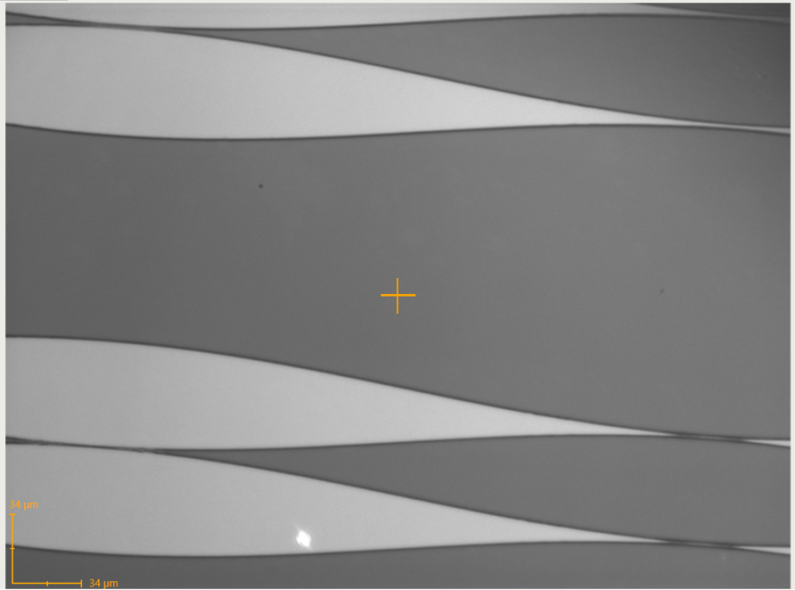
Periodic patterning design and realization
Heidelberg μMLA, at DFA
1 μm resolution
Davide De Salvador JoinUs@Thesis 2024
Notes:
During the first run, we monitored the progressive deterioration of the detector resolution. After 4 hours of irradiation and a flux of 4*10^9 the detector was no longer operable.

Slide 27
What’S NEXT
Producing crystalline undulators, test the bending by synchrotron (ESRF, DIAMOND) complete simulation (MBN – Frankfurt) and emission tests (CERN – DESY - MAINZ)
Scaling the technology to large and commercial devices LNL-MIRION (Lingolsheim) joined research activity is ongoing.
Producing a PLM planar segmented prototype and starting the R&D for satellite applications. PSA with low power consumption.
Davide De Salvador JoinUs@Thesis 2024

Slide 28


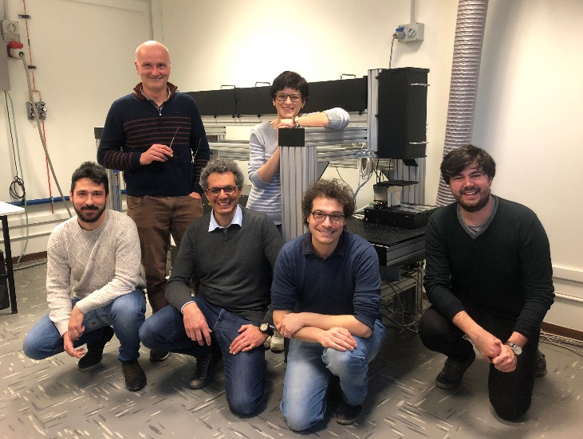


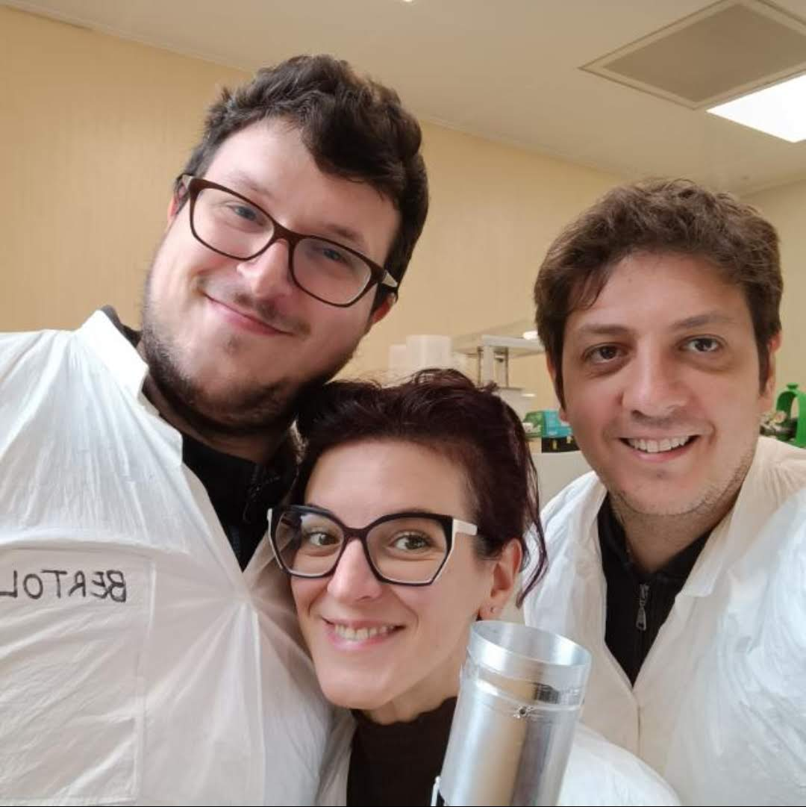

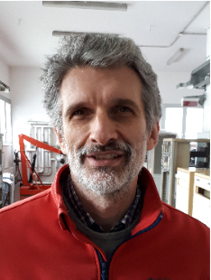


Contacts
Speaker: Davide De Salvador
Office n. 109
Email: davide.desalvador@unipd.it
Group:
Davide De Salvador
Stefano Bertoldo
Enrico Napolitani
Francesco Sgarbossa
Sara Carturan
Gianluigi Maggioni
Francesco Recchia
Dino Bazzacco
Walter Raniero
Daniel Napoli
Chiara Carraro
Davide Valzani
Notes:
I want to thank all the research team

