Slide 1


Edge and applicative plasma physics
Luigi Cordaro
On behalf of the FB group at Consorzio RFX
luigi.cordaro@igi.cnr.it
luigi.cordaro@unipd.it

Slide 2
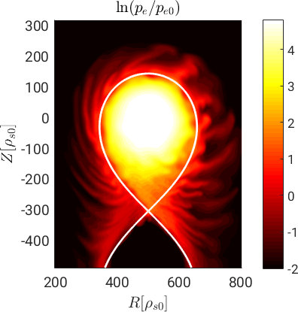
Physics of plasma edge
Why is the study of the plasma edge physics in magnetic confinement devices important?
The pressure and current gradients in the peripheral regions of a fusion experiment can induce fluctuations and turbulence, which degrade confinement properties
The investigation (theoretical, numerical and experimental) of the plasma edge is relevant for basic physics understanding and optimization of fusion performance
[Giacomin et al., Phys. Plasmas (2022)]

Slide 3
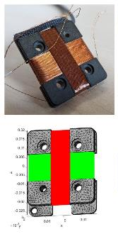
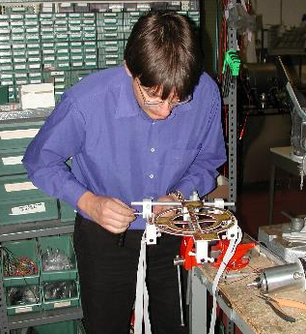
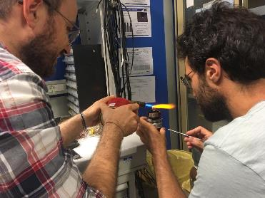
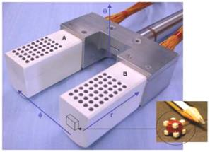
Physics of plasma edge
How are we carrying out this research activity?
DIAGNOSTICS
Design, development and realization

Slide 4
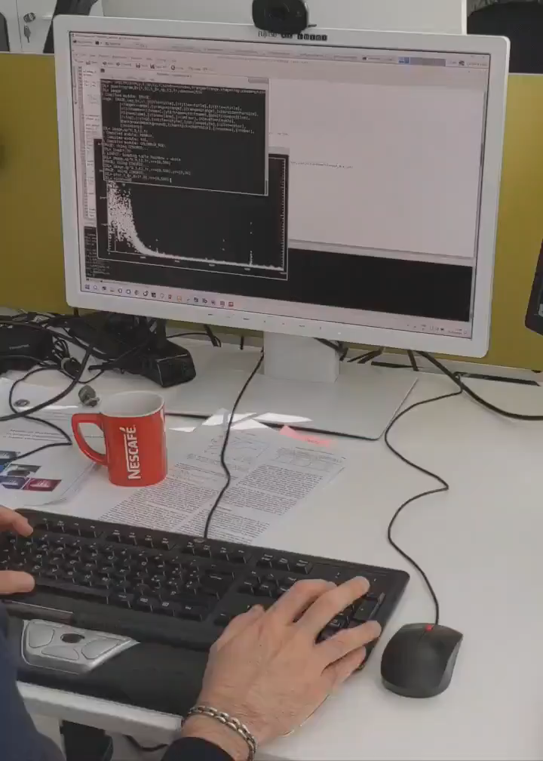
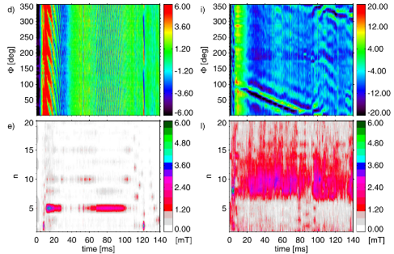
Physics of plasma edge
How are we carrying out this research activity?
DATA ANALYSIS
Time-frequency analysis of RFX-mod signals
[M. Zuin et al 2022 Nucl. Fusion 62 066029]

Slide 5
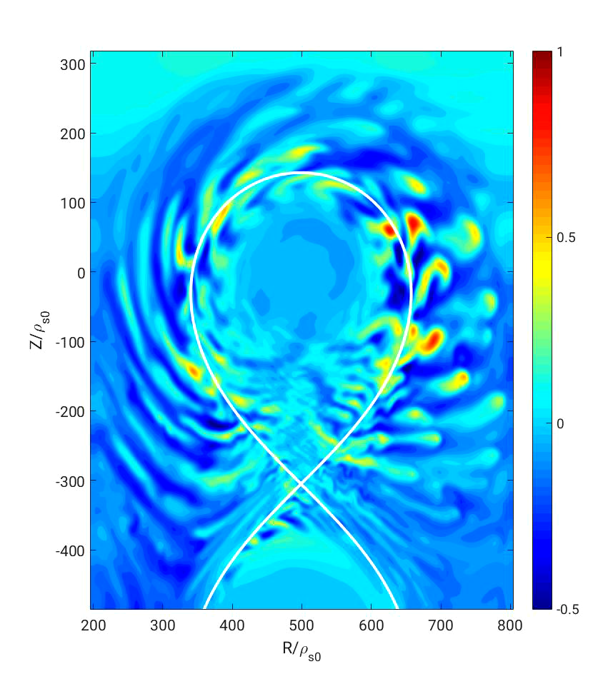
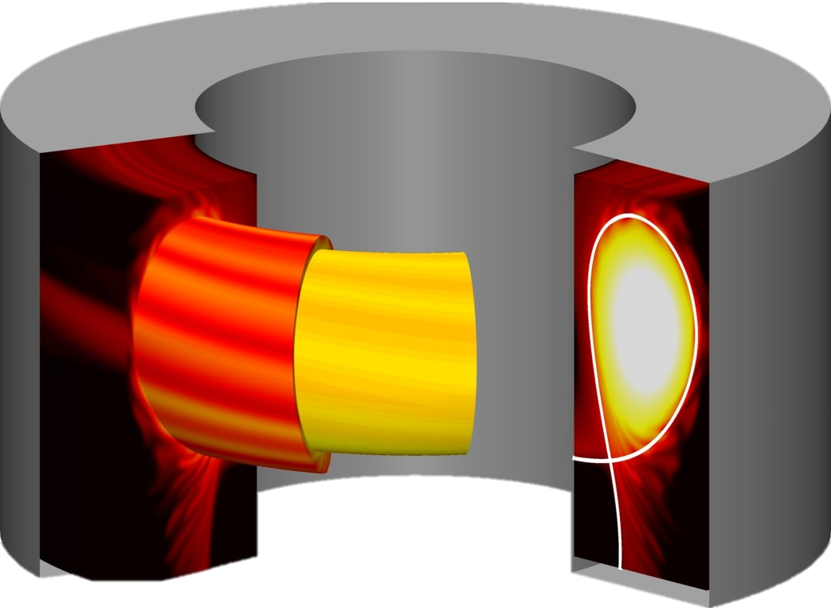
Physics of plasma edge
How are we carrying out this research activity?
MODELLING
Simulation of plasma instabilities by means of two-fluid MHD models
High Performance Computing – >10³ cpu

Slide 6
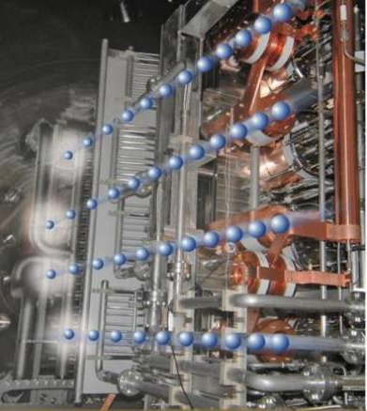
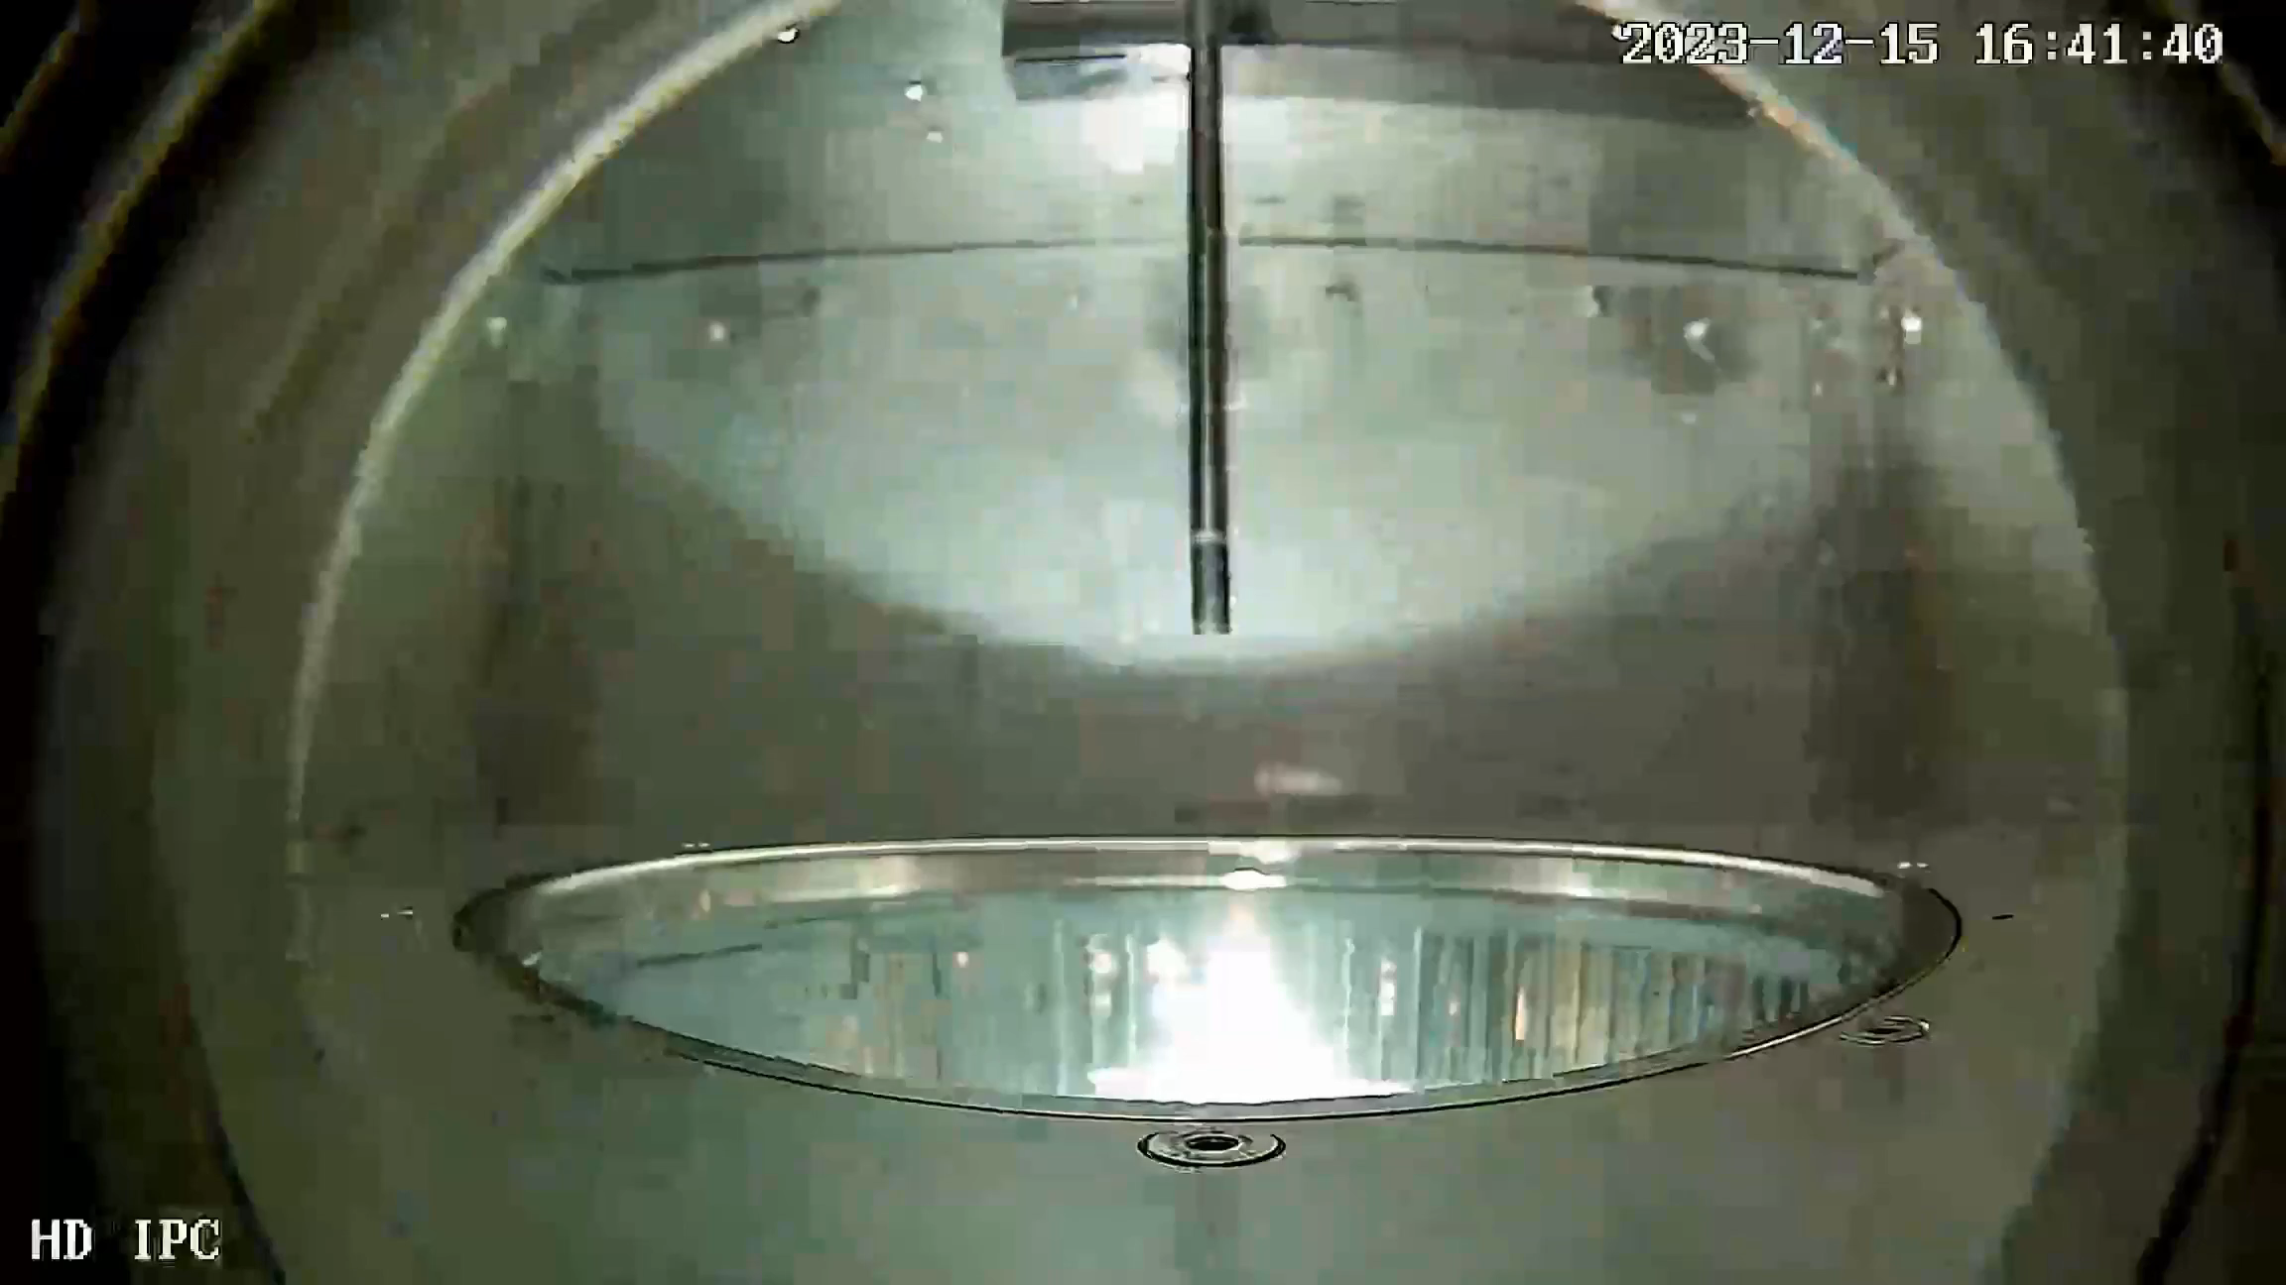
Neutral Beam Injector
The optimization of negative ion production requires an advanced characterization of a cold radiofrequency plasma
- Theoretical/Numerical analysis
- Diagnostics development
- Experimental activity
- Data analysis

Slide 7
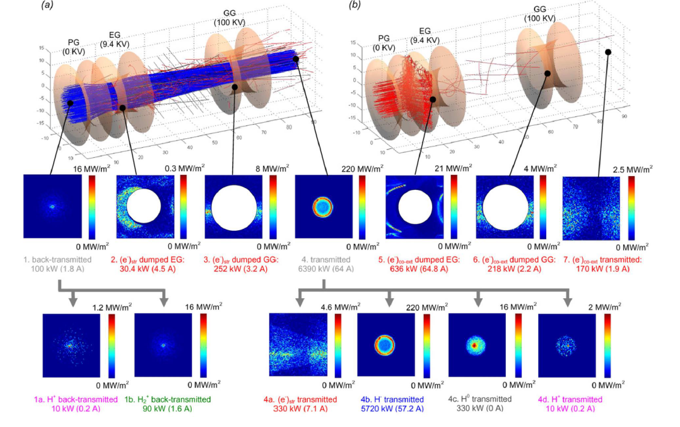
Neutral Beam Injector
Negative ion source (SPIDER) for Neutral Beam Heating system - Modeling

Slide 8
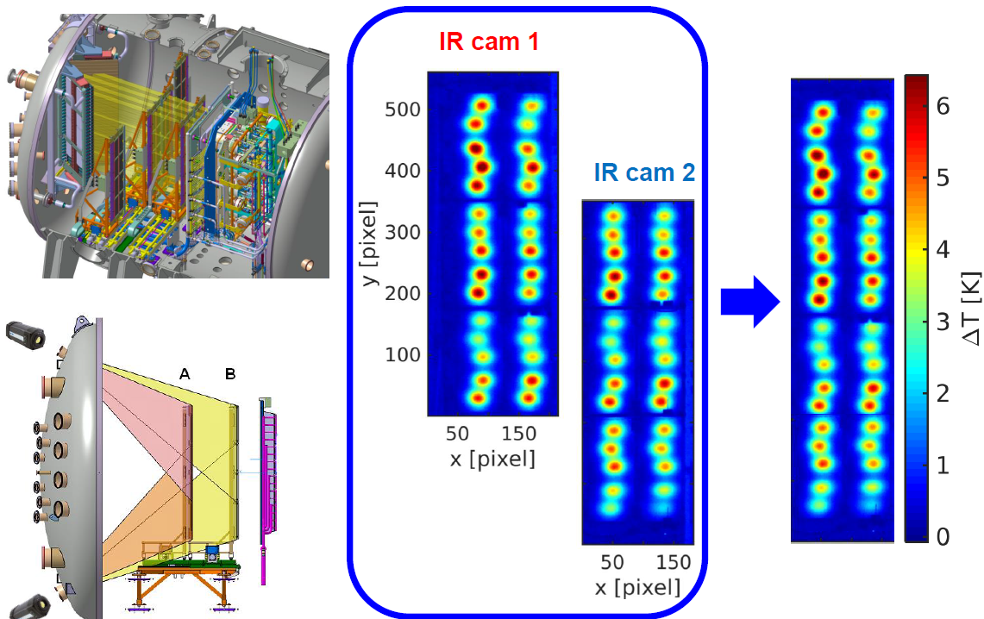
Neutral Beam Injector
Negative ion source (SPIDER) for Neutral Beam Heating system – Diagnostics/Experiment

Slide 9
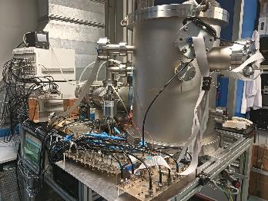
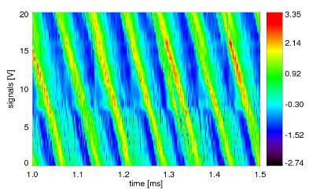
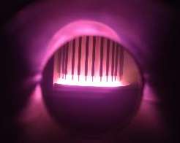
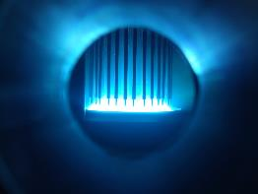
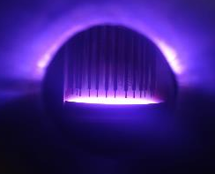
Small scale experiments
Characterization of basic plasma phenomena
Easy access to:
- instabilities, fluctuations and control studies
- ionization processes
- innovative diagnostic techniques
He
Kr
Ar

Slide 10
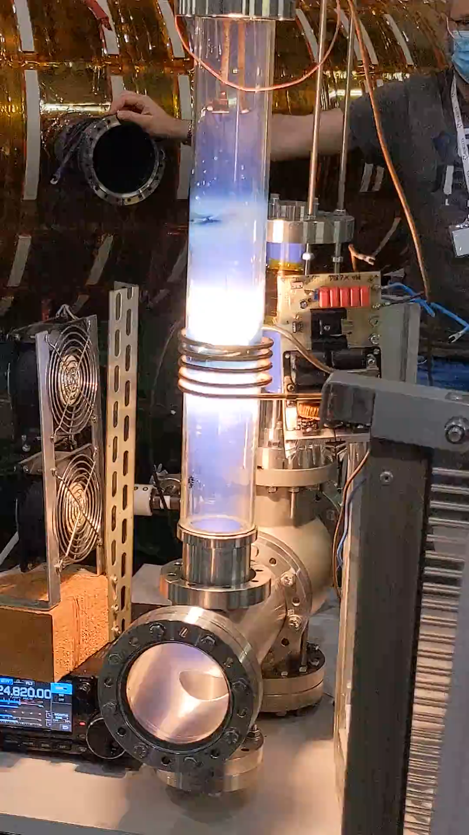
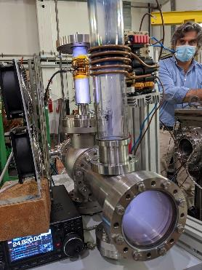
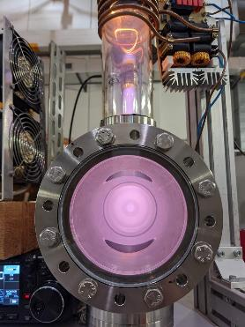
Small scale experiments
Characterization of basic plasma phenomena
Easy access to:
- instabilities, fluctuations and control studies
- ionization processes
- innovative diagnostic techniques

Slide 11
Thesis activities
Requisites: NONE
        Your knowledge is sufficient to address the research topics
        You will be able to learn with us the methods necessary to carry out research in the field of plasma physics
Flexibility: possibility to make the research project based on your skills and preferences (modelling, experimental, data analysis)

Slide 12
Interested? Please get in touch with us
We can offer a variety of theses
Matteo Zuin
Group leader
matteo.zuin@igi.cnr.it
Roberto Cavazzana
Researcher
roberto.cavazzana@igi.cnr.it
Nicola Vianello
Researcher
nicola.vianello@igi.cnr.it
Valeria Candeloro
Ph.D. student
valeria.candeloro@igi.cnr.it
Adriano Stagni
Ph.D. student
adriano.stagni@igi.cnr.it
Luigi Cordaro
Researcher
luigi.cordaro@igi.cnr.it
Monica Spolaore
Researcher
monica.spolaore@igi.cnr.it
Gianluca De Masi
Researcher
gianluca.demasi@igi.cnr.it
Silvia Spagnolo
Researcher
silvia.spagnolo@igi.cnr.it
Maurizio Giacomin
Researcher
maurizio.giacomin@igi.cnr.it
Beatrice Segalini
Ph.D. student
beatrice.segalini@igi.cnr.it
FB group
Federico Guiotto
Ph.D. student
federico.guiotto@igi.cnr.it
Federico Ruffini
Ph.D. student
federico.ruffini@igi.cnr.it
Sara Molisani
Ph.D. student
sara.molisani@igi.cnr.it
Antonio Pimazzoni
Researcher
antonio.pimazzoni@igi.cnr.it
Barbara Momo
Researcher
barbara.momo@igi.cnr.it
Yoana Nakeva
Ph.D. student
yoana.nakeva@igi.cnr.it

