Slide 1




ePIC @ EIC: mass, spin, QCD
Speaker: Rosario Turrisi
Groups: ePIC experiment (INFN exp:EIC_NET).
People: M. Benettoni , C. Bonini, D. Chiappara,
P. Giubilato, S. Mattiazzo, C. Pantouvakis, A. Rossi,
M. Turcato, R. Turrisi

Slide 2

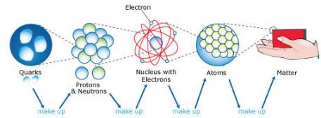
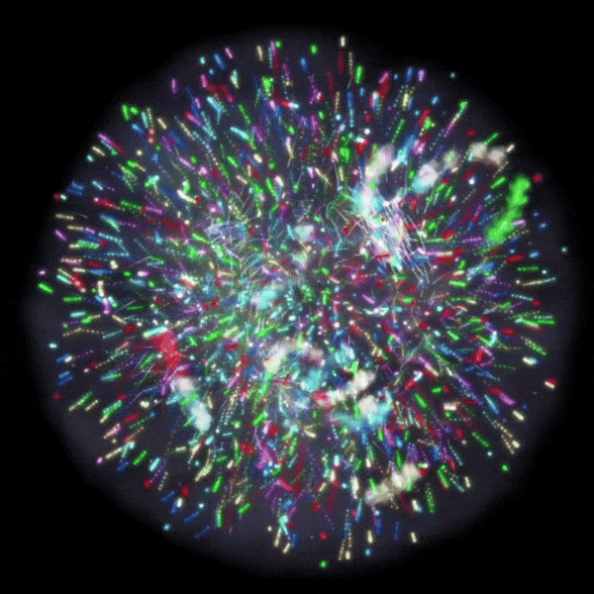
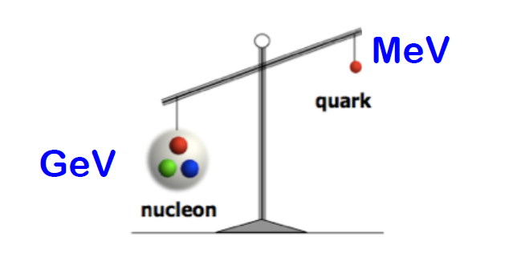
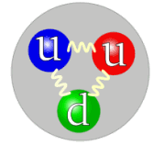
Physics challenges - mass of hadrons
oops!
Need for 3d momentum imaging of proton!
As of today, only elementary particles (quarks, leptons, gauge bosons – but photons and gluons) are justified about their mass, thanks to the Higgs mechanism…
How does the mass of nucleons (~10⁻²⁷ kg), and other hadrons,
is formed?

Slide 3
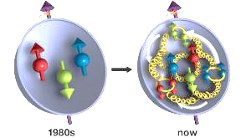
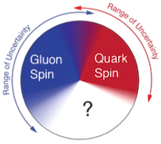

Physics challenges – spin of the nucleon
Current picture: valence/sea quarks and gluons spins, and their orbital motion are expected to contribute to overall nucleon spin…but the sum is not yet up to ½ !
Need for 3d momentum imaging of proton!
80’s view of the proton spin: sum of the spins of the constituent quarks.
How the spin of the proton originates from basic constituents?

Slide 4

Physics challenges –
a deeper look at QCD
And what about nuclei?
Nuclei are NOT a bare agglomerate of nucleons!
We know that since 1983, “EMC effect”.
Distribution of quarks/gluons are modified in a nucleus w.r.t. a nucleon…How?
The Quark Gluon Plasma, when quarks and gluons are no more confined within a nucleon. How is it formed? Can we have better clues studying the confinement in cold matter (‘’normal’’ nuclei)?
At high density of matter, a specific condition can be formed, the color glass condensate, what are its properties? What is its role in the experimental observables?
How the force keeping nuclei together arises from the interaction between partons?
Need for 3d momentum imaging of proton!

Slide 5
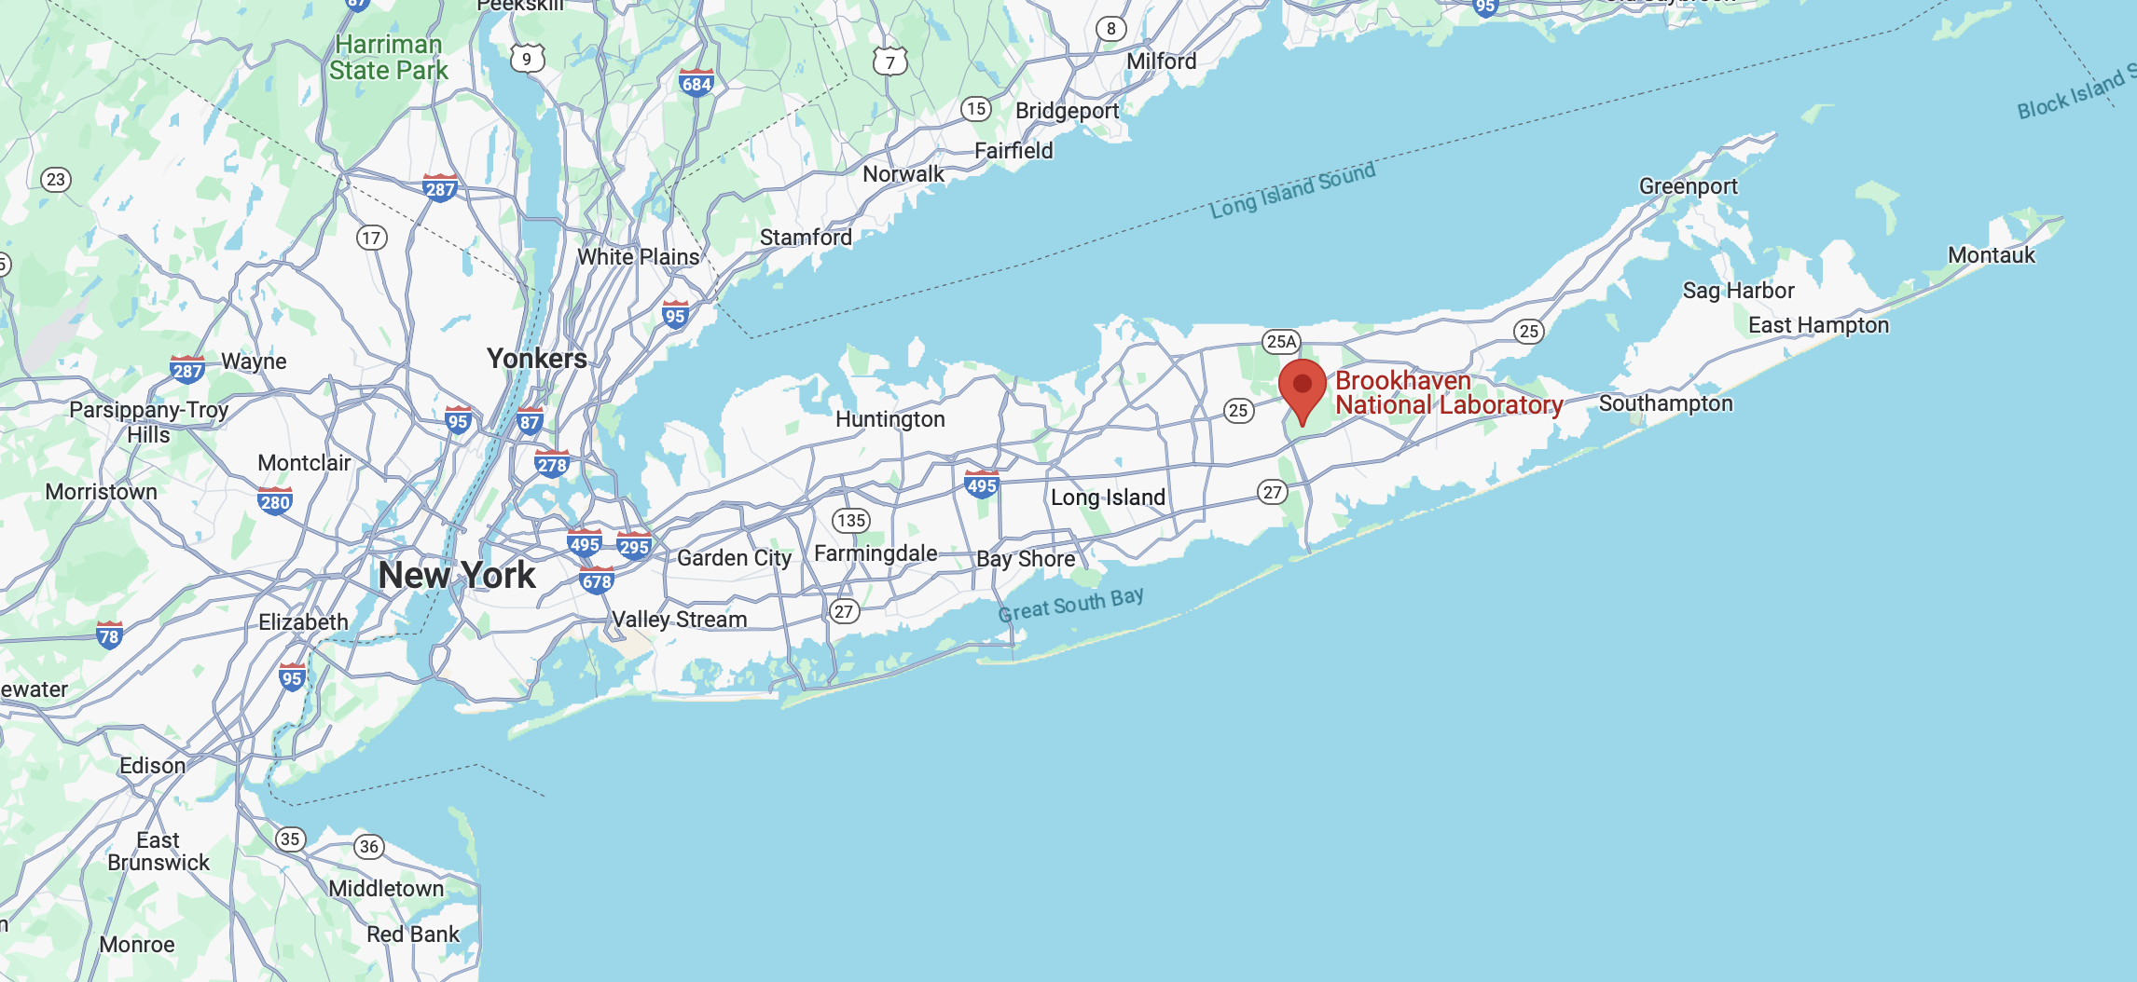
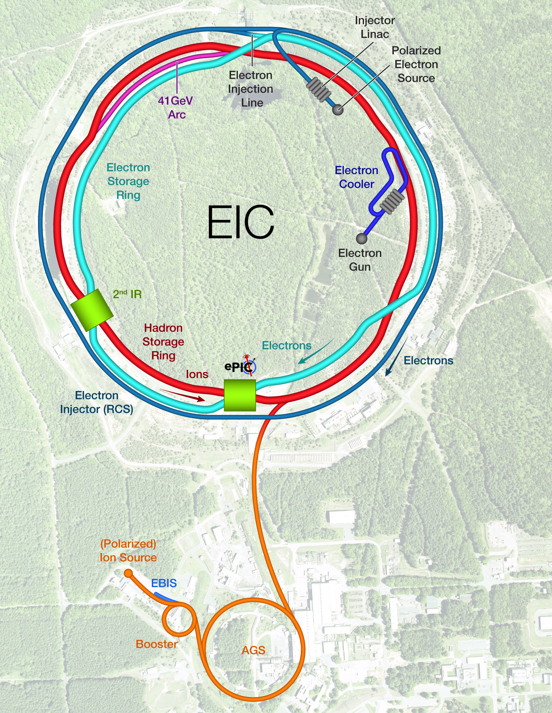
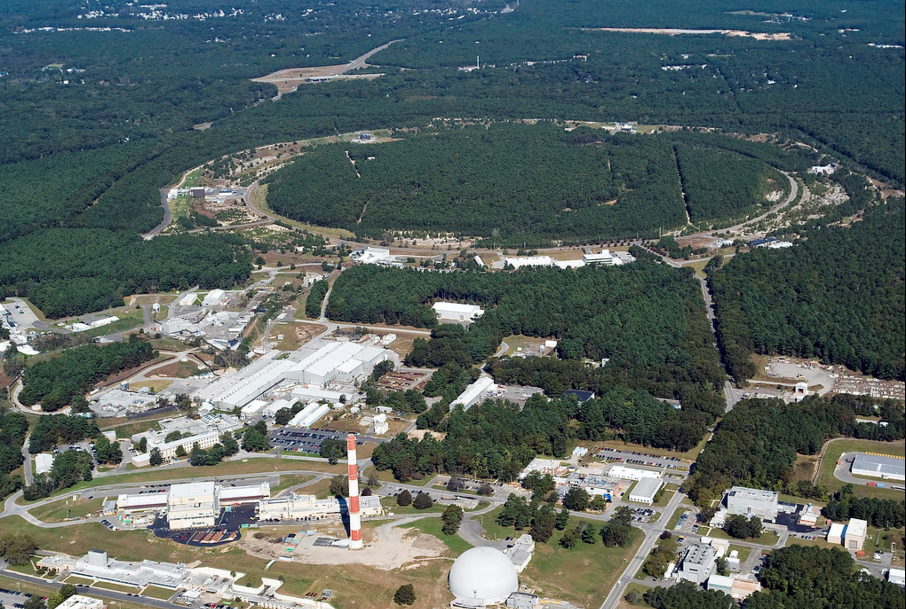
The tool – EIC
Brookhaven National Laboratory
~ 100 km
electrons
New York
The Electron-Ion Collider (EIC) will be the world’s first polarized electron-ion collider, a set of accelerator rings that bring polarized electrons and polarized ions
protons/ions
High Luminosity: L= 10³³ – 10³⁴cm-2sec-1, 10 – 100 fb⁻¹/year
Highly Polarized Beams: 70%
Large Center of Mass Energy Range: E_{cm} = 29 – 140 GeV
Large Ion Species Range: protons – Uranium
...and the only new accelerator which will be build in the next ~20 years (at least)

Slide 6
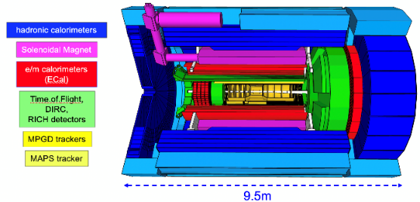
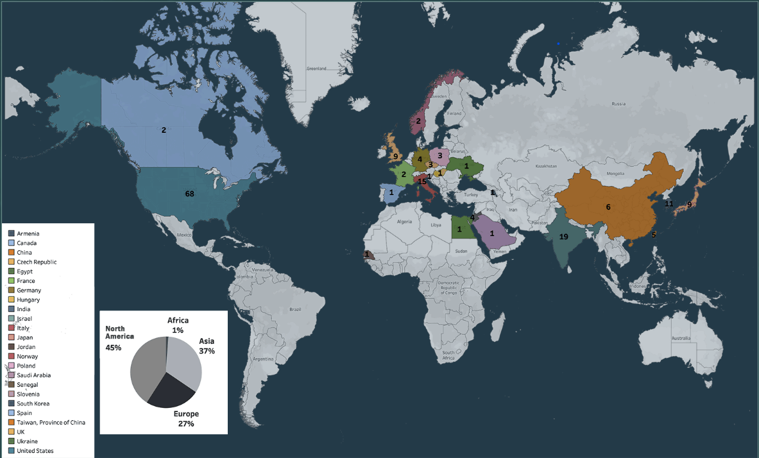
The ‘’microscope’’ - ePIC
Electron-Proton/Ion Collisions detector
Inner Barrel
24 countries
173 institutions
> 500 participants
Total size detector: ~75m
Central detector: ~10m
Backward electron detection: ~35m
Forward hadron spectrometer: ~40m
Auxiliary detectors needed to tag particles with very small scattering angles both in the outgoing lepton and hadron beam direction

Slide 7

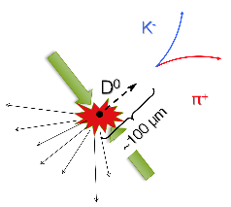

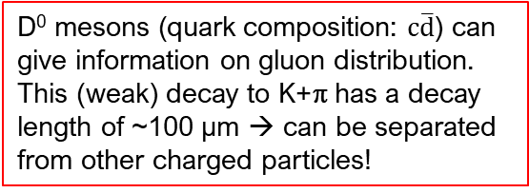
The Inner Barrel - ePIC
$\text{c}$
The game is about measuring with high accuracy momentum
and vertex position of tracks and species of particles → first two points are a tracking business!
Particle production vertex, we want to know its position with a precision of a few to ~10 μm
D⁰ mesons (quark composition: c$\overline{d}$) can give information on gluon distribution.
This (weak) decay to K+π has a decay
length of ~100 μm → can be separated
from other charged particles!

Slide 8
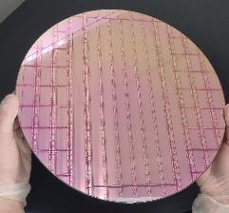
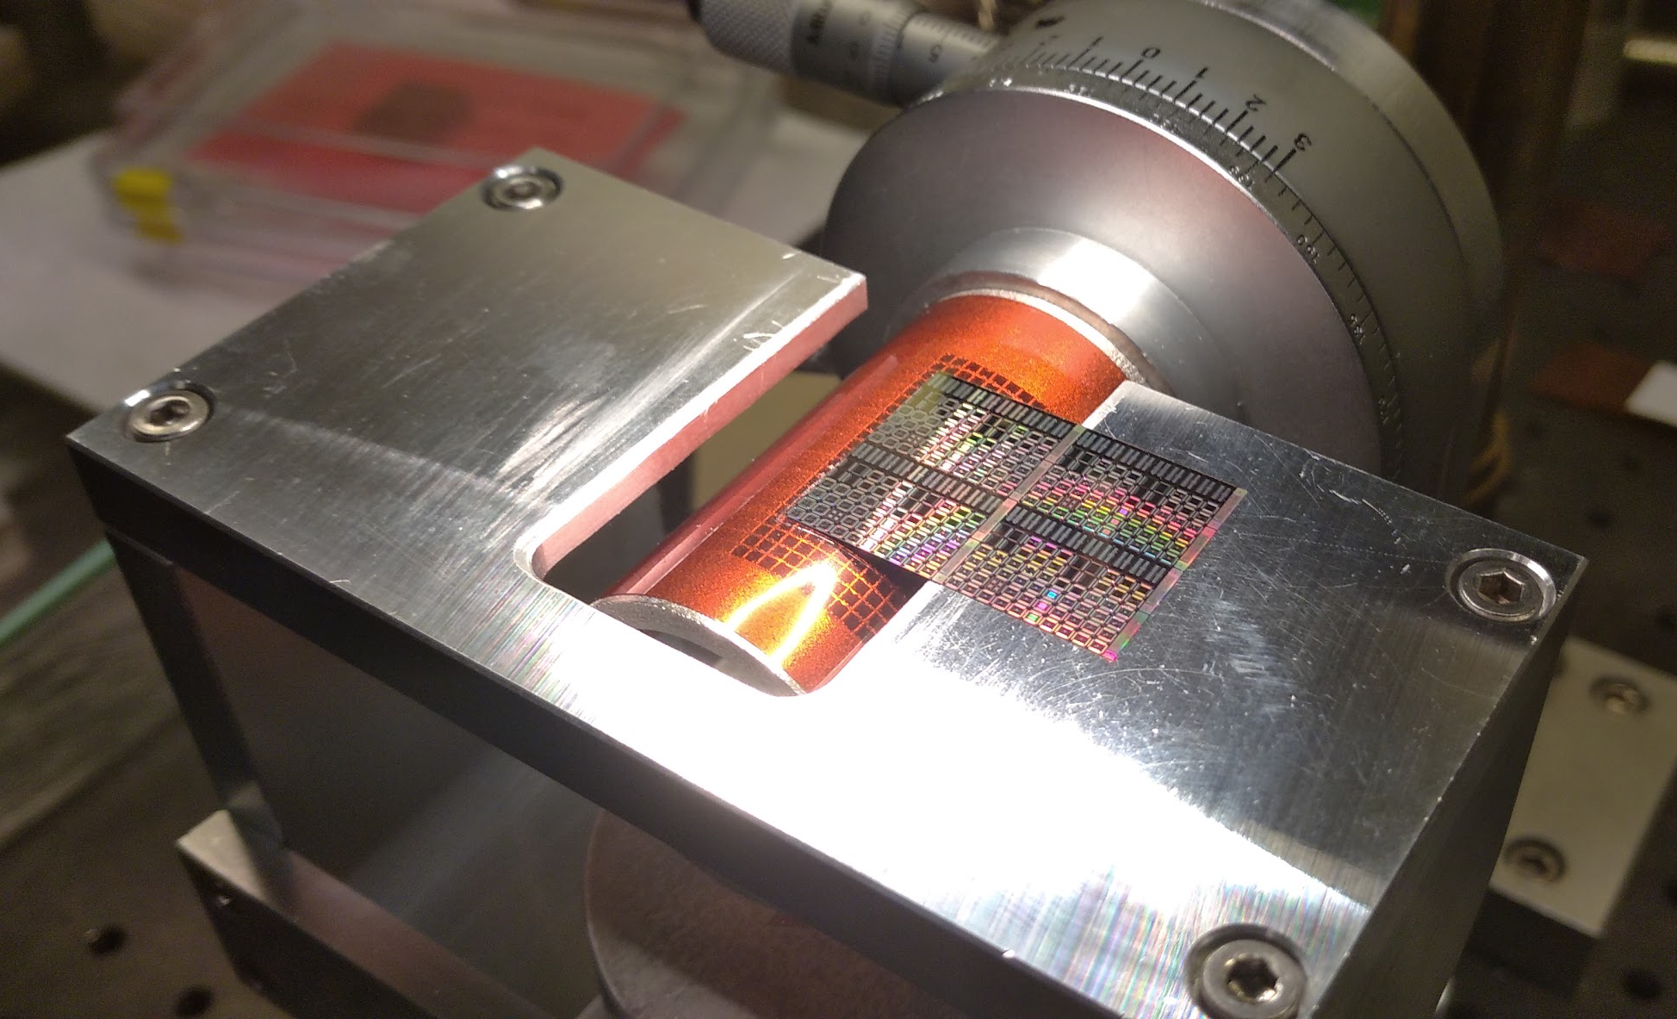
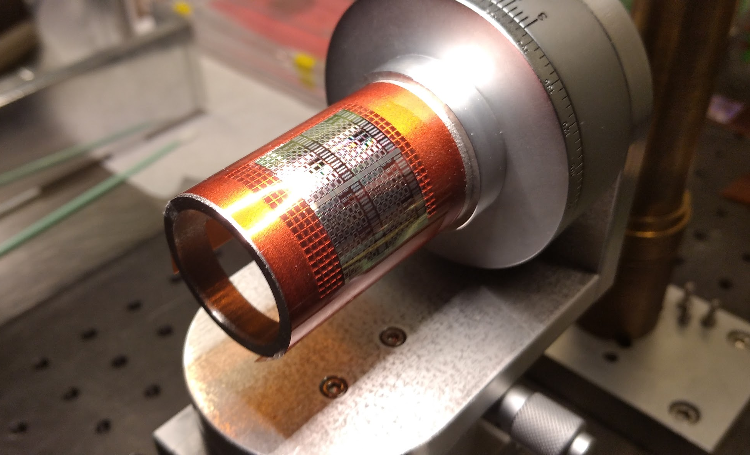
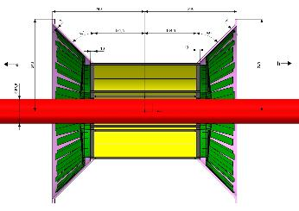
Activity in Padova -1
‘’Next thing’’ for physics performance needed:
  Granularity, coverage, resolution → small pixels, large fraction of sensitive area, low material budget, high S/N and efficiency...and reach a lower radius, and cost is also a parameter!
Monolitic Active Pixel Sensors in 65 nm technology, thin (<=50 μm) and…bent!
30 cm
Did we break it?
Hopefully not!
High technology support (composite materials, carbon foam…)

Slide 9
Activity in Padova - 2
Testing sillicon detectors for the next generation of detectors
Study of the detector performance, special attention to tracking/vertexing
Physics performance studies (tbs soon)
Possibilities to spend some time in USA labs (short visits to weeks)
And…what next?
- Several opportunities of PhD/postdoc contracts in USA/Europe
- Participation in other experiments (e.g. ALICE @ LHC)
- Detector activities include interesting applications!
Silicon detectors activities→ see also P. Giubilato talk on 23/2 h 10:30
Again: the only new accelerator in the next ~20 years (at least): don’t miss this one-in-a-lifetime opportunity, even if you will join later or in another team…

Slide 10
A few links
For more information, visit:
https://www.bnl.gov/eic/
http://www.eicug.org
First European School on the Physics of the Electron-Ion Collider
https://agenda.infn.it/event/33450/
A nice video about the physics: ‘’Visualizing the proton’’:
https://youtu.be/G-9I0buDi4s

Slide 11
Contacts
FEEL FREE TO CONTACT US!
Speaker: Rosario Turrisi - Office n.407 - Build. ‘’Paolotti’’
0499677373 rosario.turrisi@pd.infn.it
Contacts:
ePIC (INFN exp: EIC_NET)
RT rosario.turrisi@pd.infn.it
P. Giubilato piero.giubilato@pd.infn.it
S. Mattiazzo serena.mattiazzo@pd.infn.it

