Slide 1


MUON TOMOGRAPHY
Speaker: __Paolo Checchia________
Group: P.Andreetto, P.Checchia, E Conti, F. Gonella, A. Lorenzon, F. Montecassiano, G. Zumerle+ technicians

Slide 2

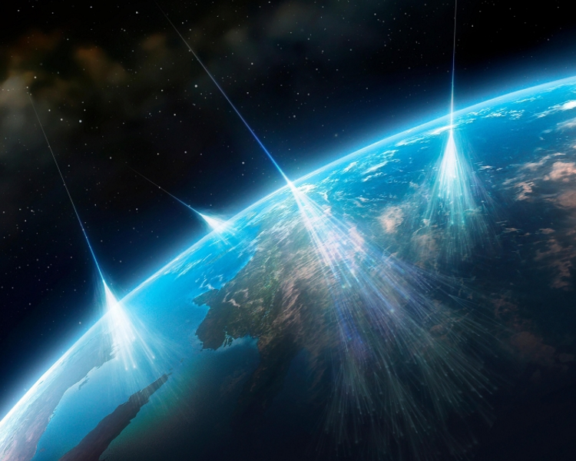
muon TomograPHY
vedere l'invisibile con le particelle che l’universo ci manda

Slide 3
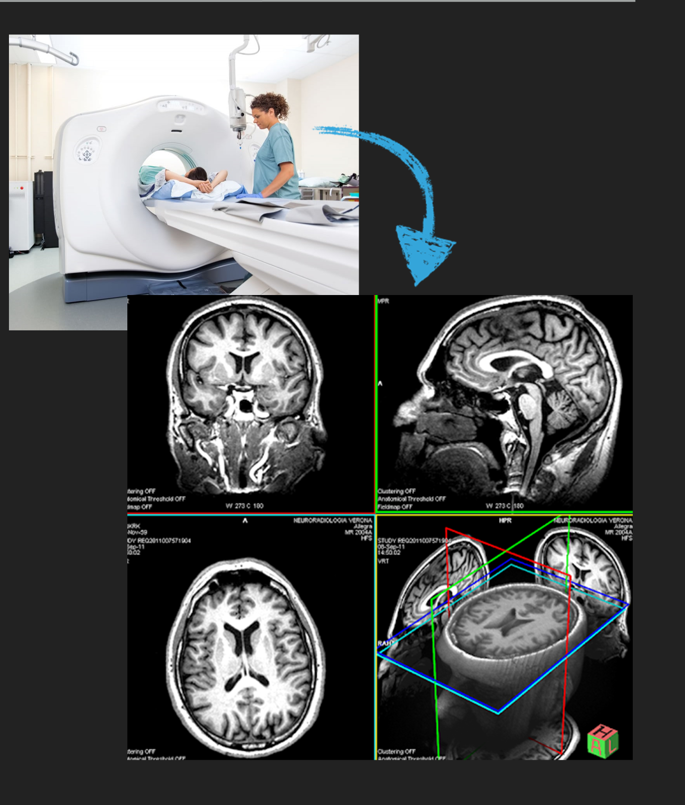
WHAT DOES TOMOGRAPHY MEAN?
Tomography is an IMAGING technique
  Imaging is the generic process to observe inside a volume not visible from outside
  3D images, e.g. sliced vision
AN EXAMPLE: CT scan (TAC)
But in this case instead of X-rays…

Slide 4

cosmic RAYS
Tomografia muonica: Vedere l’invisibile con le particelle che l’universo ci manda 21/ 2/2024
Secondary Cosmic Rays
  Produced by primary C. R. particles (p + α +…) interactions with high atmosphere
  At sea level, the main component of secondary C.R. are muons (μ):
  1 muon / min cm²
  (one in your hand each second)

Slide 5
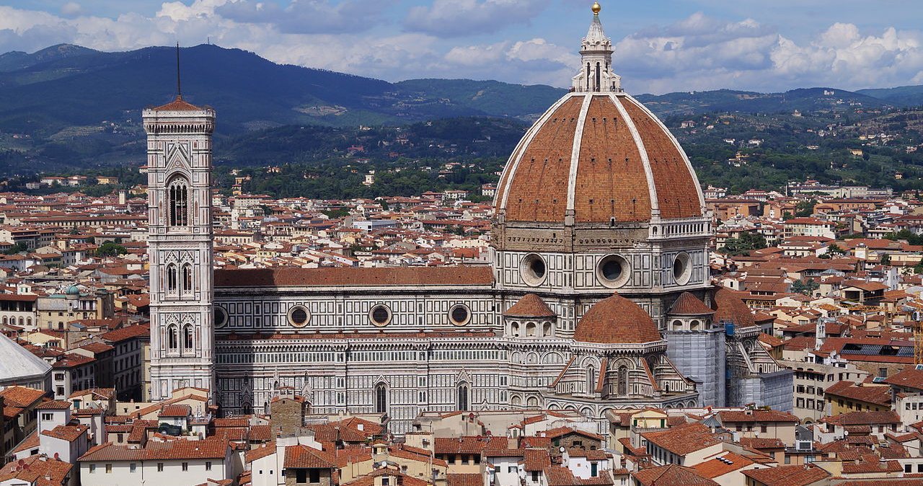
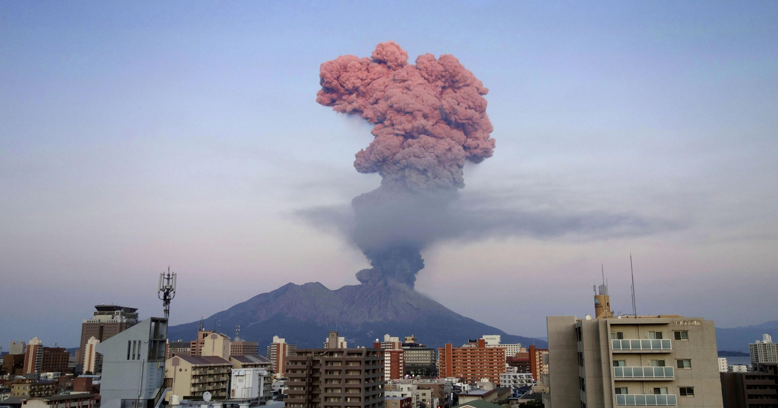
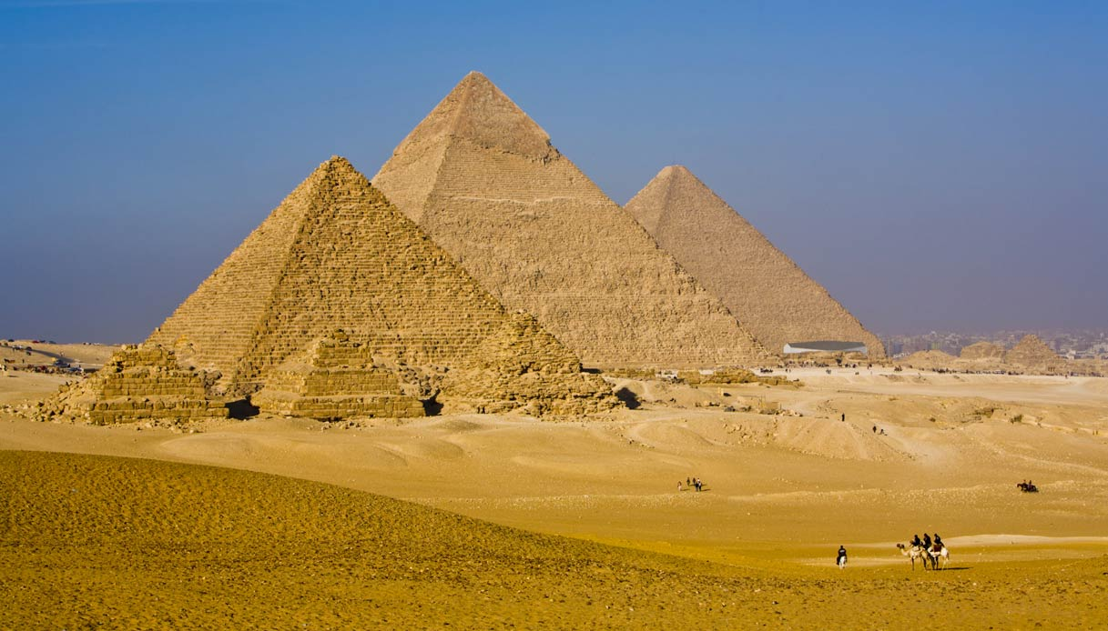
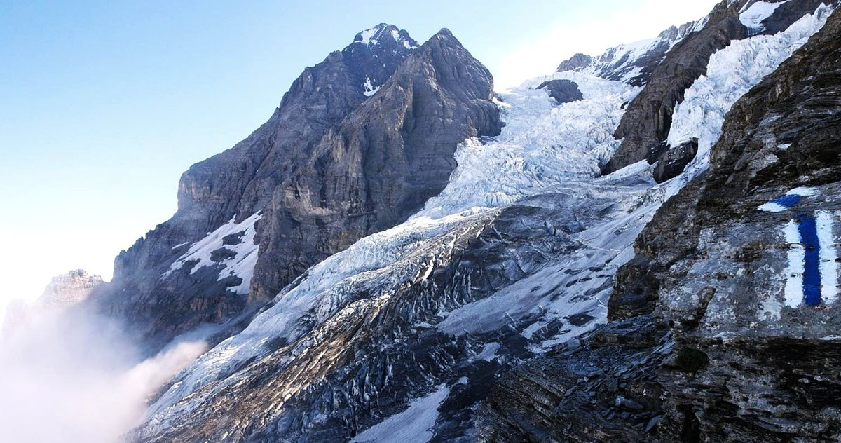
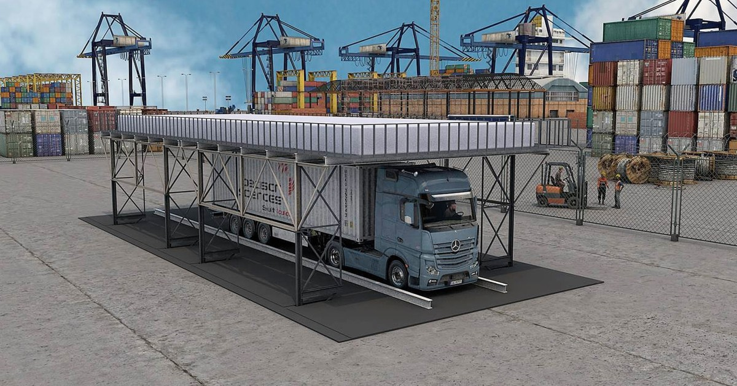
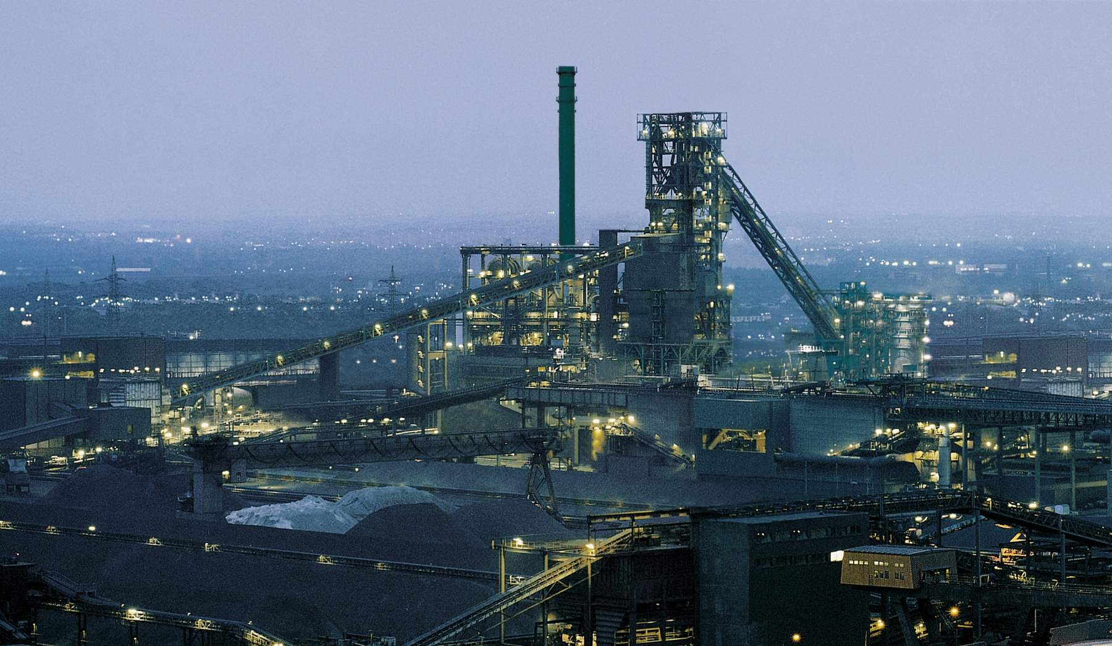
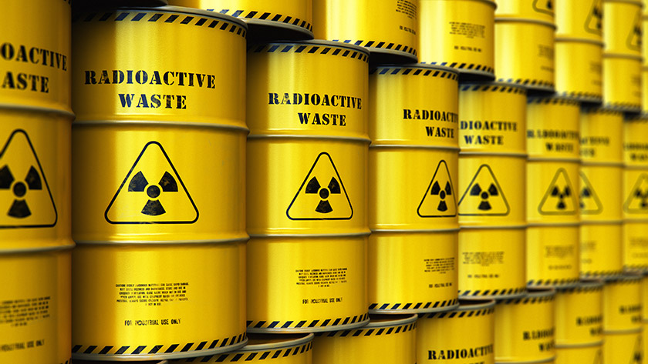
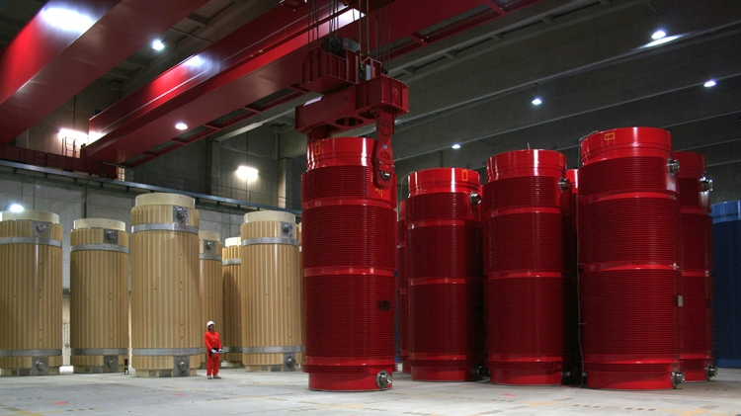
MUON TOMOGRAPHY
Particle Physics for public interest applications:
exploit cosmic ray muons to obtain images of inaccessible objects.
A technique that finds interdisciplinary uses in architecture, geology, archaeology, glaciology,
in transport controls, in industrial process and in nuclear waste and nuclear spent fuel controls

Slide 6
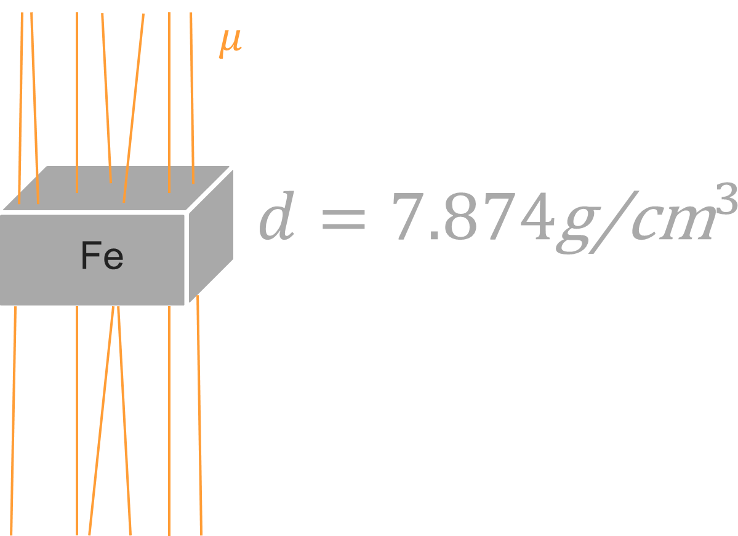
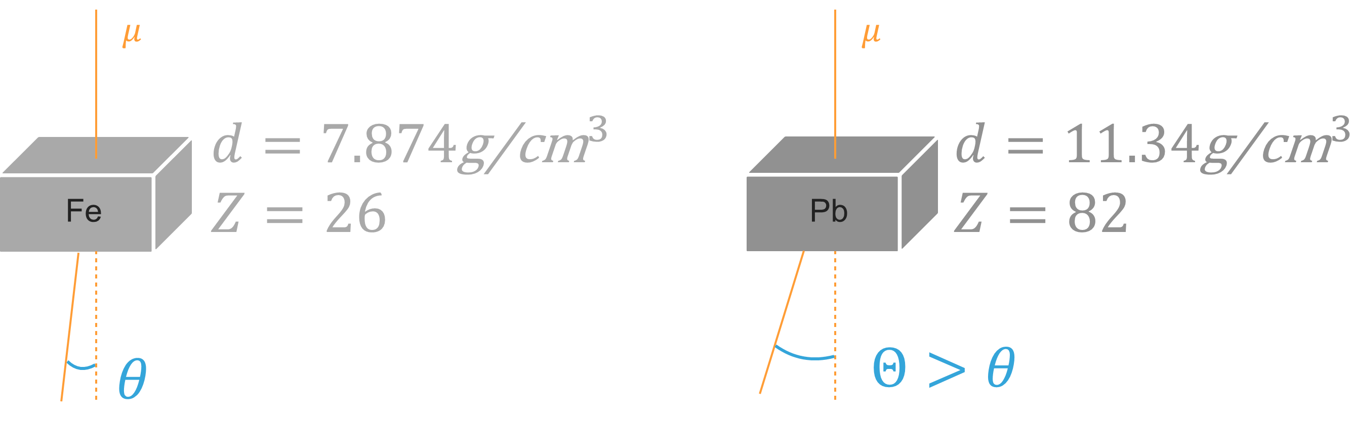

MUON TOMOGRAPHY basic physic principles:
absorption
Multiple coulomb scattering (MCS)
Similar to X-rays
$$σ_{θ}\sim \frac{13.6 \text{MeV}}{βcp}z\sqrt{\frac{x}{X_{0}}}$$
Exploiting muon capability to penetrate matter, we can reconstruct the inside of very big inaccessible volumes obtaining 3D images

Slide 7

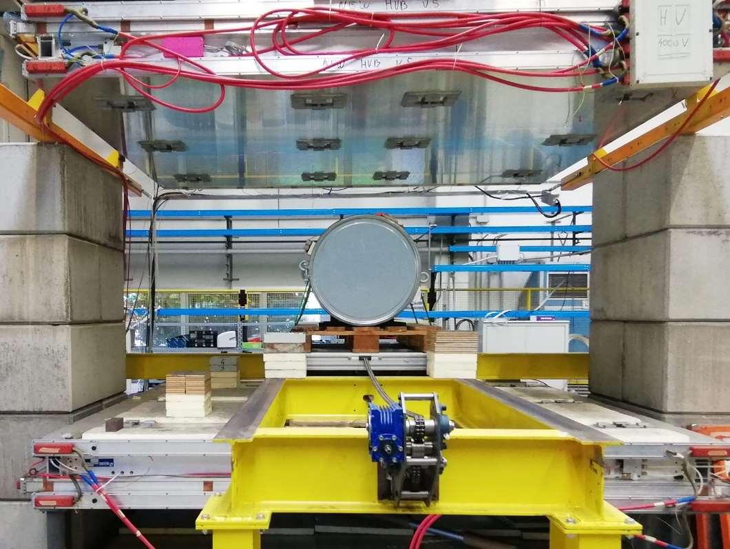





MUON TomograPHY @ INFN padova
Tomografia muonica: Vedere l’invisibile con le particelle che l’universo ci manda 21/ 2/2024
We have implemented at Laboratori Nazionali di Legnaro a system (demonstrator) devoted to muon tomography measures.
Detector 1 ($3×2.5 m2$)
$$1.60\text{m}$$
Detector 2 $\text{(}3×2.5 m2\text{)}$

Slide 8
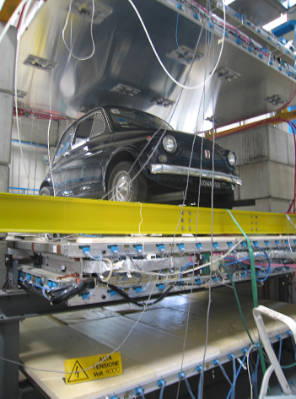
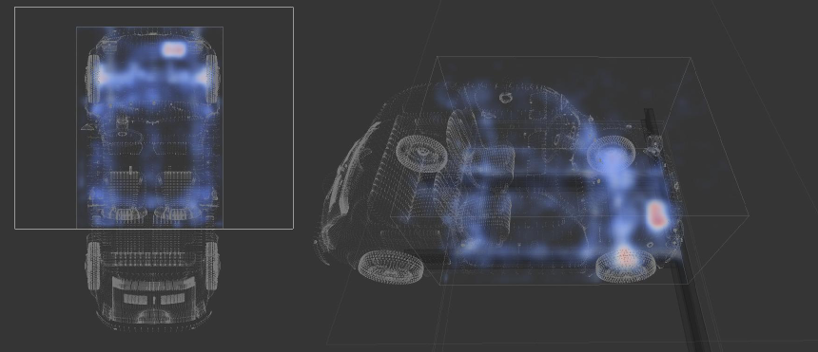
EXAMPLE
Images SCAN of a real car obtained
at INFN demonstrator in Legnaro:
Battery
detectors
Battery
Fiat 500 (1967!)
3D Reconstruction

Slide 9
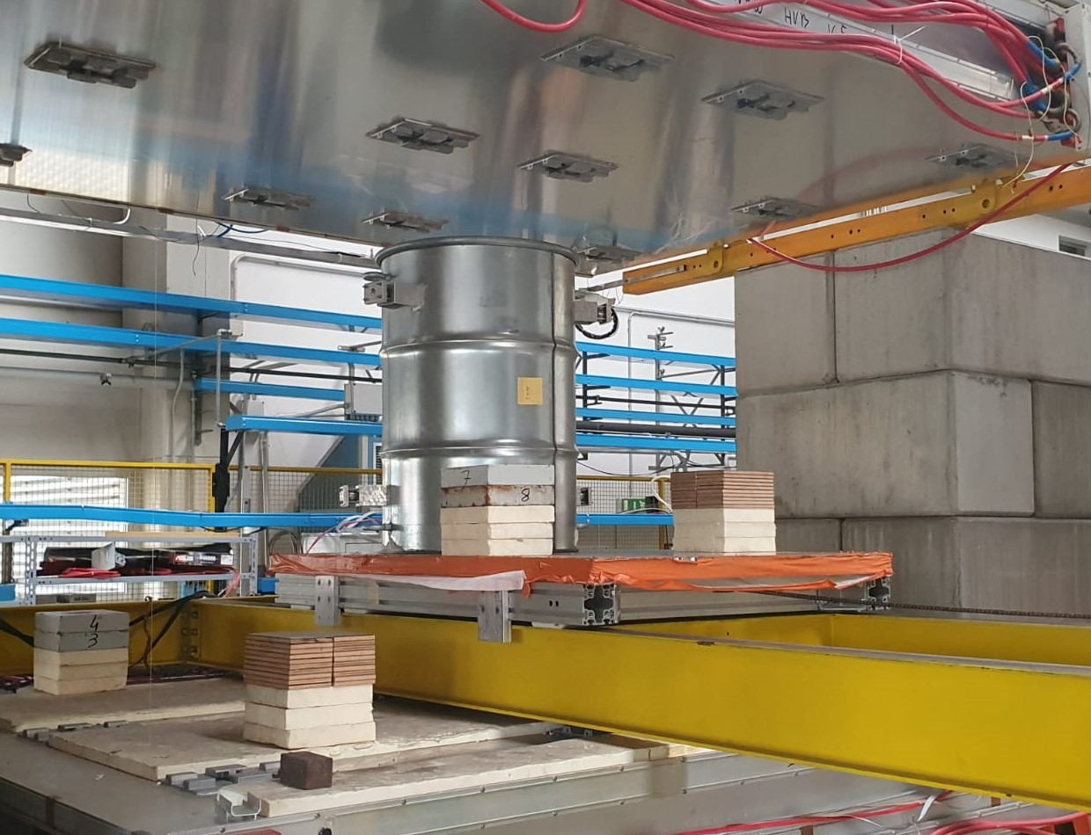
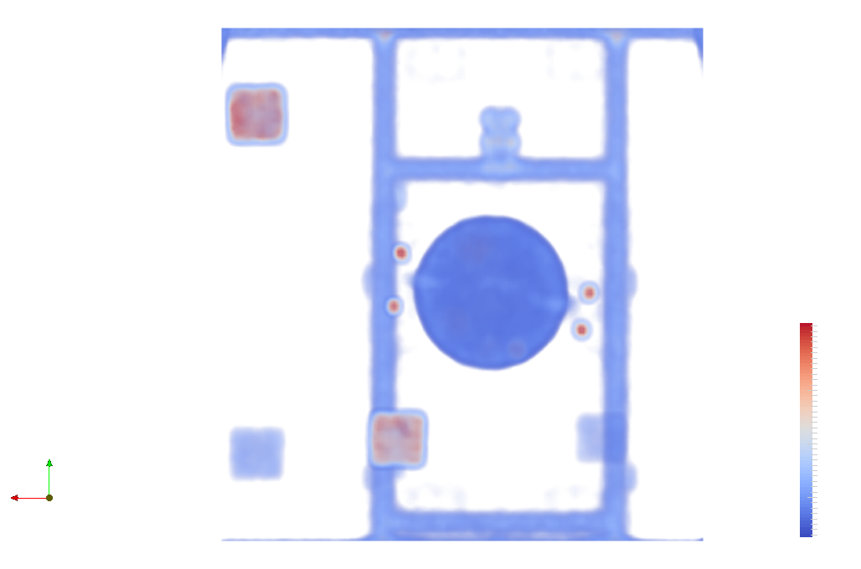
ONE MORE example
Concrete cylinder with hidden metallic objects (emulating radioactive waste)

Slide 10
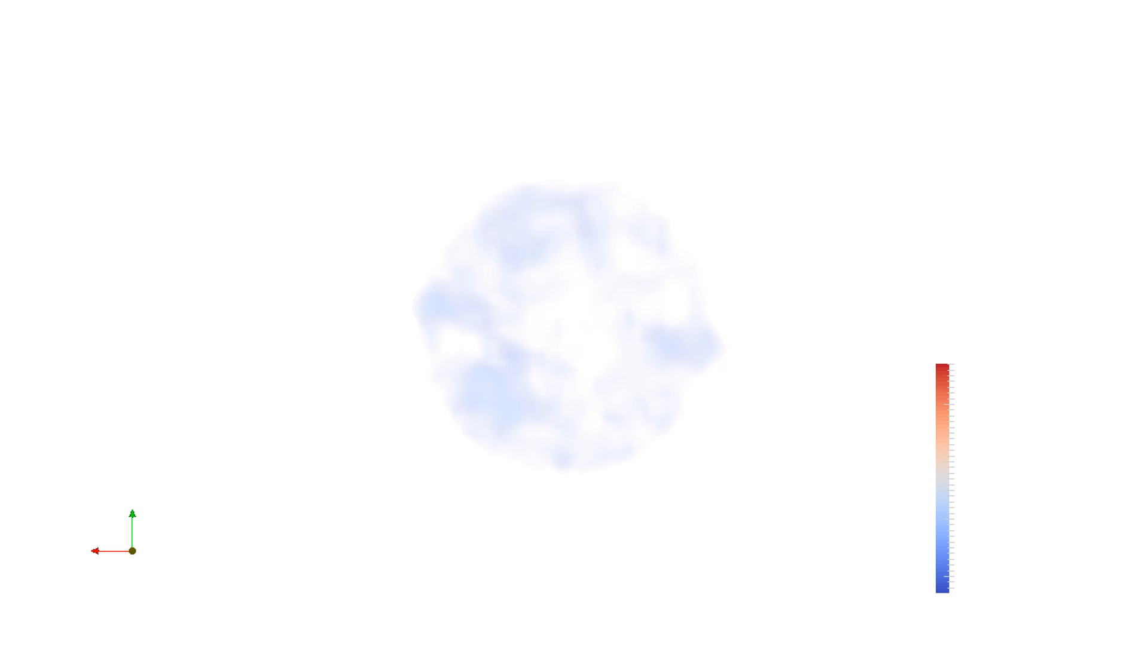
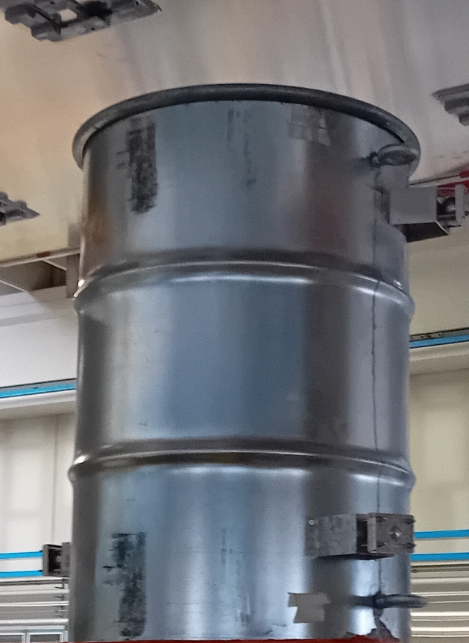
Exploiting tomographic effects …

Slide 11
Activities in Padova
Group: ~ 10 people
International Projects: in particular (but not exclusively) on nuclear spent fuel and nuclear waste controls
Graduate and Master Theses (available just now) on a) development of tomographic reconstruction methods (very useful for your curriculum to apply for future external jobs) b) use of “machine learning” techniques for tomographc data analysis c) muon detector construction
recent past/present: several graduate and master theses, research post-doc, PHD scolarship
The subject would require a dedicated seminar; two informative talks here:
https://www.youtube.com/watch?v=00sPksC1Uyo
https://www.youtube.com/watch?v=CA20m5QBe3Y
Contact paolo.checchia@pd.infn.it

Slide 12
Contacts
Speaker: Office n. 132
Email paolo.checchia@pd.infn.it
Group: P.Andreetto, P.Checchia, E Conti, F. Gonella, A. Lorenzon, F. Montecassiano, G. Zumerle+ technicians

