Slide 1


BOOSTLab
Boost Online Operations with advanced Statistics and Technologies
Speaker: prof. Marco Zanetti
BOOSTLab members:
Faculty: prof. Pazzini, prof. Triossi, Dr. Zucchetta (INFN)
PhD students: Ardino, Borella, Bortolato, Griogetti, Lai, Maccani, Migliorini

Slide 2

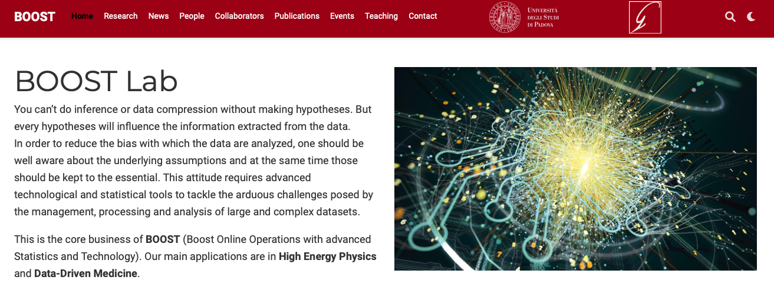
Contacts/web site
Web Site: http://boostlab.dfa.unipd.it
mailto: boostlab@dfa.unipd.it

Slide 3
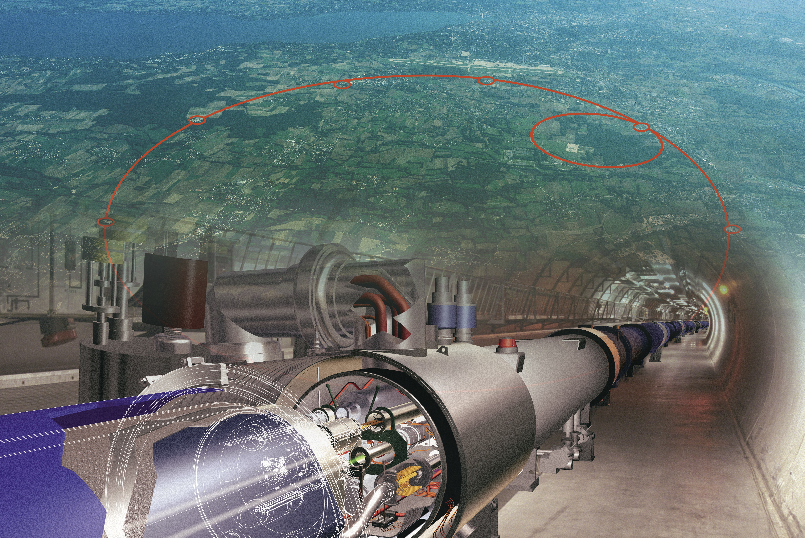
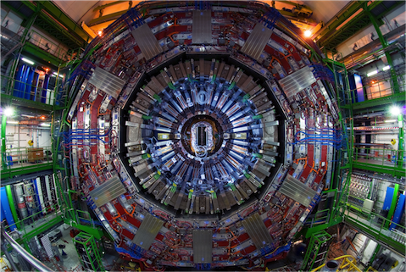
Introduction
Our current description of fundamental phenomena is incredibly accurate, but plenty of unanswered questions
Best tool currently available to look for answers is the Large Hadron Collider
Unfortunately no New Physics has been found so far, but..
We are technologically bound to check only well-formed alternative hypotheses! Little sensitivity to unexpected phenomena
Focus on the CMS experiment, more about it from Mia Tosi’s talk

Slide 4
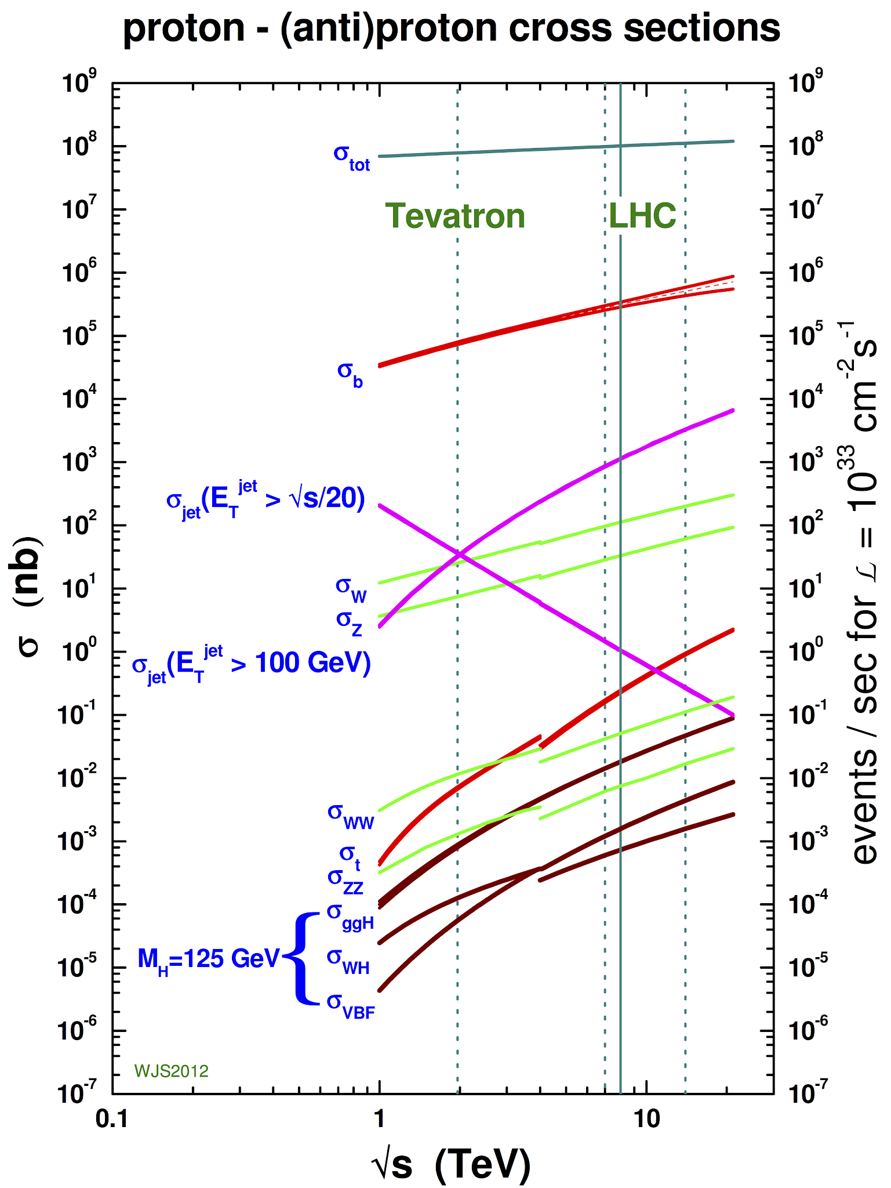
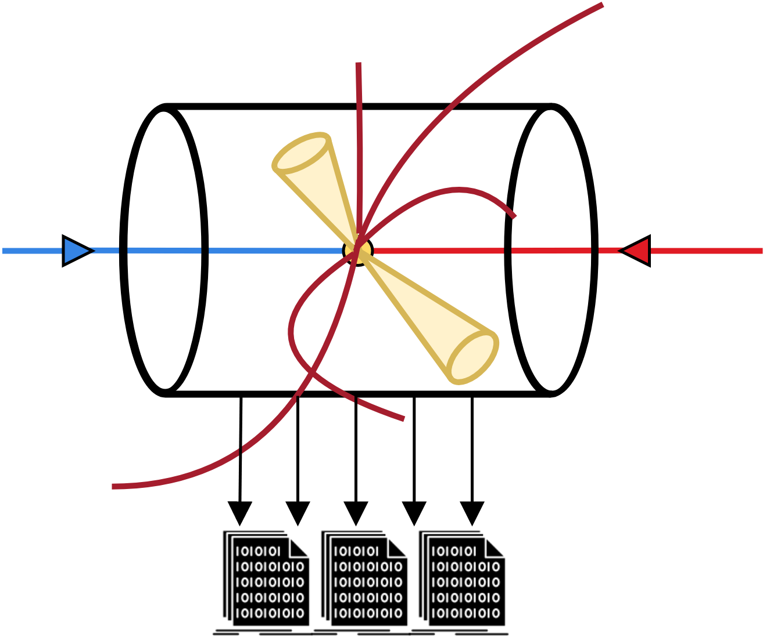
The information problem
known stuff, high probability
interesting stuff, super-rare
”take a picture” of every collisions (40 MHZ) ➔ 100 TB/s of data traffic (comparable to global internet..)
cannot (currently) deal with that, filter out 99.99% of the events based on predefined criteria
what if we are making the wrong hypothesis and through away the interesting things??

Slide 5
Mission
Develop the technologies and the statistical tools to allow unbiased search for New Physics
Those developments are worth per se and can be applied in very different domains
Develop modern digital hardware (FPGA) and software/computing applications
Develop (both theoretically and in software) advanced statistical and Machine Learning tools, also quantum-inspired
Perform data analysis on current data, plan for future ones
What do we practically do?

Slide 6
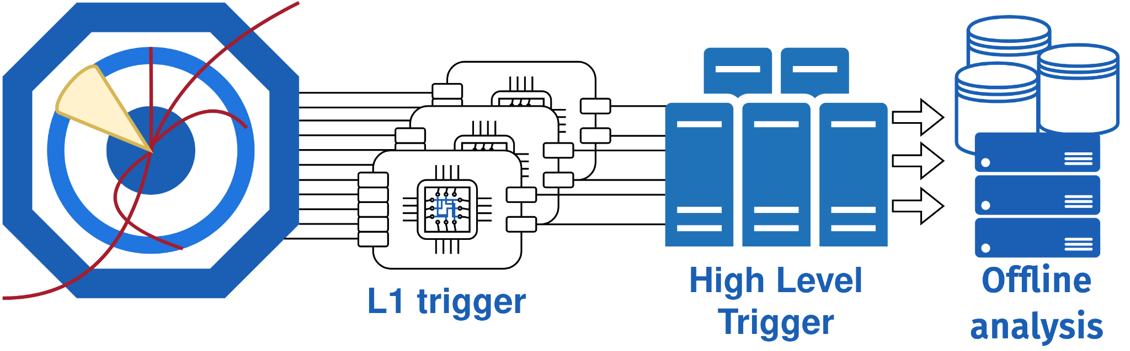


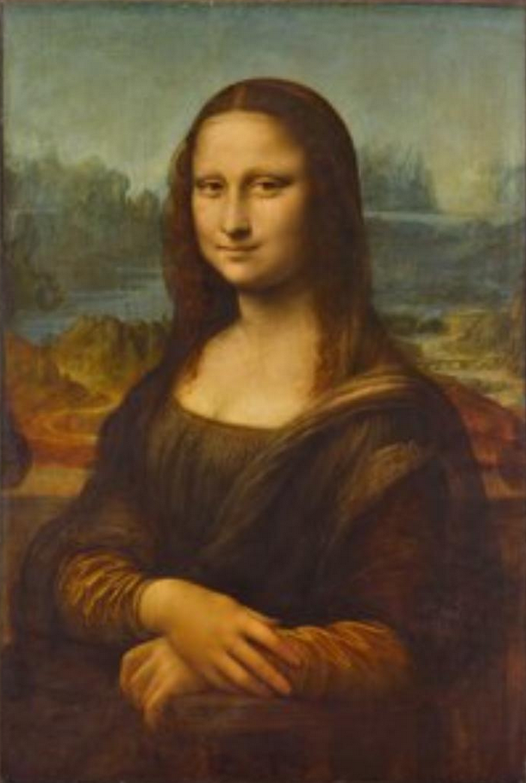
Scouting for New Physics
CMS
online
best possible resolution,
low rate (1kHz)
Lower resolution, but
high rate (40MHz)
Idea: intercept the (low resolution) data before any filter

Slide 7
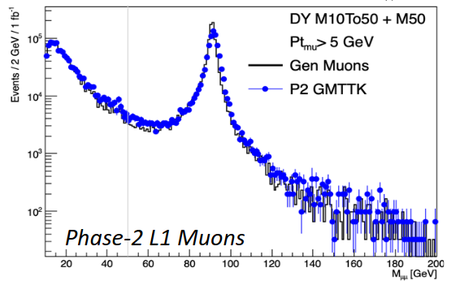
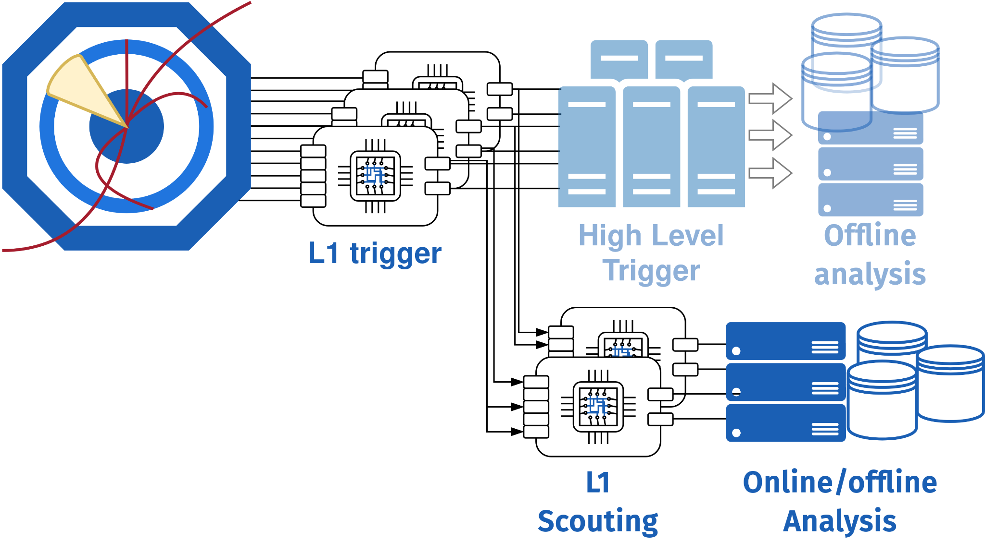

Scouting for New Physics
Idea: intercept the (low resolution) data before any filter, relying on on-going development to make that data high-resolution too!

Slide 8
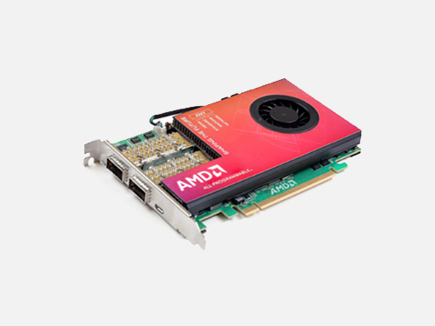
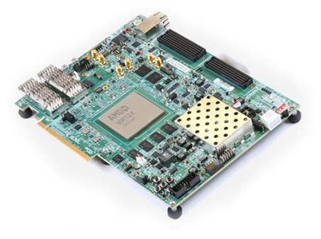
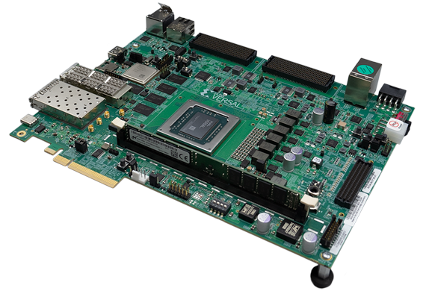
Scouting for New Physics, how?
Early readout with KCU1500 board
  8 GBTx links
  Clock reconstructed from data
    Fine tuning of the local oscillator
    Bunch/orbit counter received from FrontEnd
  DMA to server memory
Present readout with VCU118 board
  16 LpGBT links (adopting CMS framework)
  Integration in CMS clock distribution
  100G TCP/IP to server memory
Next hardware improvements
  Adaptive computing VERSAL
    AI Engines, Programmable Network on Chip
  Substitution of TCP/IP with RoCE v2 FEROCE

Slide 9
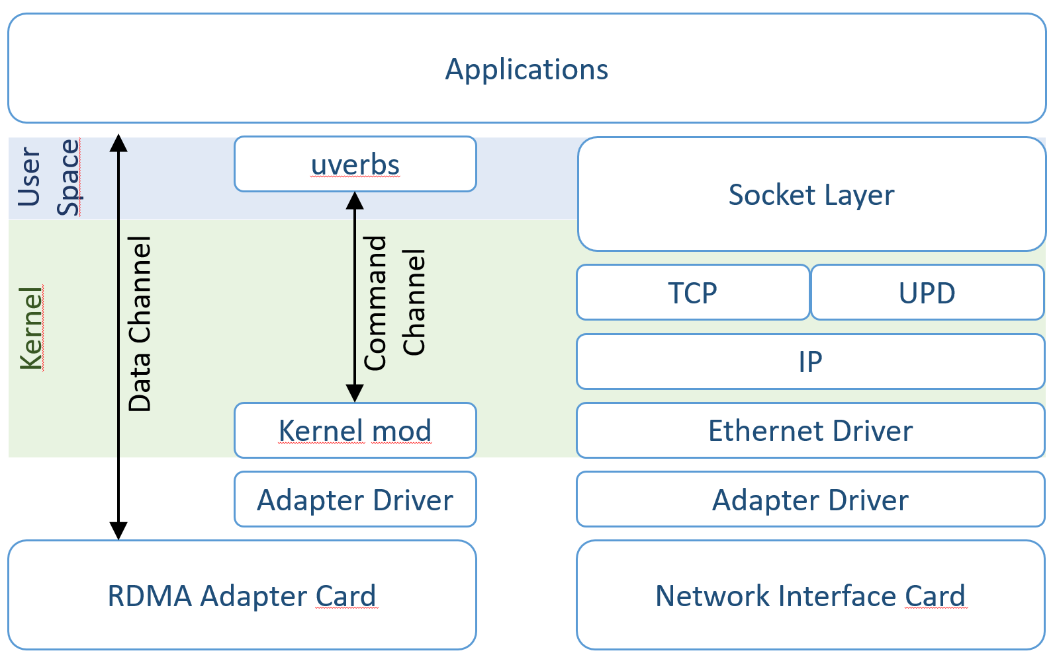
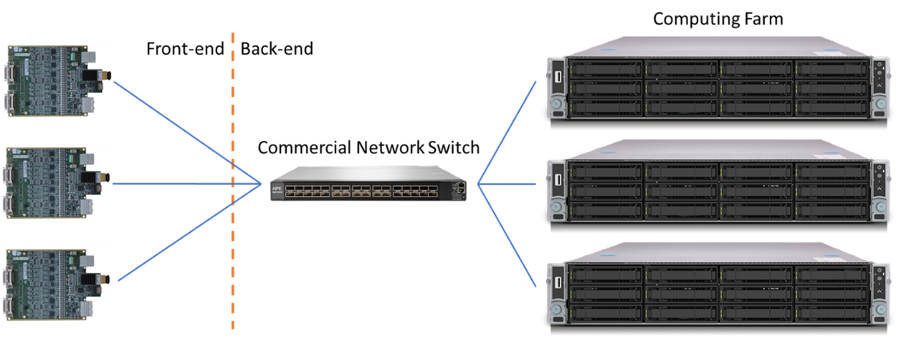
Networking: FERoCE
Front-End RDMA Over Converged Ethernet
Processing power is important as an efficient data movement
In a DAQ system a large fraction of CPU is engaged in networking
  Data manipulation (several copies)
  Latency increase and throughput reduction
Zero-copy is obtained by adding RDMA layer to the network stack
FEROCE wants to move the adoption of the network protocol to the data producer
  Front-end initiates the RDMA transfer
  No point-to-point connection between front-end and back-end
  Dynamical switching routing according to node availability

Slide 10
Machine Learning
Several studies that are currently unfeasible can be performed on unfiltered and unbiased Scouting data
either extending known signals searches or by applying anomaly detection techniques
All studies must start from good-quality inputs
⇒ heavy use of ML for enhancing the quality of the data
Neuromorphic neural networks for muon identification
use Spiking Neural Networks to exploit space and time correlation of signals released in a gaseous detector to identify signal from particle crossings and suppress noise
Design of new particle taggers
with the future upgrade of the detector, higher quality features can be combined in a ML classifier to identify/tag jets produced by heavy particles such as W or b

Slide 11
Machine Learning
Several studies can be performed that are currently unfeasible on unfiltered and unbiased Scouting data
either extending known signals searches or by applying anomaly detection techniques
All studies must start from good-quality inputs
⇒ heavy use of ML for enhancing the quality of the data
Calibration of L1 trigger muons/jets
objects collected at L1 have a worse resolution compared to offline-data
→ augment their resolution by regression to the offline targets with NNs
Custom reconstruction of muons from their stubs/tracklets
Convolutional NNs for denoising signal from background / Graph NNs for combining classification and regression tasks

Slide 12
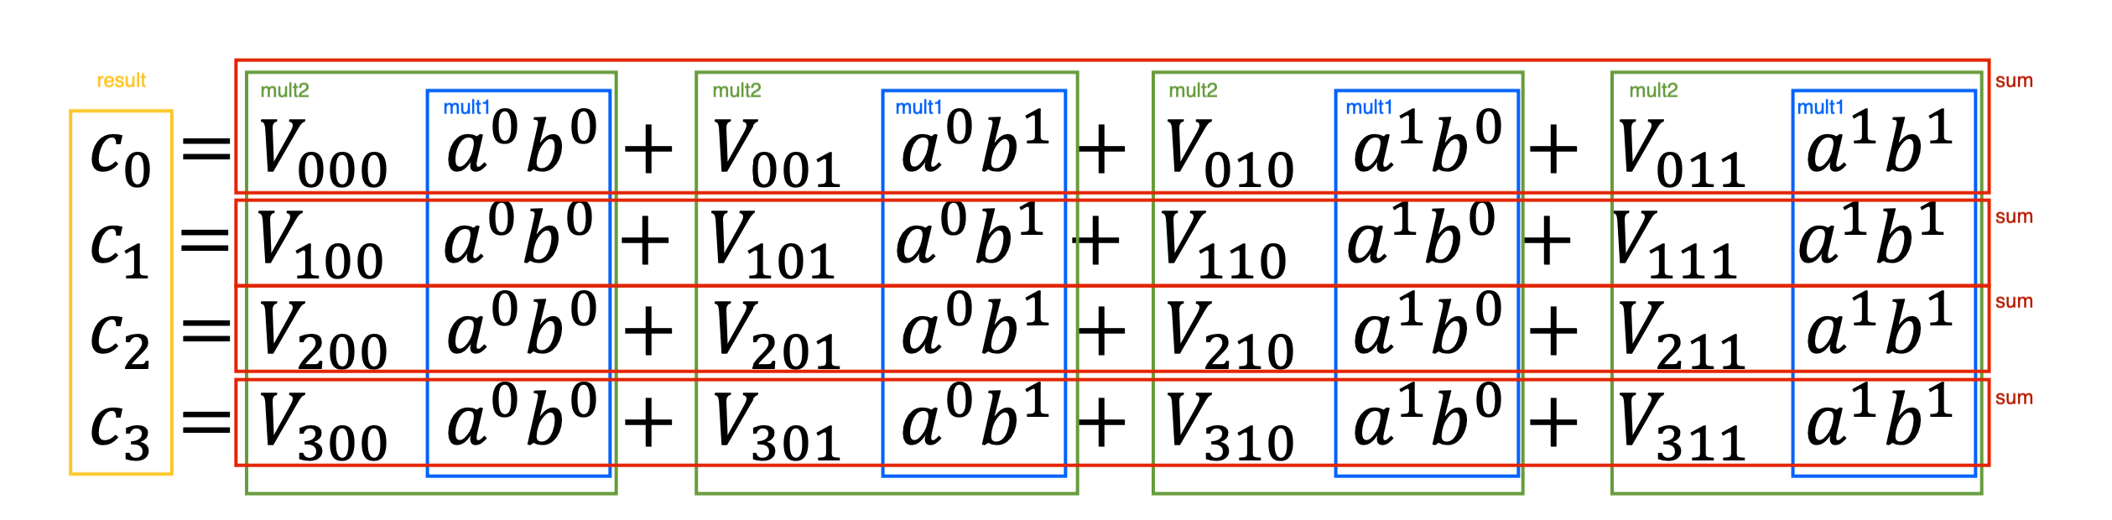
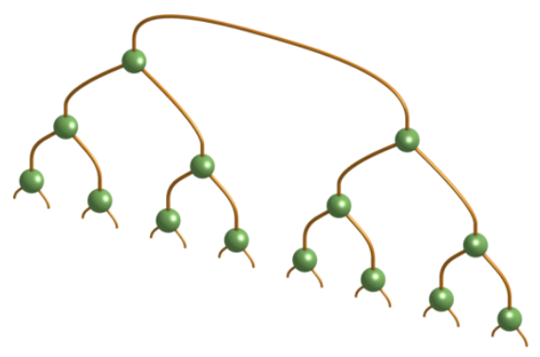
Quantum Machine Learning
Hierarchical tensor structures commonly used for simulating many-body quantum systems can be used also for classification tasks
Hardware implementation
  Ultra-low latency applications
  On-line trigger systems
  FPGAs for parallelization
Quantum features help in several ways
  Quantum correlation or entanglement entropy
  network pruning
  no non-linearities (tanh/reLU/erf/…), only linear algebra operations
Tree Tensor Network implementation
  Training analysis of bond dimension, feature ordering, weight quantization
  TTN deployment on hardware accelerator
  Inference offloading
In collaboration with Montangero’s group

Slide 13
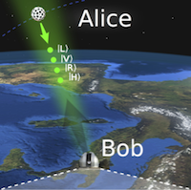
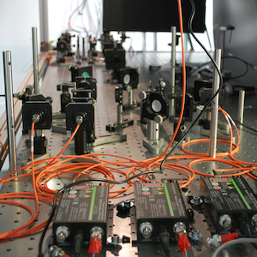

Digression: Hardware for Quantum
FPGA plays a key role (determinism!) in Quantum applications:
  Quantum Key Distribution (QKD)
  Quantum Random Number Generation (QRNG)
  Entanglement Experiment
Open issue: synchronization of Alice and Bob
Idea: implement a real-time synchronization procedure based on quantum detection
In collaboration with QuantumFuture @DEI

Slide 14
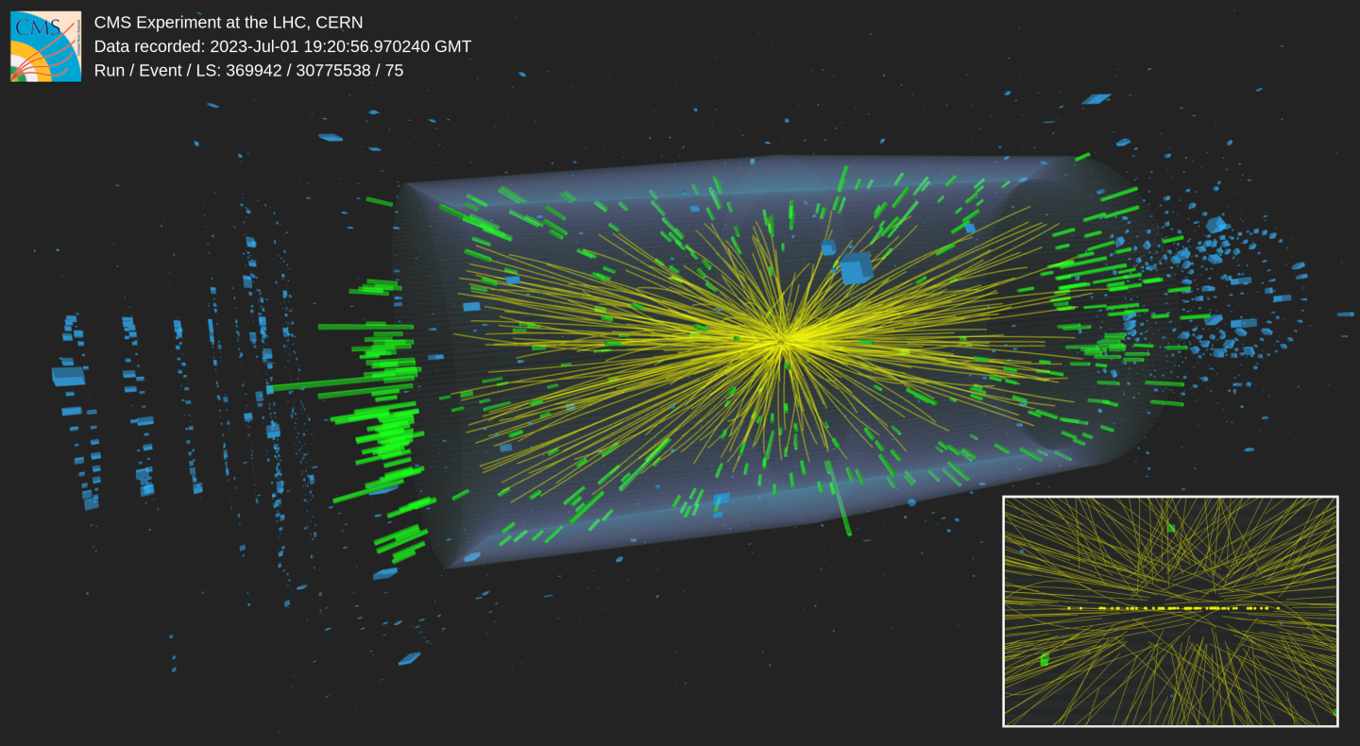
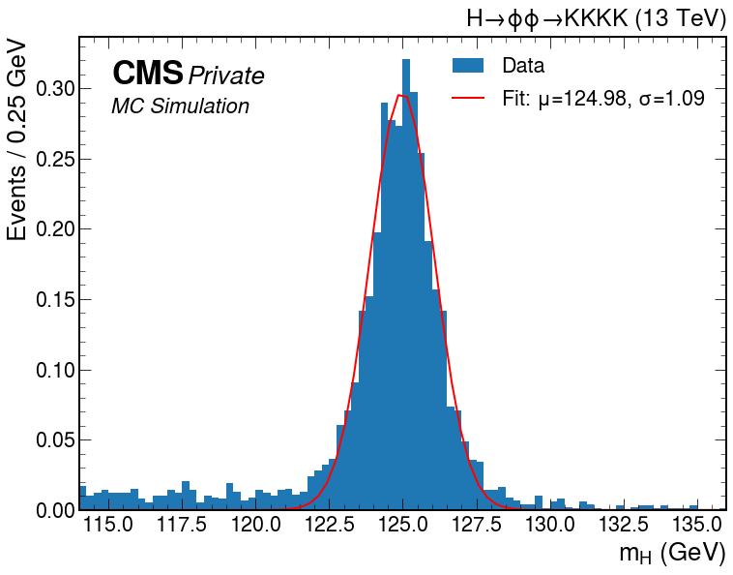
Physics analyses powered by Scouting
Weird, but true: CMS and ATLAS experiments do not store all the Higgs bosons produced by LHC!
  that is the case for final states which are too common, e.g. charged tracks
Scouting is the only way to study extremely rare decays submerged by backgrounds:
  H→φφ→KKKK is an example: allowing study of Higgs coupling to strange!

Slide 15
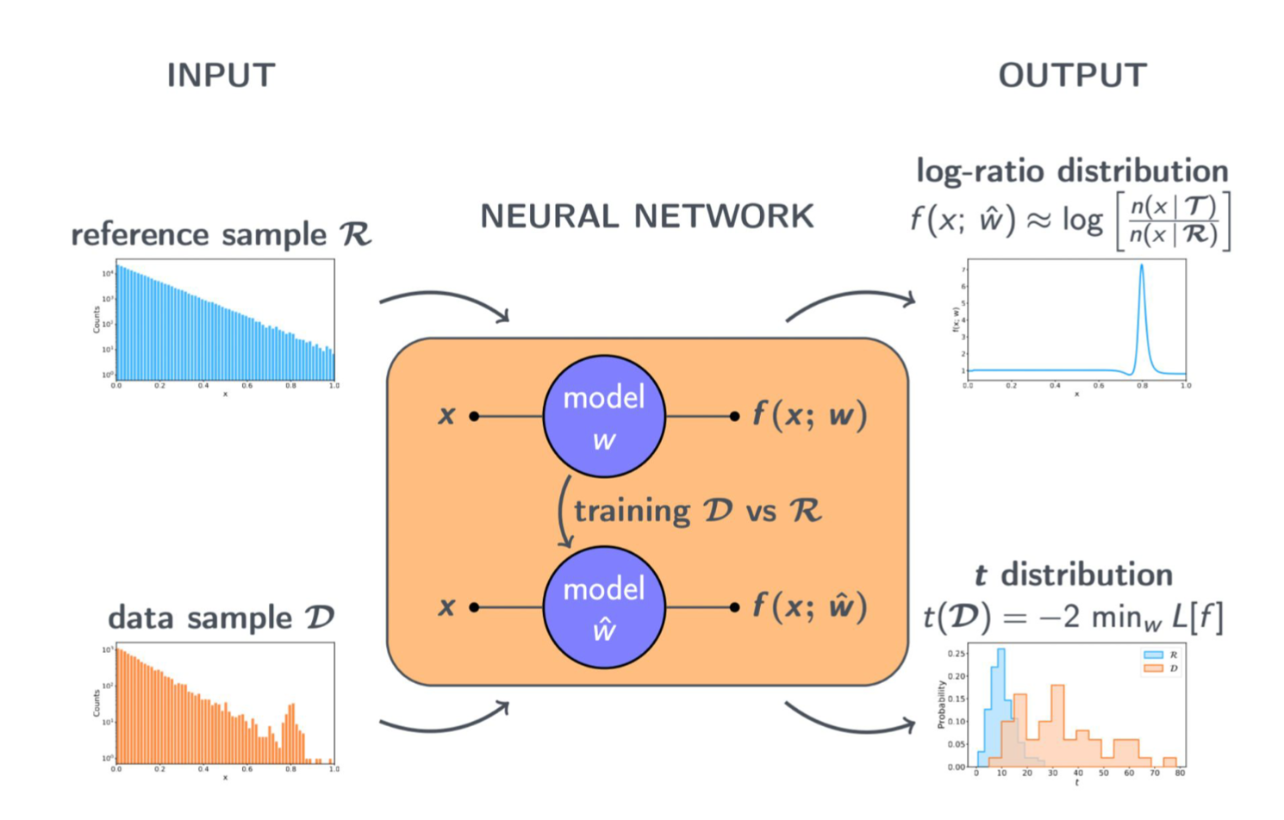
Anomaly detection
Having access to the unfiltered data is only the first step. How do you figure out that an unexpected signal is there without formulating an alternative hypothesis?
  the toughest problem in data analysis
We are developing and utilizing one of the most promising tool for anomaly detection in High Energy Physics: New Physics Machine Learning
  Leveraging on advanced Machine Learning techniques and based on sound statistical concepts
In collaboration with Rosasco’s group (IIT) and theorists (Wulzer et al.)

