Slide 1


Quantum fields, strings and gravity
Speaker: Alessandra Gnecchi
Group: String Theory, Quantum Field Theory, Supergravity

Slide 2
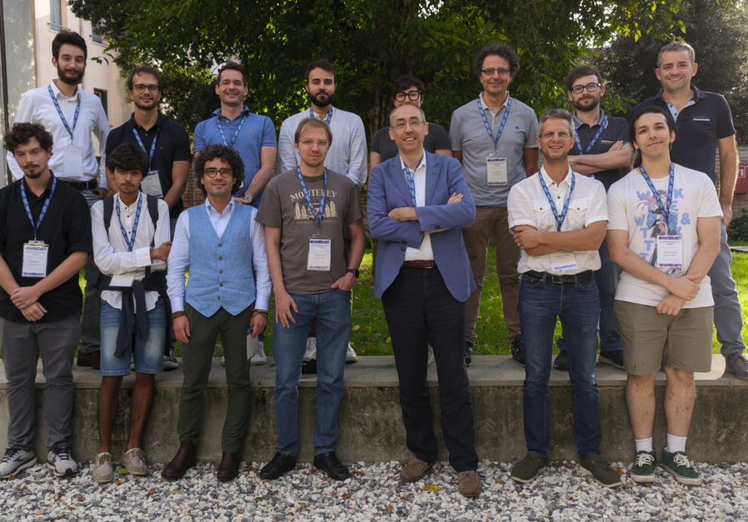
The group
UniPD: Fabio Apruzzi, Gianguido Dall’Agata, Luca Martucci, Stefano Massai
INFN: Davide Cassani, Alessandra Gnecchi, Gianluca Inverso
Postdocs
Maxim Emelin, Colin Sterckx
PhD Students
Francesco Bedogna, Fabio Billiato, Nicolò Risso, Davide Rovere, Enrico Turetta
We welcome thesis students!!

Slide 3
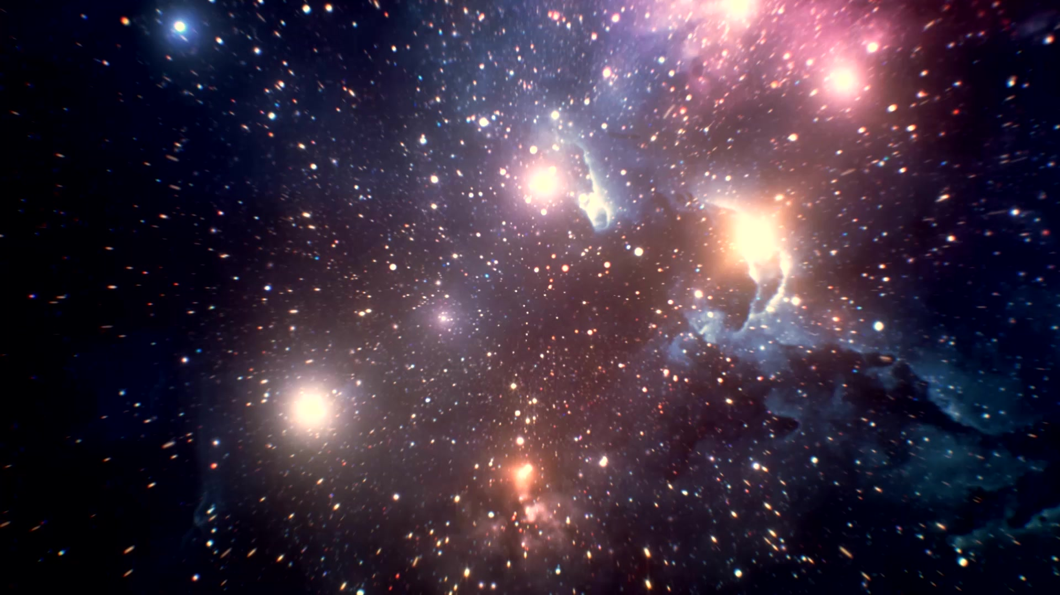
Fundamental Interactions

Slide 4
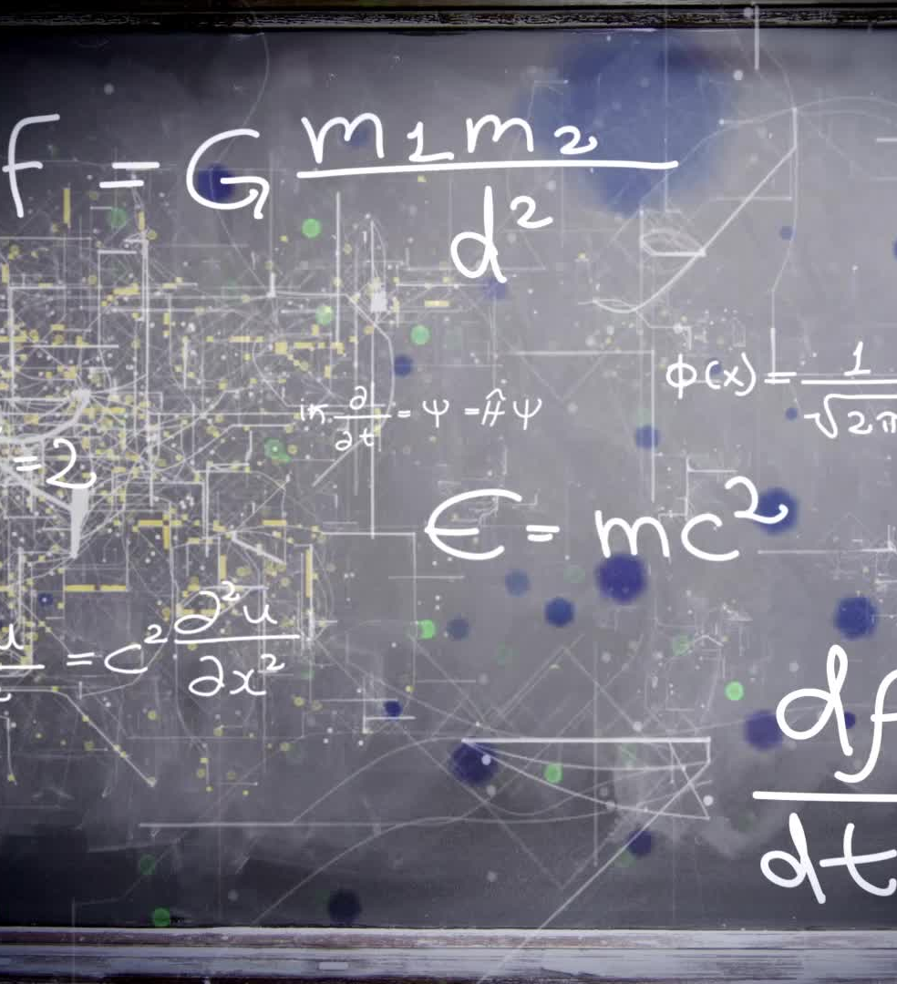
Fundamental Interactions
- Theory
How to describe the fundamental forces that act in our Universe?
How to develop a unified framework to describe quantum interactions and (quantum) gravity?
What is quantum gravity?
What is the mathematical structure of symmetries in quantum field theories?

Slide 5
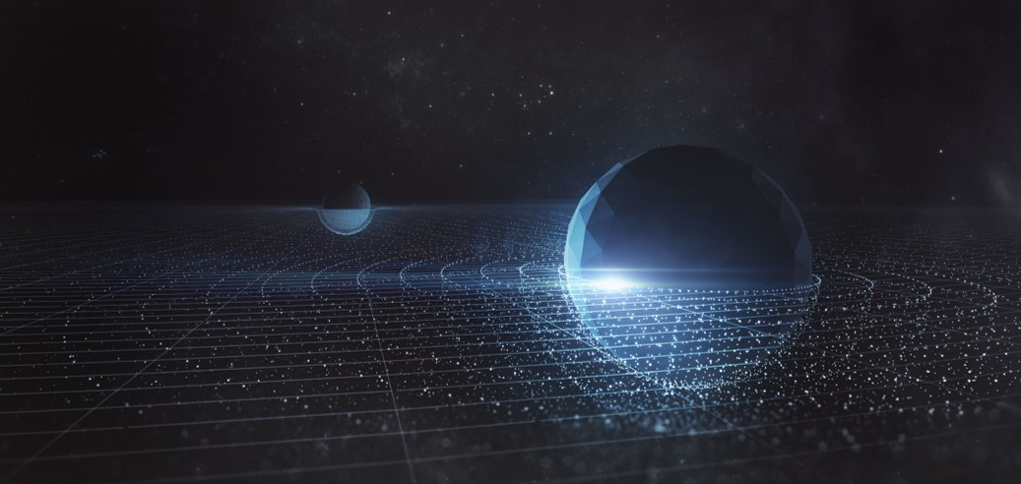

Research topics
String Phenomenology
Supergravity
Black holes in String Theory
AdS/CFT
  Holography and supersymmetry
  Holography for black holes
Symmetries in QFT

Slide 6
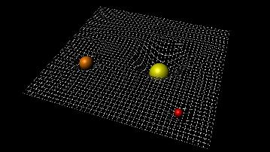

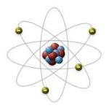
String Theory and Supergravity
A unified framework for studying quantum fields and gravity at every energy scale
Inflation and evolution of the Universe,
black holes..

Slide 7
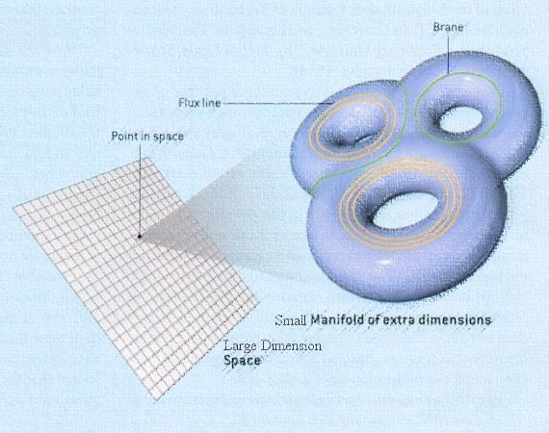
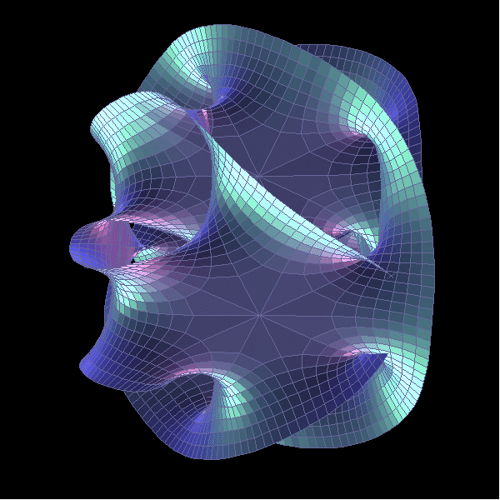
String Theory and Supergravity
How to make contact between the 10d theory and the 4d spacetime?
by String Theory
Group Uni Wien
Geometry of strings compactifications
A powerful mathematical language:
Exceptional Geometry
Work in an effective theory:
Supergravity

Slide 8
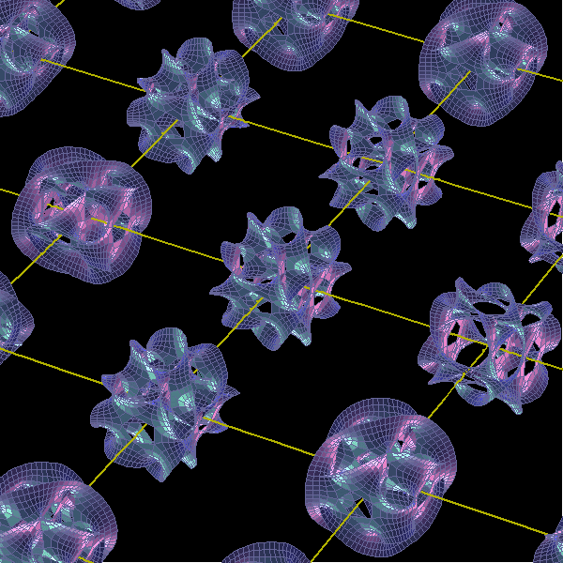
String Phenomenology
String theory meets the 4d world
Trace properties of the low energy, effective theories to their microscopic high energy origin.
Break supersymmetry
Positive cosmological constant
What properties of the effective theories are actually properties of any quantum gravity theory?
Swampland Program
Absence of global symmetries
Weak gravity conjecture
Cobordism conjecture

Slide 9

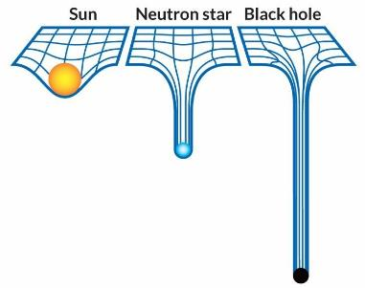
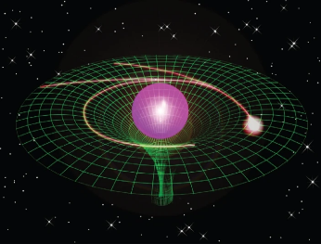
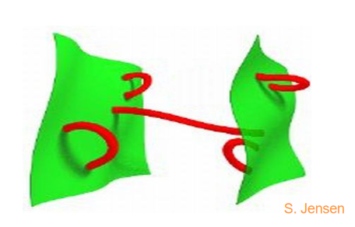

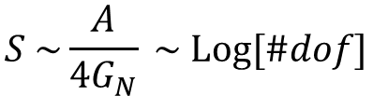
Black holes in String Theory
Black holes behave as thermodynamics systems with temperature and entropy
$$S \sim \frac{A}{4G_{N}} \sim Log[\#dof]$$

Slide 10

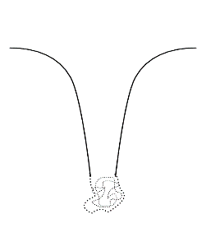
Black hole microstate geometries
No singular solutions from String Theory
Are there enough to make up black hole entropy?

Slide 11
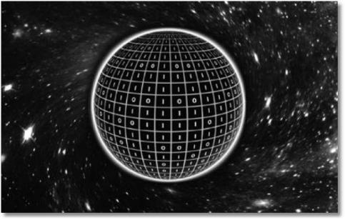
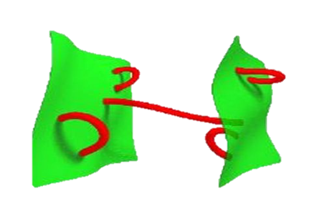
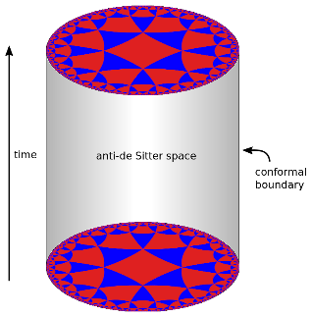
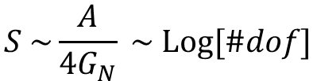
Black holes and holography
$$S \sim \frac{A}{4G_{N}} \sim Log[\#dof]$$
Quantum gravity in D dimensions
QFT in D-1 dimensions

Slide 12

Black holes and holography
Gravity is emergent
Nonperturbative definition of quantum gravity via AdS/CFT
Spacetime reconstruction
Can we reconstruct the bulk gravitational spacetime from the data of the quantum field theory?
Exact microstates counting
Can black hole microstates be identified as QFT states?
Black hole information paradox
What happens to information during black hole evaporation?
How are wormholes contributing to the gravitational path integral?

Slide 13
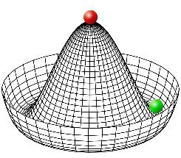
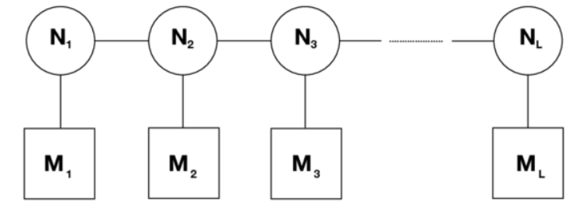
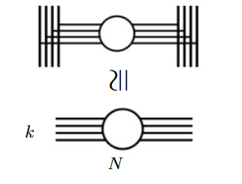
Strings, QFT and symmetries
Strongly couple QFT cannot be studied via perturbative methods
Use symmetries to classify theories
QFT living on D-branes
Supersymmetry allows to compute things exactly
New symmetries
Extension of the classical definition of symmetries to
p-form symmetries
Higher form global symmetries

Slide 14
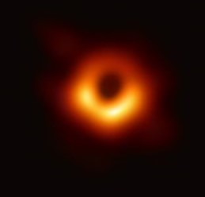
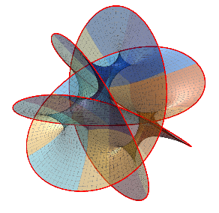


Supersymmetric Vacua and new Geometries
Gravity
Geometry
Supersymmetry as a guiding tool
by EHT
$$AdS_{d}×M_{D−d}$$
by Andart
  What are possible Supersymmetric black hole geometries in higher dimensions?
How are singularities resolved in string theory?

Slide 15
Contacts
People:
Fabio Apruzzi, Davide Cassani, Gianguido Dall’Agata, Alessandra Gnecchi, Gianluca Inverso, Luca Martucci, Stefano Massai
Email name.surname@pd.infn.it
You can find as at:
3° floor, central corridor, Edificio Galilei, via Marzolo 8 https://www3.pd.infn.it/g4/gss/
Thank You!

