Slide 1



A new supersymmetry breaking orientifold
with Gabriele Casagrande, in progress
june 26, 2024
String phenomenology, Padova
E. Dudas – CNRS and E. Polytechnique
TexPoint fonts used in EMF.
Read the TexPoint manual before you delete this box.: AAAAAAAAA

Slide 2
Outline
1) A new SUSY breaking orientifold of type IIB
- previous orientifolds of type IIB with
Scherk-Schwarz SUSY breaking
- the new orientifold
- S-selfduality, D-brane spectra, vacuum energy
2) Comparison with the SUSY shift orientifold
3) Conclusions
E. Dudas – CNRS and E. Polytechnique

Slide 3
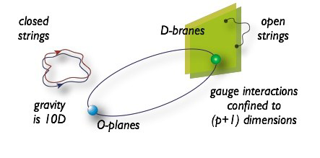
A new SUSY breaking orientifold
of type IIB
Orientifold constructions contain “bulk” closed strings and
localized Dp-branes and Orientifold Op-planes (A. Sagnotti & coll., Rome II / Pisa group…).
( courtesy C. Angelantonj)
E. Dudas – CNRS and E. Polytechnique

Slide 4
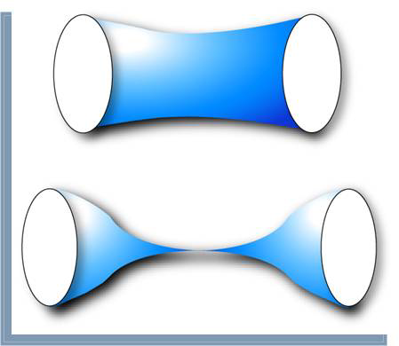
Tadpole conditions Gauss law enforce
for background branes/O-planes
Dp,
Op
Dp,
Op
Dp,
Op
Dp,
Op
E. Dudas – CNRS and E. Polytechnique

Slide 5
Perturbative orientifold constructions contain
Object RR charge NS-NS tension + + - + - - + + + - - +
with
E. Dudas – CNRS and E. Polytechnique

Slide 6
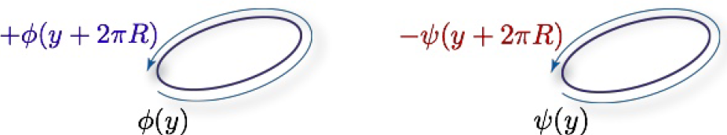
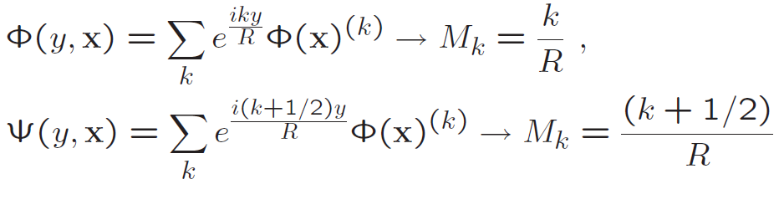
The Scherk-Schwarz deformation of type IIB strings is
the generalization of the original SUGRA version:
( courtesy C. Angelantonj)
The procedure is very similar to the breaking of SUSY at finite temperature
E. Dudas – CNRS and E. Polytechnique

Slide 7
The string construction is a freely-acting orbifold (Rohm, 1984)
where
and
The usual mass formulae are recovered after a rescaling
Orbifold basis
Scherk-Schwarz basis
NS-NS
RR
NS-R
R-NS
“twisted” states
Scalar tachyon for

Slide 8
There were three different orientifold constructions of this:
09 plane, RR tadpole 16 D9 branes
- standard SS, “parallel” to the D9 branes, usual mass shifts fermions vs. bosons
, no RR tadpole
- SS “perpendicular” to the D8 branes: massless open string spectrum SUSY (Antoniadis,E.D., Sagnotti, 1998)
RR tadpole,
16 D9 branes
(E.D., Mourad, 1999)
E. Dudas – CNRS and E. Polytechnique

Slide 9
- The D brane is parallel to the direction of breaking ;
D brane spectrum experience tree-level SUSY breaking.
Analog of the heterotic constructions:
(tree-level)
- The D brane is perpendicular to the direction of the breaking:
(M-theory breaking)
massless D brane spectrum is SUSY at tree-level.
SUSY breaking transmitted by radiative corrections from the
brane massive states or from the gravitational sector.
E. Dudas – CNRS and E. Polytechnique

Slide 10
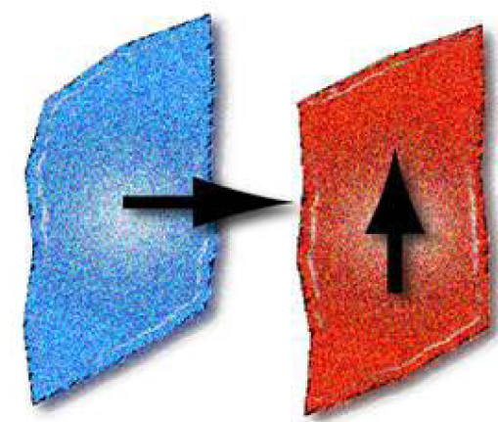
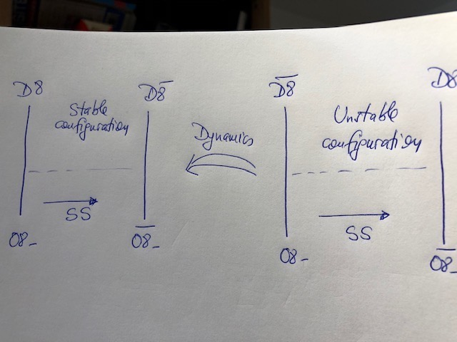
Parallel and perpendicular Scherk-Schwarz breaking
The perpendicular case is actually
subtle :
In both cases one-loop vacuum energy, but no disk NS-NS tadpoles
E. Dudas – CNRS and E. Polytechnique

Slide 11
- The new SUSY breaking orientifold
is based on
Obs: consistent only in the SS compactification
of type IIB to 9d
Action on various forms :
The invariant gravitini
are different at even and odd KK levels deformation of type IIB unrelated to type I
E. Dudas – CNRS and E. Polytechnique

Slide 12
The O9 plane in this construction is of a novel type:
Both NS-NS and RR sectors are symmetrized
(oscillating) KK tower
Loop-channel Klein bottle:
Tree-level-channel Klein :
(odd) winding tower
O9 plane has no charge and tension, couples to massive
”twisted” states, in particular to the tachyonic-like scalar
E. Dudas – CNRS and E. Polytechnique

Slide 13
S-selfduality and D-brane spectra
KK (field theory spectrum)
is compatible with S-self-duality. Moreover :
Massless RR forms
- charged D3 and D7 branes
- uncharged branes of all other dimensions
E. Dudas – CNRS and E. Polytechnique

Slide 14
Their properties can be understood from the orientifold action on D-branes of type IIB :
charged D3,D7 branes
uncharged branes
Comments on the D3 branes:
- D3 branes orthogonal to the circle have gauge group U(N),
full N=4 SUSY spectrum, like in type IIB. S-selfduality OK ?
E. Dudas – CNRS and E. Polytechnique

Slide 15
D3 branes wrapping the circle, spectrum :
At each mass level, the contribution to the beta function is zero. Compatible
with S-self-duality ?
E. Dudas – CNRS and E. Polytechnique

Slide 16
Other branes:
D9, D5 and D1 are uncharged, they couple to the closed string tachyonic-like scalar
They are of two types, depending on the sign of the coupling to the scalar
There are generically open string tachyons, but one single (appropriate) brane is stable
E. Dudas – CNRS and E. Polytechnique

Slide 17
Vacuum energy
In the string frame, the vacuum energy is of the form
Torus
(negative)
Klein
(positive)
In the Einstein frame and taking into account the constraint of S-selfduality, one gets
where is a modular form of weight (0,0) and
a modular form of weight (2,2). Possible to stabilize
both and ?
E. Dudas – CNRS and E. Polytechnique

Slide 18
2) Comparison with the SUSY shift orientifold
Dabholkar and Park (1996) constructed a SUSY orientifold in 9d with no background open strings. Similarities with our construction, but starting from type IIB superstring
Invariant gravitini
are also different at even and odd KK mass levels the model is a
continuous deformation of type IIB string unrelated to type I string.
Similar constructions: Angelantonj,Bianchi,Pradisi,Sagnotti Stanev, 1996
E. Dudas – CNRS and E. Polytechnique

Slide 19
The O-plane can be worked out from the Klein bottle
NS-NS sector symm.
RR sector antisymm.
O9 plane couple to the usual (but massive) NS-NS and RR sectors of type IIB. Geometrical interpretation easier after T-duality on the circle:
at and
no background D9 branes. One can add:
- charged D5 and D1 branes
- uncharged branes of all other dimensions (a single D7 is stable)
E. Dudas – CNRS and E. Polytechnique

Slide 20
KK (field theory spectrum)
One massless gravitino ½ of the original SUSY
Comparison with SS SUSY breaking orientifold:
- both reduce to type IIB in limit
- spectra of branes orthogonal to the circle is identical
- spectra of branes wrapping the circle seem to contain the same number of states, but summing over all KK levels.
One lacks a parameter connecting the respective spectra.
- The S-dual of the (DP) shift orientifold is the asymmetric orbifold . Our SS SUSY breaking orientifold is
(conjectured to be) S-selfdual.
E. Dudas – CNRS and E. Polytechnique

Slide 21
Conclusions and Perspectives
Single uncharged D9,D5,D1 branes are stable. Charged
D3-branes spectra give some support for S-selfduality.
Similarities with the SUSY shift orientifold.
Q: Can the (non-perturbative) vacuum energy stabilize both the axio-dilaton and the radius ?
The fourth Scherk-Scherk orientifold of type IIB strings is
peculiar: novel type of O-plane, unconnected to type I string,
potential S-selfduality.
E. Dudas – CNRS and E. Polytechnique

